Slide 1
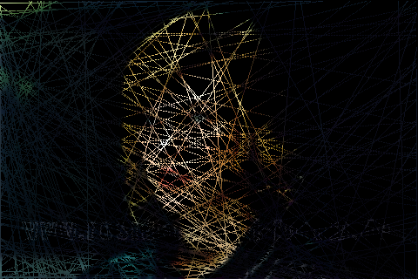
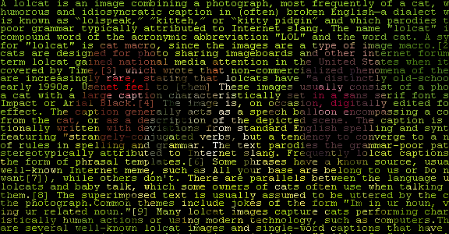
Exercise 1 - Poisson
Image completion using Discrete Poisson Linear Systems

Slide 2
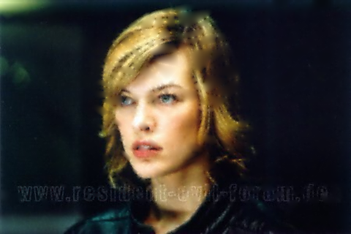
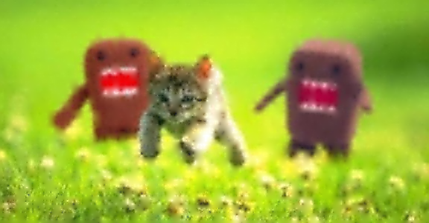
Exercise 1 - Poisson
if I_{x,y} is not black P_{x,y} = I_{x,y} else 4P_{x,y} - P_{x-1,y} - P_{x+1,y} - P_{x,y-1} - P_{x,y+1} = 0
(m)x(n) image
(m·n)x(m·n) linear system
Resolution: 480x320
Linear System: 153600x 153600
Resolution: 576x300
Linear System: 172800x172800

Slide 3
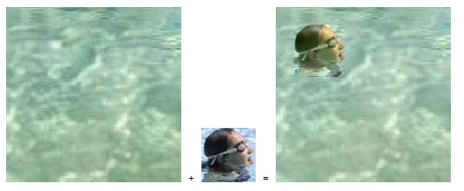
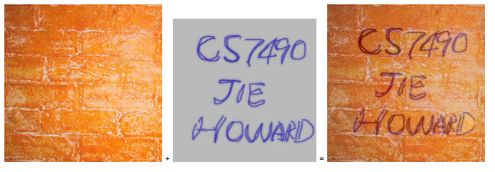
Exercise 1 - Poisson
Image
Cloning

Slide 4
Representing an image
Using a 1D array to represent a 2D image. index(x,y) = y*numOfColumns + x. This basically serializes the image row after row.
Coordinate (0,0) is always the upper left corner. The y coordinates increment going down, as opposed to normal Cartesian coordinates.

Slide 5
Representing Color
BufferedImage img = ... int c = img.getRGB(x, y);
// c == 16597993 ???
A pixel is represented by 3 values for the 3 color channels. Each color value is a number in the range [0,255]. Fits a single unsigned byte. To extract the separate values, use bit operations 16597993 = 0x00FD43E9 blue E9=233 green 43=67 red FD=253

