Slide 1
Collaborative Fitlering

Slide 2
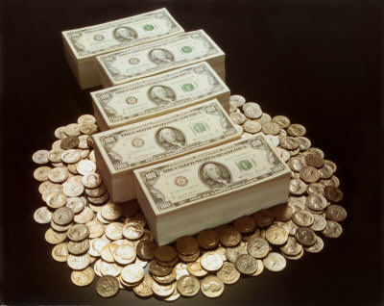
Rubi’s Motivation for CF
Find a PhD problem
Find “real life” PhD problem
Find an interesting PhD problem
Make Money!

Slide 3
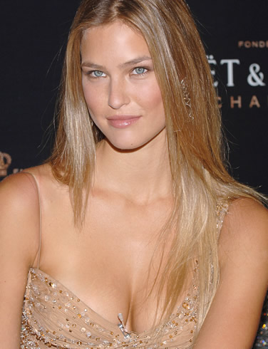
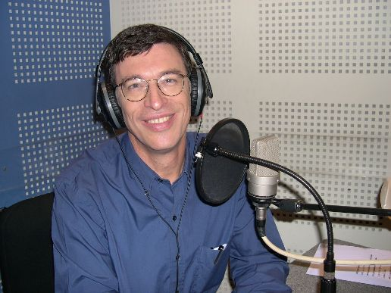
Recommender Systems
Basic implementations:
Most popular / cheap / etc.
New items
Can they go shopping together?

Slide 4
Live Demonstrations
Amazon
Netflix
XBOX360 usage:
http://www.youtube.com/watch?v=IitD0hdOCvA

Slide 5
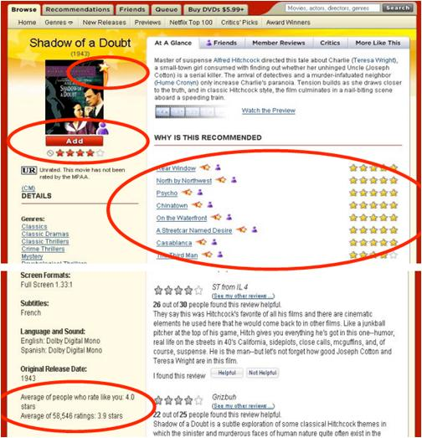
Netflix Example

Slide 6
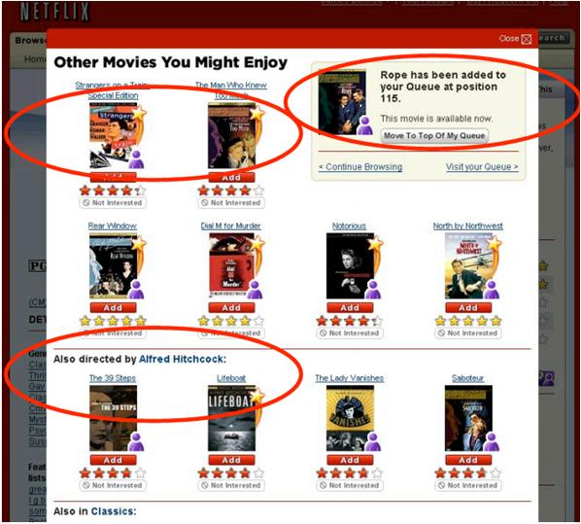
Netflix Example

Slide 7
Netflix Prize
Goal: Improve the accuracy of predictions about how much someone is going to love a movie by 10%
Started at 2006 (Max until 2011)
Prize: $1,000,000
September 2009 - 10.06%!! by Bellkor

Slide 8
Recommender Systems
Personalized Recommendations!!!
Predicts user rating →
Provide Recommendations
Attempt to profile user preferences
Model interaction between users and product

Slide 9
Recommender Systems
Requirements:
Provide good recommendations (daaaa)
Justify the recommendation
Feasible in Run-Time

Slide 10
Strategies
Content-Based
Collaborative Filtering (CF)

Slide 11

Content-Based
Actors:
Will Smith, Martin…
Genre:
Action / Comedy
Director:
Michael Bay

Slide 12
Content-Based - VSM
Domain of Features
Describing Vector
0
1
Will Smith
0
Pamela Anderson
0
1
Michael Bay
0
1
Action
1
Comedy

Slide 13
Comparing Two Vectors
Calculate the angle between the vectors
Easier to calculate the cosine

Slide 14

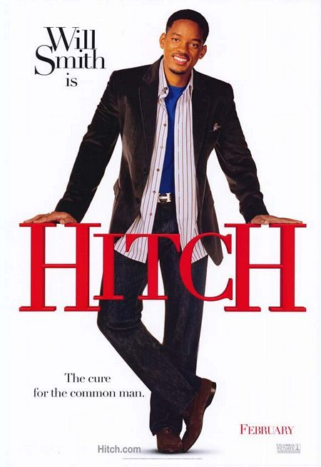
VSM – “near” vectors
- Michael Bay
- Action
- Will Smith
- Comedy

Slide 15
Content-Based - Disadvantages
Static
Can’t find “special” correlations
Requires gathering external information

Slide 16
Collaborative Filtering
Relies just on users behavior
No profiles are required
Analyzes the relationships between users and items

Slide 17
CF - Levels
Neighborhood Based
(local area)
Factorization Based
(regional area)

Slide 18









CF – Neighborhood Based

Slide 19
CF – Neighborhood Based

Slide 20
CF – Neighborhood Based

Slide 21
CF – Neighborhood Based

Slide 22
CF – Neighborhood Based

Slide 23
CF – Neighborhood Based
CF Algorithms

Slide 24
Little more formally
Missing value estimation
User-Item matrix of scores
Predict unknown scores within the matrix

Slide 25
Scores??
According to:
Purchases
Rating
Browsing history
…

Slide 26
Formally..
M (|M|=m) users
N (|N|=n) items
R mXn matrix
r_{u,i} the rating of user u of item i

Slide 27
More Problems
Massive amount of Data
99% of the matrix R is unknown
(sparse matrix)
Data is NOT uniform across users & items

Slide 28
Netflix Real-Life Data
17,700 Movies
480,000 Users
(rating in a scale of 1-5)
Over 100,000,000 Ratings!!

Slide 29
Netflix – How to Win??
Quality is measured by RMSE
(more emphasis on large errors)
Predict unknown 1,400,000 rating and compare them to real rating
Improve Netflix’s system (Cinematch) by 10%

Slide 30
Netflix – How to Win??
RMSE

Slide 31
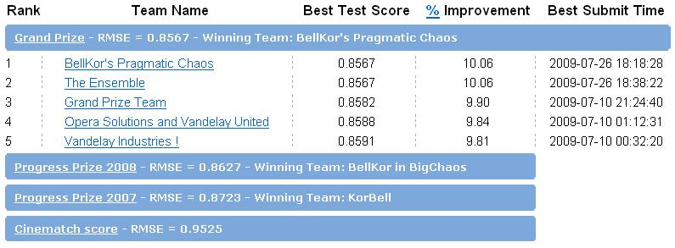
Netflix – Leaderboard

Slide 32
Netflix – Statistics
51,051 contestants, 41,305 teams
186 countries
44,014 valid submissions from 5169 different teams

Slide 33
OK, so what's the plan?
Find a “good” neighborhood
http://www.youtube.com/watch?v=XOw-ak2aJS8
(p.s. what about YouTube's related videos?)
Take a weighted average on the neighbors rate

Slide 34
More Specifically
User-Based:
N(u;i) – set of users who rate similarly to u and actually rated i

Slide 35
S_{u,v}
Key role! Used for:
Selecting N(u;i)
Weighting
Most popular implementations:
Pearson correlation coefficient
Cosine similarity

Slide 36
Pearson correlation coefficient
I(u,v) – Set of all items rated by both u and v

Slide 37
N(u;i)
Most popular / easiest ways:
Correlation Threshold
Best – n – neighbors
What about external data?

Slide 38
Social Networks!

Slide 39
Social Networks, Hot Topics
Facebook
MySpace
Delicious
Flicker

Slide 40
Quick Summary
Two main parameters:
How to choose the neighbors
How to choose the weights

Slide 41
What about performance?
Netflix Data:
N = 17,700
M = 480,000
Calculating N(u;i) is expensive
M >> N

Slide 42
Item-Based
Instead of “users” neighbors,
→ “items” neighbors
Estimate using known rating made by the user on similar items

Slide 43
More Specifically
Item-Based:
N(i;u) – set of items who other users rate similar to i. Similarly, all items needs to be rated by u as well

Slide 44
Reminder..
User-Based:
N(u;i) – set of users who rate similarly to u and actually rated i

Slide 45
Why is it better?
Similarities is between Items (not Users) → Pre-compute all S_{i,j}
Provide better recommendations?
Easier Justification
Most industry systems use it (Amazon)

Slide 46
Checkpoint
We know the basics
Can we “Tweak” the basic algorithm?

Slide 47
“Tweaks” - Normalized Data
Some rate 3 and some 5 for movies they liked
Old solution: normalize the dataset
New solution: predict the change from the average rating instead of the rating

Slide 48
“Tweaks” - Remove Global Effects
A user rates 5 all the times
A user rated 10,000 movies
Remove old rating?
Using the Time variable is not “Tweak”..

Slide 49
TAU’s Current Research
Distributed CF!!!
“Server” level

Slide 50

Distributed CF

Slide 51




Distributed CF

Slide 52

Distributed CF

Slide 53



Distributed CF

Slide 54

Distributed CF

Slide 55
Distributed CF

Slide 56
Distributed CF

Slide 57
Distributed CF
?
?

Slide 58

Shared Users

Slide 59
Shared Users

Slide 60
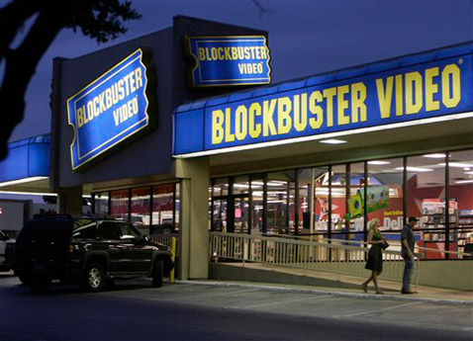
Shared Items

Slide 61
Shared Items

Slide 62
How To Do It????
Copy all data to one server?
CF algorithm do not scale linear
Privacy
Bandwidth

Slide 63
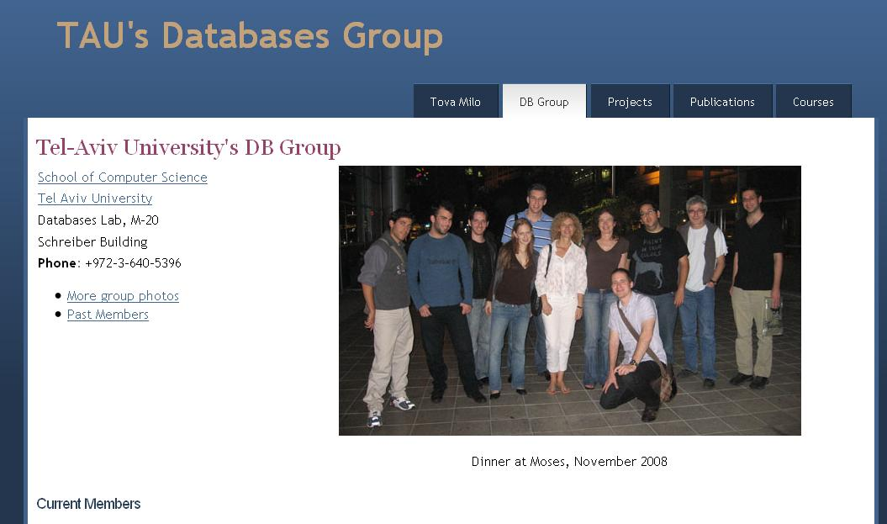
TAU’s Solution
Join TAU’s DB group for more info ☺

