Slide 1
DB Programming - Cont
Database Systems

Slide 2
Agenda
SWT
Updating UI (Why do we need Threads?)
Some Loose Ends

Slide 3
Other JAVA UI
AWT (Abstract Windowing Toolkit)
- standard for all platforms
→too simple..
- “Least Common Denominator”
SWING
- try to fix AWT’s problems
- uses AWT
- complicated to use and learn
- looks the same on every platform

Slide 4
SWT (Standard Widget Toolkit)
Developed by IBM, maintained today by Eclipse
Easy implementation
Not portable – requires implementation for each platform. BUT, all major ones has ☺
→ “LCD” fixed ☺
Had performance issues, but today its fixed ☺

Slide 5
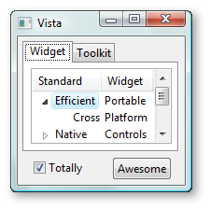
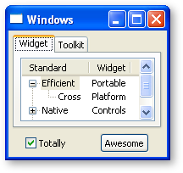
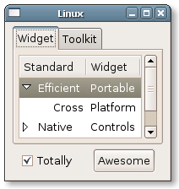
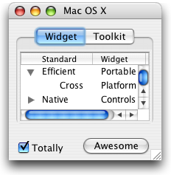
SWT - Takes the look of the OS

Slide 6
“Installing” SWT
Same as always:
- Add the right swt.jar (windows/unix/osx)
(http://www.eclipse.org/swt/)
- import org.eclipse.swt.widgets.*
(same as “installing” JDBC)

Slide 7
Widgets
Widget is the “UI element”
(window, button, icon…)
When creating a Widget, we need to supply its parent
Every Widget needs to be disposed when done.
→Luckily, disposing the parents disposes of its Childs

Slide 8
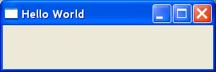
Hello World
import org.eclipse.swt.widgets.*;
import org.eclipse.swt.widgets.Shell;
public class HelloWorldAlone
{
public static void main(String[] args)
{
Display display = new Display();
Shell shell = new Shell(display);
shell.setText("Hello World");
shell.setSize(300, 100);
shell.open();
while (!shell.isDisposed()) {
if (!display.readAndDispatch()) {
display.sleep();
}
}
display.dispose();
}
}

Slide 9
Hello World – A few more words
Shell is the main window. As any widget, he must have a parent:
→ Display (windows..)
If you wont keep the Shell open (listening to events) the program will immediately terminate
Can we have a more “swing” environment?

Slide 10
SWTUtill
import org.eclipse.swt.widgets.*;
public class SWTUtil{
private static Display display = new Display();
public static Shell getShell(){
Shell shell = new Shell(display);
return shell;
}
public static void openShell(Shell shell) {
shell.open();
while (!shell.isDisposed()) {
if (!display.readAndDispatch()) {
display.sleep();
}
}
display.dispose();
}
}

Slide 11
Hello World (with SWTUtill)
import org.eclipse.swt.widgets.*;
public class HelloWorld
{
public static void main(String[] args)
{
Shell shell = SWTUtil.getShell();
shell.setText("Hello World");
shell.setSize(300, 100);
SWTUtil.openShell(shell);
}
}

Slide 12
More on Widget
Widgets are created by:
→ Specifying parent
→ Specifying style
A parent is the container that the widget is created inside (e.g. Shell)
A style is a constant from the SWT class
(SWT.BORDER, SWT.LEFT, SWT.NONE …)
Multiple styles can be joined with “|”
SWT.V_SCROLL|SWT.H_SCROLL| SWT.BORDER

Slide 13
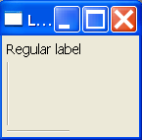
Label
Shell shell = SWTUtil.getShell();
shell.setText("Label World");
shell.setLayout(new GridLayout()); // layouts are explained later
// Create labels
new Label(shell, SWT.NONE).setText("Regular label");
new Label(shell, SWT.SEPARATOR);
new Label(shell, SWT.SEPARATOR|SWT.HORIZONTAL);
// pack and show
shell.pack();
SWTUtil.openShell(shell);

Slide 14
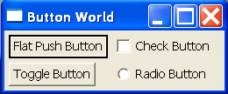
Button
shell.setText("Button World");
shell.setLayout(new GridLayout(2, true)); // layouts are explained later
new Button(shell, SWT.PUSH | SWT.FLAT).setText("Flat Push Button");
new Button(shell, SWT.CHECK).setText("Check Button");
new Button(shell, SWT.TOGGLE).setText("Toggle Button");
new Button(shell, SWT.RADIO).setText("Radio Button");

Slide 15
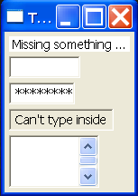
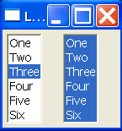
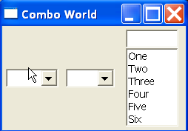
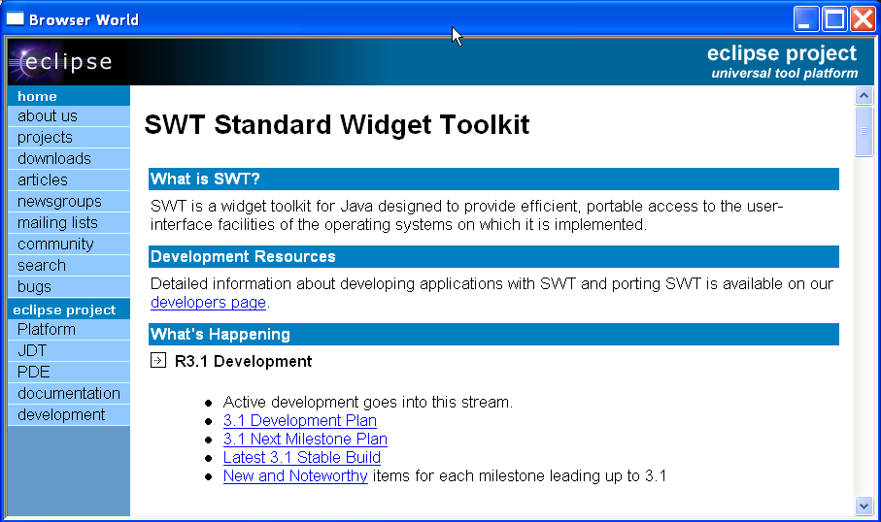
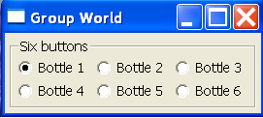
Some more Widgets
Take a look at the SWT Tutorial PPT (on the course slides page)
Who’s your daddy??

Slide 16
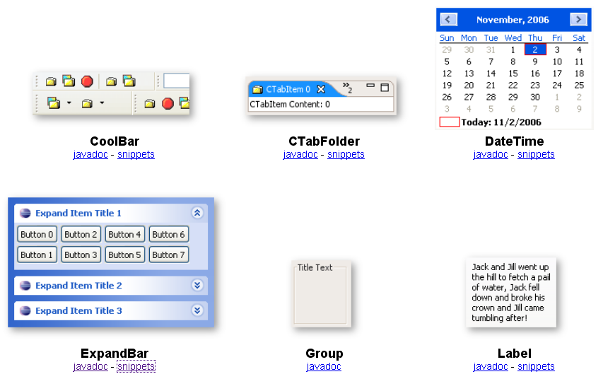
Some more Widgets (2)
http://www.eclipse.org/swt/widgets/

Slide 17
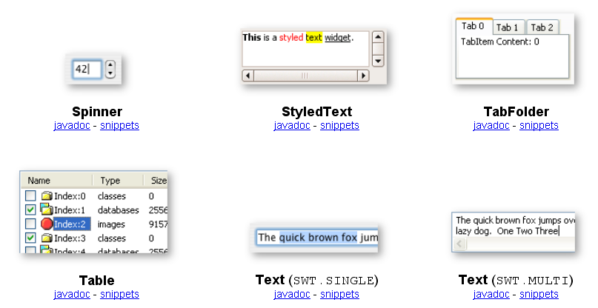
Some more Widgets (3)
http://www.eclipse.org/swt/widgets/

Slide 18
Layouts
First introduced in AWT
Ease burden of laying out components
SWT offers 5 layouts:
- FillLayout
- RowLayout
- GridLayout
- FormLayout
- (*) Stack Layout
http://www.eclipse.org/articles/article.php?file=Article-Understanding-Layouts/index.html

Slide 19
FillLayout
Places all widgets in either a single column or row (SWT.VERTICAL,SWT.HORIZONTAL)
Makes all widgets the same size

Slide 20

FillLayout
shell.setLayout(new FillLayout(SWT.HORIZONTAL));
for(int i = 0; i < 3; i ++)
{
new Button(shell,
(i % 2 == 0) ? SWT.RADIO : SWT.PUSH).setText("Button " + i);
new Text(shell, SWT.BORDER).setText("same size");
}

Slide 21
RowLayout
Places all widgets in either a single column or row (SWT.VERTICAL,SWT.HORIZONTAL)
Doesn’t force all widgets to be the same size
Can wrap to a new row or column if it runs out of space
Can use RowData objects to determine initial heights/widths for controls

Slide 22

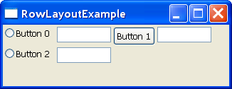
RowLayout
shell.setLayout(new RowLayout(SWT.HORIZONTAL));
for(int i = 0; i < 3; i ++) {
new Button(shell,
(i % 2 == 0) ? SWT.RADIO : SWT.PUSH).setText("Button " + i);
new Text(shell, SWT.BORDER);
}

Slide 23
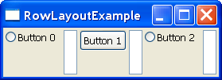
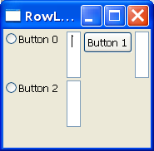
RowLayout
shell.setLayout(new RowLayout(SWT.HORIZONTAL));
for(int i = 0; i < 3; i ++) {
new Button(shell,
(i % 2 == 0) ? SWT.RADIO : SWT.PUSH).setText("Button " + i);
new Text(shell, SWT.BORDER).setLayoutData(new RowData(5, 50));
}

Slide 24
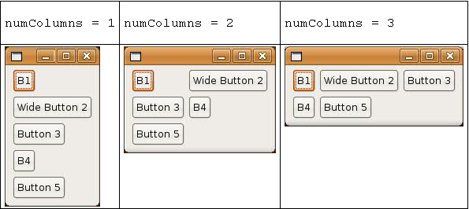
GridLayout
Lays out controls in a grid
Added from left to right, new row is created when numColumns + 1 Widgets are added

Slide 25
GridLayout – Main Properties
int horizontalSpacing – horizontal space in pixels between adjacent cells
int verticalSpacing – vertical space in pixels between adjacent cells
boolean makeColumnsEqualWidth – forces all columns to be same width
int marginWidth – margin in pixels along right and left edges
int marginHeight – margin in pixels along top and bottom edges
int numColumns – number of columns for the layout

Slide 26
GridData
Provide better control..
widget.setLayoutData(GridData)
Lots of options…check the API
Warning for Swing programmers – DO NOT TRY TO REUSE GridData objects
(simply create new for each widget)

Slide 27
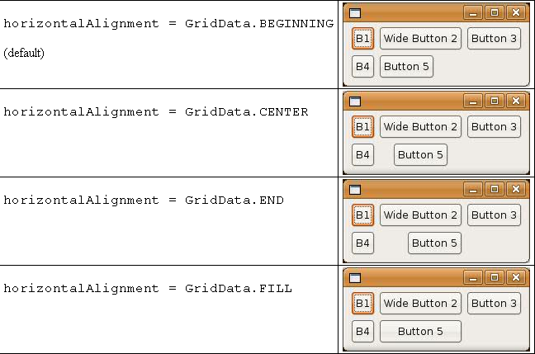
GridData - Example

Slide 28
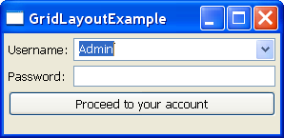
Another Example
shell.setLayout(new GridLayout(2, false));
new Label(shell, SWT.NONE).setText("Username:");
Combo cmbUsername = new Combo(shell, SWT.DROP_DOWN);
cmbUsername.setLayoutData(new GridData(GridData.FILL_HORIZONTAL));
cmbUsername.setItems(new String[]{"Howard", "Admin", "Kalman"});
cmbUsername.setText("Admin");
new Label(shell, SWT.NONE).setText("Password:");
new Text(shell, SWT.BORDER | SWT.PASSWORD).setLayoutData(new GridData(GridData.FILL_HORIZONTAL));
Button loginButton = new Button(shell, SWT.PUSH | SWT.FLAT);
loginButton.setText("Proceed to your account");
GridData data = new GridData(GridData.FILL_HORIZONTAL);
data.horizontalSpan = 2; // span 2 columns
loginButton.setLayoutData(data);

Slide 29
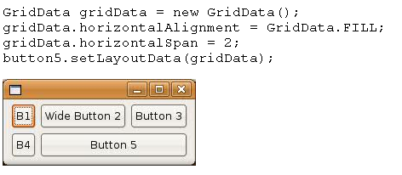
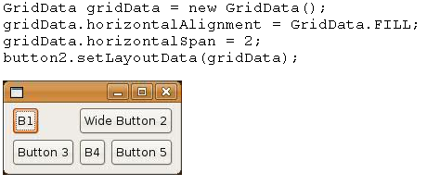
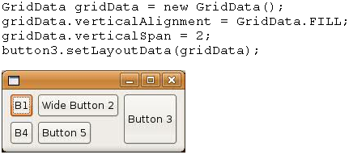
Another Example

Slide 30
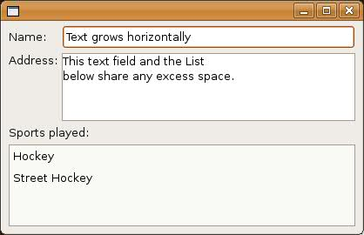
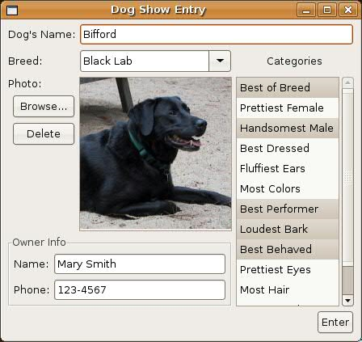
Google for other examples
http://www.eclipse.org/articles/article.php?file=Article-Understanding-Layouts/index.html

Slide 31
FormLayout
Considered the most complex layout of SWT
Based on y = ax + b (not that most people who use it care)
MAXIMUM flexibility
People who understand it – love it ☺
Needs a tutorial of its own and is therefore not covered here …

Slide 32
Event Handling
Similar to Swing..
Listener is basically an interface that defines when certain behaviors happen
Listeners are attached to widgets
Adapters implements the interfaces

Slide 33
Popular Listeners / Adapters
FocusListener/FocusAdapter – listens for focus gained and focus lost events
KeyListener/KeyAdapter – listens for key releases and key presses
ModifyListener(only has 1 method) – listens for text modifications
VerifyListener – listens for (and potentially intercepts) text modifications
MouseListener/MouseAdapter – listens for mouse button presses
SelectionListener/SelectionAdapter – listens for selection events (similar to ActionListener in Swing)

Slide 34
Simple Example
Button loginButton = new Button(shell, SWT.PUSH | SWT.FLAT);
loginButton.addSelectionListener(new SelectionAdapter() {
public void widgetSelected(SelectionEvent e) {
System.out.println(“Clicked!");
}
});

Slide 35
Agenda
SWT
Updating UI (Why do we need Threads?)
Some Loose Ends

Slide 36
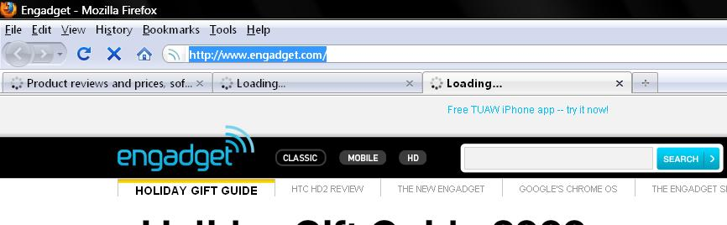
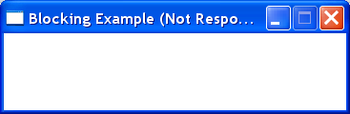
Y do we need threads??
We need threads to support:
Multitask applications
Long task applications (with GUI)

Slide 37
Threads
Context Switch / Interrupt
Threads vs Cores (CPUs)
Threads vs Processes
(Memory space, “Locking”, Lightweight)

Slide 38
Implementing Threads in Java
2 Options:
Implement the Runnable interface: myImpl
→ “create a ‘thread class’ and pass myImpl”
Extend the Thread class: myClass
→ “create your myClass and start() it

Slide 39
Locks??
Why do we need them??
No “Mutex”..
Define a function as synchronized
→ only one thread at a time can “enter it”

Slide 40
More on Java & Threads
Really not complicated..
Read link!!
http://www.javabeginner.com/learn-java/java-threads-tutorial
“ThreadPooling PDF” on the course site

Slide 41
Lets start from the end..
Update the UI from the UI thread
For any other thread, use:
- syncExec(Runnable)
- asyncExec(Runnable)

Slide 42
Going Back, Example for updating UI
final Text text = new Text(shell, SWT.BORDER);
text.setLayoutData(new GridData(GridData.FILL_HORIZONTAL));
Button button = new Button(shell, SWT.PUSH | SWT.FLAT);
button.setText("Click Me");
button.addSelectionListener(new SelectionAdapter() {
public void widgetSelected(SelectionEvent e) {
text.setText(getName());
}
});

Slide 43
Blocking function
“A function that takes long time to return..”
Example:
- While (i<100000000){…}
- Massive DB functions
- “Slow bandwidth..”

Slide 44
Blocking Function + UI
Drawing a UI never ends..
The triggered events (e.g. button click) are executed by the drawing thread
If the thread is blocked for a while, then it can’t “draw” the UI and the program “stucks”

Slide 45
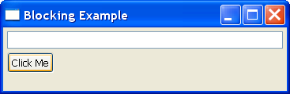
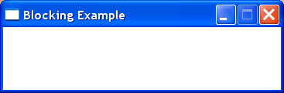
Blocking Function + UI

Slide 46
Solution – Threads
Use a different thread to calculate getName()
public void widgetSelected(SelectionEvent e) {
//text.setText(getName());
“create thread to calculate getName”
}
But who will call “text.setText(“answer”)”?

Slide 47
Setting UI from different Thread
You CANNOT call “text.setText(“answer”)”
(Exception..)
Use:
- syncExec(Runnable)
- asyncExec(Runnable)
The “sync” blocks until the UI thread updates the UI

Slide 48
Setting UI from different Thread
display.asyncExec(new Runnable() {
public void run() {
text.setText(“answer”);
}
});

Slide 49
NoneBlocking Layering
GUI
GUI Thread
Kernel
Kernel Interface
Kernel Thread
GUI Interface

Slide 50
NoneBlocking Layering – Updating GUI
gui.returnOperationResults(results)
{
text.setText(results);
}
GUI
Kernel Thread
GUI Interface
gui.returnOperationResults(results)
{
display.asyncExec(new Runnable() {
public void run() {
text.setText(results);
}
});
}

Slide 51
Example of NoneBlocking Functions (1)
(there are many ways, this is just one)
Use a “kernel” – i.e. thread manager
Implement a pool of Threads
Implement a queue of “requests”
The results of the function will be return by the pooled thread

Slide 52
Example of NoneBlocking Functions (1)
getLongOperation1()
The function returns immediately with a request id
int getLongOperation1()
requestID = “Generate unique ID”
addRequestToQueue(“LongOperation1”, requestID)
return requestID
addRequestToQueue(operation, requestID)
queue.add(opration)
wakeUpThreads

Slide 53
Example of NoneBlocking Functions (1)
returnLongOperation1Results()
AfterThreadIsAwake()
“Get top request from the queue”
“Process the request”
“return the results to the gui” →:
gui.returnOperationResults(operation, requestID)

Slide 54
Example of NoneBlocking Functions (2)
You can use Java’s thread pool / executor
http://java.sun.com/docs/books/tutorial/essential/concurrency/exinter.html
http://java.sun.com/docs/books/tutorial/essential/concurrency/pools.html
Use a combination of example (1) and (2)

Slide 55
Interesting Questions
How to return back the answer
(How to notify back the “right” GUI)
How to represents tasks (Consts / Classes)

Slide 56
Agenda
SWT
Updating UI (Why do we need Threads?)
Some Loose Ends..

Slide 57
Export Database
Very easy
Definition /+ Data (DDL/DML)
Create a script by “Tools → Database Export”
http://www.oracle.com/technology/products/database/sql_developer/howtos/export_intro.htm

Slide 58
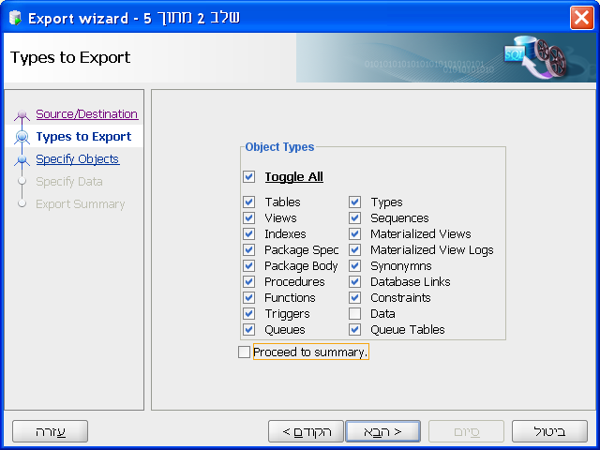
Export Database

Slide 59
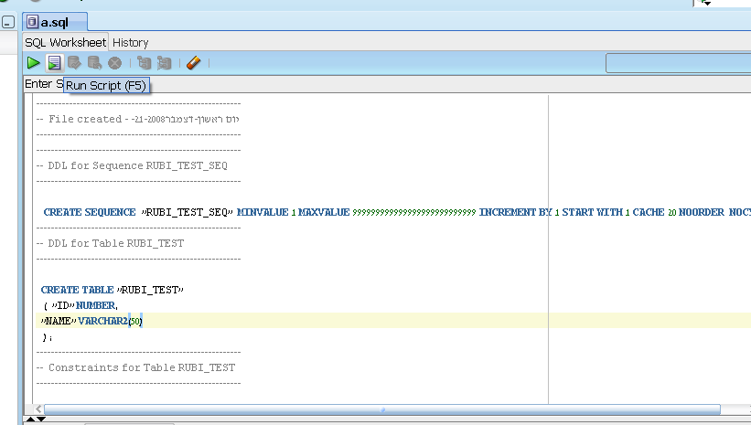
Import Database
Simply run the script in your new environment (connection)

