Slide 1
DB Programming
Database Systems
Presented by Rubi Boim

Slide 2
Agenda
Project Details
Basic Oracle Usage
Little More Complex Oracle stuff..
JDBC
Coding Tips

Slide 3
Agenda
Project Details
Basic Oracle Usage
Little More Complex Oracle stuff..
JDBC
Coding Tips

Slide 4
Oracle Data Types
There are 3 main groups of types:
Character
Numeric
Date
http://download.oracle.com/docs/cd/B28359_01/server.111/b28318/datatype.htm

Slide 5
Oracle Data Types – Character
Character set is established when you create the database (UTF-8,ANSI..). So ignore.. ☺
Char: Fixed length! Short value is padded
Varchar2: variable-length
Both types needs to define max length
(4000 max. for more use BLOB)

Slide 6
Oracle Data Types – Numeric
Implemented by the “Number” data type
A Number has two properties:
- precision: Total number of digits
- scale: Number of digits after the point
(up to 38 digits)
For floating point (if you need..):
BINARY_FLOAT, BINARY_DOUBLE

Slide 7
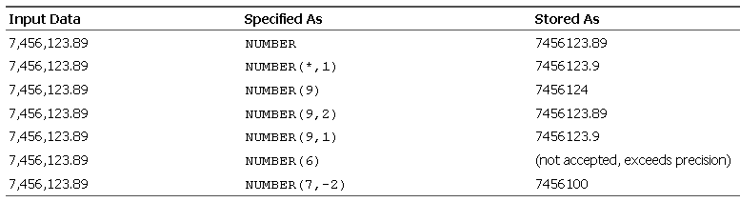
Oracle Data Types – Numeric
Number Example

Slide 8
Oracle Data Types – Date
Implemented by the “Date” data type
Stores “dates” and “times”
Default format is DD-MON-YY
Use the TO_DATE function for any other format
TO_DATE('13-AUG-66 12:56 A.M.','DD-MON-YY HH:MI A.M.')

Slide 9
Define Foreign keys
Don’t forget to define the primary key on the other table..
What happens when you delete the “key record” from the “primary table”?
- Restrict
- Cascade
- Set null

Slide 10
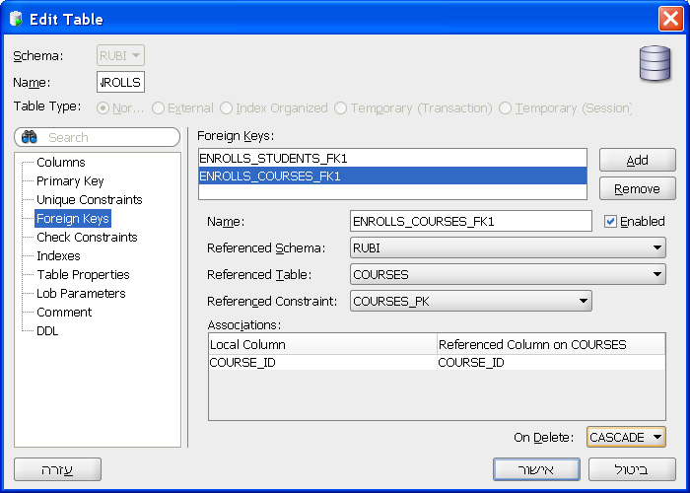
Define Foreign keys

Slide 11
Basic oracle usage - Demo
Demo..
- create table (data types)
- define primary key
- define foreign keys (insert / delete data)

Slide 12
Agenda
Project Details
Basic Oracle Usage
Little More Complex Oracle stuff..
JDBC
Coding Tips

Slide 13
Index
Index improves the speed of operations on a table
Can be created using one or more fields
You will later learn more..
But don’t forget, its important

Slide 14
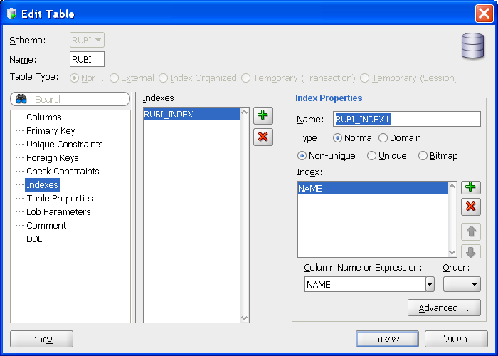
Index - HowTo

Slide 15
“AutoNumber”
How do you know how to assign an ID??
ID | NAME
1 | Rubi
2 | Tova
3 | Itay
4 | Dvir
… | …

Slide 16
“AutoNumber” – Algorithm?
Lock table
new_id = 1 + select max id from table
insert into table values(new_id, ”Rubi”);
Unlock table

Slide 17
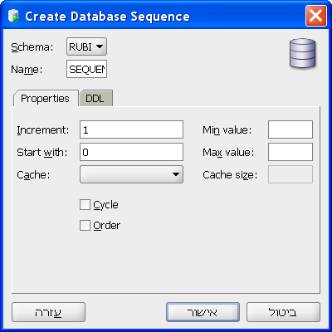
Sequence
Sequence - an object from which multiple users may generate unique integers
NEXTVAL() - increments
the sequence and returns
the new value.

Slide 18
Sequence – Insert example
If we defined the sequence as TEST_SEQ
INSERT INTO test values(TEST_SEQ.NEXTVAL, 'rubi')
Usually, sequence is defined as
table_name +”_SEQ”

Slide 19
Sequence – Can we do better?
Why are we complicating things??
Do all DBMS support sequences?
If we change a sequence name, we need to update all our queries
Can we separate it from the query?
INSERT INTO test(name) values('rubi')

Slide 20
Triggers
A database trigger is procedural code that is automatically executed in response to certain events on a particular table
Events:
BEFORE INSERT AFTER INSERT
BEFORE UPDATE AFTER UPDATE
BEFORE DELETE AFTER DELETE

Slide 21
Triggers – Statement Level
Occurs only once per Insert/Update/Delete
CREATE OR REPLACE TRIGGER <trigger_name>
<BEFORE | AFTER> <ACTION> ON <table_name>
BEGIN
<trigger_code>
END;

Slide 22
Triggers – Row Level
Occurs for each row
CREATE OR REPLACE TRIGGER <trigger_name>
<BEFORE | AFTER> <ACTION> ON <table_name>
FOR EACH ROW
  BEGIN
  <trigger_code>
  END;

Slide 23
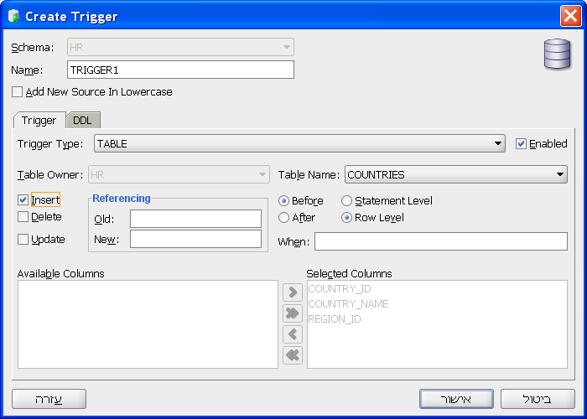
Triggers – Row Level – Example
You can not “just use the GUI” - you need to “code” the trigger”
After you press “ok” you can edit the code

Slide 24
Triggers – Row Level – Example
Use “NEW” to refer to the row
dual – simply a scratch-pad
select max(12,54,2,75,142) from dual
CREATE bi_test
BEFORE INSERT ON test
FOR EACH ROW
BEGIN
SELECT TEST_SEQ.NEXTVAL
INTO :NEW.id
FROM dual;
END;

Slide 25
“Complex” Oracle Stuff
Demo..
- Create index
- Create “Autonumber”:
- Create Sequence
- Create Trigger

Slide 26
Limit the Results
What if your query returns 1,000,000 results?
How to return the TOP n results
How to return the results from n to m

Slide 27
Oracle’s Rownum
Works only on Oracle..
(mysql has “Limit”, sql-server has “Top”)
ROWNUM is a pseudocolumn (not “real”)
Each row is assigned with a number, starting with 1
We can select just the ones we want..

Slide 28
Oracle’s Rownum – NOT THAT SIMPLE!
Its assigned BEFORE sorting or aggregation
ROWNUM value is incremented only after it is assigned
Read the previous lines 5 more times!

Slide 29
Oracle’s Rownum – Example 1
SELECT *
FROM students
WHERE ROWNUM > 1
What NOT to do… ☺

Slide 30
Oracle’s Rownum – Example 2
SELECT *
FROM students
WHERE ROWNUM < 10
ORDER BY students.name
What NOT to do… ☺

Slide 31
Oracle’s Rownum – Example 3
SELECT * FROM
( SELECT *
FROM students
ORDER BY students.name )
WHERE ROWNUM < 10
This will work…

Slide 32
Oracle’s Rownum – Example 4
SELECT * FROM
( SELECT *
FROM students
ORDER BY students.name )
WHERE ROWNUM >= 10 AND
ROWNUM < 20
What NOT to do… ☺

Slide 33
Oracle’s Rownum – Example 5
SELECT * FROM
( SELECT a.*, ROWNUM rnum FROM
(
SELECT *
FROM students
ORDER BY students.name
) a
)
WHERE rnum >= 10 AND
rnum < 20
Will work but we can do better (y)… ☺

Slide 34
Oracle’s Rownum – Example 6
SELECT * FROM
( SELECT a.*, ROWNUM rnum FROM
(
SELECT *
FROM students
ORDER BY students.name
) a
WHERE ROWNUM < 20
)
WHERE rnum >= 10
That’s the way… ☺

Slide 35
Oracle’s Rownum – Final slide ☺
There is a big difference between > and <
If you are using “example 6”, be sure the order by is unique (y?)
btw, in MySQL its simply:
select * from students order by name limit 10,20

Slide 36
Little More Complex Oracle Stuff - Demo
Demo..
- create Sequence
- create Trigger (for autonumber)
- limiting the results

Slide 37
Agenda
Project Details
Basic Oracle Usage
Little More Complex Oracle stuff..
JDBC
Coding Tips

Slide 38
During the last episode…
Application
DB infrastructure
DB driver
transport
DB engine
Storage

Slide 39
Concepts vs APIs
Concepts APIs/Language
Connection
Connection pooling
Error Handling
Fetching results
Rowset
Prepared statements
Batch processing
ODBC
JDBC
OCI/OCCI
ADO.NET
X

Slide 40
ODBC – Open Database Connectivity API
Pros:
  Cross platform and cross databases
  Easy to use
Cons:
  Too low level
We wont use it.. But its very very common

Slide 41
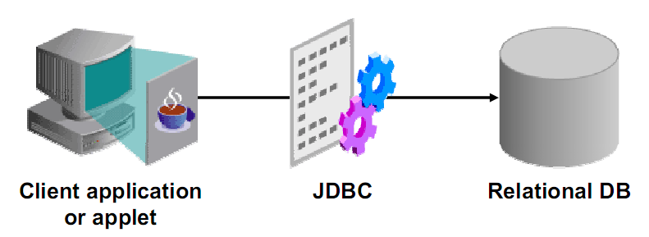
JDBC
JDBC is a standard interface for connecting to relational databases from Java

Slide 42
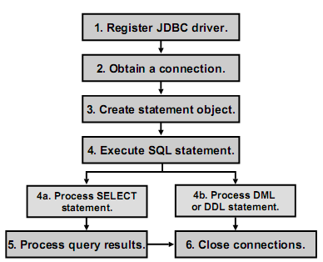
How to execute SQL using JDBC

Slide 43
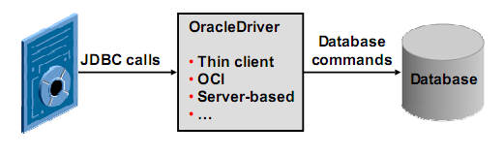
JDBC Oracle Driver
Thin Client driver
written in java
OCI Driver
written in java & c. must be installed
ODBC Bridge
(too general..)

Slide 44
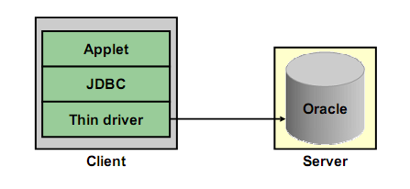
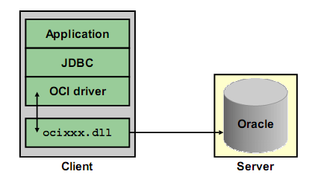
JDBC Oracle Driver
Thin vs OCI

Slide 45
Preparing the Environment 1
Download Oracle’s JDBC driver:
http://www.oracle.com/technology/software/tech/java/sqlj_jdbc/htdocs/jdbc_112010.html
Can also be found at the course page
Setup Eclipse:
- add the jar “ojdbc6.jar” to the project

Slide 46
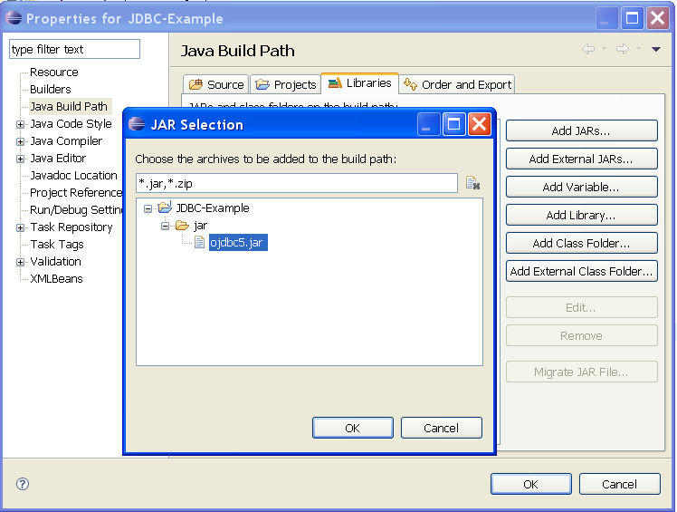
Preparing the Environment 2
If you copy the jar file to the project directory, press “add JAR”. Otherwise, “Add external JAR”

Slide 47
Preparing the Environment 3
import java.sql.* (JDBC API)
Register the driver in the code:
Class.forName("oracle.jdbc.OracleDriver");

Slide 48
Opening a Connection
Connection class - java.sql.Connection
use the DriverManager with JDBC URL
conn = DriverManager.getConnection(
"jdbc:oracle:thin:@localhost:1521:XE",
“username",
“password");

Slide 49
Opening a Connection
Demo..

Slide 50
Creating a Statement
Created from the connection object
Statement stmt = conn.createStatement();

Slide 51
Using a Statement
Three different methods:
executeQuery(String) for SELECT statements
returns ResultSet
executeUpdate(String) for DML/DDL
returns int
execute(String) for any SQL statement
returns boolean

Slide 52
executeQuery & ResultSet
ResultSet:
Maintain a curser to its current row
Provides methods for retrieving values:
getInt(), getDate(), getString()..
Fields can be identify by name or order:
getXXX(“Name”)
getXXX(2)

Slide 53
executeQuery & ResultSet
Initially the cursor is positioned before the first row
stmt = conn.createStatement();
rs = stmt.executeQuery(
"SELECT * FROM employees");
while (rs.next() == true)
System.out.println(rs.getString(“field”));
Demo..

Slide 54
executeUpdate
Again, via the statement
Execute DDL or DML
Returns Int for DML, 0 for DDL

Slide 55
executeUpdate
stmt=conn.createStatement();
result=stmt.executeUpdate(
"DELETE FROM demo");
Demo..

Slide 56
execute
Executes any command for the DB
Returns boolean (success/failure)
Not sure you’ll need it..

Slide 57
Closing Connections
Important! So don’t forget..
ResultSet.close()
Statement.close()
Connection.close()

Slide 58
Transactions
By default, connection are autocommit
Can be disabled by:
conn.setAutoCommit(false)
Commit a transaction: conn.commit()
Rollback a transaction: conn.rollback()

Slide 59
Transactions – When to use?
In general, in any logic operation that involves more than one call:
insert/update/remove into several tables
Inconsistent data is unacceptable!
Don’t forget to use!

Slide 60
PreparedStatement
Prevents reparsing of SQL statements
Used for statements executed more than once
Saves time
Nicer code

Slide 61
PreparedStatement - how
Specify a variable by “?”
PreparedStatement pstmt = conn.prepareStatement(
"INSERT INTO demo(fname, lname) VALUES(?, ?)");
Supply values for the variables:
pstmt.setXXX(index, value)
Execute the statement
pstmt.executeUpdate();

Slide 62
PreparedStatement - example
PreparedStatement pstmt = conn.prepareStatement(
"INSERT INTO demo(fname, lname) VALUES(?, ?)");
pstmt.setString(1, "Rubi");
pstmt.setString(2, "Boim”);
pstmt.executeUpdate();
pstmt.setString(1, “Tova");
pstmt.setString(2, “Milo”);
pstmt.executeUpdate();
Demo..

Slide 63
Batch PreparedStatement
PreparedStatement can be slow for long calls
Batch together all the calls!
I.E. instead of 50,000 calls, do one call with 50,000 parameters
Improves performance dramatically!

Slide 64
Batch PreparedStatement - how
Instead of pstmt.executeUpdate()
do pstmt.addBatch()
After all statement are added to the batch:
int[] = pstmt.executeBatch()
TIP: don’t batch too much together
Demo..

Slide 65
Agenda
Project Details
Basic Oracle Usage
Little More Complex Oracle stuff..
JDBC
Coding Tips

Slide 66
Layering
Separate the GUI!
Separate the DB!
Use classes to describe entities
Use interfaces!

Slide 67
Layering
DB
Logic
GUI
Interface
Interface
Data
Class
Data
Class

Slide 68
Reuse & Encapsulation
Identify main processes
Abstract implementation
Reuse..
NO COPY PASTE CODE

Slide 69
Don’t create too many functions
Search for movies:
searchMovieByName()
searchMovieByDate()
..
It’s the same query! just different “where” →
manipulate the “where” in the function:
SearchMovie(searchOptions?)
Not so easy on some parameters..
searchMovieByActors()
searchMovieByActorsAndDate() any ideas?

Slide 70
Configuration
Your program will have several (many) variables:
- server address
- textfile location
- number of connections/threads
- ….
Do not “hard code” them
*.ini file, easy GUI, ….

Slide 71
Schema
Well, you should be expert by now.. ☺
Primary Key - ALWAYS integer!
Use indexes to speed up (but not on every field)

Slide 72
Testing
Obvious not?
Try installing / running your program on different computers
Connection drops
Validate user input (date, number, special chars..)
Your program should never fall!!

Slide 73
Good questions…
Managing Database Connections
Managing Security
Managing Threads
Error handling

Slide 74
How to insert with AutoNumber
Assuming you created a trigger similar to the one showed before..
Specify the exact fields in the “Insert”
(I.E. neglect the “triggered” ones)
INSERT INTO test(name) VALUES(‘Rubi’);
ID | NAME
1 | Yonni
2 | Tova
3 | Dvir

Slide 75
Retrieving the AutoNumber Generated
When calling “executeUpdate”, you can specify which fields you can “get back”
After executing, use getGeneratedKeys() to retrieve a resultset with the returned fields
stmt.executeUpdate("INSERT INTO demo(fname, lname)
VALUES('Rubi','Boim')",
new String[]{"ID"});
rs=stmt.getGeneratedKeys();
rs.next();
id=rs.getInt(1);

Slide 76
Retrieving the AutoNumber Generated
Demo.. (I.E. there is an example code ☺ )

Slide 77
How to insert Strings
In an SQL Query, strings are surrounded by ‘
But what if we want to insert the char ‘?
INSERT INTO test VALUES(‘It’s a test’);
Simply add another ‘
INSERT INTO test VALUES(‘It’’s a test’);

Slide 78
How to insert Dates
Read the “to_date” manual..
http://www.techonthenet.com/oracle/functions/to_date.php
stmt.executeUpdate(
"INSERT INTO demo(fname, lname, mydate) VALUES('Rubi',
'Boim',
to_date('13/12/2008', 'dd/mm/yyyy'))");

Slide 79
Important Tip for Manipulating Data
What if tomorrow your switch to MySQL??
Create your own functions for adjusting types (not just dates)
String fixDate(String old_date)
{ return “to_date(‘” + old_date + ”', 'dd/mm/yyyy')”}
stmt.executeUpdate(
"INSERT INTO demo(fname, lname, mydate) VALUES('Rubi', 'Boim',” + fixDate('13/12/2008‘) + ”)”);

Slide 80
Connection Pooling
Opening a connection is “expensive”
Multi tasks requires multi connections
You should open a connection only when you need it (I.E. when a task asks for connection and there is no one available)
When the task is done, do not close the connection but returns it to the “manager” for future use

Slide 81
Connection Pooling – example
Example of what might it look..
MyConn conn = cManager.poolConn();
conn.getJDBCConn.executeQuery(..);
conn.returnConnection(); OR
cManager.returnConn(conn)
Implement it your own way, but be sure to use “synchronized”

Slide 82
Thread Pooling
If you build your application correctly, the GUI should be separate from the “program”
Same concept as the Connection Pooling
More about it when we talk about the GUI

Slide 83
Coding tips
The following next slides are EXAMPLES for what NOT-TO-DO in the project. Basically they are based on last years submissions, which were altered to express important points.

Slide 84
Database Design
Don’t forget to normalize the DB
Use the right types
ID | Number
CD_NAME | NVARCHAR(50)
ARTIST_NAME | NVARCHAR(50)
GENRE | NVARCHAR(50)
YEAR | DATE

Slide 85
Usability
“non-refreshed” windows
“Hangs” windows
“Please wait…Your query may take a couple of minutes…”

Slide 86
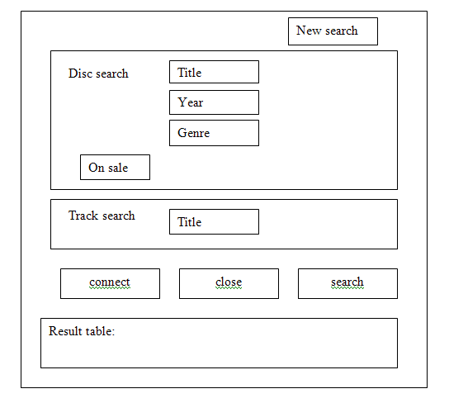
Usability II

Slide 87
Thank you

