Slide 1
Introduction to Oracle
Database Systems
Presented by Rubi Boim

Slide 2
Agenda
Bureaucracy…
Database architecture overview
Buzzwords
SSH Tunneling
Intro to Oracle
Comments on homework

Slide 3
Homework #1
Submission date is November 17. (No late arrivals will be accepted)
Work should be done in pairs
Please, please, please, names and ID on the submittals.
Submit Hardcopies to Rubi’s mailbox
USE THE FORMAT DESCRIBED IN THE ASSIGNMENT

Slide 4
Project
Hard work, but real.
Work in groups of 4
Project goal: to tackle and resolve real-life DB related development issues
One Two stages.
Use JAVA (SWT)
Thinking out of the box will be rewarded

Slide 5
Agenda
Bureaucracy…
Database architecture overview
Buzzwords
SSH Tunneling
Intro to Oracle
Comments on homework

Slide 6
DB System from lecture #1
“Two tier database system”
connection
(ODBC, JDBC)
Database server
(someone else’s
C program)
Data files
Applications

Slide 7
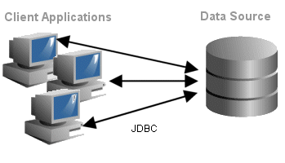
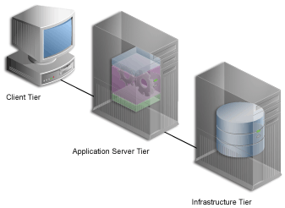
1,2,3 tiers

Slide 8
Abstractly (DB) system layers may include
Application
DB infrastructure
DB driver
Transport
DB engine
Storage

Slide 9
Why?
Gui designer
Tester
App programmer
DBA
DB programmer

Slide 10
Application layer
Application
Why should it actually use
database?
  Persistence layer
  Access data storage
  Interfacing between systems
  Large volumes
  Scalability
  Redundancy
DB infrastructure
DB driver
Transport
DB engine
Storage

Slide 11
Infrastructure layer
Application
Goals:
  Database “hiding”
  Schema abstraction
  Encapsulation of db mechanisms
How: (In two words)
DB infrastructure
DB driver
Transport
DB engine
Storage
Model Abstraction

Slide 12
DB driver / bridge
Application
Used for:
  API for database connectivity
  Protocol converter
  Performance improvements
  Transaction management
Examples:
  In a minute…
DB infrastructure
DB driver
Transport
DB engine
Storage

Slide 13
Transport
Application
Mainly TCP but not only
Secure
Efficient
Fast but not fast enough
DB infrastructure
DB driver
Transport
DB engine
Storage

Slide 14
DB engine
Application
Total management of the DB
environment including
  Security
  Scalability
  Fault tolerant (disaster management)
  Monitoring
  Services
Large DB engines include Microsoft SQL Server, Oracle, SyBase, MySQL, etc.
DB infrastructure
DB driver
Transport
DB engine
Storage

Slide 15
DB engine (2)
Application
DB engine management includes:
  Databases/Tables/Fields
  Creation/removal/modification/
  optimization
  Connections/Users/Roles
  Security/monitoring/logging
  Jobs/Processes/Threads
  Scheduling/balancing/managing
DB infrastructure
DB driver
Transport
DB engine
Storage

Slide 16
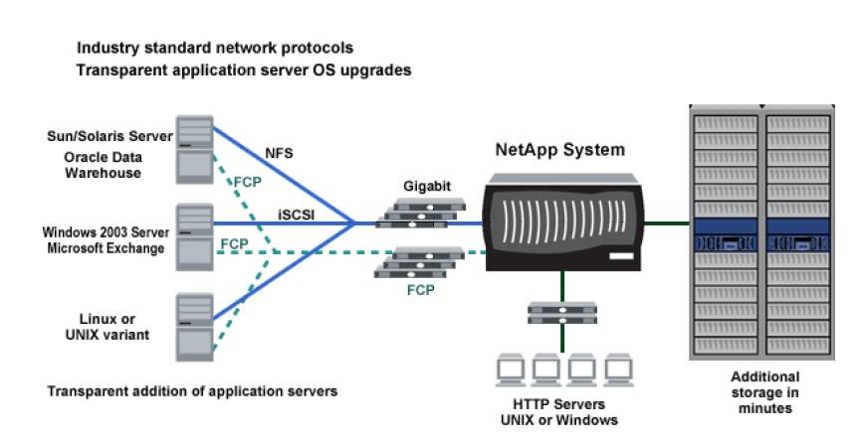
Storage
Application
NAS/SAN, Raid and other stuff…
(sorry… not in this course)
DB infrastructure
DB driver
Transport
DB engine
Storage

Slide 17
Agenda
Bureaucracy…
Database architecture overview
Buzzwords
SSH Tunneling
Intro to Oracle
Comments on homework

Slide 18
Terms…
ODBC
ADO
OLE-DB
MDAC/UDA
JDBC
ORM

Slide 19
ODBC, OLEDB and ADO
Various standards have been developed for accessing database servers.
Some of the important standards are
  ODBC (Open Database Connectivity) is the early standard for relational databases.
  OLE DB is Microsoft’s object-oriented interface for relational and other databases.
  ADO (Active Data Objects) is Microsoft’s standard providing easier access to OLE DB data for the non-object-oriented programmer.

Slide 20
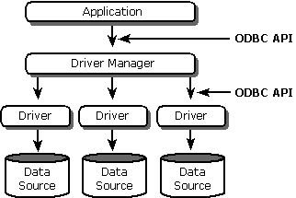
ODBC
Open Database Connectivity (ODBC) is a standard software API method for using database management systems (DBMS)
Maximum interoperability

Slide 21
ODBC
Examples of common tasks:
  Selecting a data source and connecting to it.
  Submitting an SQL statement for execution.
  Retrieving results (if any).
  Processing errors.
  Committing or rolling back the transaction enclosing the SQL statement.
  Disconnecting from the data source.

Slide 22
MDAC… UDA
UDA (Universal Data Access) and/or MDAC (Microsoft Data Access Components) include (ADO), OLE DB, and (ODBC).

Slide 23
JDBC
Java DB connectivity API
Similar to ODBC
Why do you need it:
  Pure Java
  Simple API
  Well….Multi-platform

Slide 24
JDBC
API includes:
  DriverManager, Connection, Statement, PreparedStatement, CallableStatement, ResultSet, SQLException, DataSource
JDBC Type Driver:
  Type 1 - (JDBC-ODBC Bridge) drivers.
  Type 2 - native API for data access which provide Java wrapper classes
  Type 3 - 100% Java, makes use of a middle-tier between the calling program and the database..
  Type 4 - They are also written in 100% Java and are the most efficient among all driver types. Calls directly into the vendor-specific database protocol.

Slide 25
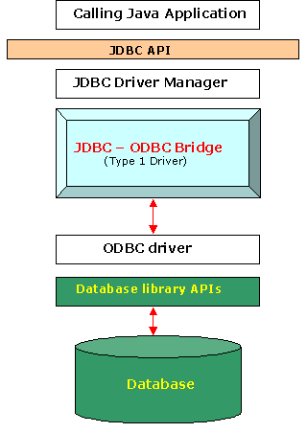
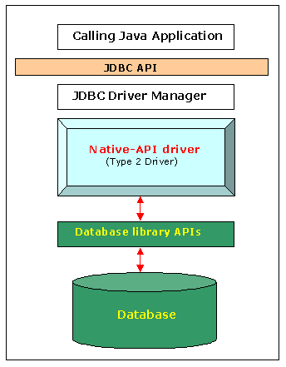
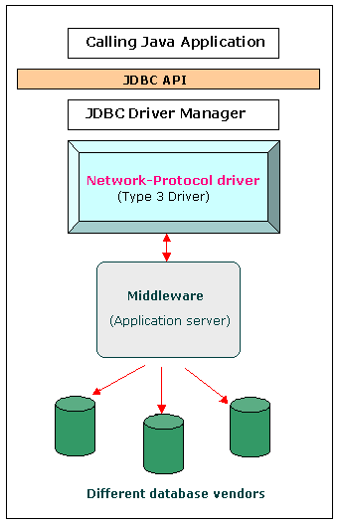
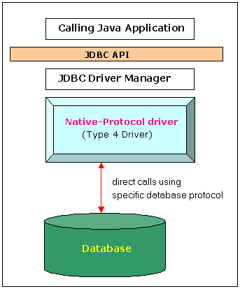
JDBC Types
Type 1
Type 2
Type 3
Type 4

Slide 26
ORM
Object-Relational mapping is a programming technique for converting data between incompatible type systems in relational databases and object-oriented programming languages.
For example: Hibernate, EJB3.0, JDO

Slide 27
Agenda
Bureaucracy…
Database architecture overview
Buzzwords
SSH Tunneling
Intro to Oracle
Comments on homework

Slide 28
Welcome to
The travels of a query
Notes:
DB Server,
Client App
Driver
Query
Packets
Firewall
Tunneling client
Ssh server

Slide 29
SSH
Standard way
Using Tunnel
Application
Client
Machine
Application
Client
Machine
DB infrastructure
DB infrastructure
DB bridge/driver
DB bridge/driver
TCP
proxy
Transport
(TCP)
SSH
Tunnel machine
(SSH server)
Proxy
Machine
DB engine
Server
Machine
TCP
DB engine
Server
Machine

Slide 30
SSH in TAU
Application
YOUR MACHINE
define DB at localhost, port 1555
DB infrastructure
Db bridge/driver
Putty connects to nova and
forward local port 1555 to orasrv port 1521
proxy
Tunnel machine
(SSH server)
Nova.cs.tau.ac.il
DB engine
orasrv port 1521

Slide 31
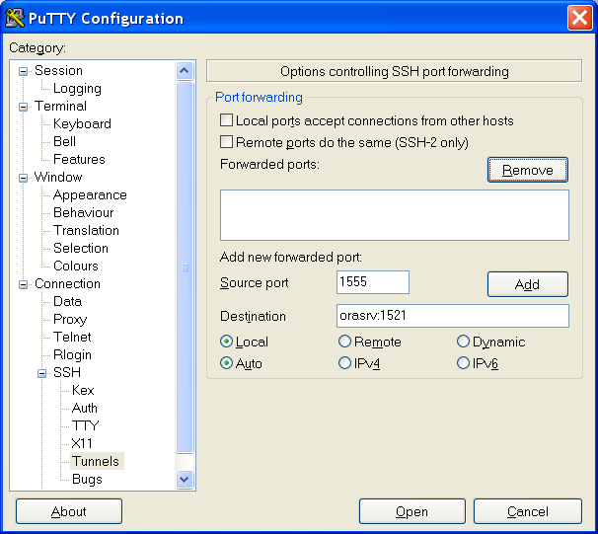
SSH in TAU

Slide 32
Agenda
Bureaucracy…
Database architecture overview
Buzzwords
SSH Tunneling
Intro to Oracle
Comments on homework

Slide 33
Products we will be using
Oracle database – (at home express edition)
SQLDeveloper
Free to download on oracle.com
(required to create an oracle account)
XE – under “Database”
SQLDeveloper – under “Middleware →
Developer Tools”

Slide 34
Server settings..
Host: localhost/orasrv
Port: 1521
SID: xe/csodb/other?
Schema system/hr/specificuser/
Use the connection guide (link on the course slides page) for instruction on how to create a DB user:
TAU HR user / password: hr_readonly / tiger

Slide 35
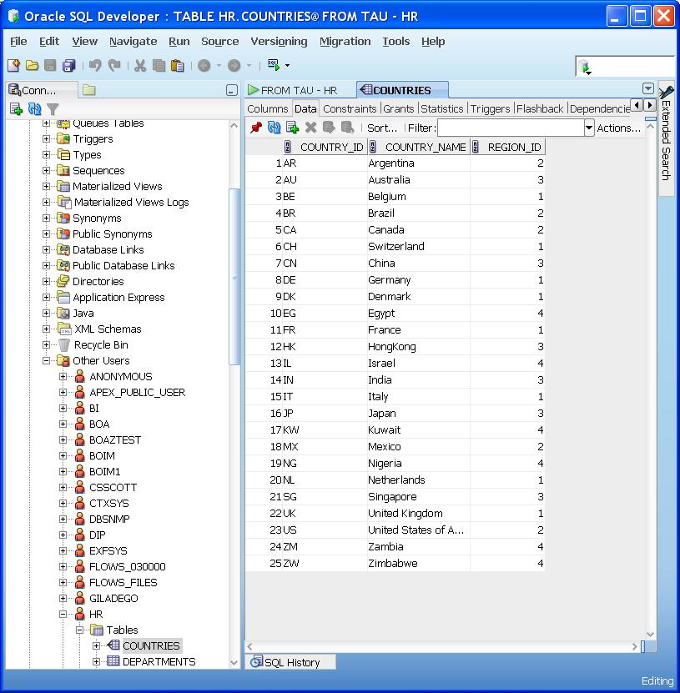
HR vs HR_Readonly

Slide 36
Oracle Express Edition (XE)
Installation only at home…

Slide 37
XE Database DEMO
Similar tutorial can be found in
http://st-curriculum.oracle.com/tutorial/DBXETutorial/index.htm
Installation
Create a user
Run a script
Query
Other database objects
Administration tasks

Slide 38
Database Homepage Demo
Demo..
Notes:
scenario
sql*Plus
invoking
login
select table_name from user_tables;
describe countries;
describe locations;
select city,country_name from locations inner join countries on locations.country_id = countries.country_id;
differences between databases
sqlDev
database connection
database objects
explain
reports
drag and drop
format
jdev
connection
editing
schema
new scema and generate
eclipse?
XE database
login
menus
graphical queries
Additional tools
aqua
smart draw

Slide 39
SQL*plus Demo
Demo..
Notes:
scenario
sql*Plus
invoking
login
select table_name from user_tables;
describe countries;
describe locations;
select city,country_name from locations inner join countries on locations.country_id = countries.country_id;
differences between databases
sqlDev
database connection
database objects
explain
reports
drag and drop
format
jdev
connection
editing
schema
new scema and generate
eclipse?
XE database
login
menus
graphical queries
Additional tools
aqua
smart draw

Slide 40
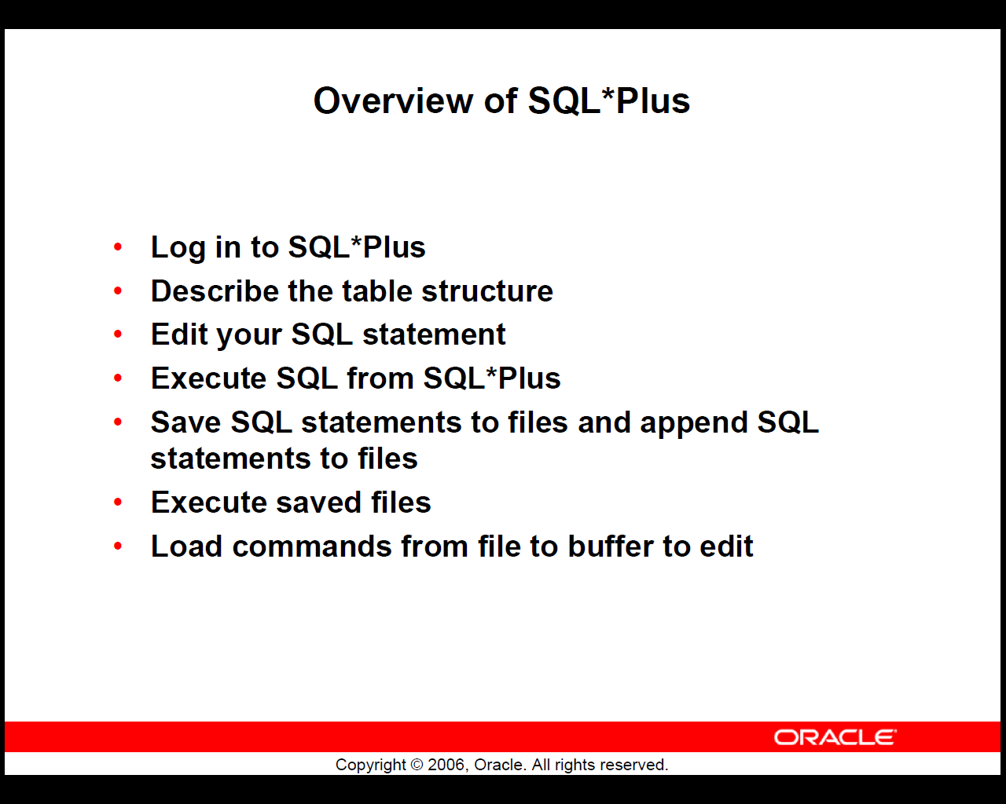

Slide 41
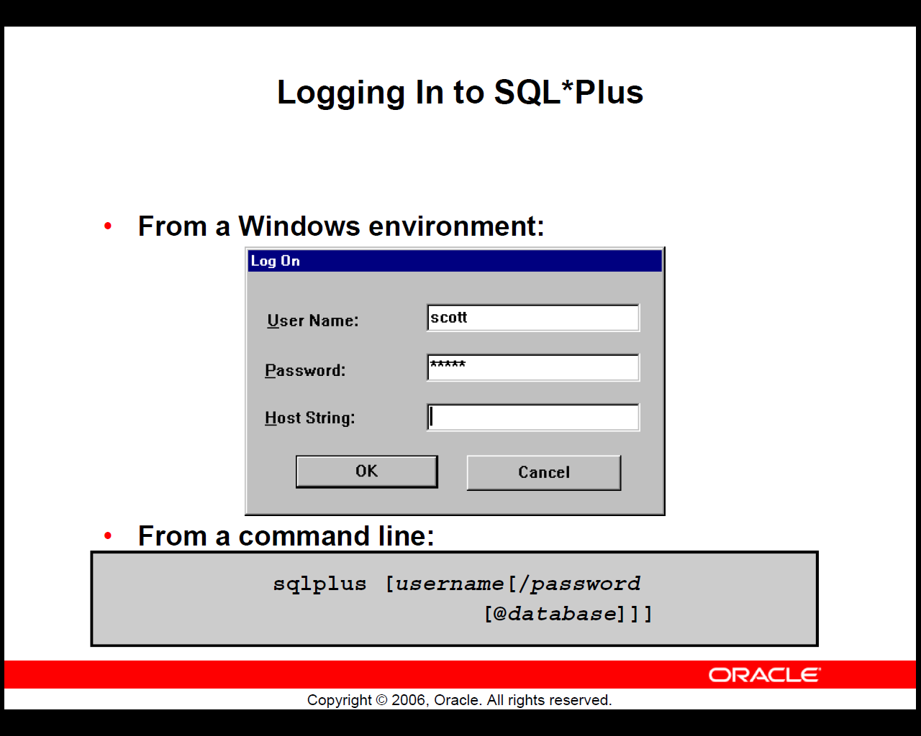

Slide 42
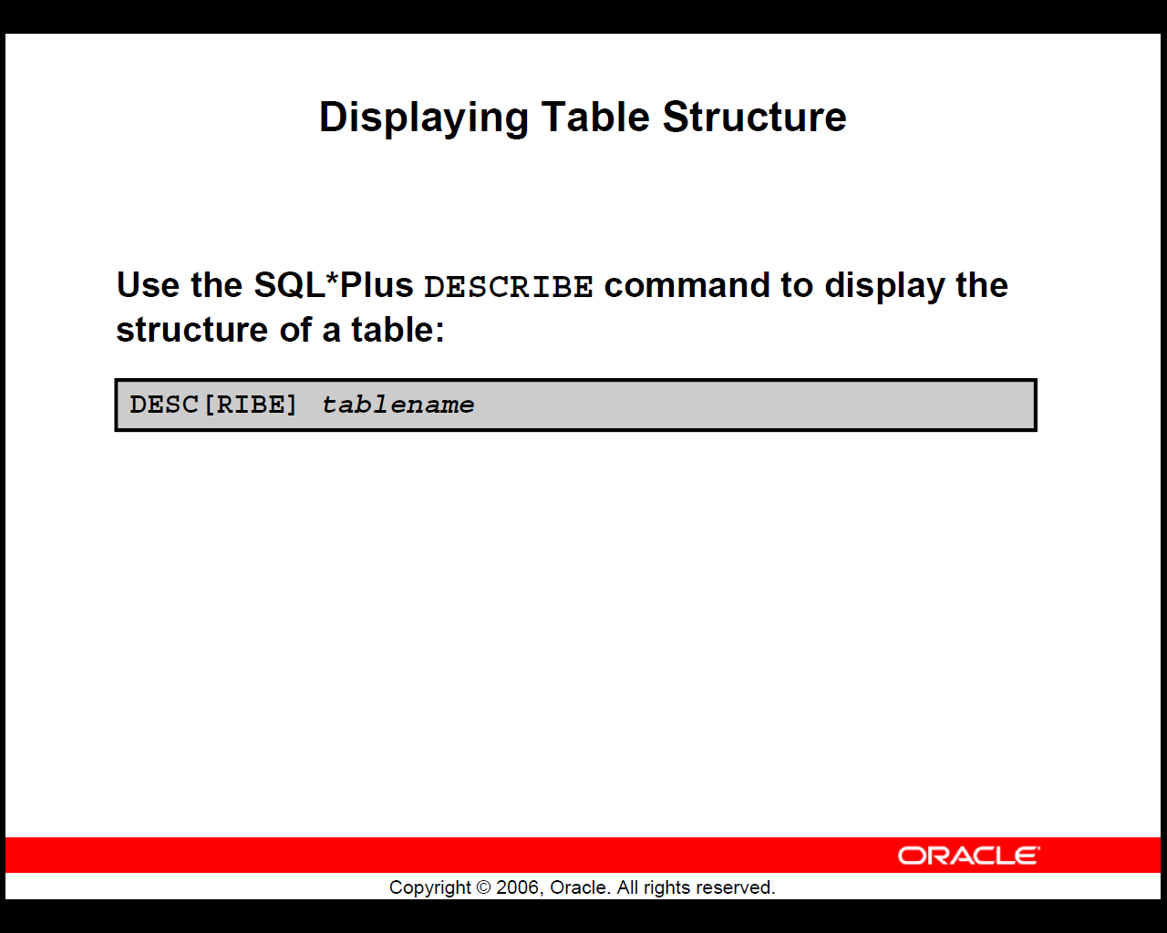

Slide 43
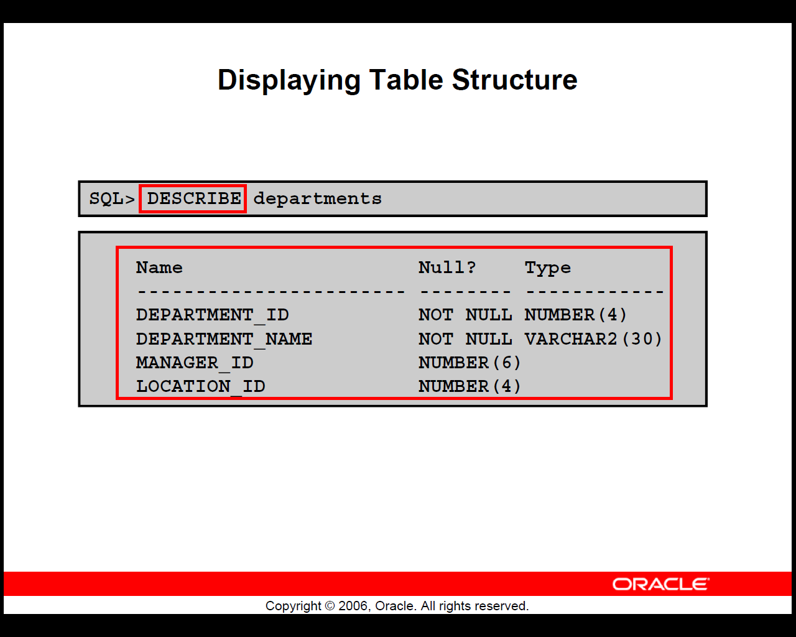

Slide 44
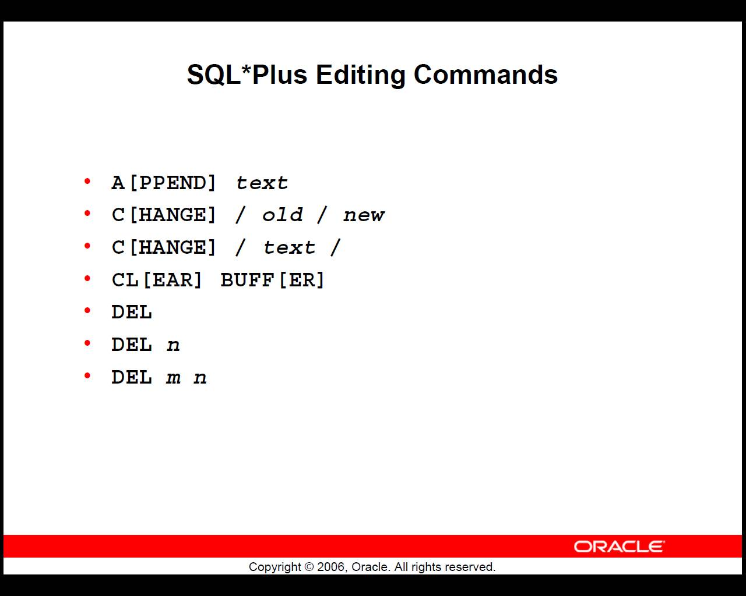

Slide 45
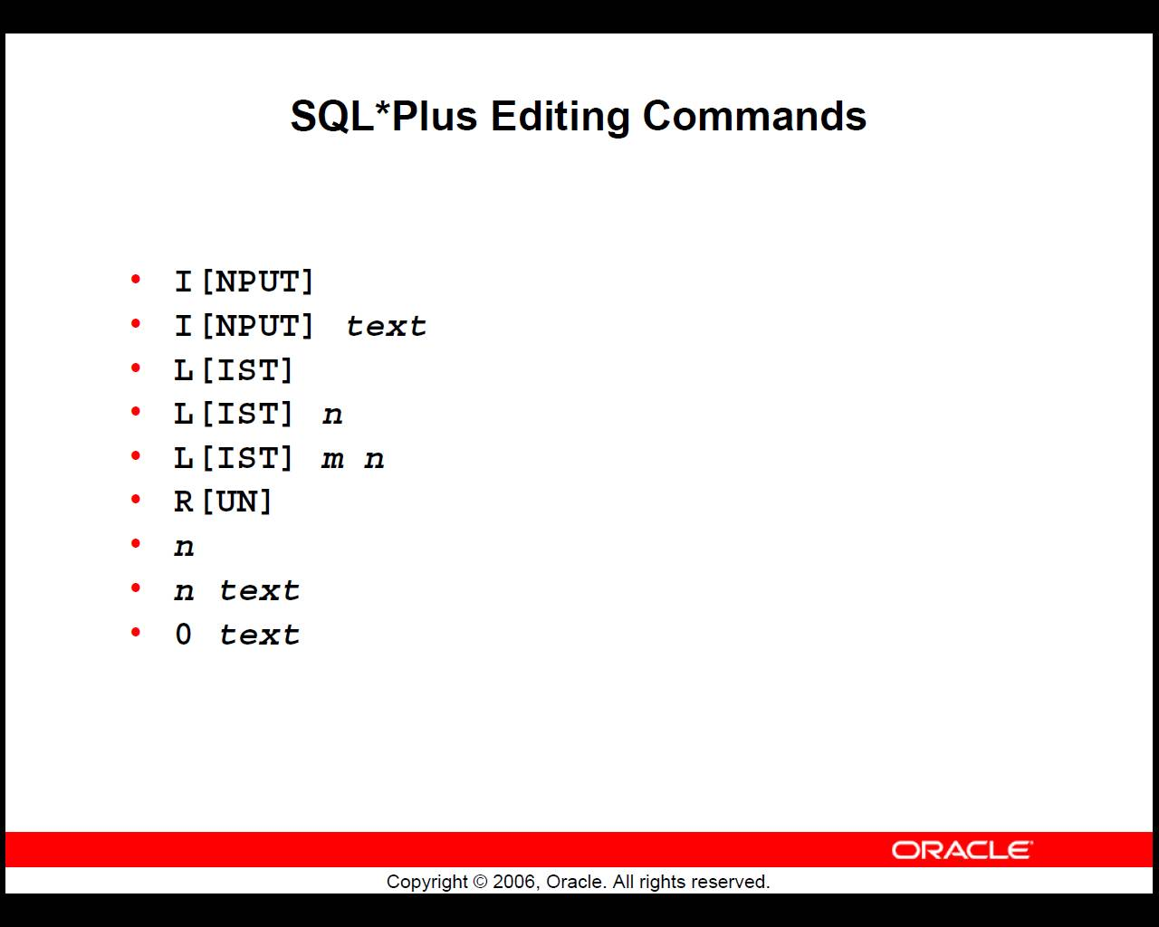

Slide 46
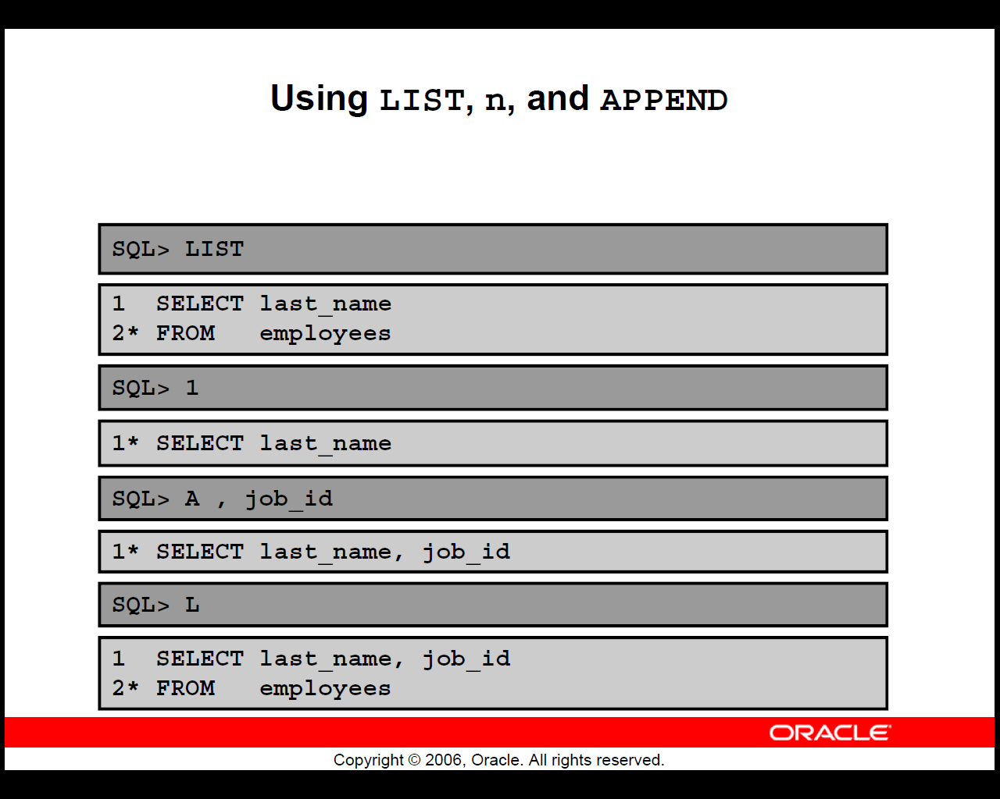

Slide 47
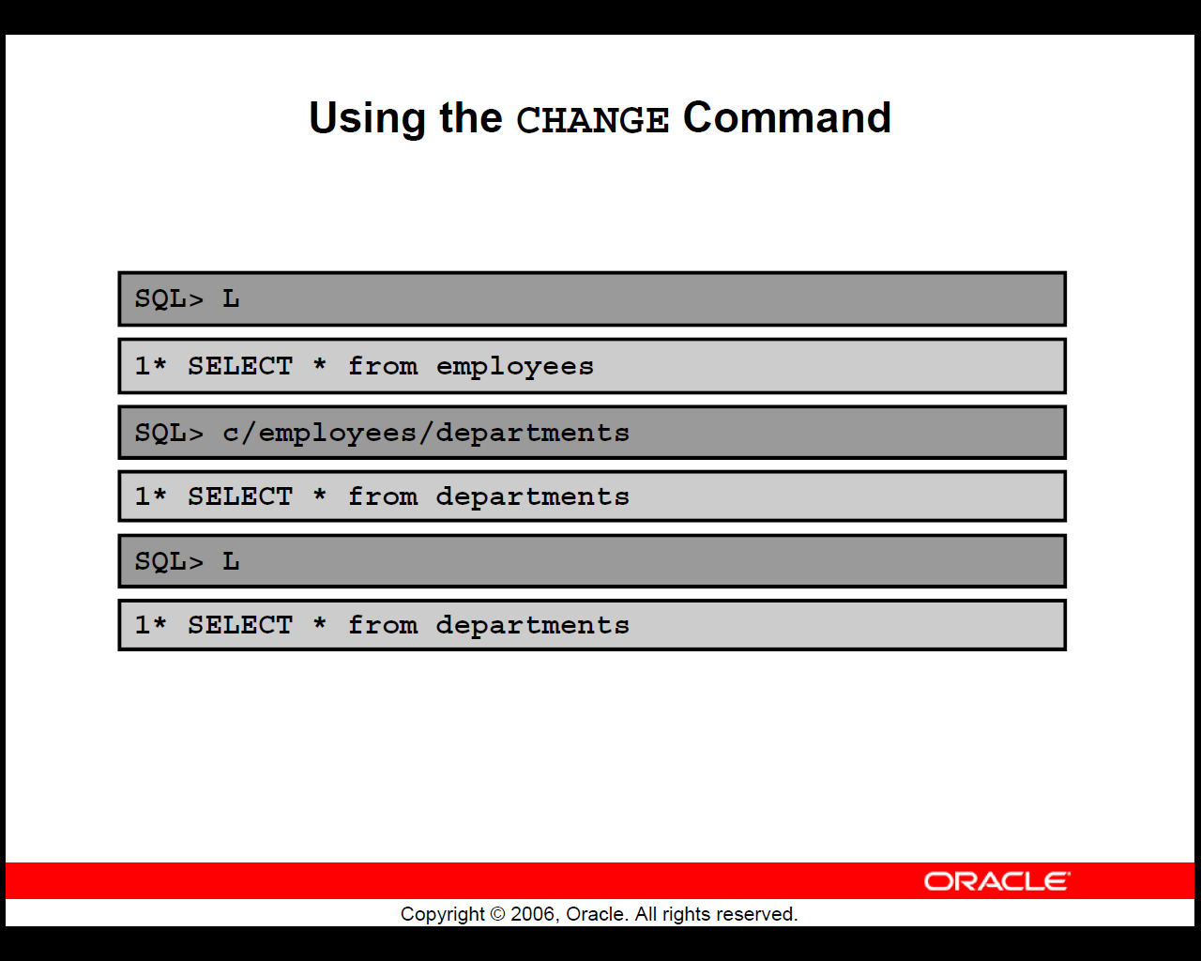

Slide 48
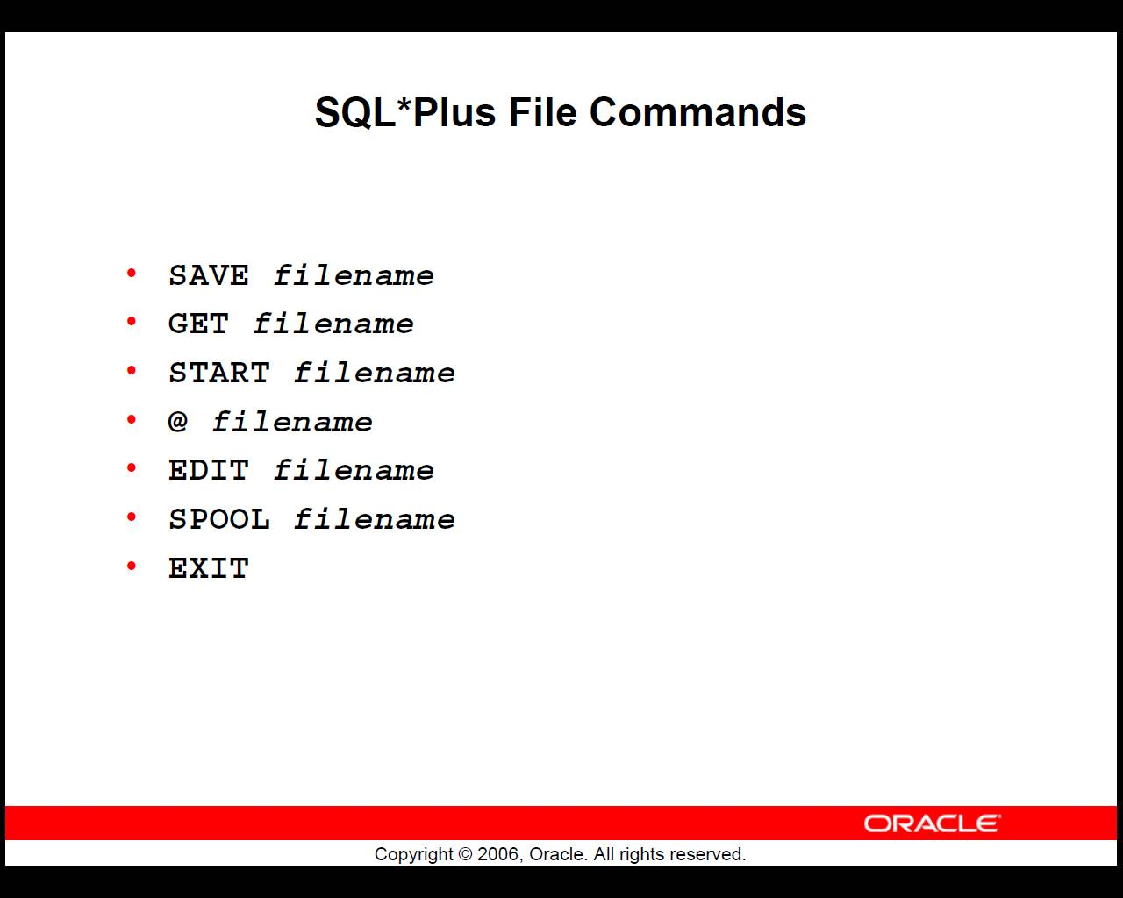

Slide 49
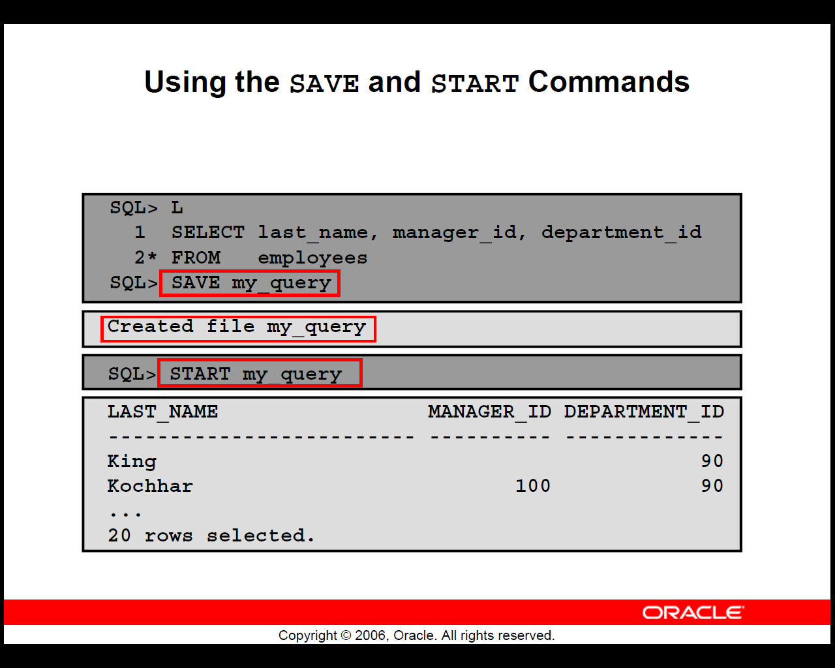

Slide 50
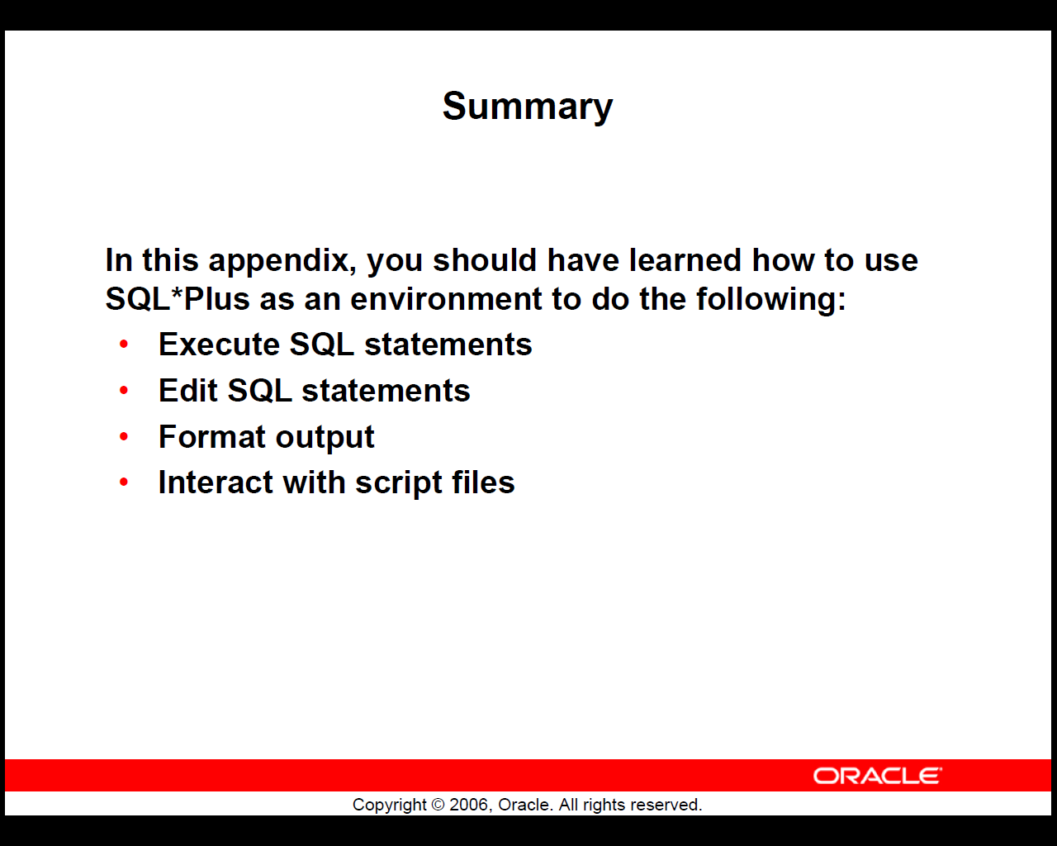

Slide 51
SQLDeveloper demo
Invoking (TAU):
sqldeveloper

Slide 52
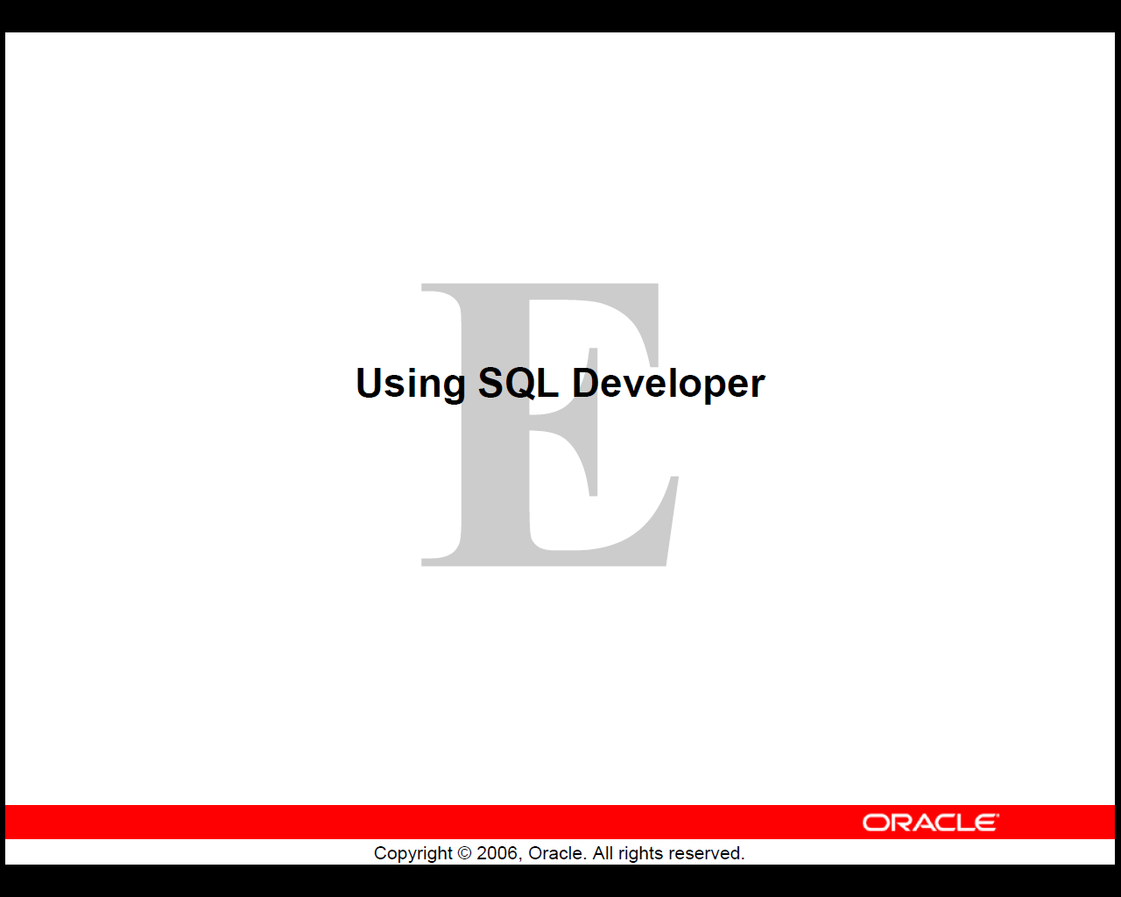

Slide 53
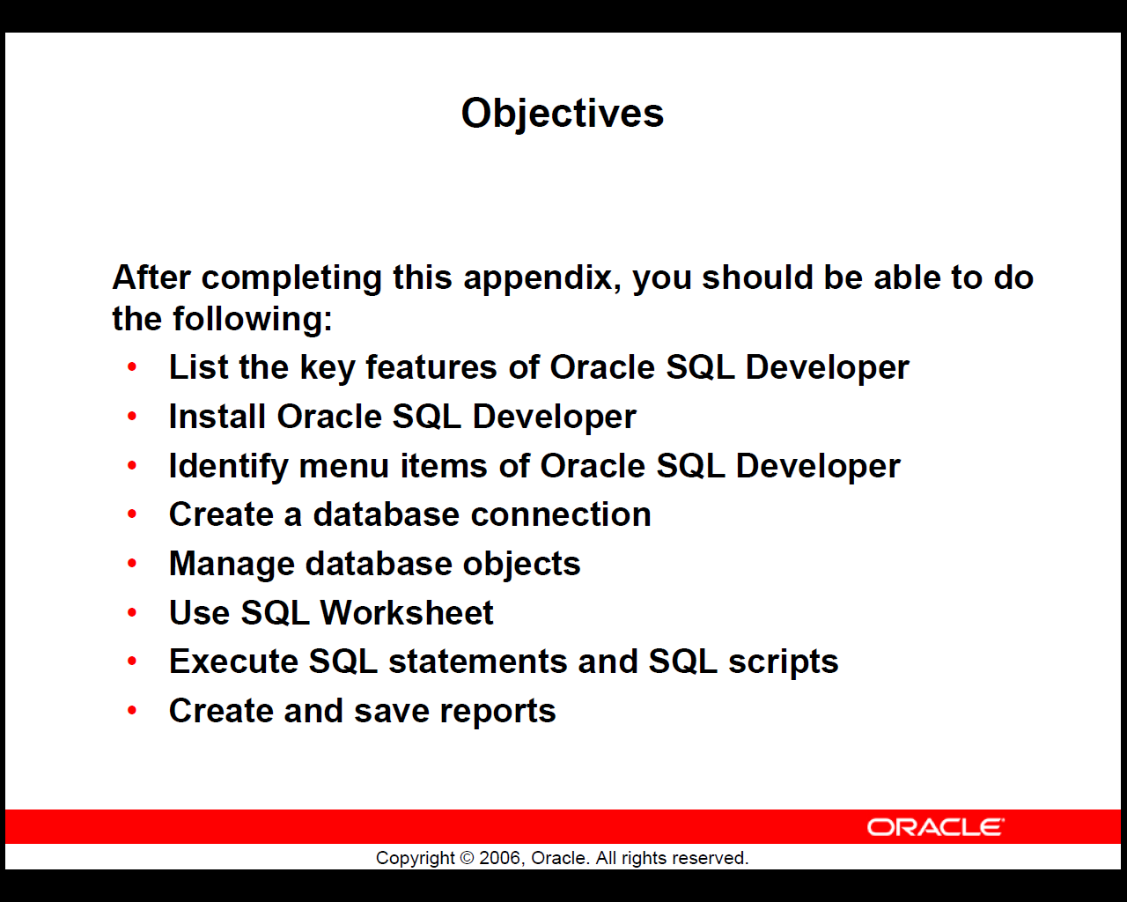

Slide 54
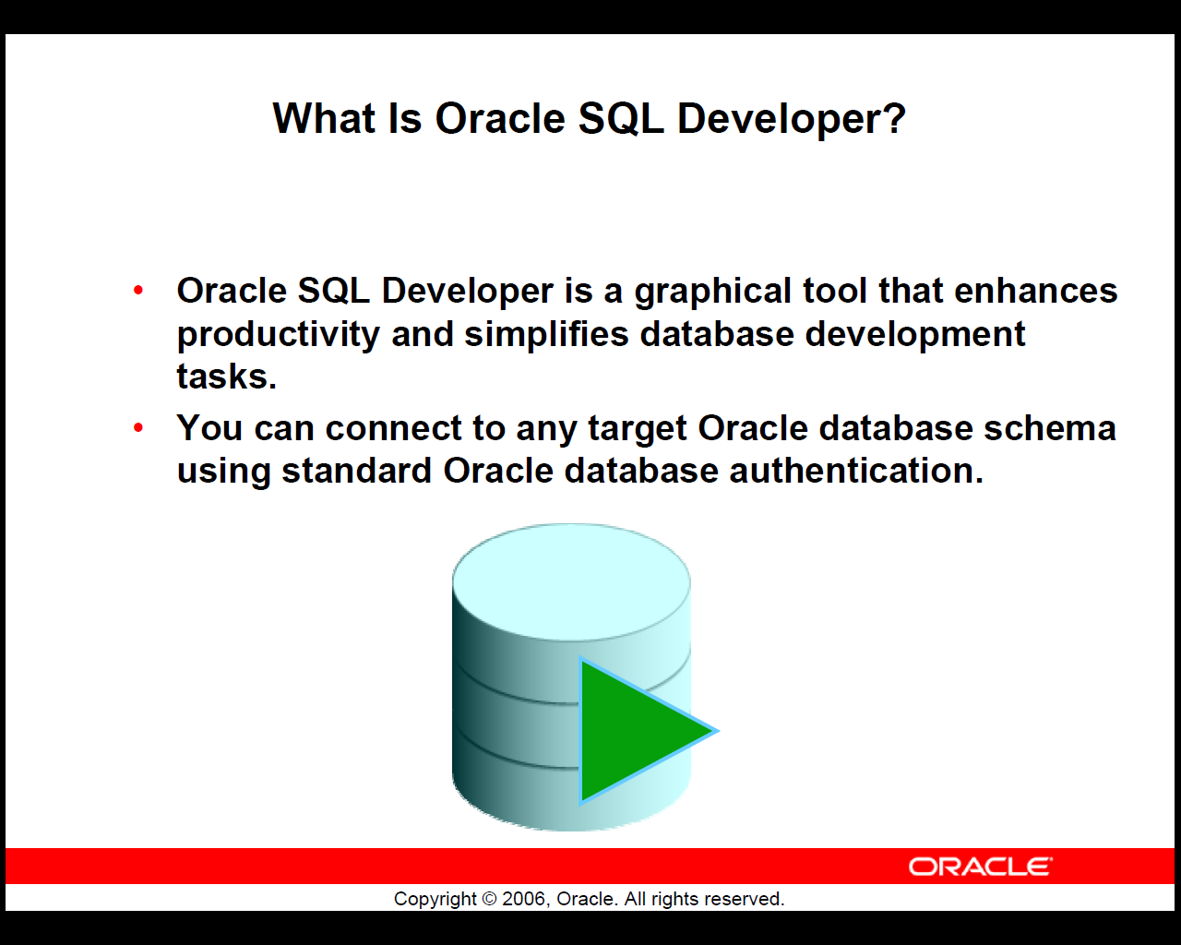

Slide 55
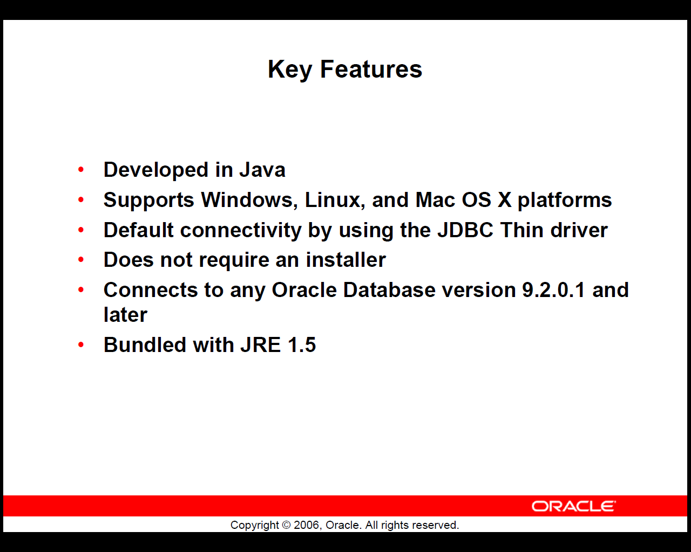

Slide 56
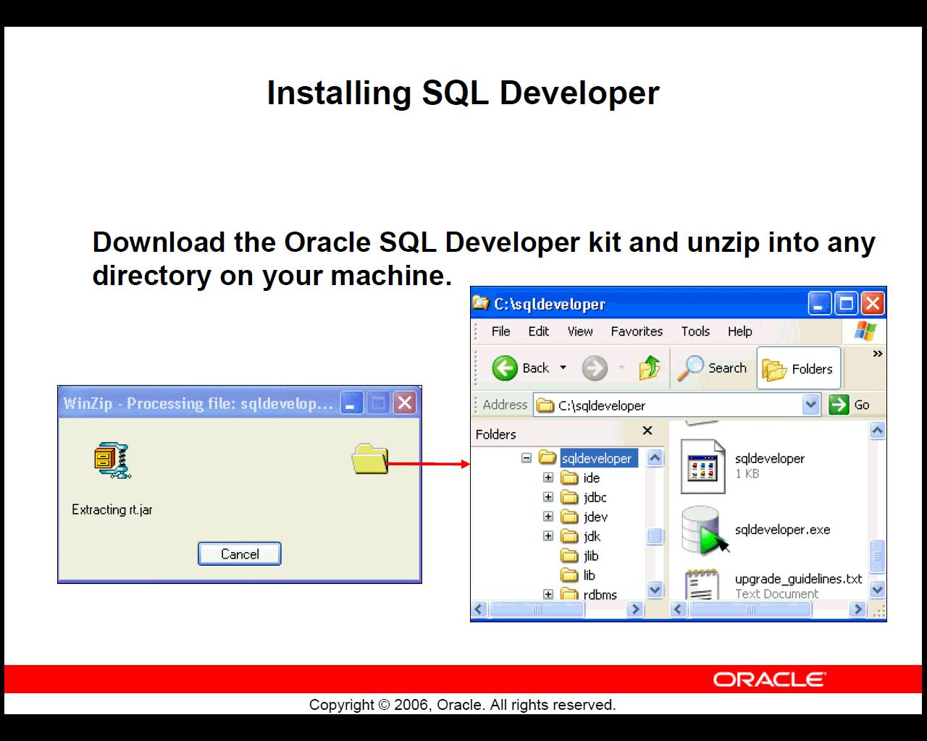

Slide 57
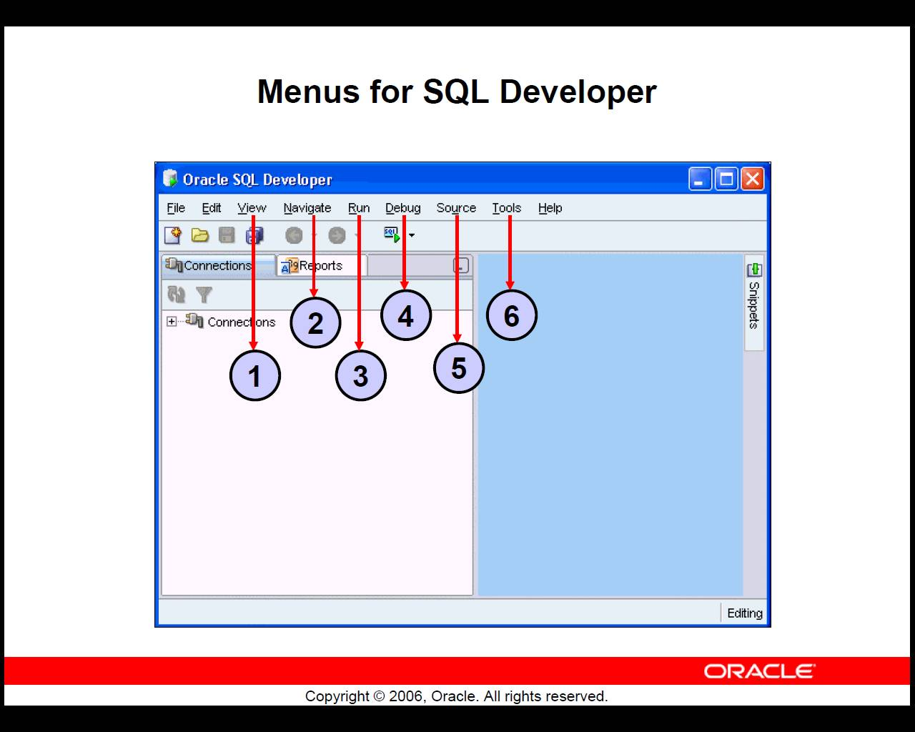

Slide 58
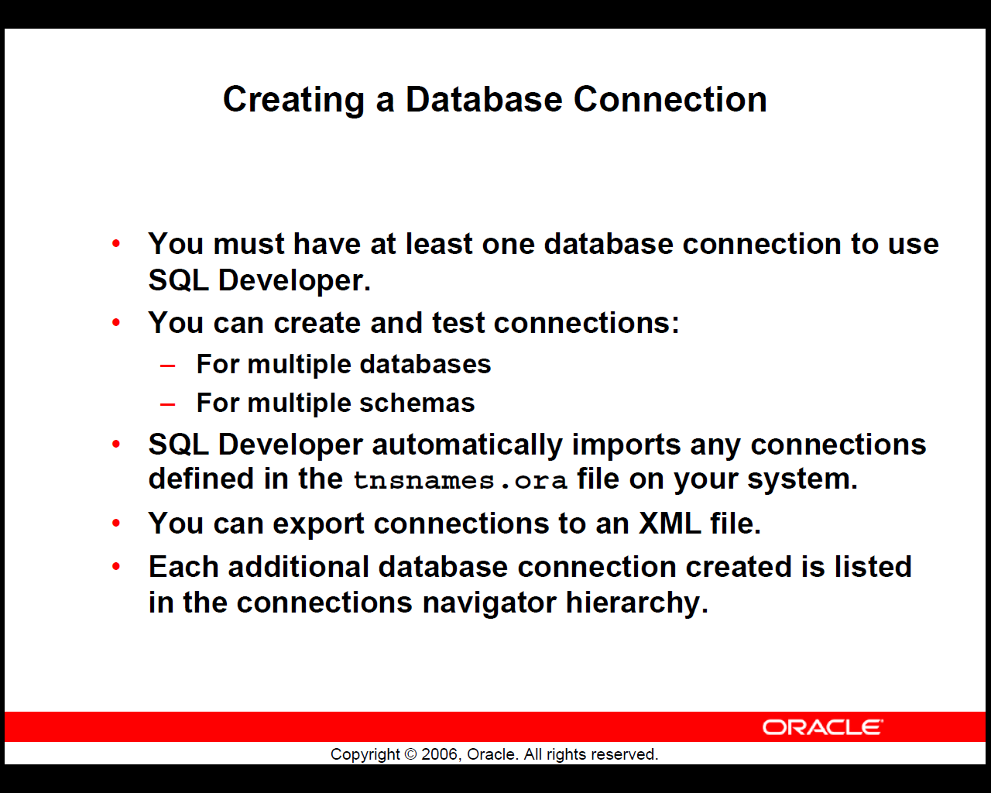

Slide 59
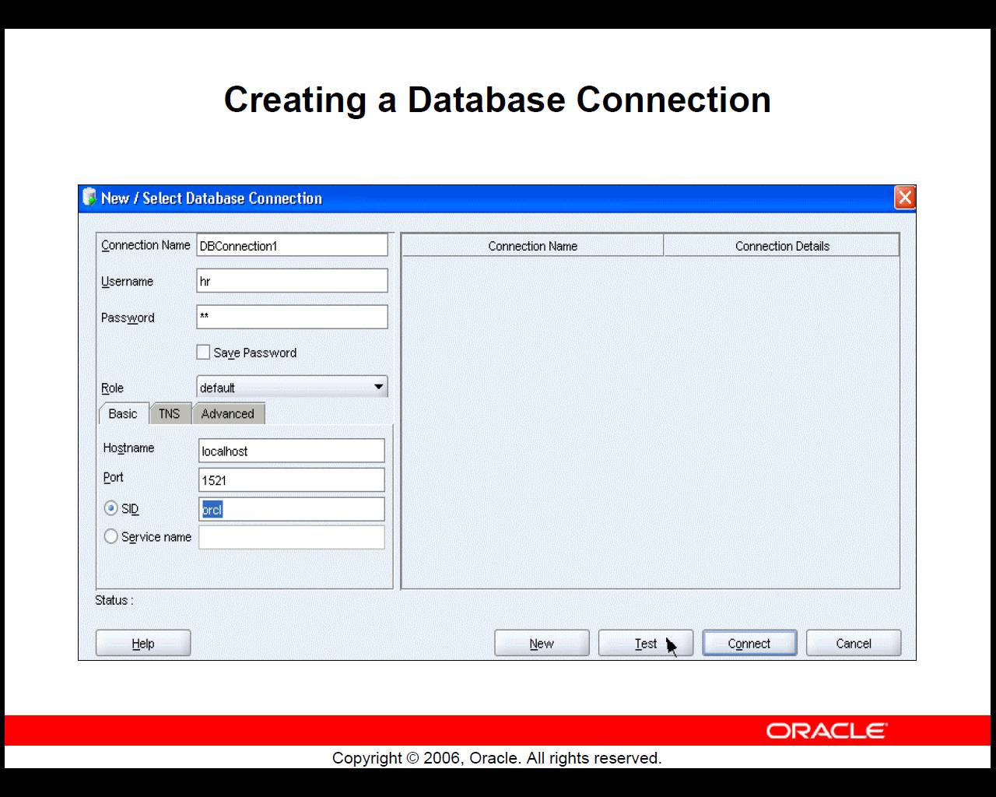

Slide 60
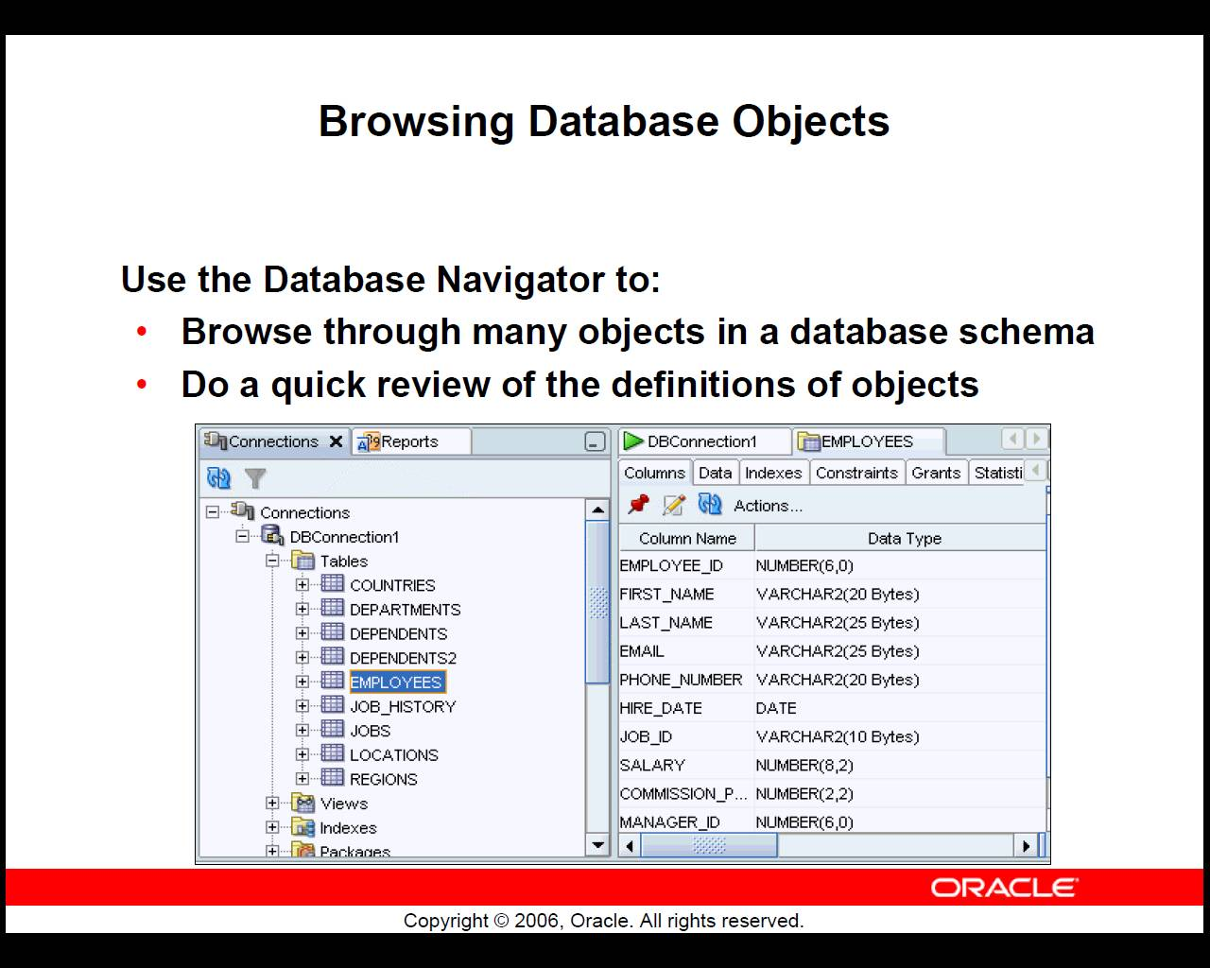

Slide 61
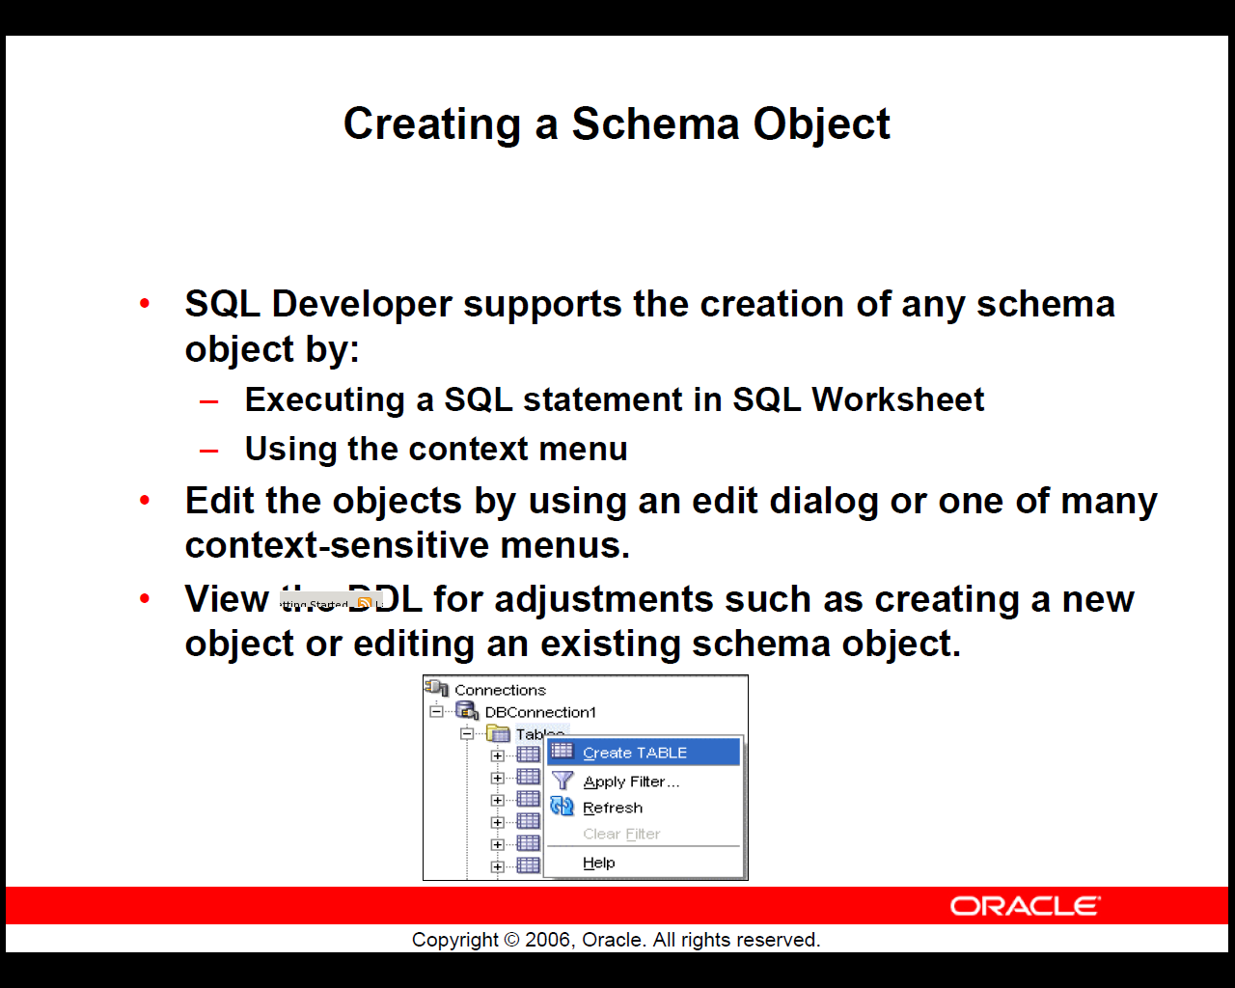

Slide 62
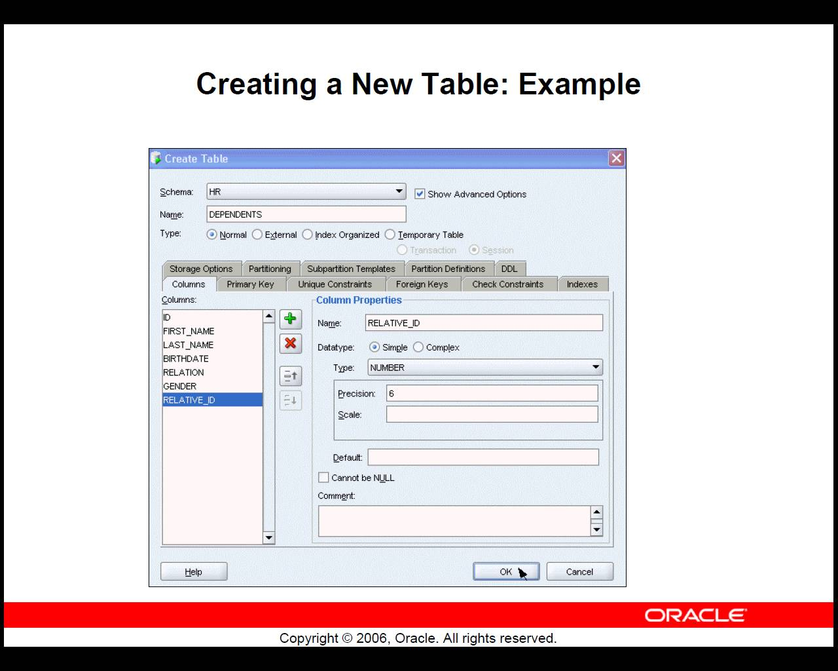

Slide 63
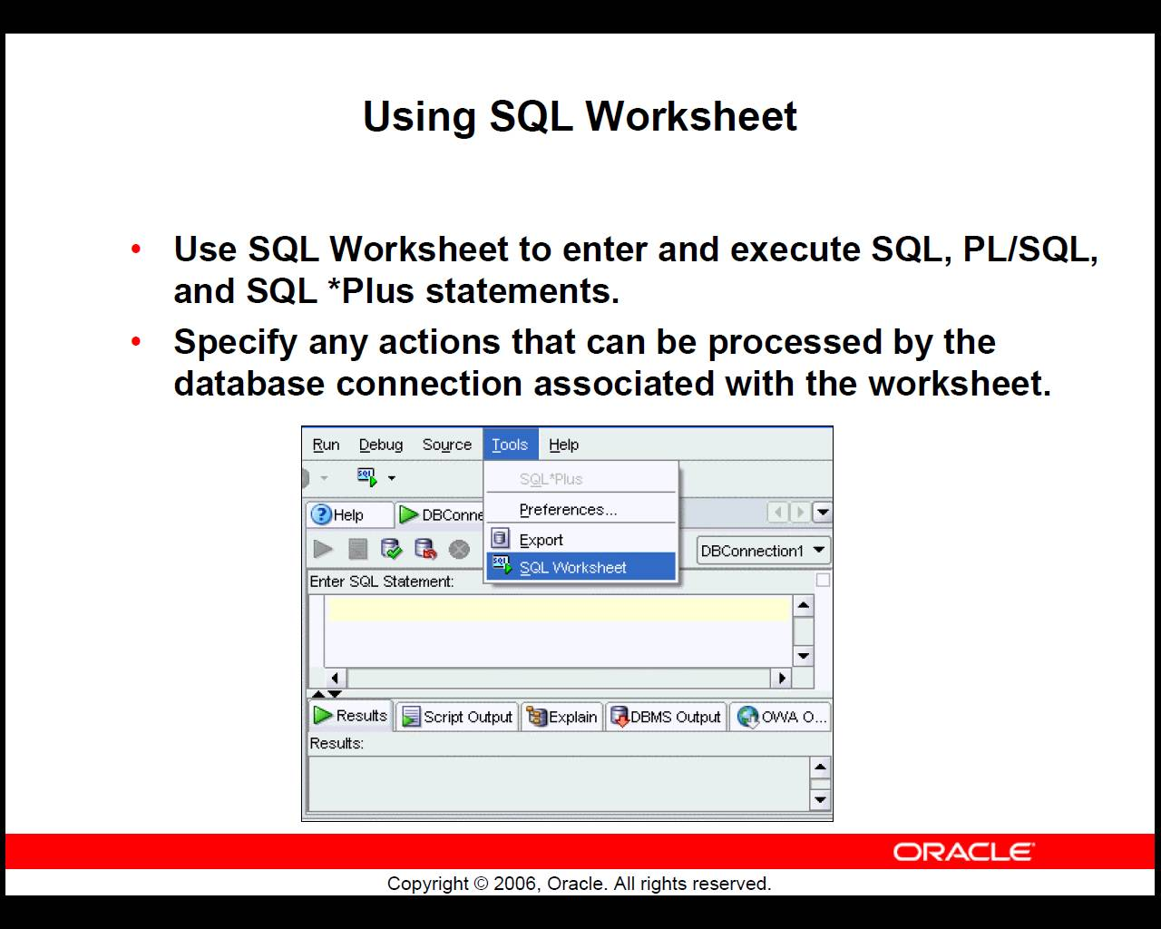

Slide 64
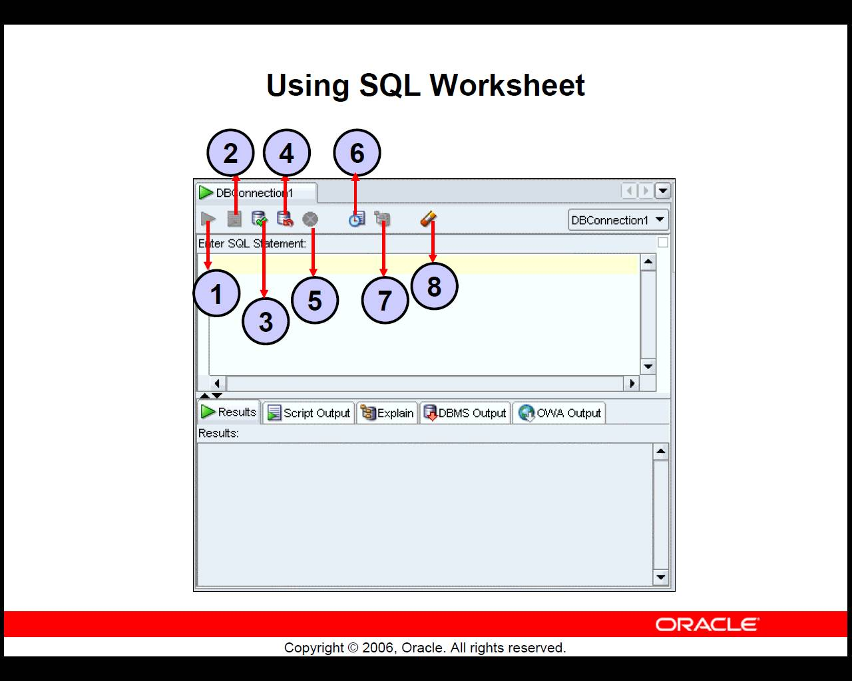

Slide 65
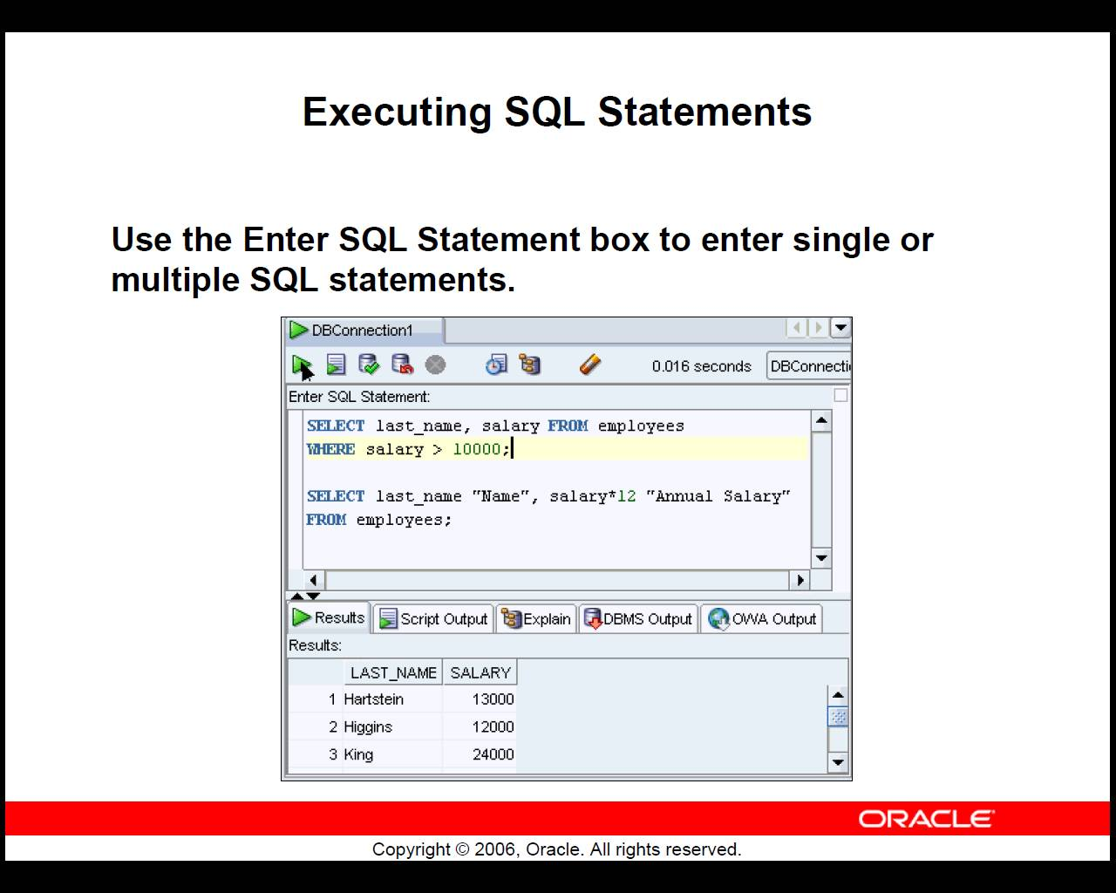

Slide 66
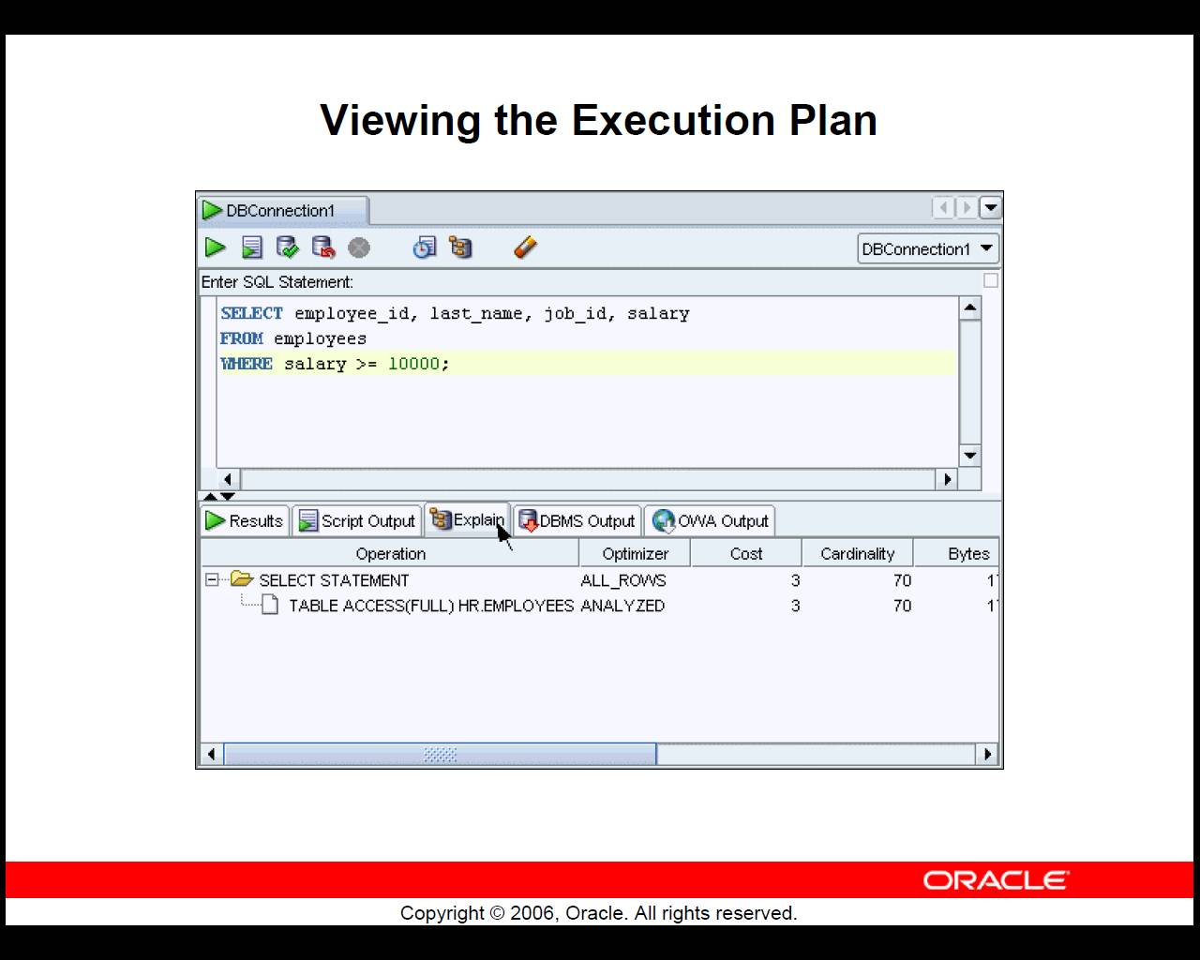

Slide 67
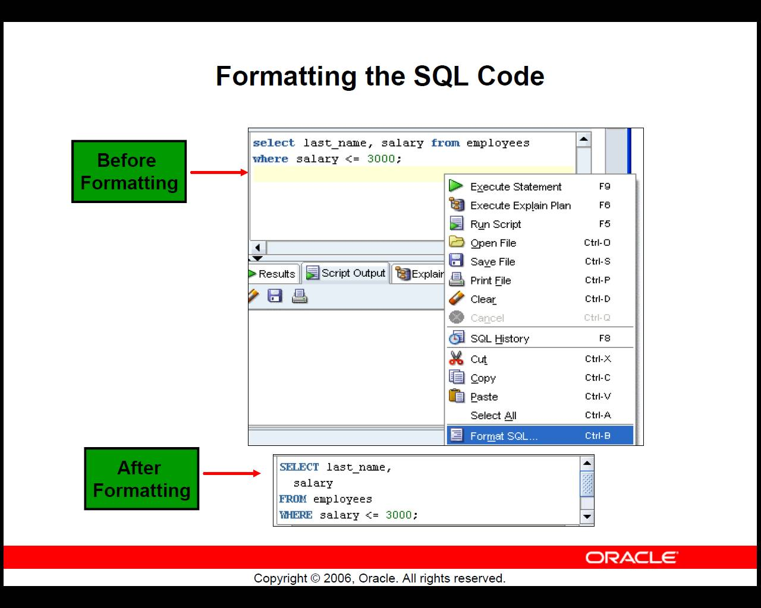

Slide 68
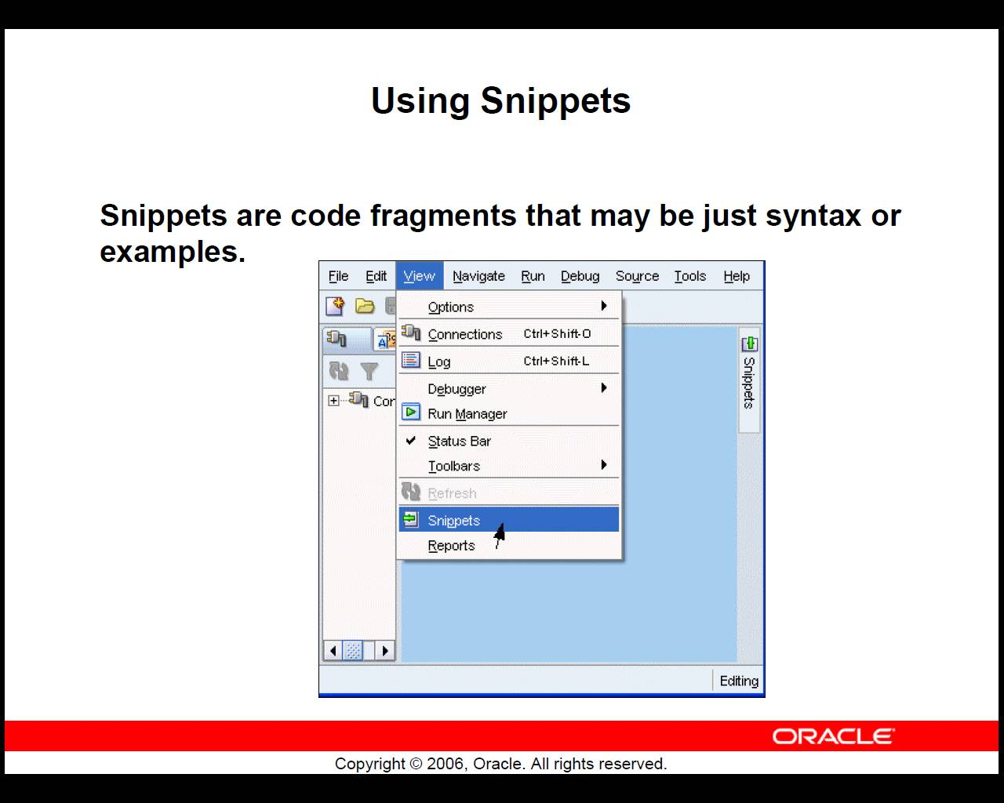

Slide 69
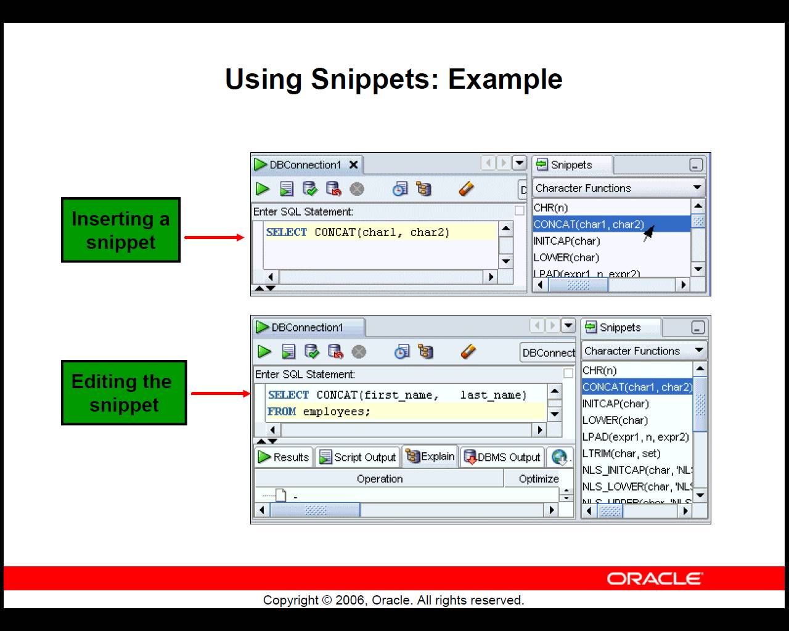

Slide 70
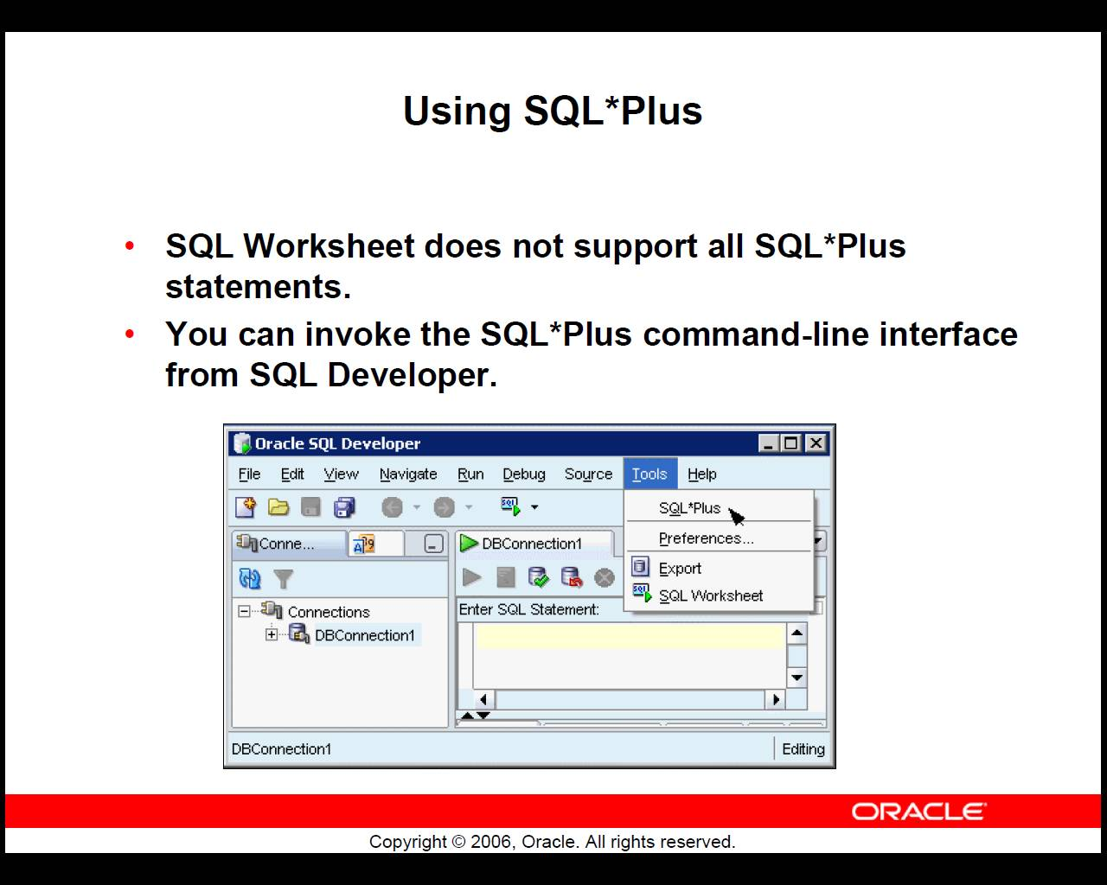

Slide 71
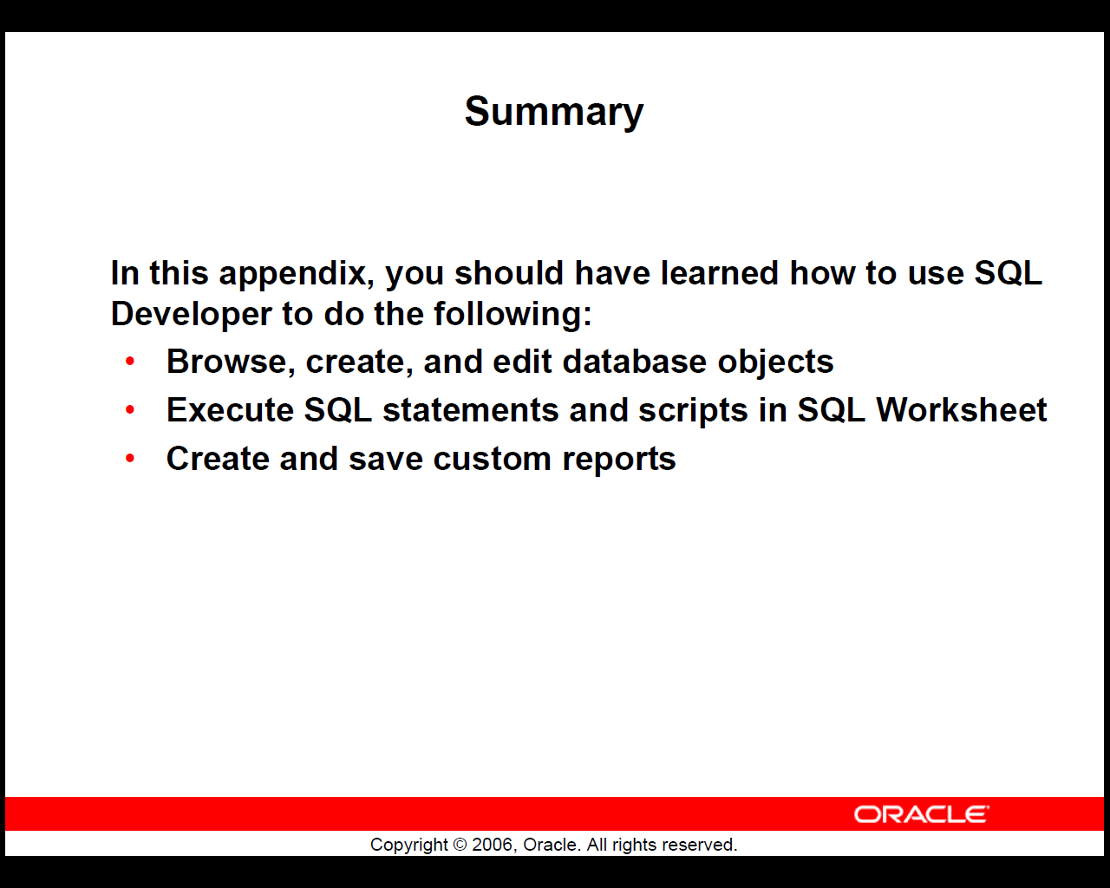

Slide 72
Agenda
Bureaucracy…
Database architecture overview
Buzzwords
SSH Tunneling
Intro to Oracle
Comments on homework

Slide 73
Homework Notes
SQL functions and arithmetic conditions.
‘strings‘
LIKE (%), LOWER
Use the Syntax help in Query browser
MAX, MIN
IN

Slide 74
Thank you ☺

Slide 75
Database Server

Slide 76
Client
Application
(your app)

Slide 77
Driver
(Oracle)

Slide 78

Firewall

Slide 79
SSH client
(Putty)

Slide 80
SSH Server
(Nova)

