Slide 1
DB Project
Database Systems
2010-2011

Slide 2
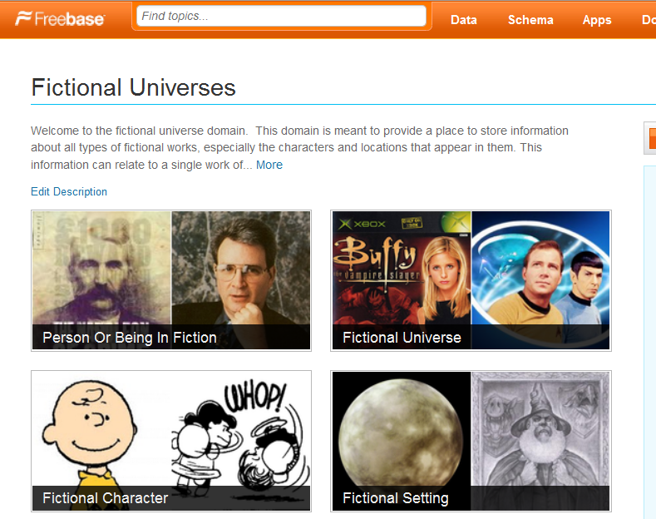
Database project – Fictional Universes
http://www.freebase.com/view/fictional_universe

Slide 3
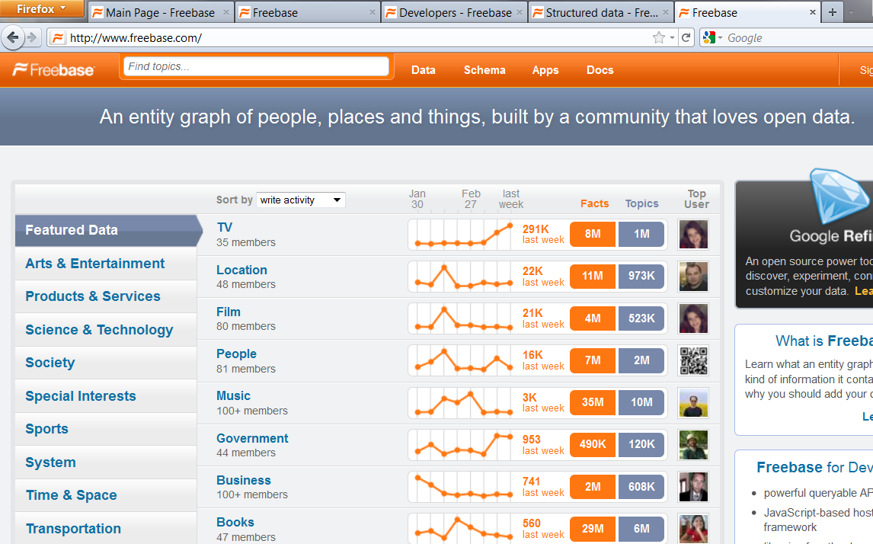
Utilizing Freebase

Slide 4
What is Freebase
Freebase is an open, licensed repository of structured data of almost 20 million entities.
An entity is a single person, place, or thing. Freebase connects entities together as a graph.
http://www.freebase.com/

Slide 5
What is Freebase (2)
Metaweb http://www.youtube.com/watch?v=TJfrNo3Z-DU&feature=player_embedded
Freebase http://wiki.freebase.com/wiki/What_is_Freebase%3F

Slide 6
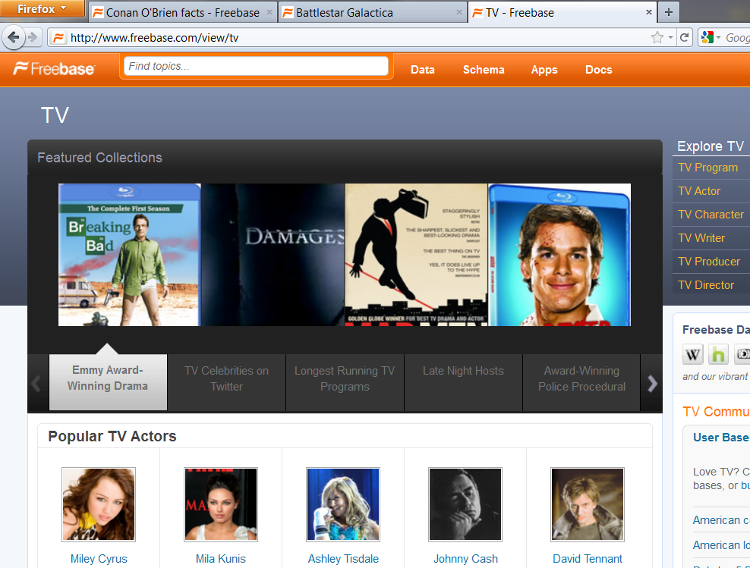
App Utilizing Freebase (1)

Slide 7
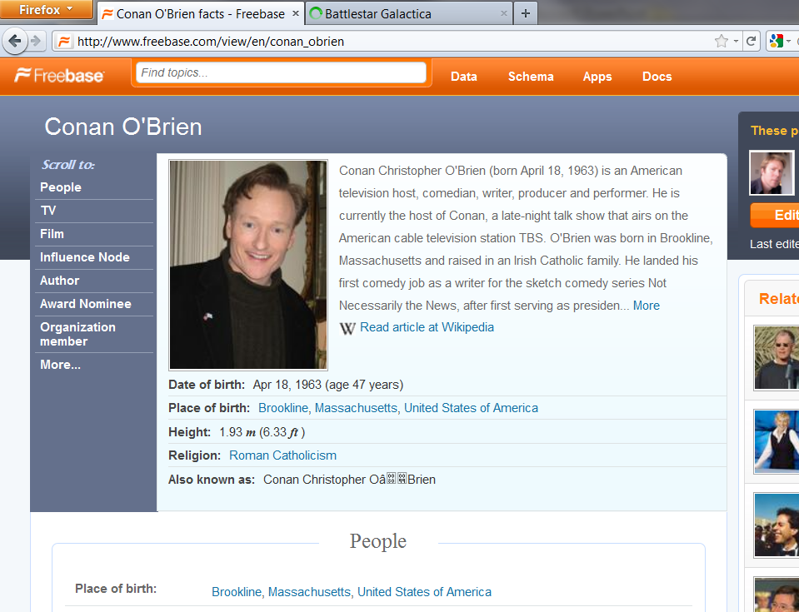
App Utilizing Freebase (2)

Slide 8
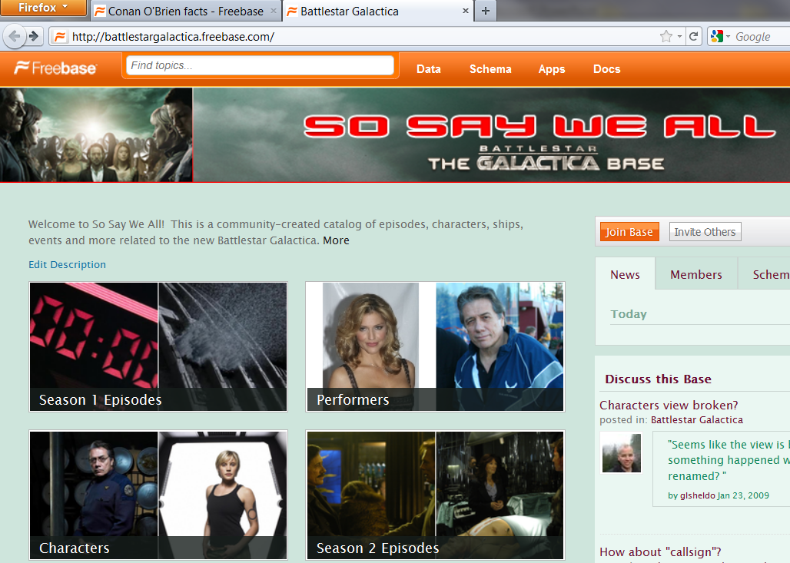
App Utilizing Freebase (3)

Slide 9
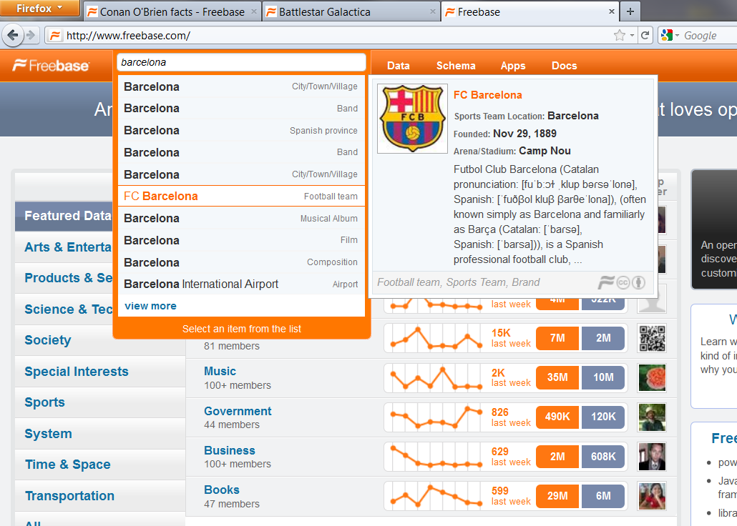
App Utilizing Freebase (4)

Slide 10
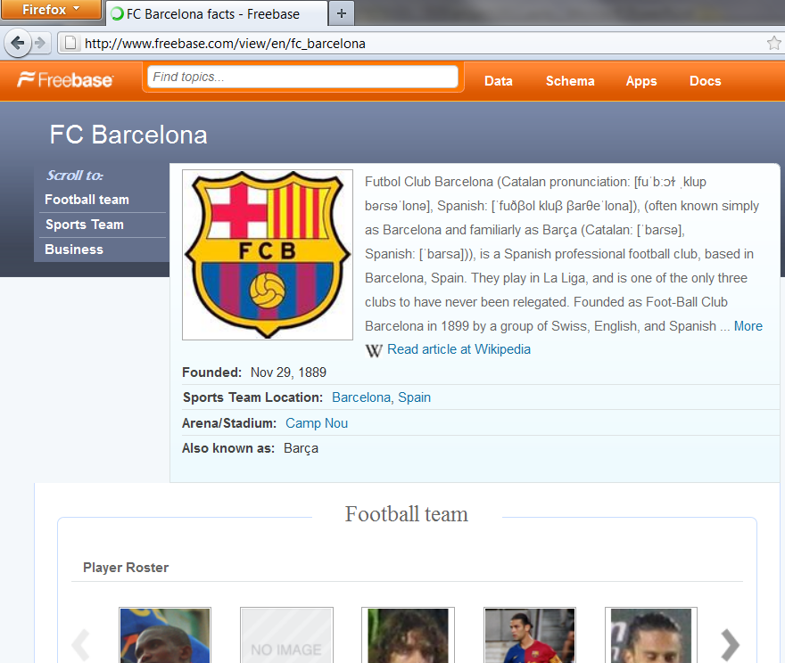
App Utilizing Freebase (5)

Slide 11
Database Project - Goals
Project goal: to tackle and resolve real-life DB related development issues
So what do we need to do:
Design database
Load data / Support updates
Think of an application
Build application
Test

Slide 12
Database Project - Goals (II)
What to focus on:
Database
Data Populating / Updating
Usability
Ideas that will give you an edge over the competition

Slide 13
Database Project - Features
Think your self! Any idea is acceptable
Requirements:
Search for specific entities (artist, player..)
Add / Edit / Remove data manually (not just massive import)
Support “Freebase” import: (what happens if you import a new file? You should be able to “skip” existing info..)
Interesting application

Slide 14
Database project - DATA????
Freebase Data dumps http://wiki.freebase.com/wiki/Data_dumps
Quad Dump ("low level" dump) <source>, <property>, <destination>, <value>
Simple Topic Dump for instance, the “beer.tsv” header: name, id, beer_style, first_brewed, alcohol_content…..

Slide 15
Database project - DATA????
Textfile (quad dump) to MySQL… Not trivial
There are 3 files. You do not need to use all.. - freebase-datadump-tsv.tar.bz2 - freebase-datadump-quadruples.tsv.bz2 - freebase-simple-topic-dump.tsv.bz2 (each is a different format..)
Additional stuff can be fetch (offline/online) via “Freebase API” http://wiki.freebase.com/wiki/Developers http://wiki.freebase.com/wiki/API

Slide 16
Popular Apps based on Freebase
Google Refine
Powerset - a semantic search engine (purchased by Microsoft)
Freebase Schema Explorer
FMDb
http://en.wikipedia.org/wiki/Freebase_%28database%29

Slide 17
Example
Choose the sports domain
Create an online (legal..) gambling app
You should add/remove/edit all players, sports, games….
You should add your own data such odds, bets…

Slide 18
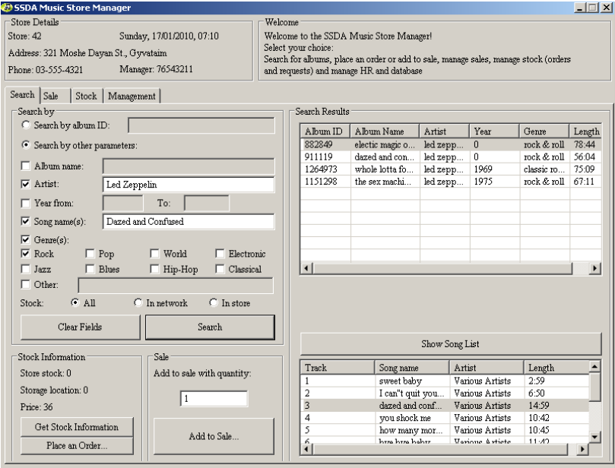
Past years projects

Slide 19
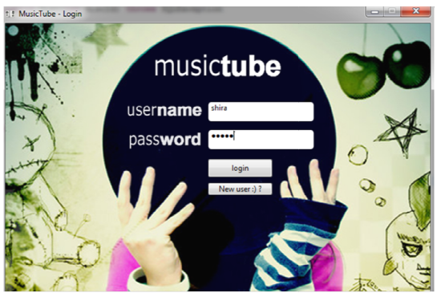
Past years projects

Slide 20
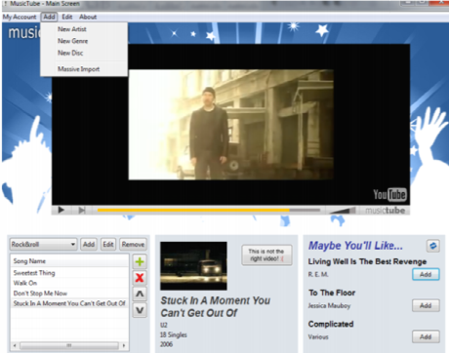
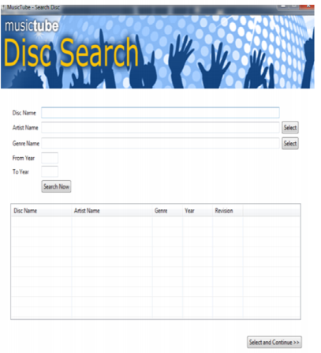
Past years projects

Slide 21
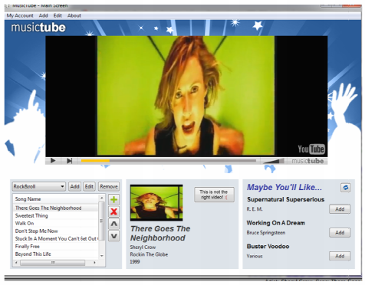
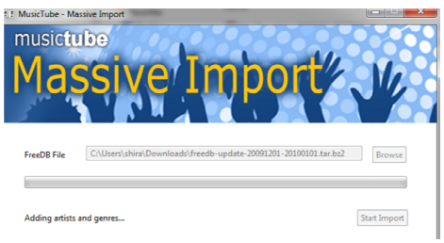
Past years projects

Slide 22
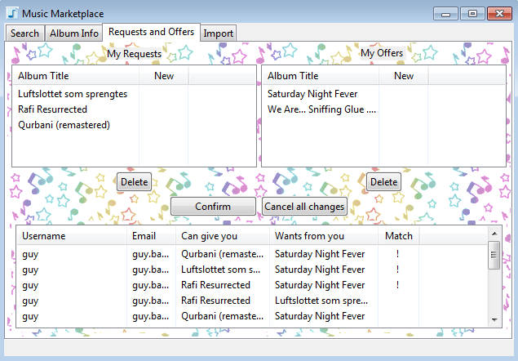
Past years projects

Slide 23
Tips
First: - understand the format.. - understand what you want to do..
Database key should always be INTEGER… not a string…. (i.e. you would need to assign it..)
Don’t forget to support manual edit of ALL data (add/update/remove) – e.g. artists/categories/values…

Slide 24
Tips (2)
Freebase supports a wide range of domains..
Focus on your specific domain - Fictional Universes
Nevertheless – you might use the data from other domains as well (depending on your app..)

Slide 25
Database Project - Bureaucracy
Hard work, but real.
Work in groups of 4
One stage
Submission database is MySQL in TAU
Java, SWT (or Swing/AWT)
Thinking out of the box will be rewarded

Slide 26
Database Project - Requirements
(at least) 150K records table
If you use other domains, don’t be afraid to import much more data (when its available).. Last year the requirement was 1M records..

