Slide 1
DB Project
Database Systems
Fall 2012-2013

Slide 2
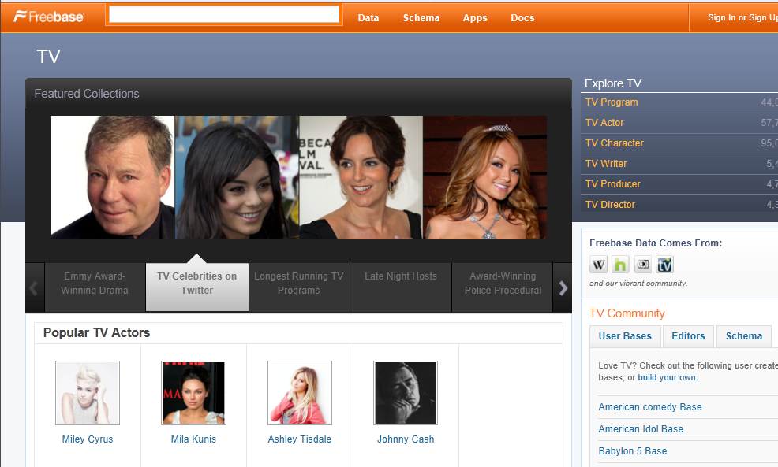
Database project – TV
http://www.freebase.com/view/tv

Slide 3
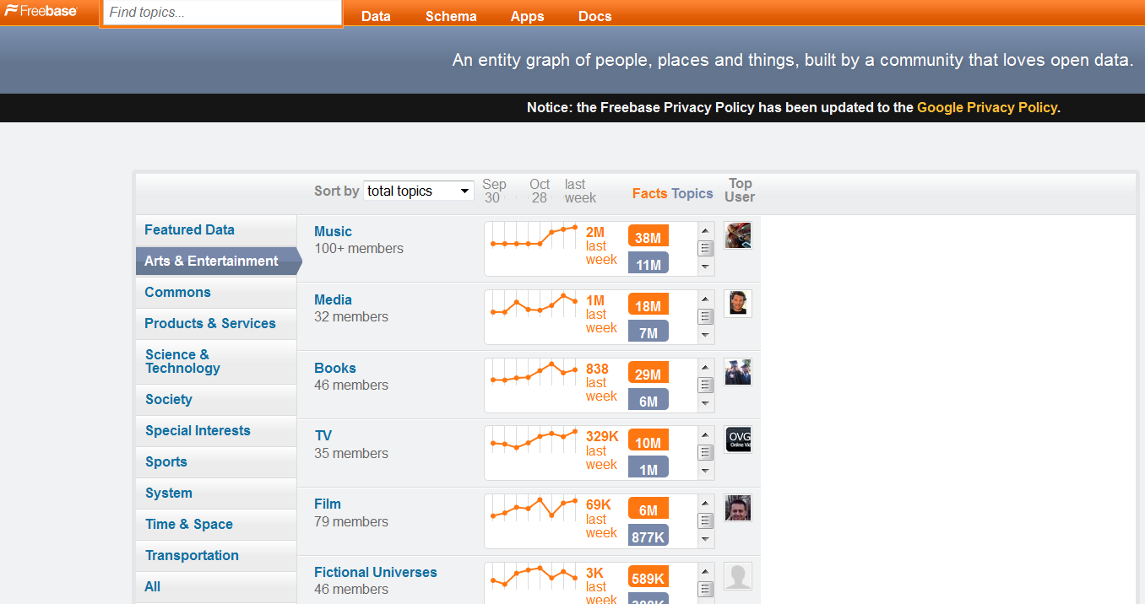
Freebase

Slide 4

What is Freebase
Freebase is an open repository of structured data of almost 23 million entities.
An entity is a single person, place, or thing. Freebase connects entities together as a graph.
http://www.freebase.com/

Slide 5
What is Freebase (2)
Metaweb
http://www.youtube.com/watch?v=TJfrNo3Z-DU&feature=player_embedded
Freebase
http://wiki.freebase.com/wiki/What_is_Freebase%3F

Slide 6
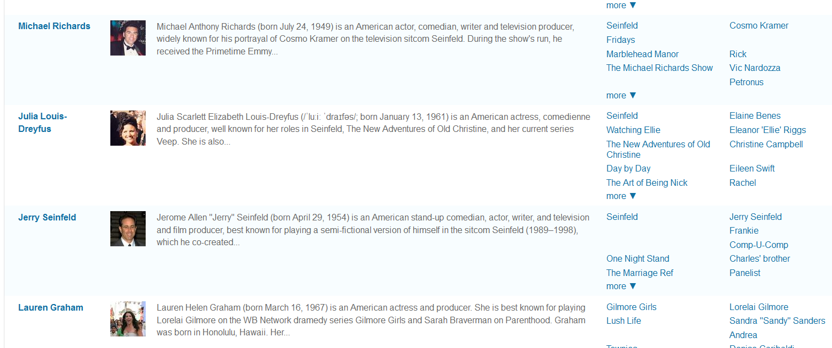
Into Freebase (1)

Slide 7
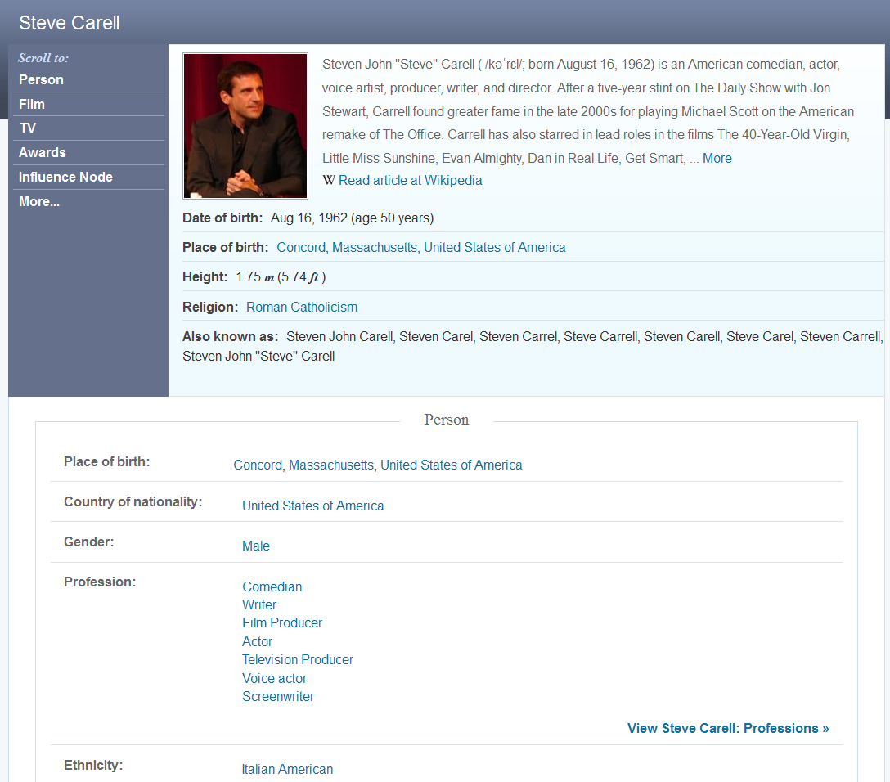
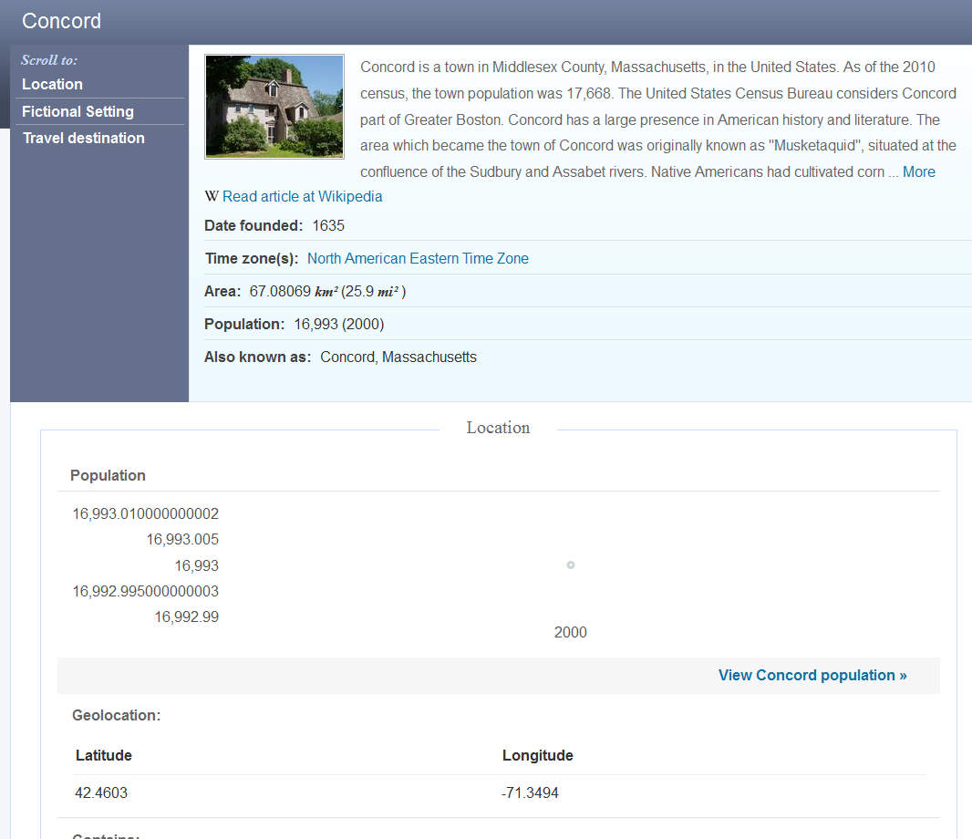
Into Freebase (2)

Slide 8
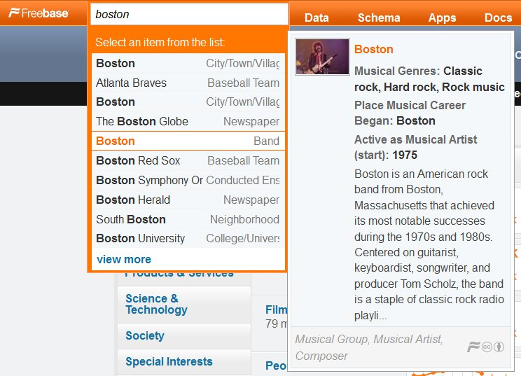
Into Freebase(3)

Slide 9
Popular Apps based on Freebase
Google "Explore More"
Google Refine
Powerset - a semantic search engine (purchased by Microsoft)
Freebase Schema Explorer
FMDb
http://en.wikipedia.org/wiki/Freebase_%28database%29

Slide 10
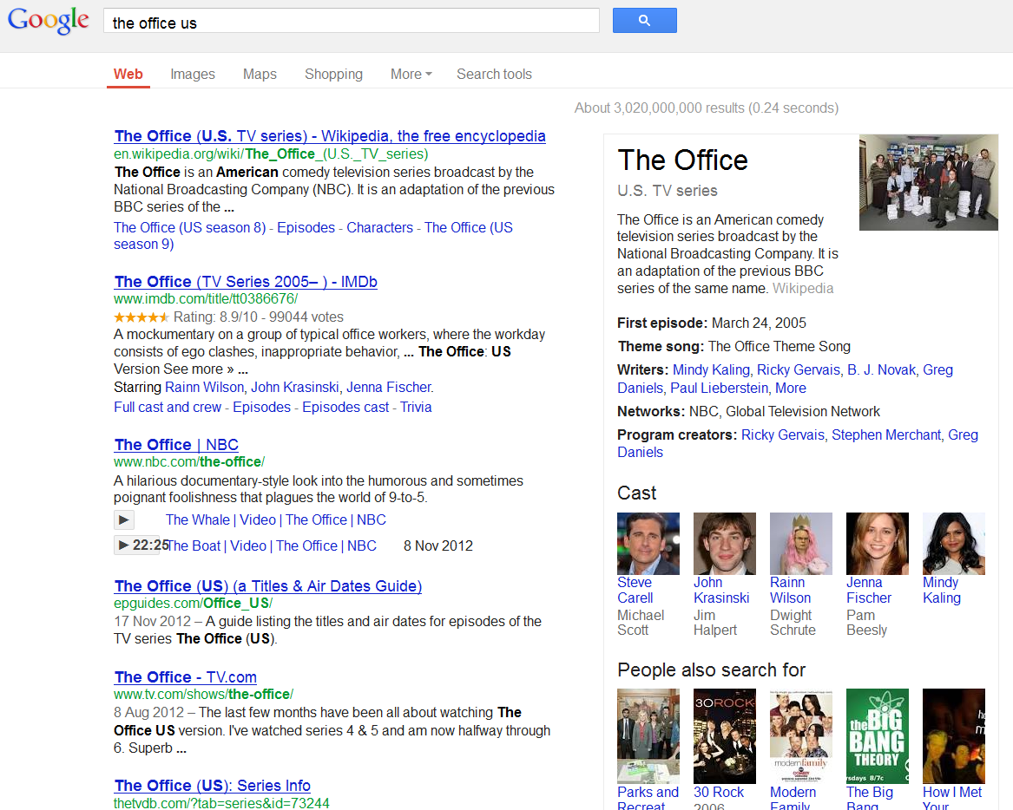
The use of Freebase in Google

Slide 11
Database Project - Goals
Project goal: to tackle and resolve real-life DB related development issues
So what do we need to do:
  Design database
  Load data / Support updates
  Think of an application
  Build application
  Test

Slide 12
Database Project - Goals (2)
What to focus on:
  Database
  Data Populating / Updating
  Usability
  WOW factor

Slide 13
Database Project - Features
Think your self! Any idea is acceptable
Requirements:
  Search for specific entities (artist, player..)
  Add / Edit / Remove data manually (not just massive import)
  Support “Freebase” import:
  (what happens if you import a new file? You should be able to “skip” existing info..)
  Interesting application

Slide 14
Database project - DATA????
Freebase Data dumps
http://wiki.freebase.com/wiki/Data_dumps
Quad Dump ("low level" dump)
<source>, <property>, <destination>, <value>
Simple Topic Dump
for instance, the “beer.tsv” header:
name, id, beer_style, first_brewed, alcohol_content…..

Slide 15
Database project - DATA????
There are 3 files. You do not need to use all..
- freebase-datadump-tsv.tar.bz2
- freebase-datadump-quadruples.tsv.bz2
- freebase-simple-topic-dump.tsv.bz2
(each is a different format..)
Additional stuff can be fetched (offline/online) via “Freebase API”
http://wiki.freebase.com/wiki/Developers
http://wiki.freebase.com/wiki/Google_API_Client_Libraries

Slide 16
Database project - DATA????
We will focus on data from the TV domain in freebase
  A subset
And related data from another origin
  Other Freebase topics (preferably weird
  ones)
  Other freely available online databases
Along with manual data

Slide 17
Example
Assume we work with the sports domain
Create an online (legal..) gambling app
You should add/remove/edit all players, sports, games….
You should add your own data such odds, bets…
Link the data with data from some sports website

Slide 18
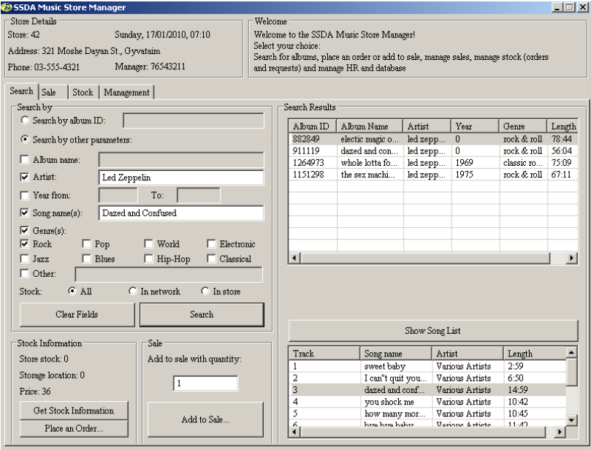
Past years projects

Slide 19
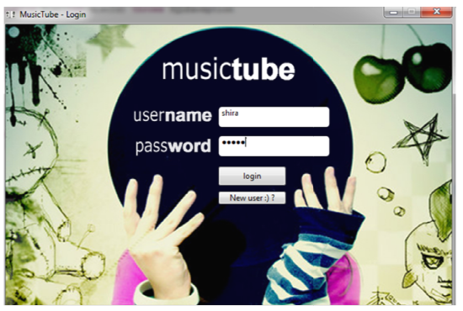
Past years projects

Slide 20
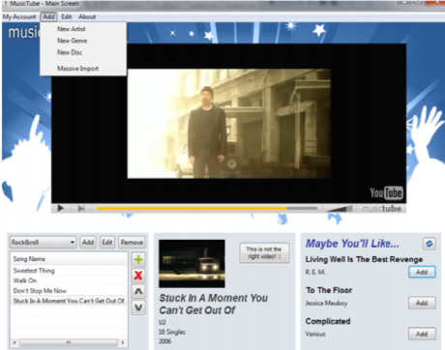
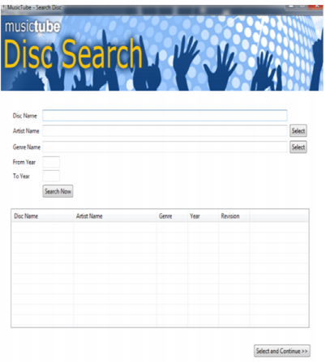
Past years projects

Slide 21
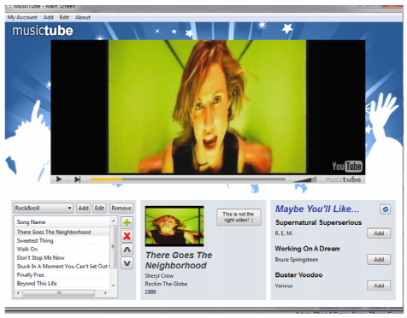
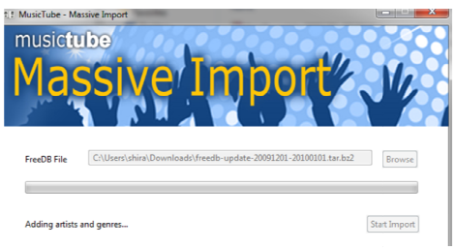
Past years projects

Slide 22
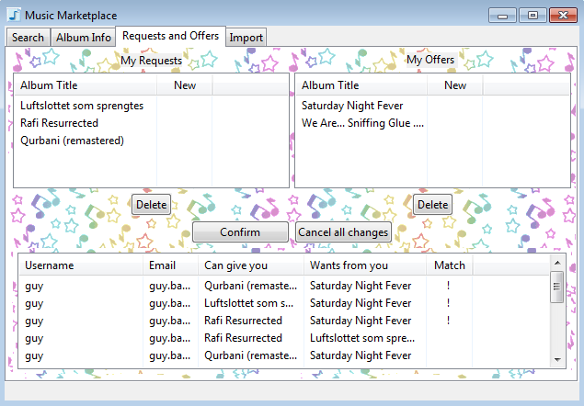
Past years projects

Slide 23
Tips
First: - understand the format..
- understand what you want to do..
Database key should always be INTEGER… not a string…. (i.e. you would need to assign it..)
Don’t forget to support manual edit of ALL data (add/update/remove) – e.g. artists/categories/values…

Slide 24
Database Project - Bureaucracy
Hard work, but real.
Work in groups of 4
Submission database is MySQL in TAU
Java, SWT (or Swing/AWT)
Thinking out of the box will be rewarded

Slide 25
Database Project - Requirements
(at least) 150K records table
If you use other domains, don’t be afraid to import much more data (when its available).

