Slide 1
DB Project
Database Systems
Spring 2013

Slide 2
Database project – YAGO
Yet Another Great Ontology

Slide 3
About YAGO*
A huge semantic knowledge base
knowledge base – a special kind of DB for knowledge management (e.g., facts)
Semantic – related to the Semantic Web where presentation is assigned a meaning http://www.youtube.com/watch?v=TJfrNo3Z-DU&feature=player_embedded
* Fabian M. Suchanek, Gjergji Kasneci and Gerhard Weikum, YAGO - A Core of Semantic Knowledge, WWW ‘07

Slide 4
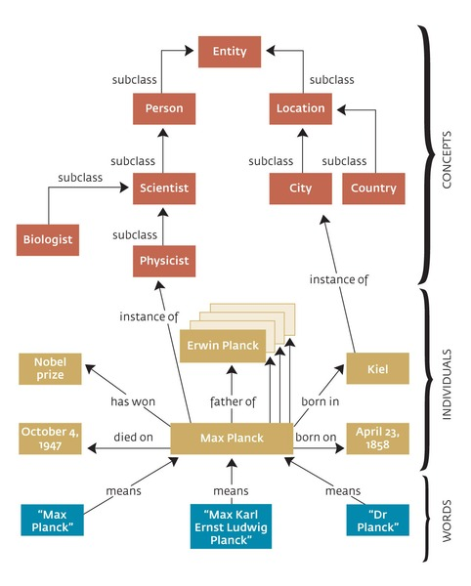
YAGO is an Ontology
A Taxonomy of concept classes
At the bottom – instances, facts about instances
This is typically the interesting part

Slide 5
A fact
A particular relationship that holds between two instances
Or, an instance and a literal (string)
hasChild
isPreferredMeaningOf
“Martin Sheen”

Slide 6
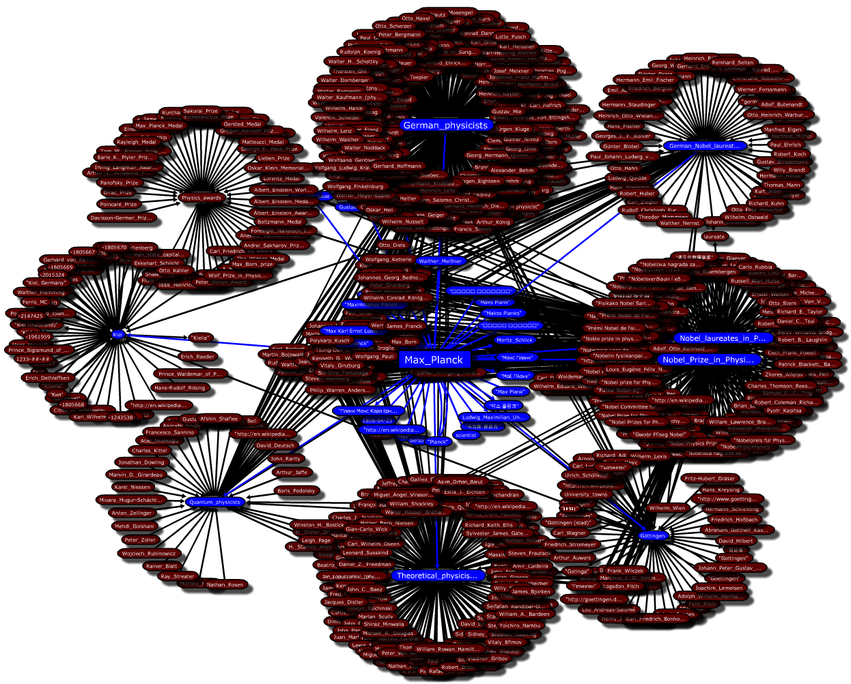
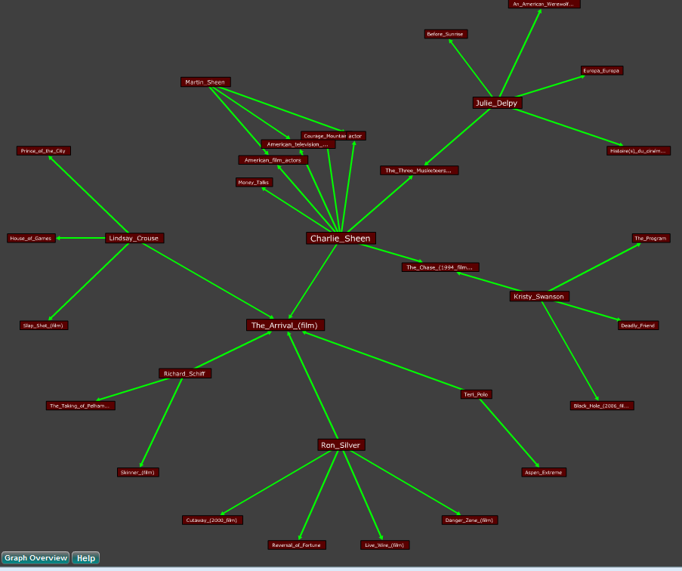
Graph of facts

Slide 7
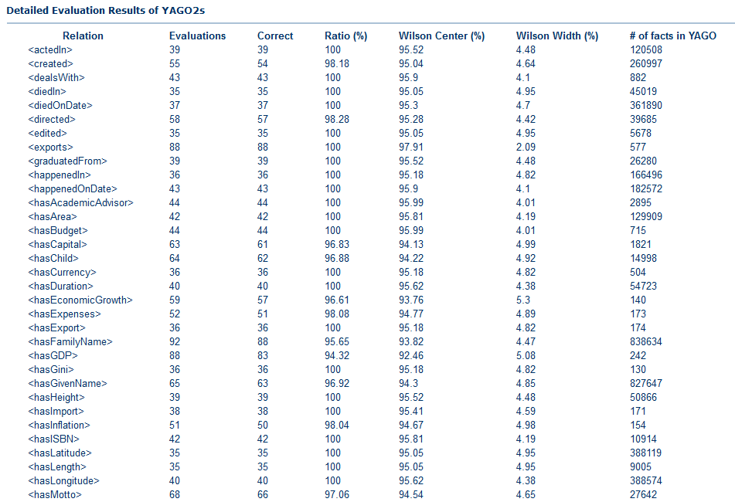
More about YAGO
More than 10 million entities
More than 120 million facts
High (but not perfect!) accuracy
Connections with other ontologies (DBPedia, SUMO, Freebase…)
Over 11 research papers (Max Planck team) with over 1k citations

Slide 8
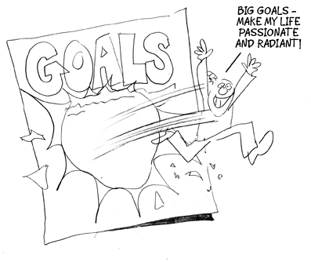
Database Project - Goals
Project goal: to tackle and resolve real-life DB related development issues
Including
DB design
Query writing
DB programming
Application design

Slide 9
Database Project - Requirements
Think of an application
Useful and creative!
Design a DB schema
According to available data
And the application usage
And principles of DB design
Load and flatten data from YAGO
Update the Database
Write an application (with UI)
Usable and fault tolerant
Accessing the data via efficient queries/updates
According to principles of coding
Support manual updates and updates from YAGO

Slide 10
1. Think of an application
Could be anything! As far as your imagination goes
YOU should want to use it…
Tip: first inspect the available data
Tip: must-have and nice-to-have features
The application can be interesting even if the UI is simple

Slide 11
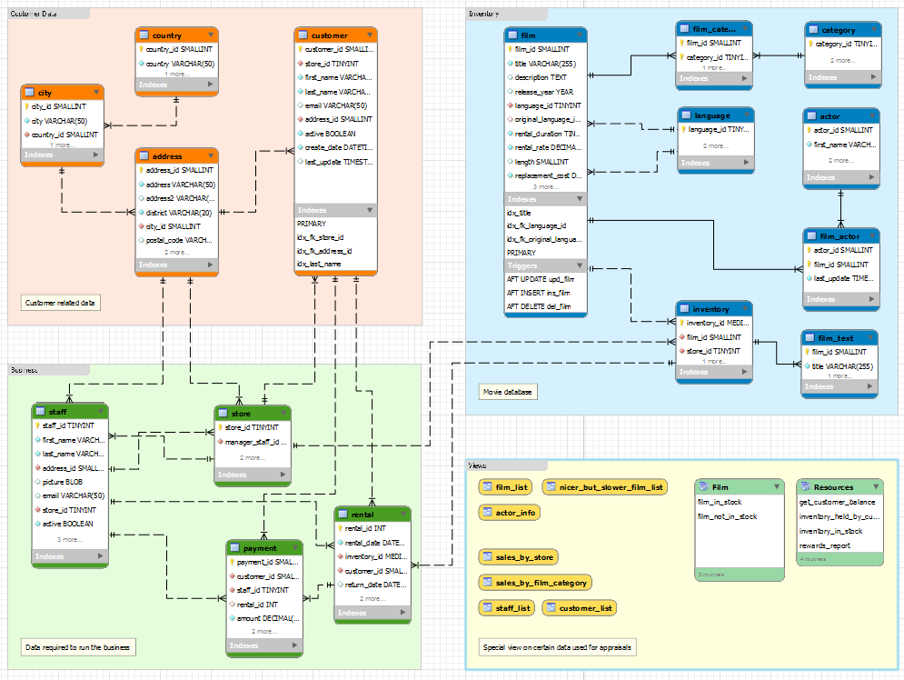
2. Design a DB Schema
Tables, indexes, keys and foreign keys
Avoid redundant information
Allow efficient queries
The script for generating the schema should be submitted with the project
More about design in the following lectures

Slide 12
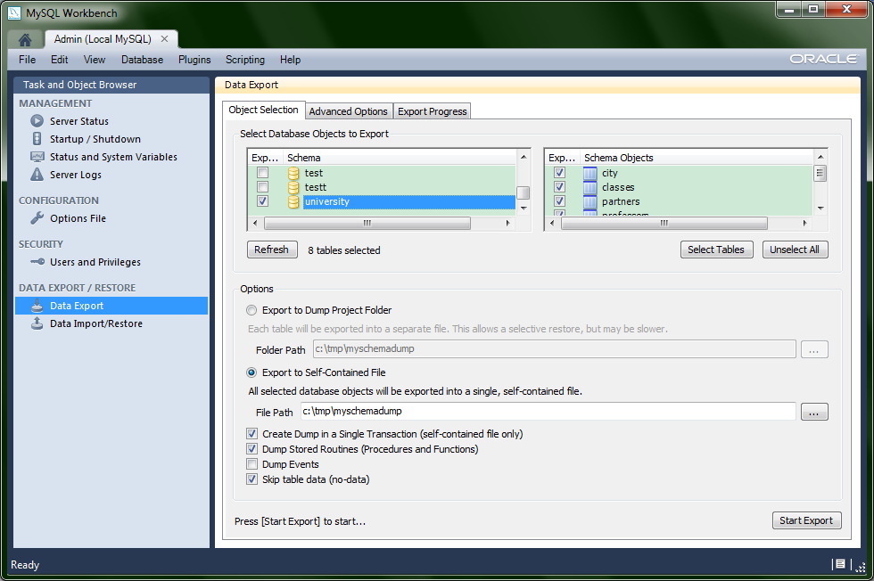
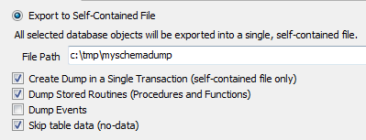
2. Creating the SQL Script
http://dev.mysql.com/doc/workbench/en/wb-manage-server-export-to-disk.html

Slide 13
3. Load data from YAGO
The entire database of YAGO is freely available online
Extract relevant parts (entities, facts)
Insert into flat tables
A few facts may be used for one record
E.g., the actor record for Martin Sheen will include his first and last name, birth date, residence, etc.
(But not the films he did… why?)
We discuss this in detail next

Slide 14
4. Update the DB
The data should be written to the DB
Before submission you will update your schema in the school MySQL server
Including relevant IDs
Actor_id, film_id,… (Must be integers in MySQL!)
Auto-incremental or based on YAGO ids

Slide 15
5. Write an application
In java, using JDBC
Desktop application
SWT for GUI (other open-source packages such as Swing, Qt Jambi…)
Any other open-source packages, except hibernate and similar packages
According to DB programming principles
Important: separate the code of the UI, the core logic and the DB

Slide 16
5. Write an application (cont.)
Using the DB data
Efficient queries / updates
Important for user experience
Use indexes!
Interesting queries / updates
Search for specific data
According to your application

Slide 17
5. Write an application (cont.)
Should be usable and easy to understand
Should be fault tolerant
Every exception should be caught, and a user-friendly message should be displayed
Test your application
Install on different environments
Portable:
Copy-paste, create DB schema, edit configuration and… play!

Slide 18
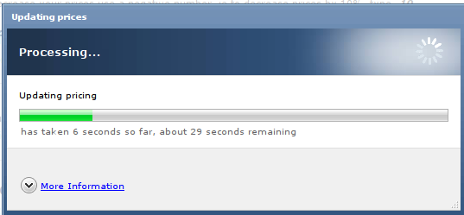
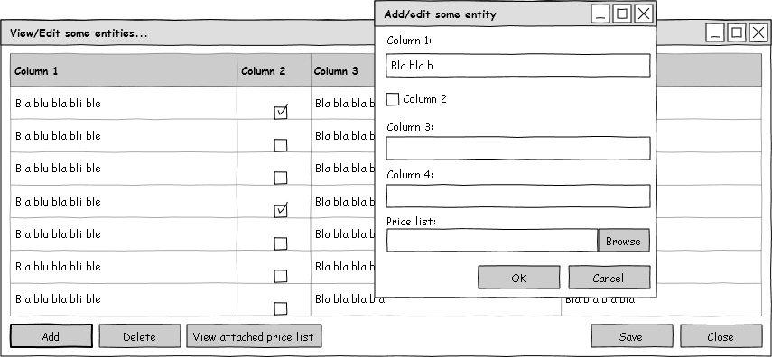
6. Support updates
A must-have feature!
“Import” from YAGO
Via the UI
To support, e.g., a new YAGO version
What happens to the “old” data?
Administrator privileges?
Manual updates
Add, edit and delete data originally taken from YAGO
Add, edit and delete user-provided data

Slide 19
In the course Website
Project details
Project examination form and grade guide
http://courses.cs.tau.ac.il/databases/databases201213b/assignments/

Slide 20
What to focus on
Database structure
Data – you choose what to take from YAGO
Query efficiency
Editing capabilities
Usability and fault tolerance

Slide 21
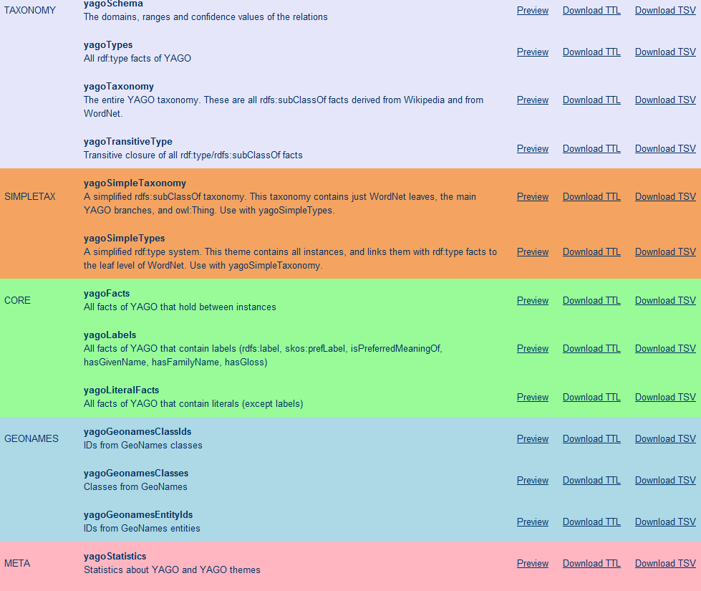
YAGO data – HowTo
YAGO downloads page - http://www.mpi-inf.mpg.de/yago-naga/yago/downloads.html

Slide 22
YAGO data – HowTo (cont.)
Data comes in TSV format – text with tab-separated fields (also TTL)
Format: yago-id entity relation entity
YAGO entities and relations are marked by < > (e.g., <Achilles>)
Others are taken from rdf, rdfs, owl, skos… (e.g., rdf:type)
Literals are marked by " "
Strings with optional locale, e.g., "Big tent"@eng
Others with datatype, e.g., "1977-08-16"^^xsd:date, "70"^<m>
See also: http://www.mpi-inf.mpg.de/yago-naga/yago/faq.html
<id_zik11d_88c_ehg9uq> <A> rdf:type <wikicategory_Vowel_letters>
<id_zik11d_88c_w3c6wm> <A> rdf:type <wikicategory_ISO_basic_Latin_letters>
<id_1bsrlah_88c_1s6g79w> <Alabama> rdf:type <wikicategory_States_of_the_United_States>
<id_3ienox_88c_4retae> <Achilles> rdf:type <wikicategory_People_of_the_Trojan_War>
<id_3ienox_88c_1rk49a2> <Achilles> rdf:type <wikicategory_Pederastic_heroes_and_deities>
<id_3ienox_88c_s57m6o> <Achilles> rdf:type <wikicategory_Kings_of_the_Myrmidons>

Slide 23
YAGO data – HowTo (cont.)
You can also download just the portions of YAGO2s that you need. Each portion is called a theme. There are 8 groups of themes:
TAXONOMY: All types of entitites, and the class structure of YAGO2s. Moreover, it has formal definitions of YAGO relations.
SIMPLETAX: An alternative, simpler taxonomy of YAGO.
CORE: Core facts of YAGO2s, such as the facts between entities, the facts containing literals,i.e., numbers, dates, strings, etc.
GEONAMES: Geographical entities, classes taken from GeoNames.
META: Temporally and spatially scoped facts together with statistics and extraction sources about the facts.
MULTILINGUAL: The multilingual names for entities.
LINK: The connection of YAGO2s to Wordnet, DBPedia, etc.
OTHER: Miscellaneous features of YAGO2s, such as Wikipedia in-outlinks, GeoNames data etc.

Slide 24
YAGO data – Taxonomy
yagoTypes – facts with relation rdf:type - contains the lowest-level classes for each entity
yagoTransitiveType – also contains the higher-level classes
<id_zik11d_88c_ehg9uq> <A> rdf:type <wikicategory_Vowel_letters>
<id_zik11d_88c_w3c6wm> <A> rdf:type <wikicategory_ISO_basic_Latin_letters>
<id_1bsrlah_88c_1s6g79w> <Alabama> rdf:type <wikicategory_States_of_the_United_States>
<id_3ienox_88c_4retae> <Achilles> rdf:type <wikicategory_People_of_the_Trojan_War>
<id_3ienox_88c_1rk49a2> <Achilles> rdf:type <wikicategory_Pederastic_heroes_and_deities>
<id_3ienox_88c_s57m6o> <Achilles> rdf:type <wikicategory_Kings_of_the_Myrmidons>

Slide 25
YAGO data - Core
yagoFacts – facts between instances
A complete list of relations – in Taxomony, yagoSchema
<Martin_Sheen> <hasChild> <Charlie_Sheen>
YagoLabels – names of entities.
There may be many labels! use skos:prefLabel
<Martin_Sheen> skos:prefLabel "Martin Sheen"@eng
yagoLiteralFacts –other facts with literals
Often properties of the entity
<Martin_Sheen> <wasBornOnDate> "1940-08-03"^^xsd:date

Slide 26
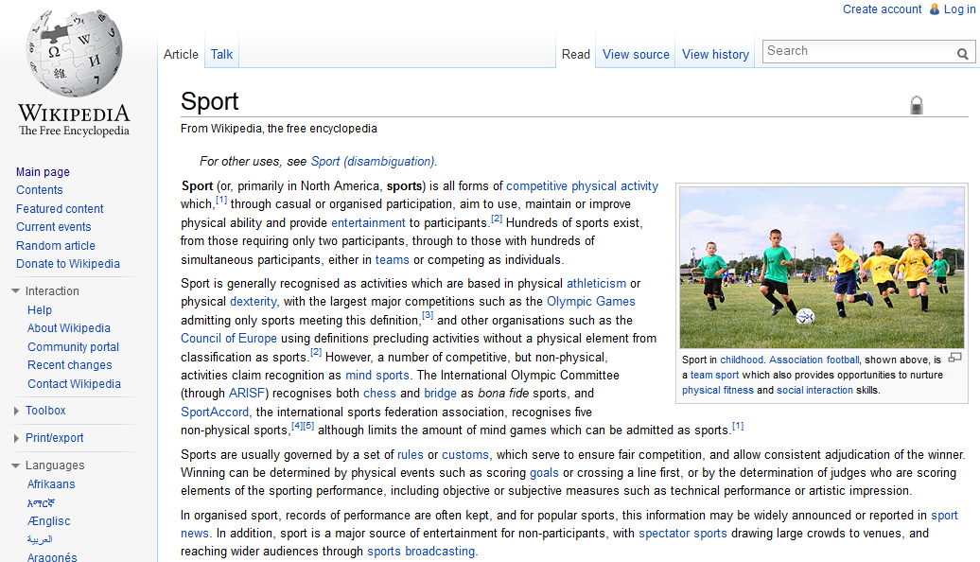
Example
Assume we work with the sports domain
Create an online application that contains details on teams and players
Users/automatic algorithms will guess game scores, awards, etc.

Slide 27
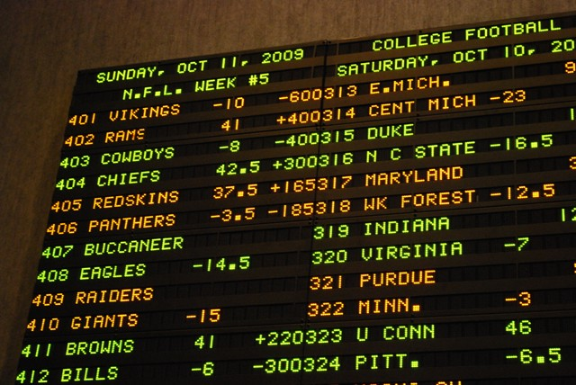
Example
Editing capabilities for YAGO data: add/remove/edit all players, teams, games…
Data of your own: odds, bets…
Your tables:
Players, Teams, Users, Bets
Linking tables: Player_team, User_bets

Slide 28
YAGO data – putting it together
We want to create records in the table Player(ID, name, birth date, height)
First, we look in yagoTransitiveType for entities that represent players
We find, e.g.,
<Lionel_Messi> rdf:type <wordnet_player_110439851>
Fixed application parameter

Slide 29
YAGO data – putting it together
Next, we create the properties
ID – e.g., automatically generated (must make sure we do not have Messi in our DB yet!)
Name – from yagoLabels
Birthdate and height – from yagoLiteralFacts
<Lionel_Messi> skos:prefLabel "Lionel Messi"@eng
<Lionel_Messi> <hasHeight> "1.69"^^<m>
<Lionel_Messi> <wasBornOnDate> "1987-06-24"^^xsd:date

Slide 30
YAGO data – Flattening process
Read the relevant TSV files
Save only the relevant data in memory or in a temporary table
Join together relevant pieces of data
Insert into the (final) schema tables

Slide 31
YAGO data – challenges
What do we do when a value is missing?
What do we do when the data in invalid?
What do we do when there is more than one value?
<Lionel_Messi> <playsFor> <FC_Barcelona_B>
<Lionel_Messi> <playsFor> <FC_Barcelona_C>
<Lionel_Messi> <playsFor> <Newell's_Old_Boys>
<Lionel_Messi> <playsFor> <Argentina_national_football_team>
<Lionel_Messi> <playsFor> <FC_Barcelona>

Slide 32
Relaxations
You do not have to fix errors in YAGO’s data (but you can allow the application users to do so)
You can choose an arbitrary value if there are many (where this makes sense! playsFor can be many-to-one, actedIn cannot)
You can use an additional data source to complete missing data (must be freely available)

Slide 33
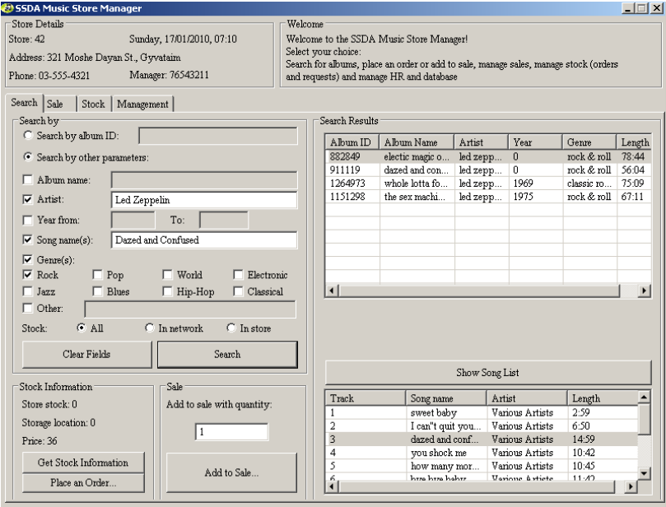
Past years projects

Slide 34
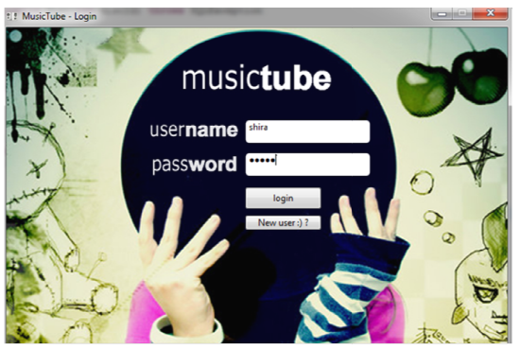
Past years projects

Slide 35
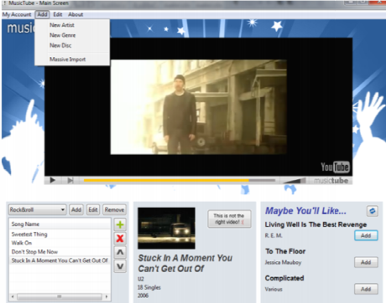
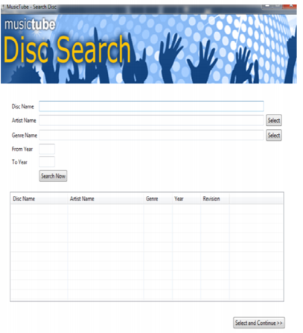
Past years projects

Slide 36
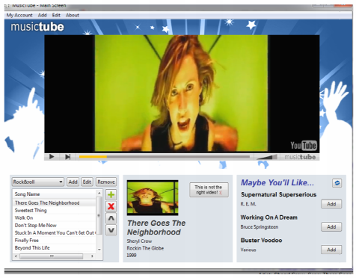
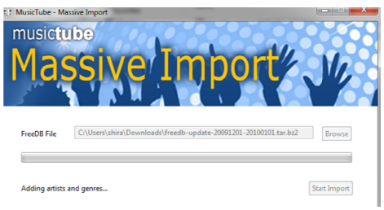
Past years projects

Slide 37
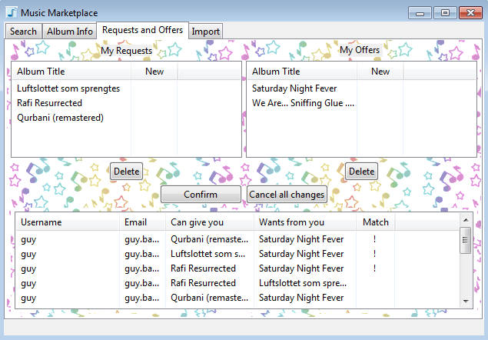
Past years projects

Slide 38
Tips
First: - understand the data format. - understand what you want to do. - find relevant data and relations.
Be flexible: work with what you have!
Database key should always be an INTEGER.
Don’t forget to support manual edit of the data (add/update/remove) – e.g., artists/categories/values…
Configuration – for DB connection, OS, etc.

Slide 39
Database Project - Bureaucracy
Hard work, but a practical experience.
Work in groups of 4
Submission database is MySQL in TAU
Java, SWT (or Swing/AWT)
Thinking out of the box will be rewarded

Slide 40
Database Project - Requirements
(at least) 150K records table
But could be much more!
Also see the course website for full instructions http://courses.cs.tau.ac.il/databases/databases201213b/assignments/

Slide 41
Time schedule
April 9th – Project distribution
April 18th – Last date for submitting the team member names
May 21st – “Project days”
I will meet with each group
You need to prepare: DB design, preferably have data in the school DB, work plan – what is left to do, who does what and when, optional – presentation or demonstration
June 18th – Project due!
Aim to submit a week before, to avoid network crushes, mysterious illnesses…

Slide 42
DB Project
בהצלחה!

