Slide 1
Lecture 11: DMBS Internals

Slide 2
What Should a DBMS Do?
Store large amounts of data
Process queries efficiently
Allow multiple users to access the database concurrently and safely
Provide durability of the data.
How will we do all this??

Slide 3
Generic Architecture
User / Application
Query
update
Query compiler/optimizer
Query execution
plan
Transaction
commands
Execution engine
Record,
Index requests
Transaction manager:
Concurrency control
Logging/recovery
Index/record mgr.
Page
commands
Buffer manager
Read/write
pages
Storage manager
storage

Slide 4
The Memory Hierarchy
Main Memory Disk Tape
Up to 1.6 GB/S
transmission rates
Teras of storage
average time to
access a block:
a few ms
Need to consider
seek, rotation,
transfer times.
Keep records “close” to each other.
1.5 MB/S transfer rate
280 GB typical
capacity
Only sequential access
Not for operational
data
Volatile
limited address spaces
expensive
avg access time:
10-100 ns
Cache:
access time 10 ns

Slide 5
Main Memory
Fastest, most expensive
Today: 4-8GB are common on desktops/laptops
Many databases could fit in memory
  Main Memory Database
  E.g TimesTen
Main issue is volatility

Slide 6
Secondary Storage
Disks
Slower, cheaper than main memory
Persistent
Used with a main memory buffer

Slide 7
Buffer Management in a DBMS
Page Requests from Higher Levels
BUFFER POOL
disk page
free frame
MAIN MEMORY
DISK
DB
choice of frame dictated
by replacement policy
Data must be in RAM for DBMS to operate on it!
Table of ⟨frame#, pageid⟩ pairs is maintained.
LRU is not always good.
Notes:
4

Slide 8
Buffer Manager
Manages buffer pool: the pool provides space for a limited
number of pages from disk.
Needs to decide on page replacement policy.
Enables the higher levels of the DBMS to assume that the
needed data is in main memory.
Why not use the Operating System for the task??
- DBMS may be able to anticipate access patterns
- Hence, may also be able to perform prefetching
- DBMS needs the ability to force pages to disk.

Slide 9
Tertiary Storage
Tapes or optical disks
Relatively extremely slow: used for long term archiving only

Slide 10
The Mechanics of Disk
Cylinder
Mechanical characteristics:
Seek time (4 ms)
Rotation speed (7200RPM)
Number of platters (1-30)
Number of tracks (≥10000)
(Relevant for HDDs but not SSDs)
Spindle
Disk head
Tracks
Sector
Arm movement
Platters
Arm assembly

Slide 11
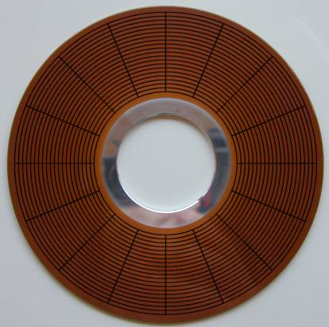

Slide 12
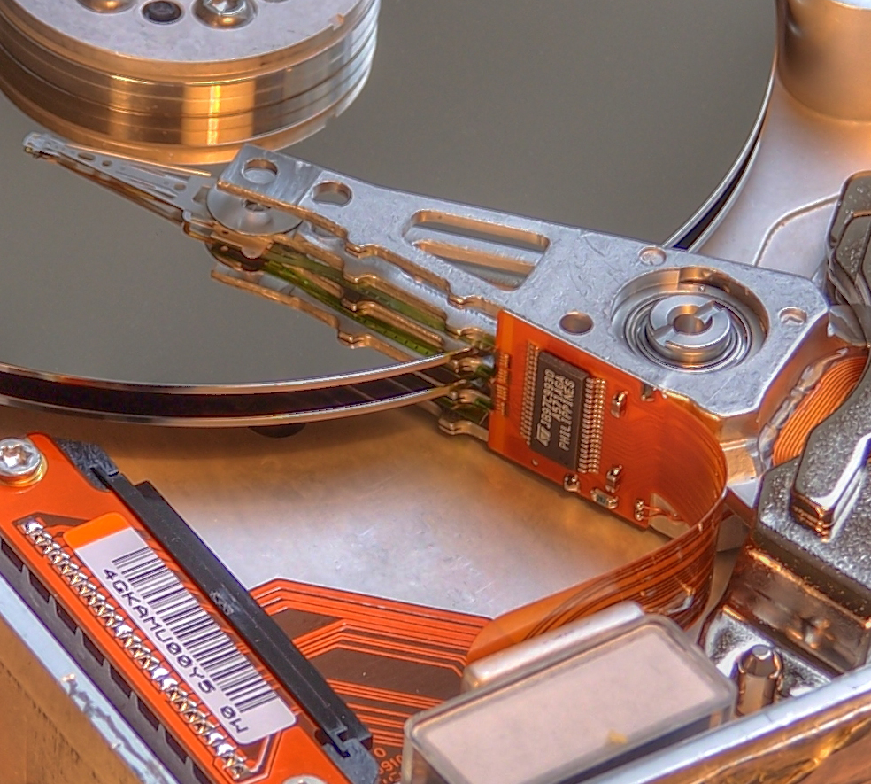

Slide 13
Disk Access Characteristics
Disk latency = time between when command is issued and when data is in memory
Disk latency = seek time + rotational latency
  Seek time = time for the head to reach cylinder
    4ms
  Rotational latency = time for the sector to rotate
    Rotation time = 4ms
    Average latency = 4ms/2
Transfer time = typically 100MB/s
Disks read/write one block at a time (typically 4KB)

Slide 14
The I/O Model of Computation
In main memory algorithms we care about CPU time
In databases time is dominated by I/O cost
Assumption: cost is given only by I/O
Consequence: need to redesign certain algorithms
Will illustrate here with sorting

Slide 15
Sorting
Illustrates the difference in algorithm design when your data is not in main memory:
  Problem: sort 1Gb of data with 1Mb of RAM.
Arises in many places in database systems:
  Data requested in sorted order (ORDER BY)
  Needed for grouping operations
  First step in sort-merge join algorithm
  Duplicate removal
  Bulk loading of B+-tree indexes.
Notes:
4

Slide 16
2-Way Merge-sort:
Requires 3 Buffers
Pass 1: Read a page, sort it, write it.
  only one buffer page is used
Pass 2, 3, …, etc.:
  three buffer pages used.
INPUT 1
INPUT 1
OUTPUT
INPUT 2
Main memory buffers
Disk
Disk
Notes:
5

Slide 17
Two-Way External Merge Sort
Each pass we read + write each page in file.
N pages in the file => the number of passes
So total cost is:
Improvement: start with larger parts
Sort 1GB with 1MB memory in 10 passes
3,4
6,2
9,4
8,7
5,6
3,1
2
Input file
PASS 0
3,4
2,6
4,9
7,8
5,6
1,3
2
1-page parts
PASS 1
2,3
4,7
1,3
2-page parts
4,6
8,9
5,6
2
PASS 2
2,3
4,4
1,2
4-page parts
6,7
3,5
8,9
6
PASS 3
1,2
2,3
3,4
8-page parts
4,5
6,6
7,8
9
Notes:
6

Slide 18
Can We Do Better ?
We have more main memory
Should use it to improve performance

Slide 19
Cost Model for Our Analysis
B: Block size
M: Size of main memory
N: Number of records in the file
R: Size of one record
Notes:
3

Slide 20
External Merge-Sort
Phase one: load M bytes in memory, sort
  Result: parts of length M/R records
M/R records
. . .
. . .
Disk
M bytes of main memory
Disk
Not exactly – sorting requires extra memory

Slide 21
N records, divided to NR/M sorted parts of M/R records each
M
M
M
M
M
M
M
M
M
M
M
M
M
M
M
Notes:
6

Slide 22
Phase Two
Merge M/B – 1 parts into a new part
Result: parts have now M/R (M/B – 1) records
INPUT 1
. . .
INPUT 2
. . .
. . .
OUTPUT
INPUT M/B -1
Disk
M bytes of main memory
Disk
A block of each part
Notes:
7

Slide 23
N records, divided to NR/M sorted parts of M/R records each
M
M
M
M
M
M
M
M
M
M
M
M
M
M
M
M
M
M
M
M
M
M
M
M
M
M
M
M
M
M
Merge of M/B – 1 parts into a new one
INPUT 1
. . .
INPUT 2
. . .
. . .
OUTPUT
INPUT M/B -1
Disk
M bytes of main memory
Disk
We now have M/R (M/B-1) sorted records at each part
Notes:
6

Slide 24
Phase Three
Merge M/B – 1 parts into a new part
Result: parts have now M/R (M/B – 1)² records
INPUT 1
. . .
INPUT 2
. . .
. . .
OUTPUT
INPUT M/B -1
Disk
M bytes of main memory
Disk
Notes:
7

Slide 25
N records, divided to NR/M sorted parts of M/R records each
M
M
M
M
M
M
M
M
M
M
M
M
M
M
M
M
M
M
M
M
M
M
M
M
M
M
M
M
M
M
M
M
M
M
M
M
M
M
M
M
M
M
M
M
M
Final sorted result..
Notes:
6

Slide 26
Cost of External Merge Sort
Number of passes:
Cost = 2(NR / B) * #passes
Think differently
  Given B = 4KB, M = 64MB, R = 0.1KB
  Pass 1: parts of length M/R = 640000
    Have now sorted parts of 640000 records
  Pass 2: parts increase by a factor of M/B – 1 = 16000
    Have now sorted parts of 10,240,000,000 = 10¹⁰ records
  Pass 3: parts increase by a factor of M/B – 1 = 16000
    sorted parts of 10¹⁴ records (Nobody has so much data !)
Can sort everything in 2 or 3 passes !
Notes:
8

Slide 27
Number of Passes of External Sort
B: number of frames in the buffer pool; N: number of pages in relation.
Notes:
9

Slide 28
Next on Agenda
File organization (brief)
Indexing
Query execution
Query optimization

