Slide 1
Lecture 12: Storage and Indexing

Slide 2
Storage and Indexing
How do we store efficiently large amounts of data?
The appropriate storage depends on what kind of accesses we expect to have to the data.
We consider:
primary storage of the data
additional indexes (very very important).

Slide 3
Cost Model for Our Analysis
As a good approximation, we ignore CPU costs:
B: The number of data pages
R: Number of records per page
D: (Average) time to read or write disk page
Measuring number of page I/O’s ignores gains of pre-fetching blocks of pages; thus, even I/O cost is only approximated.
Average-case analysis; based on several simplistic assumptions.
Notes:
3

Slide 4
File Organizations and Assumptions
Heap Files:
Equality selection on key; exactly one match.
Insert always at end of file.
Sorted Files:
Files compacted after deletions.
Selections on sort field(s).
Hashed Files:
No overflow buckets, 80% page occupancy.
Single record insert and delete.
Notes:
4

Slide 5
Cost of Operations
Notes:
5

Slide 6
Indexes
If you don’t find it in the index,
look very carefully through the entire catalog.
Sears, Roebuck and Co., Consumer’s Guide, 1897.

Slide 7
Indexes
An index on a file speeds up selections on the search key fields for the index.
Any subset of the fields of a relation can be the search key for an index on the relation.
Search key is not the same as key (minimal set of fields that uniquely identify a record in a relation).
An index contains a collection of data entries, and supports efficient retrieval of all data entries k* with a given key value k.
Notes:
7

Slide 8
Alternatives for Data Entry k* in Index
Three alternatives:
Data record with key value k
<k, rid of data record with search key value k>
<k, list of rids of data records with search key k>
Choice of alternative for data entries is orthogonal to the indexing technique used to locate data entries with a given key value k.
Examples of indexing techniques: B+ trees, hash-based structures
Notes:
8

Slide 9
Alternatives for Data Entries (2)
Alternative 1:
If this is used, index structure is a file organization for data records (like Heap files or sorted files).
At most one index on a given collection of data records can use Alternative 1. (Otherwise?)
Index files are large, often much more auxiliary information in the index.
Notes:
9

Slide 10
Alternatives for Data Entries (3)
Alternatives 2 and 3:
Data entries typically much smaller than data records. So, better than Alternative 1 with large data records, especially if search keys are small.
If more than one index is required on a given file, at most one index can use Alternative 1; rest must use Alternatives 2 or 3.
Alternative 3 more compact than Alternative 2, but leads to variable sized data entries even if search keys are of fixed length.
Notes:
10

Slide 11
Index Classification
Primary vs. secondary: If search key contains primary key, then called primary index.
Clustered vs. unclustered: If order of data records is the same as, or `close to’, order of data entries, then called clustered index.
Alternative 1 implies clustered, but not vice-versa.
A file can be clustered on at most one search key.
Cost of retrieving data records through index varies greatly based on whether index is clustered or not!
Notes:
11

Slide 12
Clustered vs. Unclustered Index
Data entries
Data entries
(Index File)
(Data file)
Data Records
Data Records
CLUSTERED
UNCLUSTERED
Notes:
12

Slide 13
Index Classification (Contd.)
Dense vs. Sparse: If there is at least one data entry per search key value (in some data record), then dense.
Alternative 1 always leads to dense index.
Every sparse index is clustered!
Sparse indexes are smaller;
Ashby, 25, 3000
Basu, 33, 4003
22
Bristow, 30, 2007
25
Ashby
30
Cass
Cass, 50, 5004
33
Smith
Daniels, 22, 6003
Jones, 40, 6003
40
44
Smith, 44, 3000
44
Tracy, 44, 5004
50
Sparse Index
Dense Index
on
Data File
on
Name
Age
Notes:
13

Slide 14
Index Classification (Contd.)
Composite Search Keys: Search on a combination of fields.
Equality query: Every field value is equal to a constant value. E.g. wrt <sal,age> index:
age=20 and sal =75
Range query: Some field value is not a constant. E.g.:
age =20; or age=20 and sal > 10
Examples of composite key
indexes using lexicographic order.
11,80
11
12,10
12
12,20
name
age
sal
12
13,75
bob
12
10
13
<age, sal>
cal
11
80
<age>
joe
12
20
10,12
sue
13
75
10
20,12
Data records
sorted by name
20
75,13
75
80,11
80
<sal, age>
<sal>
Data entries in index
sorted by <sal,age>
Data entries
sorted by <sal>
Notes:
13

Slide 15
Tree-Based Indexes
``Find all students with grade > 92’’
If data is in sorted file, do binary search to find first such student, then scan to find others.
Cost of binary search can be quite high.
Simple idea: Create an ‘index’ file.
k₁
k₂
k_{N}
Index File
Page 1
Page 2
Page 3
Page N
Data File
Allows performing a binary search on (smaller) index file!
Notes:
3

Slide 16
Tree-Based Indexes (2)
index entry
P₀
K₁
P₁
K₂
P₂
K_{m}
P_{m}
40
Root
20
33
51
63
10*
15*
20*
27*
33*
37*
40*
46*
51*
55*
63*
97*

Slide 17
B+ Tree: The Most Widely Used Index
Insert/delete at log _{F} N cost; keep tree height-balanced. (F = fanout, N = # leaf pages)
Minimum 50% occupancy (except for root). Each node contains d <= m <= 2d entries. The parameter d is called the order of the tree.
Root
Index Entries
Data Entries
Notes:
9

Slide 18
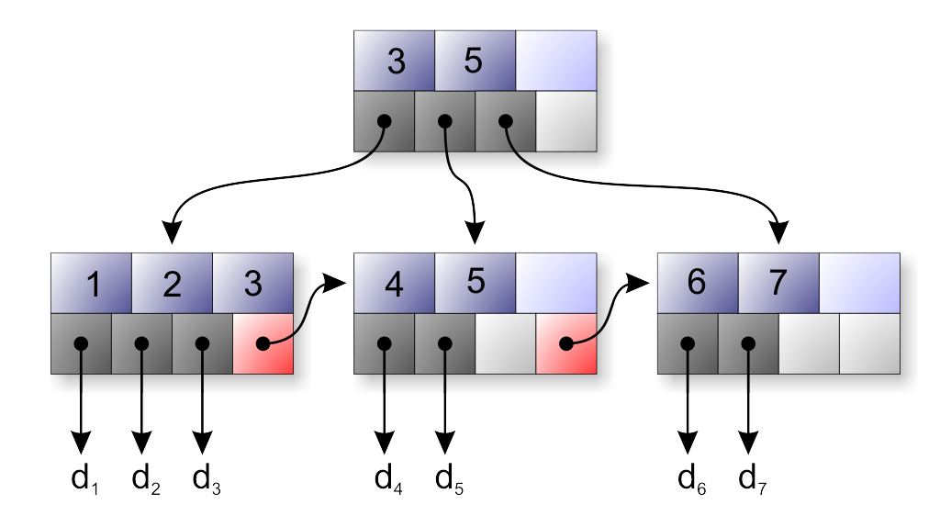

Slide 19
Example B+ Tree
Search begins at root, and key comparisons direct it to a leaf.
Search for 5*, 15*, all data entries >= 24* ...
13
17
24
30
2*
3*
5*
7*
14*
16*
19*
20*
22*
24*
27*
29*
33*
34*
38*
39*
Notes:
10

Slide 20
B+ Trees in Practice
Typical order: 100. Typical fill-factor: 67%.
average fan-out = 133
Typical capacities:
Height 4: 133⁴ = 312,900,700 records
Height 3: 133³ = 2,352,637 records
Can often hold top levels in buffer pool:
Level 1 = 1 page = 8 KB
Level 2 = 133 pages = 1 MB
Level 3 = 17,689 pages = 133 MB

Slide 21
Inserting a Data Entry into a B+ Tree
Find correct leaf L.
Put data entry onto L.
If L has enough space, done!
Else, must split L (into L and a new node L2)
Redistribute entries evenly, copy up middle key.
Insert index entry pointing to L2 into parent of L.
This can happen recursively
To split index node, redistribute entries evenly, but push up middle key. (Contrast with leaf splits.)
Notes:
6

Slide 22
Insertion in a B+ Tree
Insert (K, P)
Find leaf where K belongs, insert
If no overflow (2d keys or less), halt
If overflow (2d+1 keys), split node, insert in parent:
If leaf, keep K₃ too in right node
When root splits, the new root has only one key
(K₃, ) to parent
K₁ |  | K₂ |  | K₃ |  | K₄ |  | K₅
P₀ | P₁ |  | P₂ |  | P₃ |  | P₄ |  | P₅
K₁ |  | K₂
P₀ | P₁ |  | P₂
K₄ |  | K₅
P₃ | P₄ |  | P₅

Slide 23
Insertion in a B+ Tree
Insert K=19
80
20 |  | 60
100 |  | 120 |  | 140
10 |  | 15 |  | 18
20 |  | 30 |  | 40 |  | 50
60 |  | 65
80 |  | 85 |  | 90
10
15
18
20
30
40
50
60
65
80
85
90

Slide 24
Insertion in a B+ Tree
After insertion
80
20 |  | 60
100 |  | 120 |  | 140
10 |  | 15 |  | 18 |  | 19
20 |  | 30 |  | 40 |  | 50
60 |  | 65
80 |  | 85 |  | 90
10
15
18
19
20
30
40
50
60
65
80
85
90

Slide 25
Insertion in a B+ Tree
Now insert 25
80
20 |  | 60
100 |  | 120 |  | 140
10 |  | 15 |  | 18 |  | 19
20 |  | 30 |  | 40 |  | 50
60 |  | 65
80 |  | 85 |  | 90
10
15
18
19
20
30
40
50
60
65
80
85
90

Slide 26
Insertion in a B+ Tree
After insertion
80
20 |  | 60
100 |  | 120 |  | 140
10 |  | 15 |  | 18 |  | 19
20 |  | 25 |  | 30 |  | 40 |  | 50
60 |  | 65
80 |  | 85 |  | 90
10
15
18
19
20
25
30
40
50
60
65
80
85
90

Slide 27
Insertion in a B+ Tree
But now have to split !
80
20 |  | 60
100 |  | 120 |  | 140
10 |  | 15 |  | 18 |  | 19
20 |  | 25 |  | 30 |  | 40 |  | 50
60 |  | 65
80 |  | 85 |  | 90
10
15
18
19
20
25
30
40
50
60
65
80
85
90

Slide 28
Insertion in a B+ Tree
After the split
80
20 |  | 30 |  | 60
100 |  | 120 |  | 140
10 |  | 15 |  | 18 |  | 19
20 |  | 25
30 |  | 40 |  | 50
60 |  | 65
80 |  | 85 |  | 90
10
15
18
19
20
25
30
40
50
60
65
80
85
90

Slide 29
Insertion in a B+ Tree
Another B+ Tree
80
20 |  | 30 |  | 60 |  | 70
100 |  | 120 |  | 140
10 |  | 15 |  | 18 |  | 19
20 |  | 25
30 |  | 40 |  | 50
60 |  | 65
80 |  | 85 |  | 90
10
15
18
19
20
25
30
40
50
60
65
80
85
90

Slide 30
Insertion in a B+ Tree
Now Insert 12
80
20 |  | 30 |  | 60 |  | 70
100 |  | 120 |  | 140
10 |  | 15 |  | 18 |  | 19
20 |  | 25
30 |  | 40 |  | 50
60 |  | 65
80 |  | 85 |  | 90
10
15
18
19
20
25
30
40
50
60
65
80
85
90

Slide 31
Insertion in a B+ Tree
Need to split leaf
80
20 |  | 30 |  | 60 |  | 70
100 |  | 120 |  | 140
10 |  | 12 |  | 15 |  | 18 |  | 19
20 |  | 25
30 |  | 40 |  | 50
10
12
15
18
19
20
25
30
40
50

Slide 32
Insertion in a B+ Tree
Need to split branch
80
15 |  | 20 |  | 30 |  | 60 |  | 70
100 |  | 120 |  | 140
10 |  | 12
15 |  | 18 |  | 19
20 |  | 25
30 |  | 40 |  | 50
10
12
15
18
19
20
25
30
40
50

Slide 33
Insertion in a B+ Tree
After split
30 |  | 80
15 |  | 20
60 |  | 70
100 |  | 120 |  | 140
10 |  | 12
15 |  | 18 |  | 19
20 |  | 25
30 |  | 40 |  | 50
10
12
15
18
19
20
25
30
40
50

Slide 34
Deleting a Data Entry from a B+ Tree
Start at root, find leaf L where entry belongs.
Remove the entry.
If L is at least half-full, done!
If L has only d-1 entries,
Try to re-distribute, borrowing from sibling (adjacent node with same parent as L).
If re-distribution fails, merge L and sibling.
If merge occurred, must delete entry (pointing to L or sibling) from parent of L.
Merge could propagate to root, decreasing height.
Notes:
14

Slide 35
Deletion from a B+ Tree
Delete 30
80
20 |  | 30 |  | 60
100 |  | 120 |  | 140
10 |  | 15 |  | 18 |  | 19
20 |  | 25
30 |  | 40 |  | 50
60 |  | 65
80 |  | 85 |  | 90
10
15
18
19
20
25
30
40
50
60
65
80
85
90

Slide 36
Deletion from a B+ Tree
After deleting 30
May change to 40, or not
80
20 |  | 30 |  | 60
100 |  | 120 |  | 140
10 |  | 15 |  | 18 |  | 19
20 |  | 25
40 |  | 50
60 |  | 65
80 |  | 85 |  | 90
10
15
18
19
20
25
40
50
60
65
80
85
90

Slide 37
Deletion from a B+ Tree
Now delete 25
80
20 |  | 30 |  | 60
100 |  | 120 |  | 140
10 |  | 15 |  | 18 |  | 19
20 |  | 25
40 |  | 50
60 |  | 65
80 |  | 85 |  | 90
10
15
18
19
20
25
40
50
60
65
80
85
90

Slide 38
Deletion from a B+ Tree
After deleting 25
Need to rebalance
Rotate
80
20 |  | 30 |  | 60
100 |  | 120 |  | 140
10 |  | 15 |  | 18 |  | 19
20
40 |  | 50
60 |  | 65
80 |  | 85 |  | 90
10
15
18
19
20
40
50
60
65
80
85
90

Slide 39
Deletion from a B+ Tree
Now delete 40
80
19 |  | 30 |  | 60
100 |  | 120 |  | 140
10 |  | 15 |  | 18
19 |  | 20
40 |  | 50
60 |  | 65
80 |  | 85 |  | 90
10
15
18
19
20
40
50
60
65
80
85
90

Slide 40
Deletion from a B+ Tree
After deleting 40
Rotation not possible
Need to merge nodes
80
19 |  | 30 |  | 60
100 |  | 120 |  | 140
10 |  | 15 |  | 18
19 |  | 20
50
60 |  | 65
80 |  | 85 |  | 90
10
15
18
19
20
50
60
65
80
85
90

Slide 41
Deletion from a B+ Tree
Final tree
80
19 |  | 60
100 |  | 120 |  | 140
10 |  | 15 |  | 18
19 |  | 20 |  | 50
60 |  | 65
80 |  | 85 |  | 90
10
15
18
19
20
50
60
65
80
85
90

Slide 42
Important to note
If the index is in the main memory, searching and updating are “free”
Otherwise, some levels are saved on disk
If a node fits in the memory search within the node is “free”, and reading a node costs 1
Otherwise, we count the number of blocks read/written
When does this happen?

