Slide 1
Lecture 15: Mob Data Sourcing

Slide 2
Outline
Crowdsourcing
Crowd data sourcing
Towards a principled solution
Conclusions and challenges

Slide 3
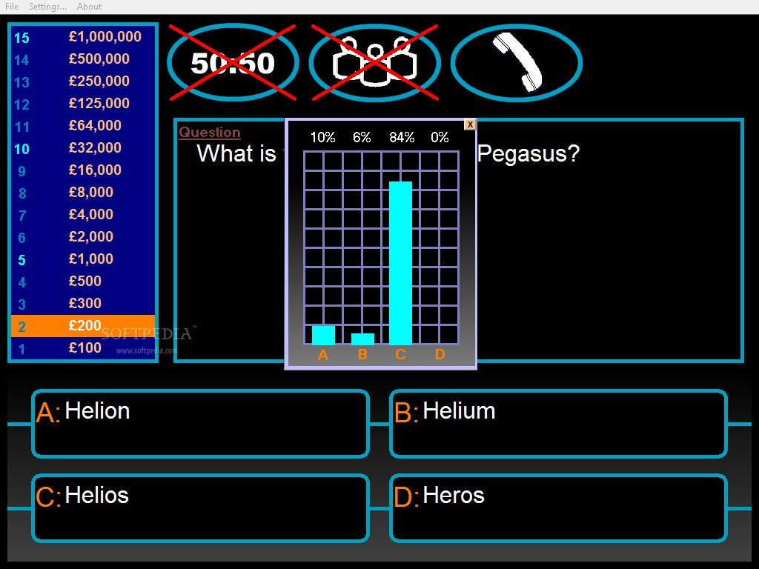
The “wisdom of the crowd”

Slide 4
CrowdSourcing
Main idea: outsource tasks to the crowd of Web users
Task: solve bugs
Task: find an appropriate treatment to an illness
Task: construct a database of facts
…
Why now?
Internet and smart phones …
We are all connected, all of the time!!!

Slide 5
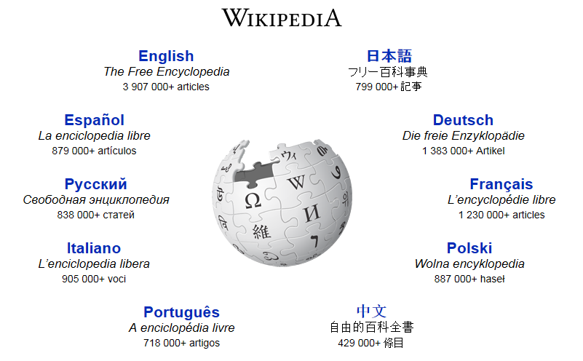
The classical example

Slide 6
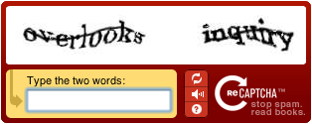
Other famous examples
reCAPTCHA

Slide 7
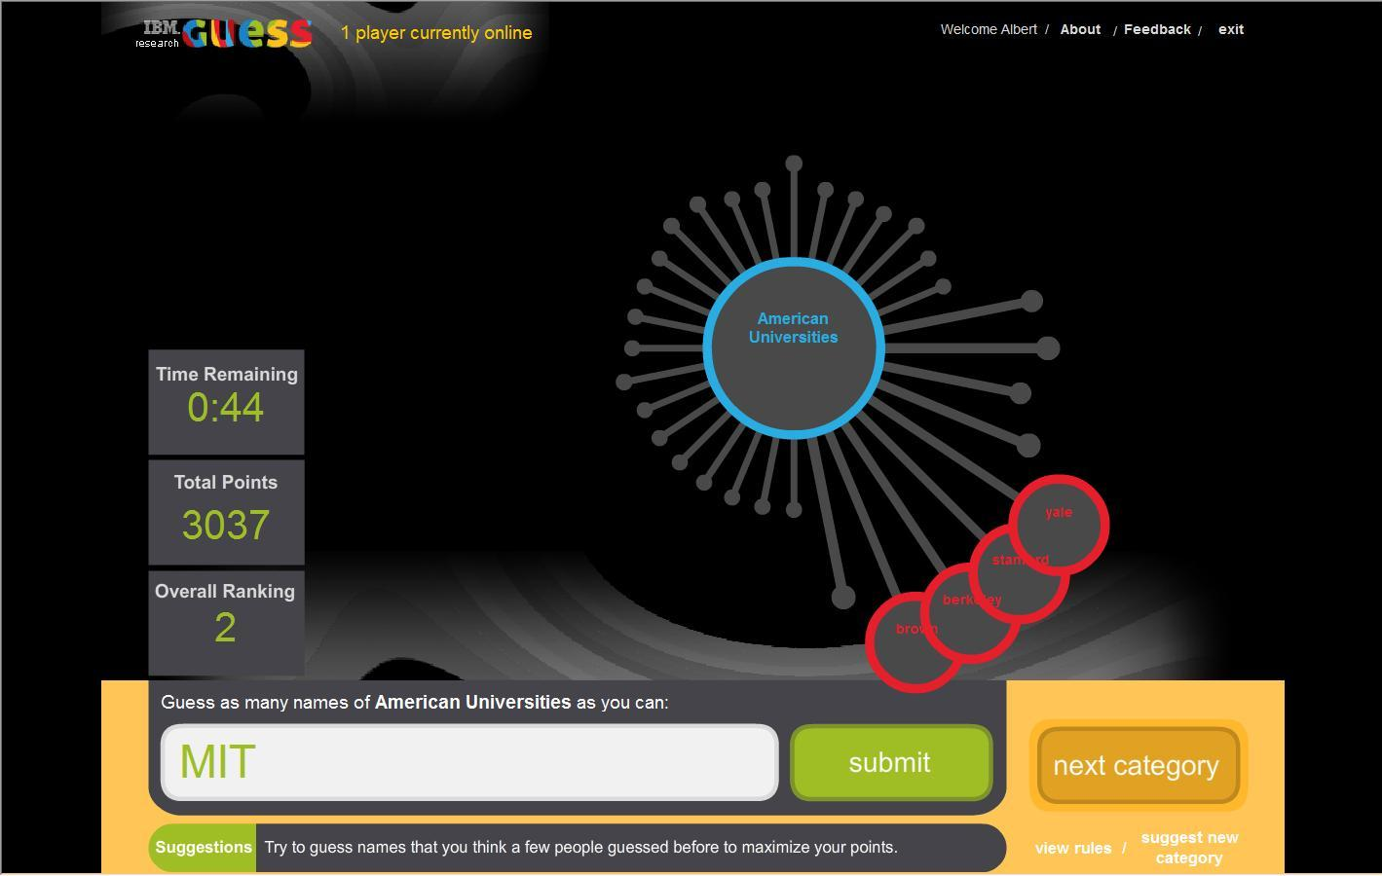
Playing Trivia

Slide 8
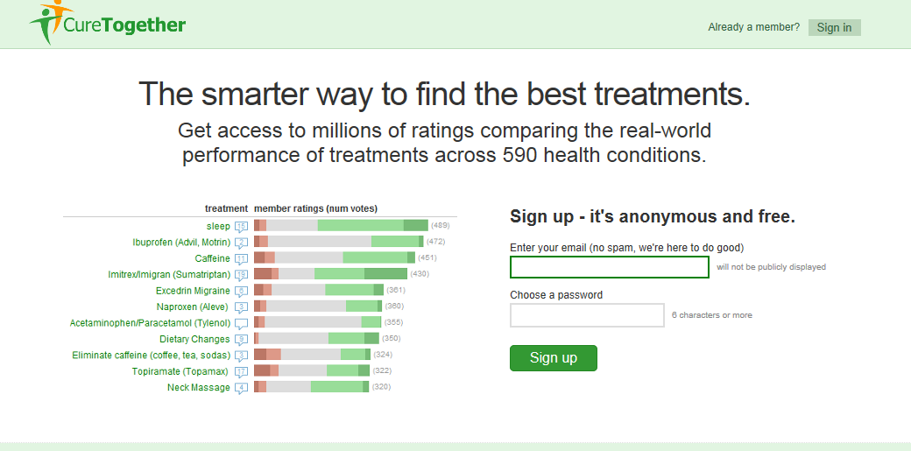
Curing Together

Slide 9
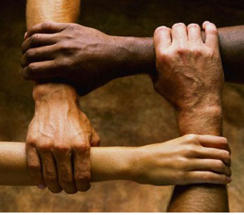
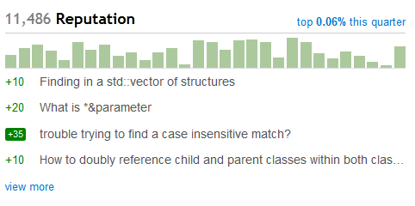
Incentives for the crowd
Money
Altruism
Reputation
Fun

Slide 10
Tasks for people
Tasks that can be performed by a computer, but inefficiently
Tasks that can be performed by a computer, but inaccurately
Tasks that cannot be performed by a computer

Slide 11
The crowd vs. experts
Big volumes of data
Always available
Diverse opinions
Cheaper

Slide 12
Inter-disciplinary research
Data management
Psychology and sociology
Social media
Game theory
Natural language processing and information extraction
Image processing

Slide 13
Outline
Crowdsourcing
Crowd data sourcing
Towards a principled solution
Conclusions and challenges

Slide 14
Crowd Data Sourcing
The case where the task is collection of data
Two main aspects [DFKK’12]:
Using the crowd to create better databases
Using database technologies to create
better crowd data sourcing applications
[DFKK’12]: Crowdsourcing Applications and Platforms: A Data Management Perspective, A.Doan, M. J. Franklin, D. Kossmann, T. Kraska, VLDB 2011

Slide 15
Data-related Tasks (that can be) Performed by Crowds
Data Collection
When people can help finding the data
When people are the only source of data
Data Cleaning
E.g., repairing key violations by settling contradictions
Data Integration
E.g. identify mappings
Information Extraction
E.g. entity resolution

Slide 16
Outline
Crowdsourcing
Crowd data sourcing
Towards a principled solution
Conclusions

Slide 17
Main Tasks in Crowd Data Sourcing
What questions to ask?
How to define correctness of answers?
How to clean the data?
Who to ask? how many people?
How to best use resources?
Declarative Framework!
Probabilistic Data!
Data Cleaning!
Optimizations and Incremental Computation

Slide 18
Platforms for Crowdsourcing
Qurk (MIT)
CrowdDB (Berkeley and ETH Zurich)
CrowdForge (CMU)
Deco (Stanford and UCSC)
MoDaS (Tel Aviv University)
…

Slide 19
Qurk
Main observation: We can use the crowd as a computational resource and thus combine
Queries on existing data
“Black boxed” (User Defined Functions) that generate tasks (HITs) to be performed by turkers
Crowdsourced Databases: Query Processing with People, A. Marcus, E. Wu, D. R. Karger, S. Madden, R. C. Miller, CIDR 2011

Slide 20
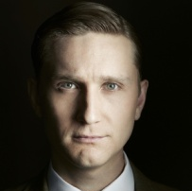
Qurk example
Picture | name
 | Lucy
 | Don
 | Ken
… | …
The goal:
Find the names of all the women in the people table
SELECT name
FROM people p
WHERE isFemale(p)
TASK isFemale(tuple)
TYPE:Filter
Question: “Is ” + tuple[name] + "a female?”, tuple[picture]
YesText: “Yes”
NoText: “No”

Slide 21
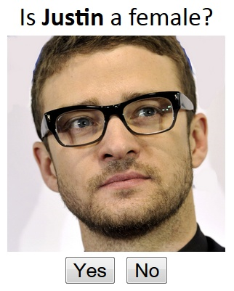
Qurk example
Picture | name
 | Lucy
 | Don
 | Ken
… | …

Slide 22
The magic is in the templates
Templates generate UIs for different kinds of crowd-sourcing tasks
Filters: Yes/No questions
Joins: comparisons between two tuples (equality)
Order by: comparisons between two tuples (>=)
Generative: crowdsource attribute value

Slide 23
Multiple questions and answers
Problem: not every person knows the answer to every question
Solution: send the HIT to multiple users
New Problem: How many users should answer each question?
New Problem: Contradictions may rise
Diversity is desired in some cases, and a single answer in others
E.g., multiple CEOs to the same companies
Can be identified as a key violation
In Qurk one can choose a combiner to aggregate the answers
Out of a predefined set of options
E.g., Majority Vote
We will get back to this point!

Slide 24
Optimization Issues
Cost of a HIT
Money and latency
Optimized statically or at runtime
Given a limited number of HITs, choosing a subset
Batch Predicates
Get more answers while asking only one question
Limited attention / willingness of the turker
Asynchronous Implementation

Slide 25
CrowdDB
A different declarative framework for crowd data sourcing
Main difference: allows crowdsourcing the generation of new tuples
CrowdDB: Answering Queries with Crowdsourcing,
M. J. Franklin, D. Kossmann ,T. Kraska, S. Ramesh, R. Xin
SIGMOD ‘11

Slide 26
CrowdForge
A declarative framework inspired by MapReduce
Provides a small set of task primitives (partition, map, and reduce) that can be combined and nested
Allows to break MTurk tasks to small tasks and combine the answers
Sub-tasks are then issued to the crowd (turkers)
CrowdForge: Crowdsourcing Complex Work, A. Kittur, B. Smus S. Khamkar R. E. Kraut , UIST ‘11

Slide 27
Where are we?
What questions to ask?
How to define correctness of answers?
How to clean the data?
Who to ask? how many people?
How to best use resources?
Declarative Framework!
Probabilistic Data!
Data Cleaning!
Optimizations and Incremental Computation

Slide 28
Errors, Contradictions and Motivation
The solutions described so far propose declarative infrastructures for collecting data from crowds
But how credible is the data?
It is likely to contain errors, disagreements, lies (spam)
As well as contradictions
We need ways to
settle contradictions, and
estimate trust in users
Also related to the incentives and budget
Can we reward trust-worthy users?

Slide 29
Deco (sCOOP project)
A declarative platform based on 3 main concepts:
1. Fetch: add tuples
Fetch Rules (FR) procedures
2. Resolve: resolve dependent attributes
Resolution Rules (RR) procedures
3. Join: Outerjoin of tables
Deco: Declarative Crowdsourcing, A. Parameswaran, H. Park, H.G. Molina, N. Polyzotis, J. Widom, Stanford Infolab Technical Report, 2011
[Deco slides based on slides presented in Crowd-Crowd 2011]

Slide 30
Fetch Rules
R (restaurant, address, [rating], [cuisine]), S (address, [city, zip])
LHS → RHS with procedure P
Given LHS value, procedure P can obtain RHS values
from external source(s)
restaurant,address → rating
Restaurant → cuisine
Address → city,zip

Slide 31
Resolution Rules
R (restaurant, address, [rating], [cuisine])
S (address, [city, zip])
A resolution rule per dependent attribute-group
restaurant,address → rating (F=avg)
restaurant → cuisine (F=dup-elim)
Address → city, zip (F=majority)

Slide 32
Designing Resolution Rules
Average value? Majority vote?
But some people know nothing about a given topic
So maybe a “biased vote”?
But how to bias?
A “chicken or the egg” problem:
To decide which answers are correct, we have to know whom to trust; to know whom to trust we have to know which answers are correct…

Slide 33
MoDaS
Observation: two key aspects in the design of crowdsourcing applications
Uncertainty in data
Recursion in policies
Approach: take declarative solutions further
Use probabilistic DBs for modeling uncertainty in data
Use datalog for modeling recursion

Slide 34
Example
Start with some probability reflecting the trust in users (turkers)
Gain confidence in facts based on the opinion of users that supported them
Choose probabilistically “believed” facts
Assign greater weight (in probability computation) to trusted users
Then update the trust level in users, based on how many of the facts which they submitted, we believe
Iterate until convergence
Trusted users give us confidence in facts,
and users that supported these facts gain our trust…

Slide 35
Declarative Approach
That was one possible policy
We want to have easy control on the employed policy
We want to be able to design such policies for conflict resolution
But also for
rewarding turkers, choosing which question to ask…
and for data cleaning, query selection, user game scores,…

Slide 36
Declarative Approach (cont.)
We don’t want to (re)write Java code (for each tiny change!)
We want (seamless) optimization, update propagation,…
Database approach:
Define a declarative language for specifying policies
Based on probabilistic databases and (recursive) datalog
[D., Greenshpan, Kostenko, M. ICDE’11 ,WWW’12]
[D., Koch, M. PODS’10]

Slide 37
Block-Independent Disjoint (BID) Tables
Prob | Cuisine | Rest
0.7 | French | Alouette
0.3 | American | Alouette
1 | Fast food | Mcdonald’s
Cuisine | Rest
French | Alouette
Fast food | Mcdonald’s
Cuisine | Rest
American | Alouette
Fast food | Mcdonald’s
0.7
0.3
Efficient Query Evaluation on Probabilistic Databases, N. Dalvi and D. Suciu, VLDB ‘04

Slide 38
Repair-Key
Prob | Cuisine | Rest
0.7 | French | Alouette
0.3 | American | Alouette
1 | Fast food | Mcdonald’s
REPAIR-KEY[Rest@ Prob](Restaurants)
Cuisine | Rest
French | Alouette
Fast food | Mcdonald’s
Cuisine | Rest
American | Alouette
Fast food | Mcdonald’s
0.7
0.3
Approximating predicates and expressive queries on probabilistic databases, C. Koch, PODS ‘08

Slide 39
Proposed Language
Enrich SQL with the REPAIR-KEY construct
And a WHILE construct
Semantics: Markov chain of DB instances.
Return the Probability of a fact to hold in a given instance.
Allows to easily express nicely common policies for cleaning, selection of questions, scoring answers

Slide 40
Recursion on Prob. Data!
The “while” language consists of 3 parts:
Update rules, to be evaluated repeatedly.
Intuitively, rules to settle contradictions.
A boolean condition, deciding when to sample.
Intuitively, when the DB includes no contradiction.
3. A query of interest, to be sampled.
E.g. what kind of cuisine is Alouette?

Slide 41
Example
Confidence | User
6 | Alice
2 | Bob
2 | Carol
User | Cuisine | Rest
Alice | French | Alouette
Bob | French | Alouette
Carol | American | Alouette
Carol | French | McDonalds
Bob | Fast Food | McDonalds

Slide 42
Example (cont.)
$$\frac{8 ∗2}{10 ∗4 }$$
C | R
F | A
FF | M
C | U
7 | A
3 | B
3 | C
…
…
C | U
6 | A
2 | B
2 | C
…
$$\frac{8 ∗2}{10 ∗4 }$$
C | R
F | A
F | M
…
$$\frac{2 ∗2}{10 ∗4 }$$
C | R
A | A
F | M
…
C | R
A | A
FF | M
$$\frac{2 ∗2}{10 ∗4 }$$
…

Slide 43
Example: Update Rules
Update user authorities according to number of believed facts
U1 U2
Drop BelievedRestaurants;
INSERT INTO BelievedRestaurants
REPAIR-KEY[Restaurant @ authority] ON
(SELECT name, cuisine, authority
FROM Restaurants AS R, Users AS U
WHERE R.user = U.user);
UPDATE Users
SET Authority =
(SELECT CorrectFacts
FROM T1
WHERE T1.user = Users.user)
T1 = SELECT user, COUNT(DISTINCT name) AS CorrectFacts
FROM T2
GROUP BY user;
T2 = SELECT user, name, cuisine
FROM UserRest UR
WHERE EXISTS
(SELECT * FROM BelievedRestaurants BR
WHERE BR.name = UR.name AND
BR.cuisine = UR.cuisine);
Compute a subset of believed facts based on user authorities
Boolean condition: Name is a key in BelievedRestaurants

Slide 44
TriviaMaster

Slide 45
Some Complexity Results
Formal problem: Given a Markov Chain of database instances and an SQL query on the database (“what is Alouette’s cuisine?”), compute the probabilities of the different answers.
Theorem: Exact computation is #P-hard
Theorem: If Markov Chain is ergodic, computable in EXPTIME
Compute the stochastic matrix of transitions
Compute its fixpoint
For ergodic Markov Chain corresponds to correct probabilities
Sum up probabilities of states where the query event holds
Theorem: In general, 2-EXPTIME
Apply the above to each connected component of the Markov Chain
Factor by probability of being in each component

Slide 46
Some Complexity (cont.)
Approximations:
Absolute approximation: approximates correct probability ±ε
Relative approximation: approximates correct probability up to a factor in-between (1- ε), (1+ ε).
[Relative is harder to achieve]
Absolute approx | Relative approx | Exact computation | Language
In PTIME | NP-hard | #P-hard In PSPACE | (Linear) datalog
In PTIME | NP-hard | #P-hard In PSPACE | Inflationary fixpoint
NP-hard; PTIME in input size and mixing time | NP-hard | #P-hard In (2)EXP-TIME | Non-inflationary fixpoint

Slide 47
Sampling
Algorithm induced by the (operational) semantics:
Perform a random walk on the Markov Chain of database states
Sample the query results on observed states
Upon convergence, report the fraction of states in which a tuple was observed in the query result, as an approximation of its probability
Convergence?
Guaranteed to converge to absolute (±ε) approximation
However the time until convergence depends on the MC structure
Polynomial in the database size and MC mixing time

Slide 48
Still Lots of Open Questions
How (and when) can we evaluate things fast enough?
How to store the vast amount of data?
Distributed Databases? Map-reduce?
The data keeps changing. How to handle updates?
…

Slide 49
Where are we?
What questions to ask?
How to define correctness of answers?
How to clean the data?
Who to ask? how many people?
How to best use resources?
Declarative Framework!
Probabilistic Data!
Data Cleaning!
Optimizations and Incremental Computation

Slide 50
Partial Knowledge
Goal: Compute an aggregate function f for each query, e.g.
Some metric of the distribution (e.g. entropy)
Most frequent answer
Aggregated value (e.g., average)
 |  | … | q6 | q5 | q4 | q3 | q2 | q1
 |  |  |  |  | b |  | 5 | a | u1
 |  |  |  |  |  | 3 |  | a | u2
 |  |  |  |  | b | 3 | 5 |  | u3
 |  |  |  |  |  | 3 | 2 | b | u4
 |  |  |  |  | a | 3 |  | c | u5
 |  |  |  |  |  |  |  |  | …

Slide 51
Increasing Knowledge
Limited overall resources
Limited user availability
Bounded resources per question
Which cells to resolve?
[Boim, Greenshpan, M., Novgorodov, Polyzotis, Tan. ICDE’12,…]

Slide 52
Quantifying Uncertainty
Assume t answers suffice for computing f for q
Comp(q): all possible completions of q’s column
Dist(r , r’): distance between two results of f
Uncertainty(q): max{ Dist(f(X), f(Y)) | X,Y in Comp(q) }
i.e. the largest distance between possibly completions

Slide 53
Quantifying Uncertainty (cont.)
Uncertainty measures for a Users-Answer matrix M
Max-uncertainty(M)
Sum-uncertainty(M)
Problem statement (X-uncertainty Reduction)
Given a matrix M, a choice x ϵ {max,sum}, and a set of constraints,
identify a set C of empty cells that satisfy the constraints and where
Max _{M’ ϵ MC} X-uncertainty(M’) is minimized.
Where M_{C} contains all possible matrices that we can derive from M by resolving solely the cells in C.

Slide 54
Examples
Target function f
Entropy, majority-vote, average,…
Constraints
A: bound k on the overall number of cells
B: also a bound k’ on questions per users
C: here k’ is a bound on users per question

Slide 55
Some Complexity Results
max-Uncertainty Reduction
in PTIME for all constraint classes
Greedy algorithm for constraint class esA and C
Using Max-flow for constraint class B
sum-Uncertainty Reduction
in PTIME for constraint classes A and C
Dynamic programming
NP-COMPLETE for constraint class B
Reduction from set cover

Slide 56
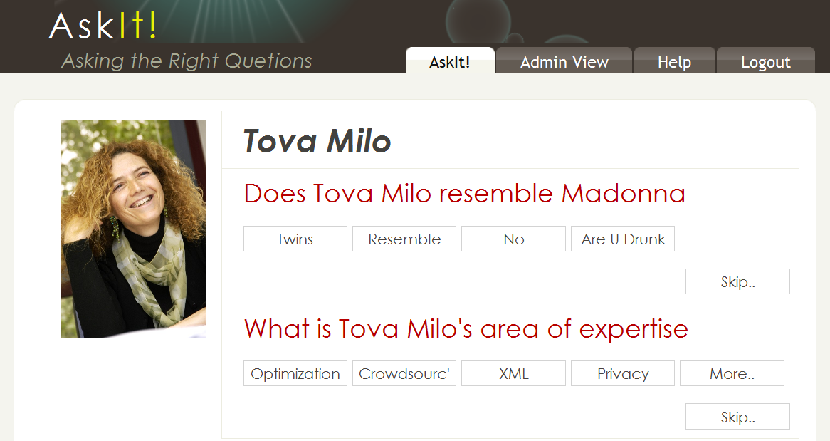
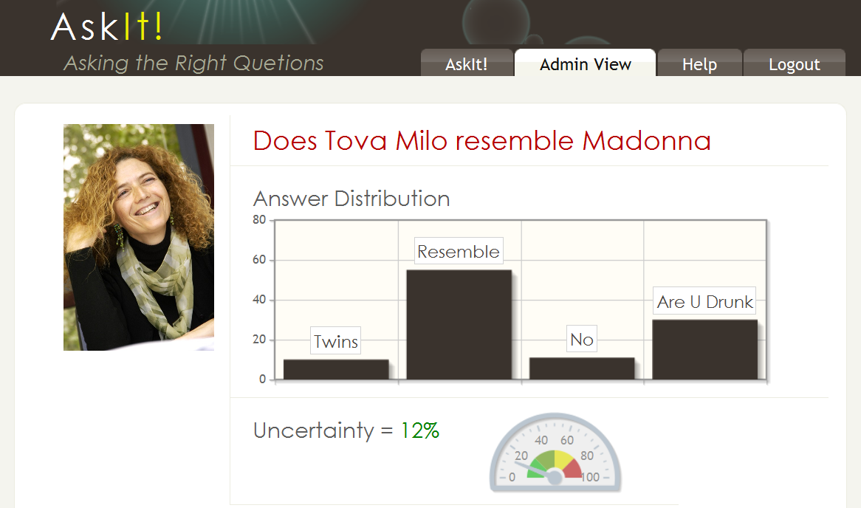
AskIt (ICDE’12 demo)
Gather information (scientific as well as fun) on ICDE’12 authors, participants, papers, presentations,…

Slide 57
Lots of Open Questions
Use prior knowledge about users/answers
Predict answers
Predict who can/will answer what
[Collaborative Filtering-style analysis is useful here]
Worse-case analysis vs. expected error
Incremental computation & optimization
…

Slide 58
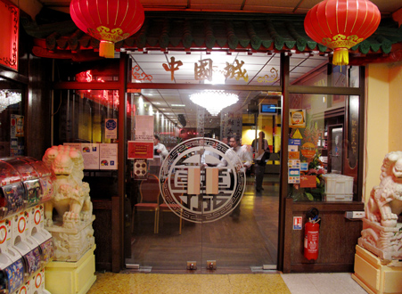
Resource usage optimization: Human-Assisted Graph Search
Given a DAG and some unknown target(s)
We can ask YES/NO questions
E.g., reachability
Asian
Is it Asian?
: YES
East Asian
Is it Thai?
: No
Japanese
Chinese
Thai
Sushi
Ramen
Is it Chinese?
: YES
Human-Assisted Graph Search: It’s Okay to Ask Questions, A. Parameswaran, A. D. Sarma, H. G. Molina, N. Polyzotis, j. Widom, VLDB ‘11

Slide 59
The Objective
Find an optimal set of questions in the search of the target node(s)
Optimize cost: Minimal # of questions
Optimize accuracy: Minimal # of possible targets
Challenges
Answer correlations (Falafel → Middle Eastern)
Location in the graph affects information gain (leaves are more likely to get a NO)
Asking several questions in parallel to reduce latency

Slide 60
Problem Dimensions
Single target/Multiple targets
Online/Offline
Online: one question at a time
Offline: pre-compute all questions
Hybrid approach
Graph structure

Slide 61
Outline
Crowdsourcing
Crowd data sourcing
Towards a principled solution
Conclusions and challenges

Slide 62
Conclusions
All the classical issues:
Data models, query languages, query processing, optimization, HCI
Database techniques are very useful
“Classical” as well as new
BUT
(Very) interactive computation
(Very) large scale data
(Very) little control on quality/reliability

Slide 63
Challenges
Open vs. closed world assumption
Asking the right questions
Estimating the quality of answers
Incremental processing of updates

Slide 64
More Challenges
Distributed management of huge data
Processing of textual answers
Semantics
More ideas?

Slide 65
“Computers are useless, they can only give you answers”
- Pablo Picasso

