Slide 1
DB Project
Database Systems
2011-2012 A

Slide 2
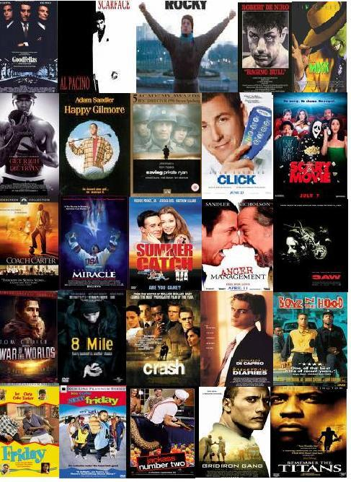

Database project – Movie DB

Slide 3
Database Project - Goals
Project goal: to tackle and resolve real-life DB related development issues
So what do we need to do:
  Design database
  Load data / Support updates
  Think of an application
  Build application
  Test

Slide 4
Database Project - Goals (II)
What to focus on:
  Database
  Data Populating / Updating
  Usability
  Ideas that will give you an edge over the competition

Slide 5
Database Project - Features
Think your self! Any idea is acceptable
Requirements:
  Search for specific entities (movies, player..)
  Add / Edit / Remove data manually (not just massive import)
  Support “IMDb” data:
  (a) Initial import
  (b) Updates
  (is there a difference?)
  Interesting application

Slide 6

IMDb Data
http://www.imdb.com/interfaces#plain
Lots of files, you don’t need to use them all..
(decide on your own)
“Updates” are simply “newer” files

Slide 7
Example
Online movie store?
(you don’t really need to stream the data..)
Celebrity facebook?
Please do something different…

Slide 8
Database project – Note on IMDb textfiles
It is not trivial to deal with large text files…
Understand first what each file represents
You don’t have to use all of them..
(do you even know what laserdisc is??)
You will need to generate IDs for everything!

Slide 9
Tips
First: - understand the format..
- understand what you want to do..
Database key should always be INTEGER… not a string…. (i.e. you would need to assign it..)
Don’t forget to support manual edit of ALL data (add/update/remove) – e.g. artists/categories/values…

Slide 10
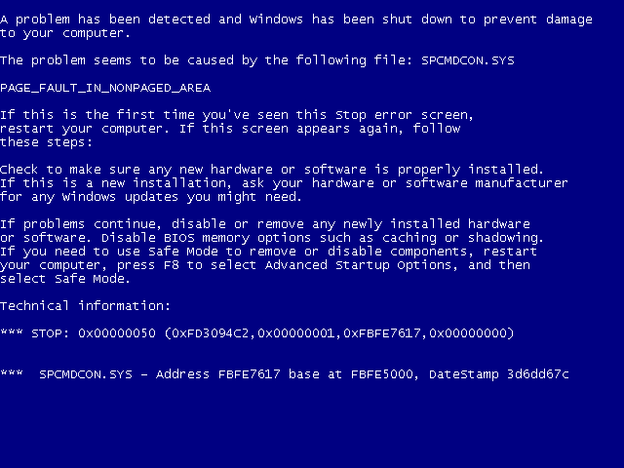
Tips (II)
What happens if you open a 100M file in notepad?
Use TextPad
http://www.textpad.com/

Slide 11
Tips (III) – Working from TAU
Quota issues..
local copy is available from unix by:
cd /users/courses/databases/datasets/imdb
Also available by the website
http://www.cs.tau.ac.il/courses/databases/datasets/imdb/

Slide 12
Tips (IV) – Updating Records
Assume you import from IMDb:
“Smith, Will (I)”
If you run the “import” algorithm again (e.g. connect to the IMDb site), you don’t want to add another copy of “Smith, Will (I)”.
The same applies for all entities (movies, cast..)

Slide 13
Tips (V) – Updating Records (2)
Continuing the example from before, the user (who use your app) update the name of “Smith, Will (I)” to “Smith, Will”
What happens if you run the import again?
……
Optional solution: save the “original IMDb name” and search for such scenarios..

Slide 14
Tips (VI) – Updating Records (3)
The user creates a new actor with the name “Smith, Will (I)”
What happens if you run the import again?
Entity matching is a HARD PROBLEM. You can’t solve anything in this project….

Slide 15
Important Tip
For the previous scenarios (and any other) you can decide on your own whatever action (if any) you take.
For instance, if you imported “Smith, Will (I)” once, you can decide not to update his details, but only check that you do not add him again.
However, as actors keep starring in new movies, it is “unreasonable” to dismiss it.

Slide 16
Important Tip (2)
Can you think of a scenario where you can dismiss it?
Assume you imported the movie “Bad Boys”, and the user changed its “running time” from 110 to 121 min.
Do you want to “overwrite” this update when you run the import algorithm again?

Slide 17
Database Project - Requirements
(at least) 1M records table
Originality
Add your OWN local data!!!!!!!!!
For example
  users and their purchase history in your online shop
  Playlists?
  Facebook messages
  ……….

Slide 18
Database Project - Bureaucracy
Hard work, but real.
Work in groups of 4
One stage
Submission database is MySQL in TAU
Java, SWT (or Swing/AWT)
Thinking out of the box will be rewarded

Slide 19
Past years projects

Slide 20
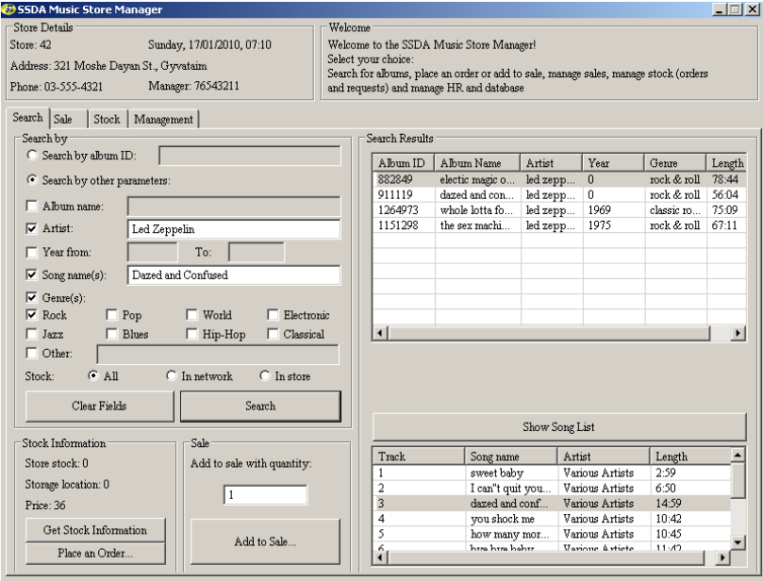
Past years projects

Slide 21
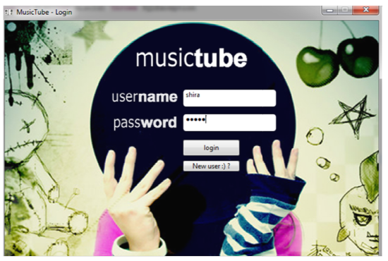
Past years projects

Slide 22
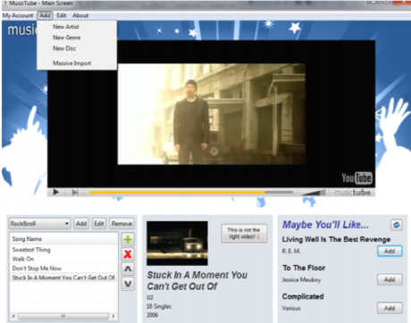
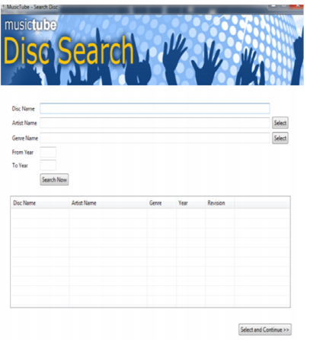
Past years projects

Slide 23
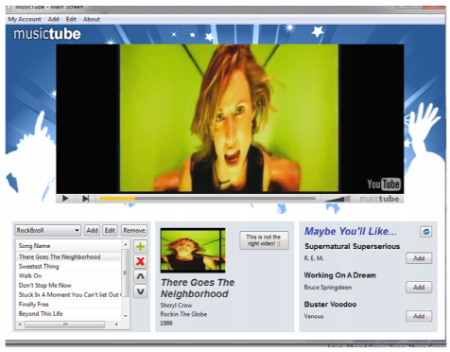
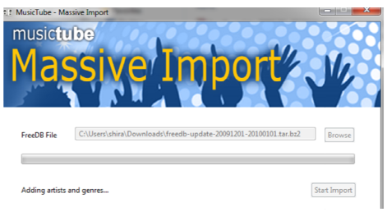
Past years projects

Slide 24
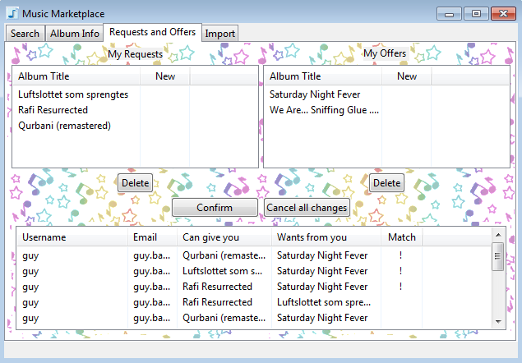
Past years projects

