Slide 1
DB Project
Database Systems
2011-2012 B

Slide 2
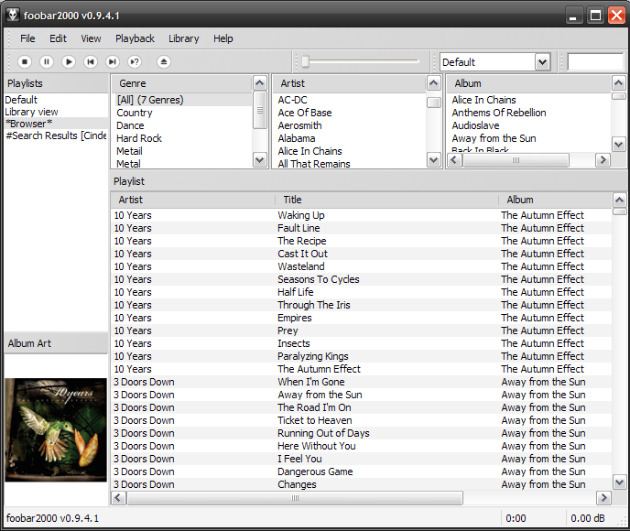
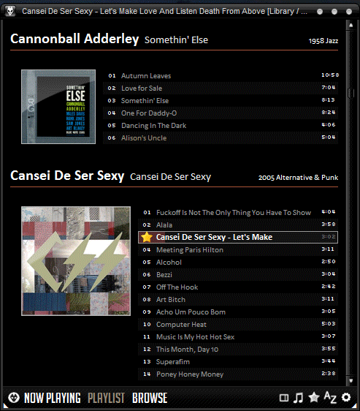
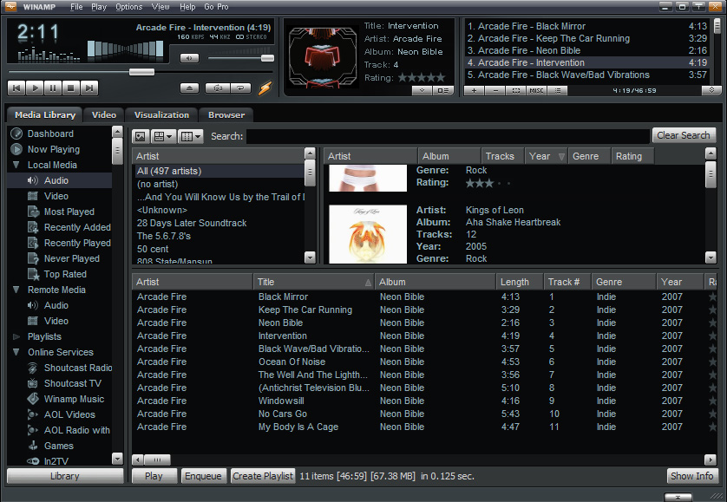
Database project – App Utilizing CDs Info

Slide 3
Database project II
Project goal: to tackle and resolve real-life DB related development issues
So what do we need to do:
  Design database
  Load data / Support updates
  Think of an application
  Build application
  Test

Slide 4
Database project III
What to focus on:
  Database
  Data Populating / Updating
  Usability
  Ideas that will give you an edge over the competition

Slide 5
Database project - Features
Think your self! Any idea is acceptable
Some (kinda mandatory) ideas:
  Search for cd title/ artist / track title.. (daaaaa..)
  Add / Edit / Remove data manually (not just massive import)
  Support “freeDB”
  Interesting application

Slide 6
Database project IV
Hard work, but real.
Work in groups of 4
One stage
Submission database is MySQL in TAU
Thinking out of the box will be rewarded

Slide 7

Database project - DATA????
freeDB
http://www.freedb.org/
http://www.freedb.org/en/download__database.10.html
Textfile to MySQL… Not trivial
You can find other sources (min 1M records)

Slide 8
Database project – Note on freeDB
It is not trivial to deal with large amount of files…
Understand data format
http://ftp.freedb.org/pub/freedb/misc/freedb_howto1.07.zip
http://ftp.freedb.org/pub/freedb/misc/freedb_database_format_specs.zip
You will need to generate IDs for everything!

Slide 9
Database project – freeDB tips
11 fixed categories?? Naïve..
Where are the track lengths?
http://en.wikipedia.org/wiki/Track_%28CD%29
Revisions
ASCII / UTF-8 / UTF-16
(you can neglect any non-english cds)

Slide 10
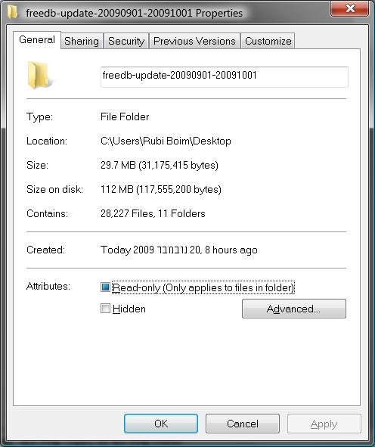

Database project – Data size
Start with “freeDB-update”,
→ supporting “freeDB-complete“?? (bonus..)

Slide 11
Database project – Working from TAU
Quota issues..
local copy is available from unix by:
cd /users/courses/databases/datasets/freedb
Also available by the website
http://www.cs.tau.ac.il/courses/databases/datasets/freedb/
“on-the-fly” extraction..
(that is, “unzip” from Java…)

Slide 12
Database Project - Requirements
(at least) 1M records table
EDIT (add/update/delete) everything manually!
(that is, a GUI screen for everything..)
Support “update” from the freedb site
Originality
Add your OWN local data!!!!!!!!!
For example
  users and their purchase history in your online shop
  Playlists?
  Facebook messages
  ………

Slide 13
Requirements (II) – Important!
Relatively to previous projects, freedb has “less data”
(“less width, not height”)
For example, IMDb had actors/genres/direcors/releases/plot and the list is long…
Thus, YOU HAVE TO ADD YOUR OWN TABLES AND DATA
→ the data does not need to be a part of the CD
→ for example, a store management system
Again, Originality!!!

Slide 14
Database Project - Bureaucracy
Hard work, but real.
Work in groups of 4
One stage
Submission database is MySQL in TAU
Java, SWT (or Swing/AWT)
Thinking out of the box will be rewarded

Slide 15
Past years projects

Slide 16
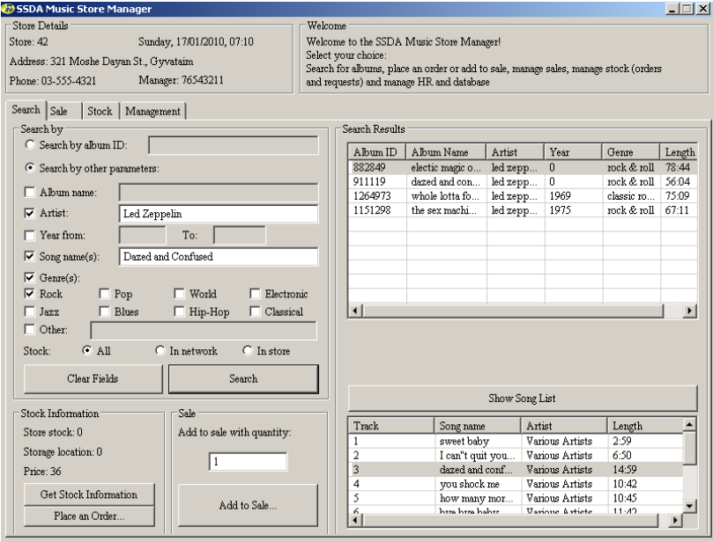
Past years projects

Slide 17
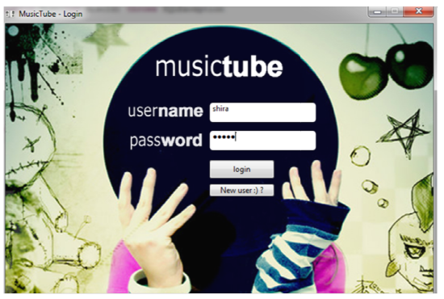
Past years projects

Slide 18
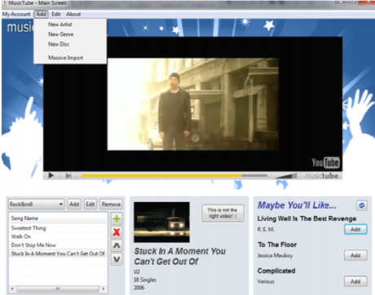
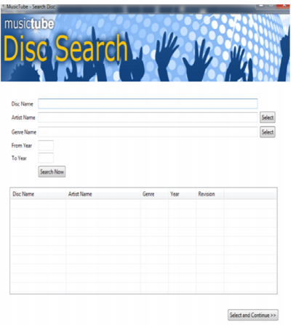
Past years projects

Slide 19
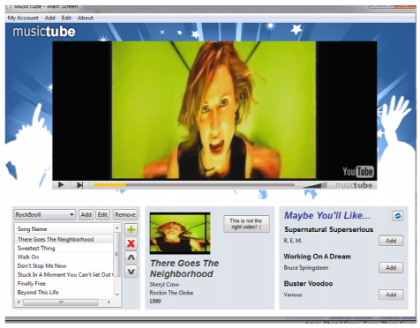
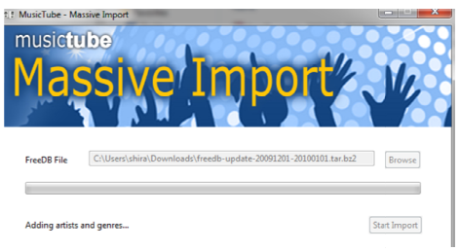
Past years projects

Slide 20
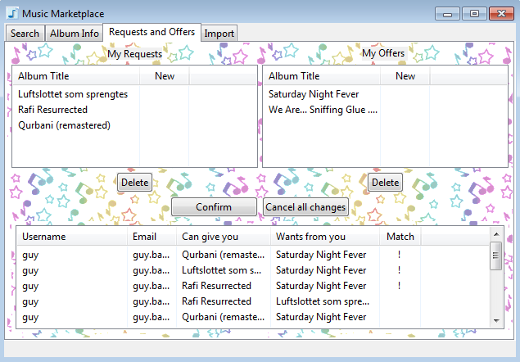
Past years projects

