Slide 1
Mob Data Sourcing
MoDaS
Mob Data Sourcing

Slide 2



Outline
Crowdsourcing
Crowd data-sourcing
Towards a principled solution
Conclusions and challenges
Warning: some (tasteful) nudity ☺

Slide 3
Outline
Crowdsourcing
Crowd data-sourcing
Towards a principled solution
Conclusions and challenges
Warning: some (tasteful) nudity ☺

Slide 4
CrowdSourcing
Main idea: Harness the crowd to a “task”
  Task: solve bugs
  Task: find an appropriate treatment to an illness
  Task: construct a database of facts
  …
Why now?
  Internet and smart phones …
  We are all connected, all of the time!!!

Slide 5
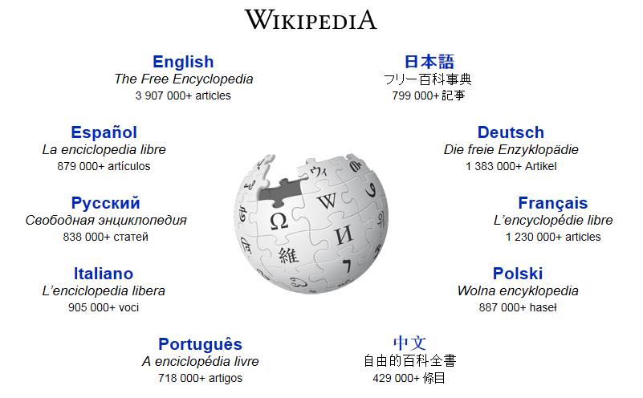
The classical example

Slide 6
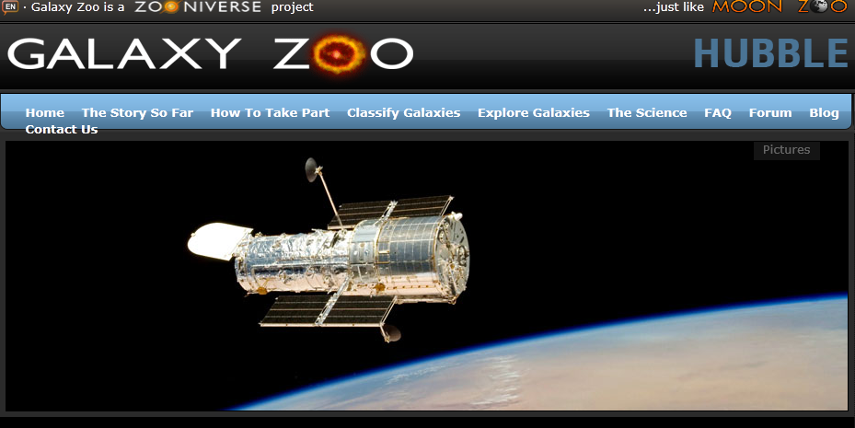
Galaxy Zoo

Slide 7
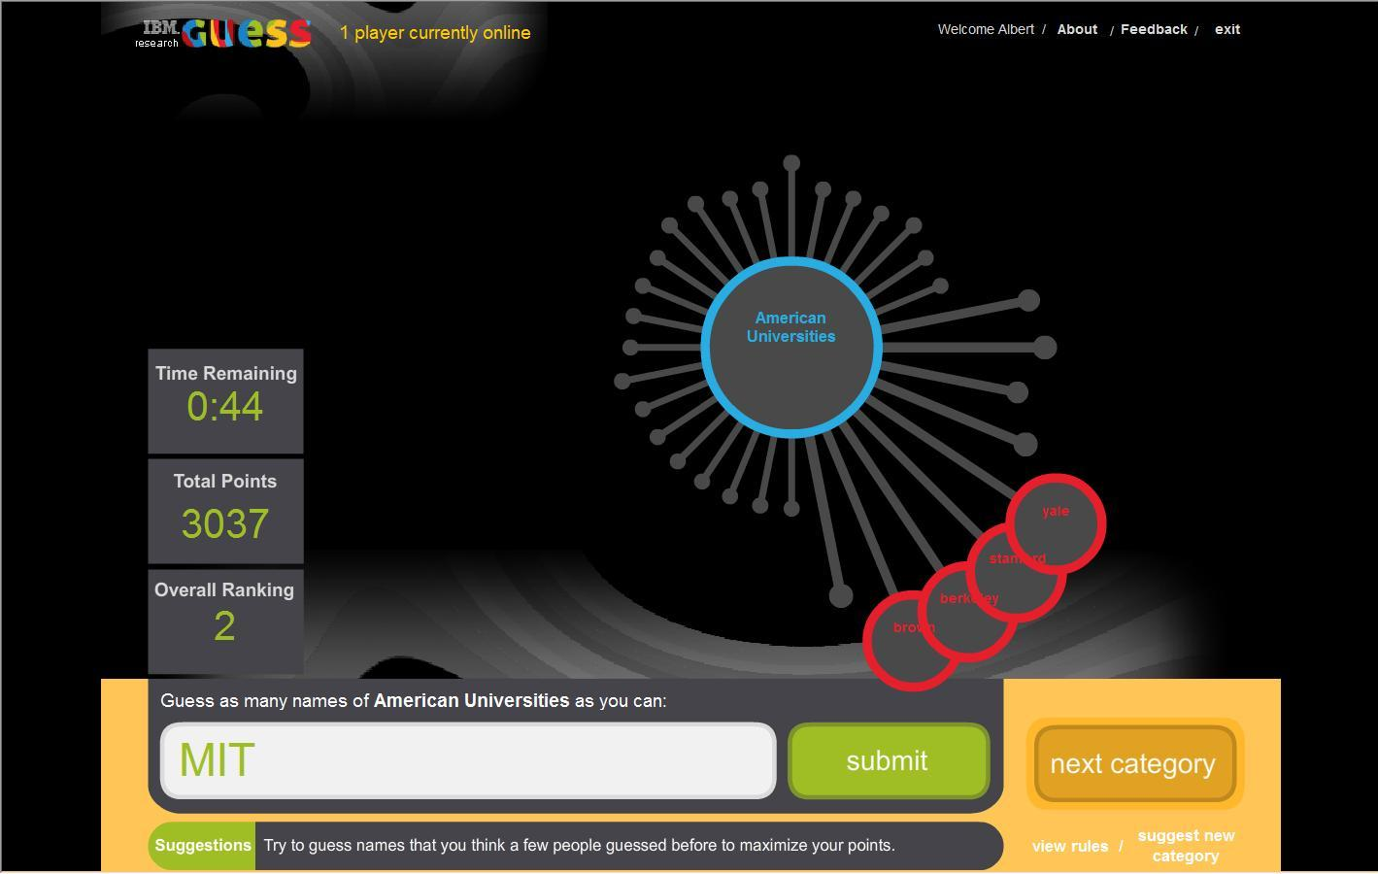
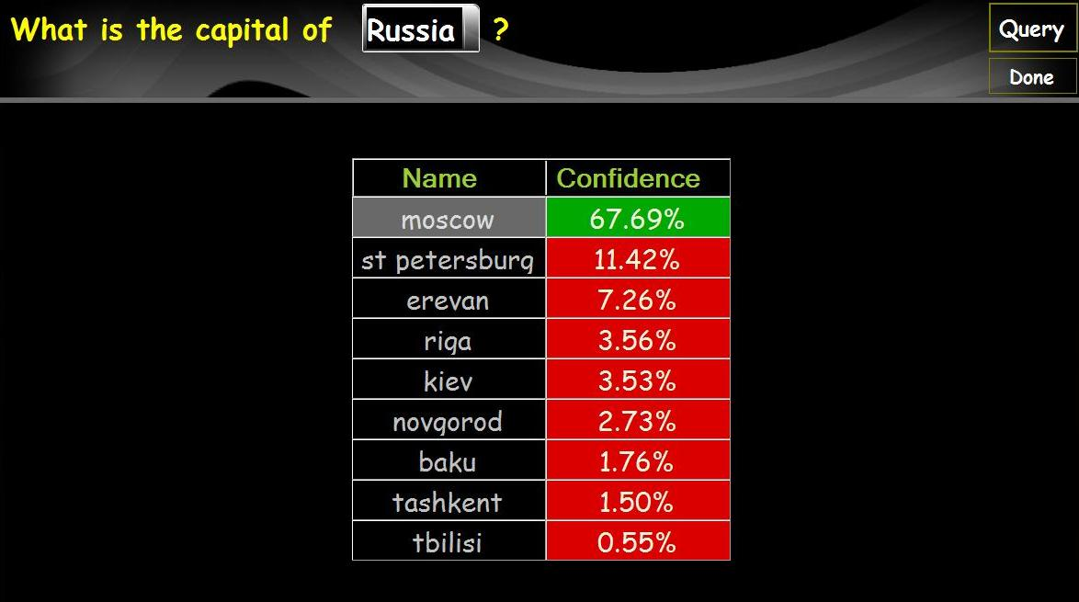
Playing Trivia

Slide 8
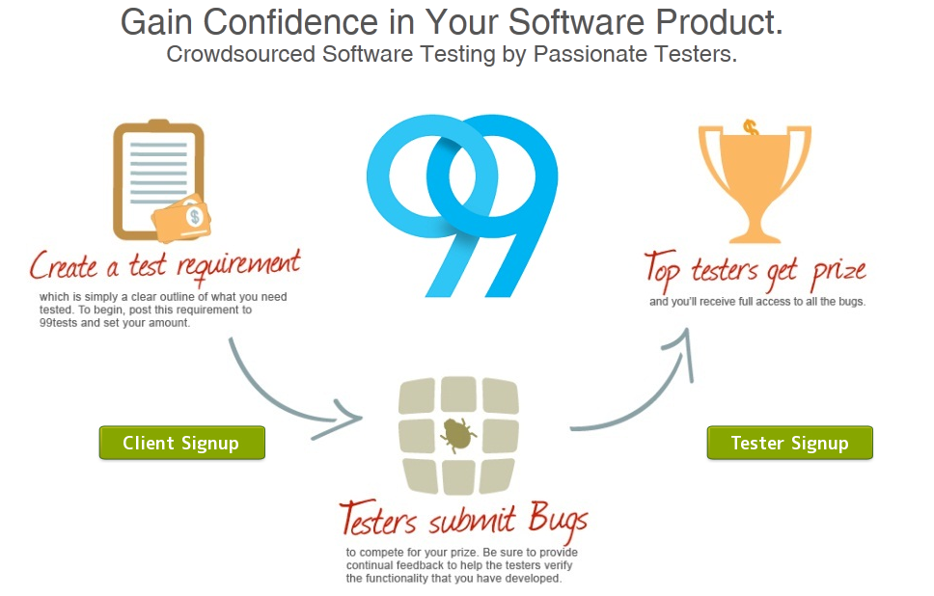
Collaborative Testing

Slide 9
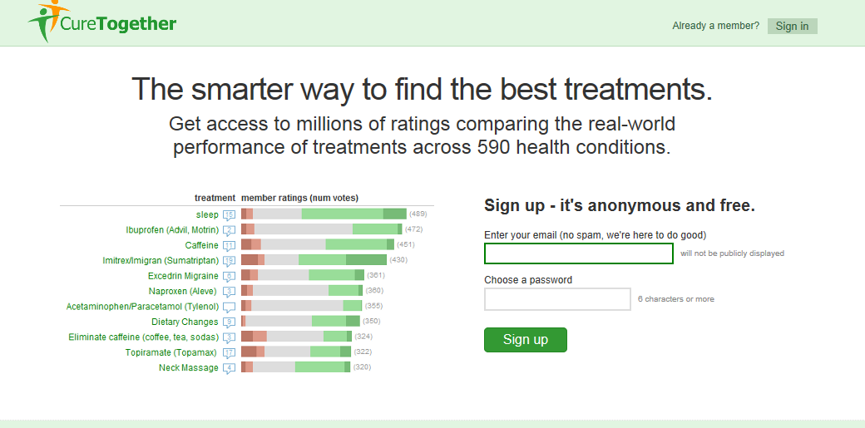
Curing Together
Notes:
And for more serious things…

Slide 10
CrowdSourcing:
Unifying Principles
Main goal
  “Outsourcing” a task to a crowd of users
Kinds of tasks
  Tasks that can be performed by a computer, but inefficiently
  Tasks that can’t be performed by a computer
Challenges
  How to motivate the crowd?
  Get data, minimize errors, estimate quality
  Direct users to contribute where is most needed \ they are experts
Next (very briefly)
Rest of this tutorial

Slide 11
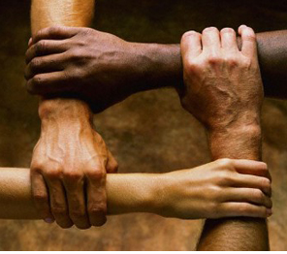

Motivating the Crowd
Altruism
Fun
Money

Slide 12
Outline
Crowdsourcing
Crowd data-sourcing
Towards a principled solution
Conclusions and challenges

Slide 13
Crowd Data Sourcing
The case where the task is collection of data
Two main aspects [DFKK’12]:
  Using the crowd to create better databases
  Using database technologies to create
  better crowd datasourcing applications
[DFKK’12]: Crowdsourcing Applications and Platforms: A Data Management Perspective, A.Doan, M. J. Franklin, D. Kossmann, T. Kraska, VLDB 2011
Our focus

Slide 14

Data-related Tasks
(that can be) Performed by Crowds
Data cleaning
  E.g. repairing key violations by settling contradictions
Data Integration
  E.g. identify mappings
Data Mining
  E.g. entity resolution
Information Extraction

Slide 15
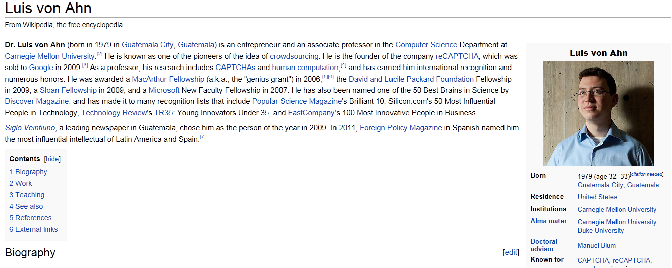
Information Extraction

Slide 16
Database Approach for Developing Crowd Data Sourcing Apps
Declarative framework
  To choose questions to be addressed to the crowd,
  To choose people to whom questions are addressed
  Can even use queries to generate UIs automatically!
  Allows for optimizations, easy deployment…
(Declarative) Data cleaning techniques
  To deal with crowd errors
Incremental maintenance techniques
  To handle the huge, ever changing, amount of data
Notes:
Will be the focus of the rest of this tutorial

Slide 17
Main Tasks in
Crowd Data Sourcing
What questions to ask?
How to define correctness of answers?
How to clean the data?
Who to ask? how many people?
How to best use resources?
Declarative Framework!
Probabilistic Data!
Data Cleaning!
Optimizations and Incremental Computation

Slide 18
Outline
Crowdsourcing
Crowd datasourcing
Towards a principled solution
Conclusions

Slide 19
Platforms for Crowdsourcing
Qurk (MIT)
CrowdDB (Berkeley and ETH Zurich)
CrowdForge (CMU)
Deco (Stanford and UCSC)
MoDaS (Tel Aviv University)
…

Slide 20
Qurk
Main observation: Tasks aided by Mturk can be expressed as workflows, with
  Queries on existing data
  “Black boxed” (User Defined Functions) that are tasks (HITs) to be performed by the turker
Crowdsourced Databases: Query Processing with People, A. Marcus, E. Wu, D. R. Karger, S. Madden, R. C. Miller, CIDR 2011

Slide 21
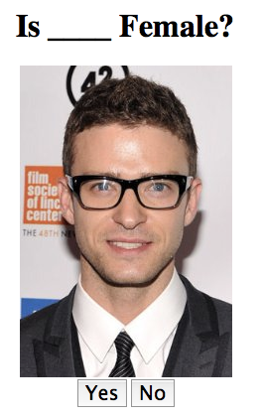
Qurk Example
Task: Find all women in a “people” database
Schema
  CREATE TABLE people(
  name varchar(256),
  photo blob);
Query
  SELECT name
  FROM people p
  WHERE isFemale(p);
  TASK isFemale(tuple) TYPE:Filter Question: “is %s Female”,
  Tuple[“photo”]
  YesText: “Yes”
  NoText: “No”

Slide 22
The magic is in the templates
Templates generate UIs for different kinds of crowd-sourcing tasks
  Filters: Yes/No questions
  Joins: comparisons between two tuples (equality)
  Order by: comparisons between two tuples (>=)
  Generative: crowdsource attribute value

Slide 23
Contradictions?
The same form is presented to multiple users
  Not everyone will have the answer to every question
But then contradictions may rise
  E.g. multiple CEOs to the same companies
  Can be identified as a key violation
In Qurk one can choose a combiner to aggregate the answers
  Out of a predefined set of options
  E.g. Majority Vote
We will get back to this point!

Slide 24
Optimization Issues
Cost of a HIT
  Optimized statically or at runtime
Given a limited number of HITs, choosing a subset
Batch Predicates
Asynchronous Implementation

Slide 25
CrowdDB
A different declarative framework for crowd data sourcing
Main difference: allows to crowd-source the generation of new tuples
CrowdDB: Answering Queries with Crowdsourcing,
M. J. Franklin, D. Kossmann ,T. Kraska, S. Ramesh, R. Xin
SIGMOD ‘11

Slide 26
CrowdForge
A declarative framework inspired by MapReduce
Provides a small set of task primitives (partition, map, and reduce) that can be combined and nested
  Allows to break MTurk tasks to small tasks and combine the answers
Sub-tasks are then issued to the crowd (turkers)
CrowdForge: Crowdsourcing Complex Work, A. Kittur, B. Smus S. Khamkar R. E. Kraut , UIST ‘11

Slide 27
How Well are We Doing?
√
What questions to ask?
How to define correctness of answers?
How to clean the data?
Who to ask? how many people?
How to best use resources?
Declarative Framework!
Probabilistic Data!
Data Cleaning!

Slide 28
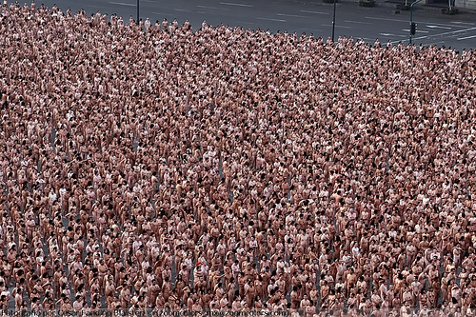
?The Naked Truth
Spencer Tunick

Slide 29
Errors, Contradictions and Motivation
The solutions described so far propose declarative infrastructures for collecting data from crowds
But how credible is the data?
  It is likely to contain errors
  As well as contradictions
We need ways to
  settle contradictions, and
  estimate trust in users
Also related to the incentives and budget
  Can we reward correct users?

Slide 30
Deco (sCOOP project)
A declarative platform based on 3 main concepts:
  1. Fetch: add tuples
  Fetch Rules (FR) procedures
  2. Resolve: resolve dependent attributes
  Resolution Rules (RR) procedures
  3. Join: Outerjoin of tables
Deco: Declarative Crowdsourcing, A. Parameswaran, H. Park, H.G. Molina, N. Polyzotis, J. Widom, Stanford Infolab Technical Report, 2011
[Deco slides based on slides presented in Crowd-Crowd 2011]

Slide 31
Fetch Rules
R (restaurant, address, [rating], [cuisine]), S (address, [city, zip])
LHS ⇨ RHS with procedure P
Given LHS value, procedure P can obtain RHS values
from external source(s)
restaurant,address ⇨ rating
restaurant ⇨ cuisine
address ⇨ city,zip

Slide 32
Resolution Rules
R (restaurant, address, [rating], [cuisine])
S (address, [city, zip])
A resolution rule per dependent attribute-group
restaurant,address ➔ rating (F=avg)
restaurant ➔ cuisine (F=dup-elim)
address ➔ city,zip (F=majority)

Slide 33
Designing Resolution Rules
Average value? Majority vote?
But some people know nothing about a given topic
So maybe a “biased vote”?
But how to bias?
A “chicken or the egg” problem:
To know what is true we need to know who to believe.
But to know this we need to know who is usually right
(and in particular, what is true..)

Slide 34
MoDaS
Observation: two key aspects in the design of crowdsourcing applications
  Uncertainty in data
  Recursion in policies
Approach: take declarative solutions further
  Use probabilistic DBs for modeling uncertainty in data
  Use datalog for modeling recursion

Slide 35
Example
Start with some probability reflecting the trust in users (turkers)
Gain confidence in facts based on the opinion of users that supported them
  Choose probabilistically “believed” facts
  Assign greater weight (in probability computation) to trusted users
Then update the trust level in users, based on how many of the facts which they submitted, we believe
Iterate until convergence
Trusted users give us confidence in facts,
and users that supported these facts gain our trust…

Slide 36
Declarative Approach
That was one possible policy
We want to have easy control on the employed policy
We want to be able to design such policies for conflict resolution
But also for
  rewarding turkers, choosing which question to ask…
  and for data cleaning, query selection, user game scores,…

Slide 37
Declarative Approach (cont.)
We don’t want to (re)write Java code (for each tiny change!)
We want (seamless) optimization, update propagation,…
Database approach:
Define a declarative language for specifying policies
Based on probabilistic databases and (recursive) datalog
[D., Greenshpan, Kostenko, M. ICDE’11 ,WWW’12]
[D., Koch, M. PODS’10]

Slide 38
Block-Independent Disjoint (BID) Tables
Prob. | Cuisine | Name
0.7 | French | Alouette
0.3 | American | Alouette
1 | Fast food | Mcdonald’s
Cuisine | Name
French | Alouette
Fast food | Mcdonald’s
Cuisine | Name
American | Alouette
Fast food | Mcdonald’s
0.7
0.3
Efficient Query Evaluation on Probabilistic Databases, N. Dalvi and D. Suciu, VLDB ‘04

Slide 39
Repair-Key
Prob. | Cuisine | Name
0.7 | French | Alouette
0.3 | American | Alouette
1 | Fast food | Mcdonald’s
Restaurants
REPAIR-KEY[Rest@ Support](Restaurants)
Cuisine | Rest
French | Alouette
Fast food | Mcdonald’s
Cuisine | Rest
American | Alouette
Fast food | Mcdonald’s
0.7
0.3
Approximating predicates and expressive queries on probabilistic databases, C. Koch, PODS ‘08

Slide 40

Proposed Language
Enrich SQL with the REPAIR-KEY construct
And a WHILE construct
Semantics: Markov chain of DB instances.
Return the Probability of a fact to hold in a give instance.
Allows to easily express nicely common policies for cleaning, selection of questions, scoring answers

Slide 41
Recursion on Prob. Data!
The “while” language consists of 3 parts:
  Update rules, to be evaluated repeatedly.
  Intuitively, rules to settle contradictions.
  A boolean condition, deciding when to sample.
    Intuitively, when the DB includes no contradiction.
  3. A query of interest, to be sampled.
  E.g. what kind of cuisine is Alouette?

Slide 42
Example
Confidence | User
6 | Alice
2 | Bob
2 | Carol
User | Cuisine | Rest
Alice | French | Alouette
Bob | French | Alouette
Carol | American | Alouette
Carol | French | McDonalds
Bob | Fast Food | McDonalds

Slide 43




Example (cont.)
$$\frac{8 ∗2}{10 ∗4 }$$
T | R
F | A
FF | M
C | U
7 | A
3 | B
3 | C
…
C | U
6 | A
2 | B
2 | C
…
…
$$\frac{8 ∗2}{10 ∗4 }$$
T | P
F | A
F | M
$$\frac{2 ∗2}{10 ∗4 }$$
T | P
A | A
F | M
…
T | P
A | A
FF | M
$$\frac{2 ∗2}{10 ∗4 }$$
…

Slide 44
Example: Update Rules
U1 U2
Drop BelievedRestaurants;
INSERT INTO BelievedRestaurants
REPAIR-KEY[Restaurant @ authority] ON
(SELECT name, cuisine, authority
FROM Restaurants AS R, Users AS U
WHERE R.user = U.user);
UPDATE Users
SET Authority =
(SELECT CorrectFacts
FROM Q1
WHERE Q1.user = Users.user)
Q1 = SELECT user, COUNT(DISTINCT name)
AS CorrectFacts FROM Q2
GROUP BY user;
Q2 = SELECT user, name, cuisine
FROM UserRest UR
WHERE EXISTS
(SELECT * FROM BelievedRestaurants BR
WHERE BR.name = UR.name AND
BR.cuisine = UR.cuisine);
Update user authorities according to number of believed facts
Compute a subset of believed facts based on user authorities
Boolean condition: Name is a key in BelievedRestaurants

Slide 45
TriviaMasster

Slide 46
Some Complexity Results
Formal problem: Given a Markov Chain of database instances and an SQL query on the database (“what is Alouette’s cuisine ?”), compute the probabilities of the different answers.
Theorem: Exact computation is #P-hard
Theorem: If Markov Chain is ergodic, computable in EXPTIME
    Compute the stochastic matrix of transitions
    Compute its fixpoint
    For ergodic Markov Chain corresponds to correct probabilities
    Sum up probabilities of states where the query event holds
Theorem: In general, 2-EXPTIME
    Apply the above to each connected component of the Markov Chain
    Factor by probability of being in each component

Slide 47
Some Complexity (cont.)
Approximations:
  Absolute approximation: approximates correct probability ±ε
  Relative approximation: approximates correct probability up to a factor in-between (1- ε), (1+ ε).
  [Relative is harder to achieve]
Absolute approx | Relative approx | Exact computation | Language
In PTIME | NP-hard | #P-hard In PSPACE | (Linear) datalog
In PTIME | NP-hard | #P-hard In PSPACE | Inflationary fixpoint
NP-hard; PTIME in input size and mixing time | NP-hard | #P-hard In (2)EXP-TIME | Non-inflationary fixpoint

Slide 48
Sampling
Algorithm induced by the (operational) semantics:
Perform a random walk on the Markov Chain of database states
Sample the query results on observed states
Upon convergence, report the fraction of states in which a tuple was observed in the query result, as an approximation of its probability
Convergence?
  Guaranteed to converge to absolute (±ε) approximation
  However the time until convergence depends on the MC structure
  Polynomial in the database size and MC mixing time

Slide 49
Still Lots of Open Questions
How (and when) can we evaluate things fast enough?
How to store the vast amount of data?
    Distributed Databases? Map-reduce?
The data keeps changing. How to handle updates?
…

Slide 50
How Well are We Doing?
√
What questions to ask?
How to define correctness of answers?
How to clean the data?
Who to ask? how many people?
How to best use resources?
Declarative Framework!
√
Probabilistic Data!
√
Data Cleaning!
Optimizations and Incremental Computation

Slide 51

Partial Knowledge
Goal: Compute an aggregate function f for each query, e.g.
  Some metric of the distribution (e.g. entropy)
  Most frequent answer
  Aggregated value (e.g. average)
 |  | … | q6 | q5 | q4 | q3 | q2 | q1
 |  |  |  |  | b |  | 5 | a | u1
 |  |  |  |  |  | 3 |  | a | u2
 |  |  |  |  | b | 3 | 5 |  | u3
 |  |  |  |  |  | 3 | 2 | b | u4
 |  |  |  |  | a | 3 |  | c | u5
 |  |  |  |  |  |  |  |  | …

Slide 52
Increasing Knowledge
Limited overall resources
Limited user availability
Bounded resources per question
Which cells to resolve?
[Boim, Greenshpan, M., Novgorodov, Polyzotis, Tan. ICDE’12,…]

Slide 53
Quantifying Uncertainty
Assume t answers suffice for computing f for q
Comp(q): all possible completions of q’s column
Dist(r – r’): distance between two results of f
Uncertainty(q): max{ Dist(f(X) - f(Y )) | X,Y in Comp(q) }
  i.e. the largest distance between possibly completions

Slide 54
Quantifying Uncertainty (cont.)
Uncertainty measures for a Users-Answer matrix M
  Max-uncertainty(M)
  Sum-uncertainty(M)
Problem statement (X-uncertainty Reduction)
Given a matrix M, a choice x ϵ {max,sum}, and a set of constraints,
identify a set C of empty cells that satisfy the constraints and where
Max _{M’ ϵ MC} X-uncertainty(M’) is minimized.
Where M_{C} contains all possible matrices that we can derive from M by resolving solely the cells in C.

Slide 55
Examples
Target function f
  Entropy, majority-vote, average,…
Constraints
  A: bound k on the over number of cells
  B: also a bound k’ on questions per users
  C: here k’ is a bound on users per question

Slide 56
Some Complexity Results
max-Uncertainty Reduction
in PTIME for all constraints classes
  Greedy algo for constraints class A (and C)
  Using Max-flow for constraints class B
sum-Uncertainty Reduction
in PTIME for constraint classes A and C
  Dynamic programming
NP-COMPLETE for constraints class B
  Reduction for perfect 3 set cover

Slide 57
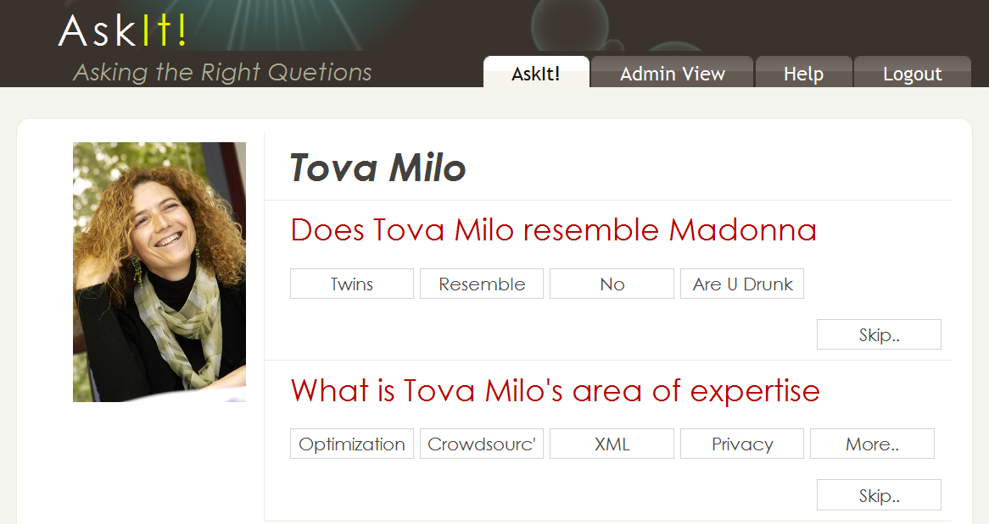
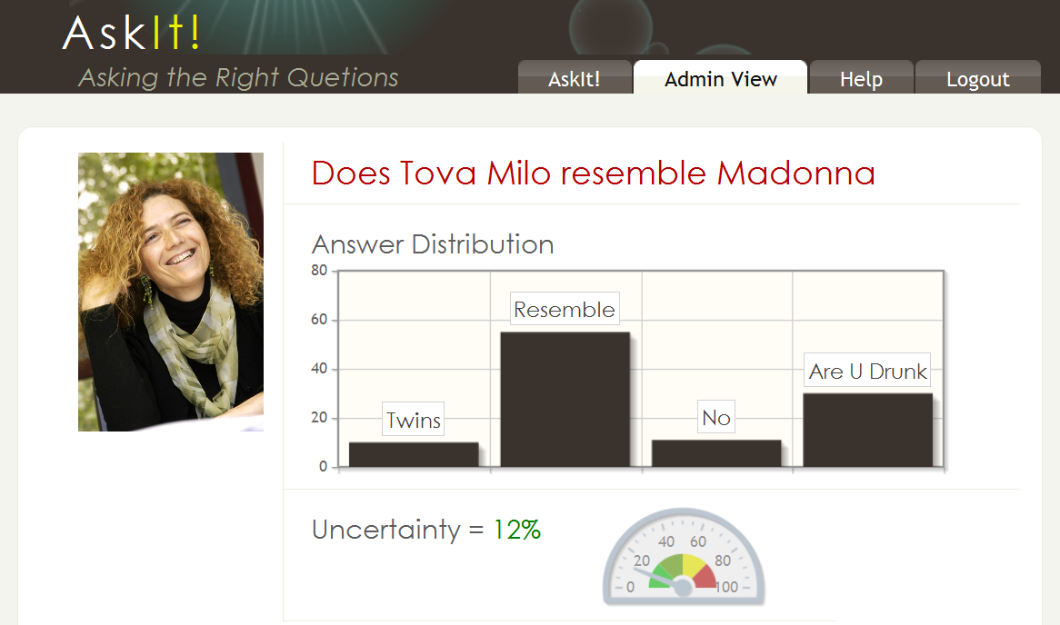
AskIt (ICDE’12 demo)
Gather information (scientific as well as fun) on ICDE’12 authors, participants, papers, presentations,…

Slide 58
Lots of Open Questions
Use prior knowledge about users/answers
    Predict answers
    Predict who can/will answer what
  [Collaborative Filtering-style analysis is useful here]
Worse-case analysis vs. expected error
Incremental computation & optimization
…

Slide 59
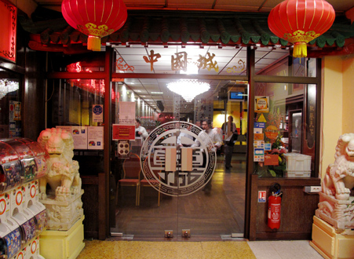

Best use of resources:
Human Assisted Graph Search
Given a DAG and some unknown target(s)
We can ask YES/NO questions
  E.g. reachability
Asian
Is it Asian?
: YES
East Asian
Is it Thai?
: No
Japanese
Chinese
Thai
Sushi
Ramen
Is it Chinese?
: YES
HumanAssisted Graph Search:
It’s Okay to Ask Questions, A. Parameswaran, A. D. Sarma, H. G. Molina, N. Polyzotis, j. Widom, VLDB ‘11

Slide 60
The Objective
Find an optimal set of questions to find the target nodes
  Optimize cost: Minimal # of questions
  Optimize accuracy: Minimal # of possible targets
Challenges
  Answer correlations (Falafel → Middle Eastern)
  Location in the graph affects information gain
  (leaves are likely to get a NO)
  Asking several questions in parallel to reduce latency

Slide 61
Problem Dimensions
Single target/Multiple targets
Online/Offline
  Online: one question at a time
  Offline: pre-compute all questions
  Hybrid approach
Graph structure

Slide 62
Outline
Crowdsourcing
Crowd datasourcing
Towards a principled solution
Conclusions and challenges

Slide 63
Conclusions
All classical issues:
  Data models, query languages, query processing, optimization, HCI
Database techniques are very useful
  “Classical” as well as new
BUT
  (Very) interactive computation
  (Very) large scale data
  (Very) little control on quality/reliability

Slide 64
Challenges
Open vs. closed world assumption
Asking the right questions
Estimating the quality of answers
Incremental processing of updates

Slide 65
More Challenges
Distributed management of huge data
Processing of textual answers
Semantics
More ideas?

Slide 66

Thank You!
תודה!

