Slide 1
Lecture 6: SQL Constraints and Programming

Slide 2
Agenda
Constraints in SQL
Systems aspects of SQL.

Slide 3
Constraints in SQL
A constraint = a property that we’d like our database to hold
The system will enforce the constraint by taking some actions:
forbid an update
or perform compensating updates

Slide 4
Constraints in SQL
Constraints in SQL:
Keys, foreign keys
Attribute-level constraints
Tuple-level constraints
Global constraints: assertions
The more complex the constraint, the harder it is to check and to enforce
simplest
Most complex

Slide 5
Keys
CREATE TABLE Product (
name CHAR(30) PRIMARY KEY,
category VARCHAR(20))
OR:
CREATE TABLE Product (
name CHAR(30),
category VARCHAR(20)
PRIMARY KEY (name))

Slide 6
Keys with Multiple Attributes
CREATE TABLE Product (
name CHAR(30),
category VARCHAR(20),
price INT,
PRIMARY KEY (name, category))

Slide 7
Other Keys
CREATE TABLE Product (
productID CHAR(10),
name CHAR(30),
category VARCHAR(20),
price INT, PRIMARY KEY (productID),
UNIQUE (name, category))
There is at most one PRIMARY KEY; there can be many UNIQUE

Slide 8
Foreign Key Constraints
Referential integrity constraints
CREATE TABLE Purchase (
prodName CHAR(30)
REFERENCES Product(name),
date DATETIME)
prodName is a foreign key to Product(name) name must be a primary key in Product

Slide 9
Product
Purchase
Name | Category
Gizmo | gadget
Camera | Photo
OneClick | Photo
ProdName | Store
Gizmo | Wiz
Camera | Ritz
Camera | Wiz

Slide 10
Foreign Key Constraints
OR
(name, category) must be a PRIMARY KEY
CREATE TABLE Purchase (
prodName CHAR(30),
category VARCHAR(20),
date DATETIME,
FOREIGN KEY (prodName, category)
REFERENCES Product(name, category)

Slide 11
What happens during updates ?
Types of updates:
In Purchase: insert/update
In Product: delete/update
Product
Purchase
Name | Category
Gizmo | gadget
Camera | Photo
OneClick | Photo
ProdName | Store
Gizmo | Wiz
Camera | Ritz
Camera | Wiz

Slide 12
What happens during updates ?
SQL has three policies for maintaining referential integrity:
Restrict: violating modifications (default)
Cascade: after a delete/update do a delete/update
Set NULL: set foreign-key field to NULL
READING ASSIGNEMNT: 7.1.5, 7.1.6

Slide 13
Constraints on Attributes and Tuples
Constraints on attributes: NOT NULL -- obvious meaning... CHECK condition -- any condition !
Constraints on tuples CHECK condition

Slide 14
What is the difference from Foreign-Key ?
CREATE TABLE Purchase (
prodName CHAR(30)
CHECK (prodName IN SELECT Product.name FROM Product),
date DATETIME NOT NULL)

Slide 15
General Assertions
CREATE ASSERTION myAssert CHECK NOT EXISTS(
SELECT Product.name FROM Product, Purchase WHERE Product.name = Purchase.prodName GROUP BY Product.name HAVING count(*) > 200)

Slide 16
Final Comments on Constraints
Can give them names, and alter later
Read in the book !!!
We need to understand exactly when they are checked
We need to understand exactly what actions are taken if they fail

Slide 17
Triggers in SQL
A trigger contains an event, a condition, an action.
Event = INSERT, DELETE, UPDATE
Condition = any WHERE condition (may refer to the old and the new values)
Action = more inserts, deletes, updates
Many, many more bells and whistles...
Read in the book (it only scratches the surface...)

Slide 18
Programming SQL
Embedded SQL
direct SQL (= ad-hoc SQL)
* Stored Procedures

Slide 19
Programs with Embedded SQL
Host language + Embedded SQL
Preprocessor
Preprocessor
Call-level interface (CLI): ODBC,JDBC, ADO
Host Language + function calls
Host language compiler
Host language compiler
Host language program

Slide 20
Embedded SQL
SQL code within C (more languages are supported, but not all)
Impedance mismatch = incompatible types (types variables)
Not so popular / recommended..

Slide 21
Direct SQL
Use specific interfaces (ODBC..) to call the DB
Execute “Strings” or use “smarter” drivers
We use it... More details on the following programming lectures

Slide 22
Stored Procedures
Different for each DBMS
“Enhanced” programming language (variables, loops..)
better Security / better Abstraction
(too bad this is just a basic course...)
Many tutorials online, e.g.: http://net.tutsplus.com/tutorials/an-introduction-to-stored-procedures/

Slide 23
Transactions
Address two issues:
Access by multiple users
Remember the “client-server” architecture: one server with many clients
Protection against crashes

Slide 24
Multiple users: single statements
Client 1:
UPDATE Product SET Price = Price – 1.99 WHERE pname = ‘Gizmo’ Client 2: UPDATE Product SET Price = Price*0.5 WHERE pname=‘Gizmo’
Two managers attempt to do a discount. Will it work ?

Slide 25
Multiple users: multiple statements
Client 1: INSERT INTO SmallProduct(name, price) SELECT pname, price FROM Product
WHERE price <= 0.99
DELETE Product WHERE price <=0.99 Client 2: SELECT count(*) FROM Product SELECT count(*) FROM SmallProduct
What’s wrong ?

Slide 26
Protection against crashes
Client 1:
INSERT INTO SmallProduct(name, price) SELECT pname, price FROM Product
WHERE price <= 0.99
DELETE Product WHERE price <=0.99
Crash !
What’s wrong ?

Slide 27
Transactions
Transaction = group of statements that must be executed atomically
Transaction properties: ACID
ATOMICITY = all or nothing
CONSISTENCY = leave database in consistent state
ISOLATION = as if it were the only transaction in the system
DURABILITY = store on disk !

Slide 28
Transactions: Serializability
Serializability = the technical term for isolation
An execution is serial if it is completely before or completely after any other function’s execution
An execution is serializable if it is equivalent to one that is serial
DBMS can offer serializability guarantees

Slide 29
Example
T1: R(x) R(y) W(x) W(y)
T2: R(x) R(z) R(y) W(x) W(y)
R(x) R(y) W(x) R(x) R(z) W(y) R(y) W(x) W(y)
R(x) R(y) W(x) R(x) R(z) R(y) W(y) W(x) W(y)
R(x) R(z) R(y) R(x) R(y) W(x) W(y) W(x) W(y)

Slide 30
Serializability
Enforced with locks, like in Operating Systems !
But this is not enough:
User 1
LOCK A
[write A=1]
UNLOCK A
. . . . . . . . . . . .
LOCK B
[write B=2]
UNLOCK B
User 2
LOCK A
[write A=3]
UNLOCK A
LOCK B
[write B=4]
UNLOCK B
time
What is wrong ?
Notes:
The final values are A=3, B=2. If the two transactions were executed serially, then we would have either A=1,B=2, or A=3,B=4. This is not a serializable execution

Slide 31
Serializability
Solution: two-phase locking
Lock everything at the beginning
Unlock everything at the end
Read locks: many simultaneous read locks allowed
Write locks (update/delete): only one write lock allowed
Insert locks: one per table

Slide 32
Isolation Levels in SQL
“Dirty reads”
SET TRANSACTION ISOLATION LEVEL READ UNCOMMITTED
“Committed reads”
SET TRANSACTION ISOLATION LEVEL READ COMMITTED
“Repeatable reads”
SET TRANSACTION ISOLATION LEVEL REPEATABLE READ
Serializable transactions (default):
SET TRANSACTION ISOLATION LEVEL SERIALIZABLE
Recommended Reading: chapter 6.6

Slide 33
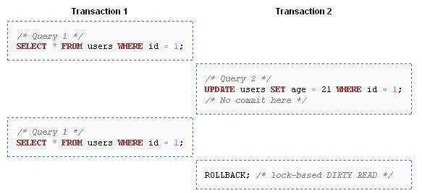
“Dirty”

Slide 34
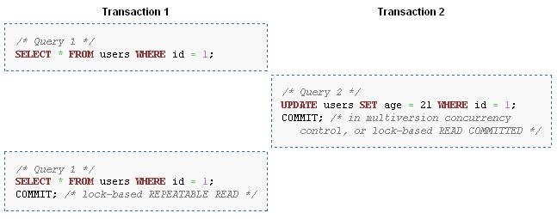
“Committed” VS “Repeatable”

Slide 35
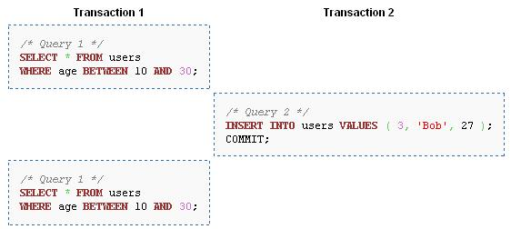
“Repeatable” VS “Serializable”

