Slide 1
Database Programming (cont.)

Slide 2
The Need for DB Programming
Using serialization, we can read and write objects to disk (for python, see pickle module)
When do we still need a DBMS?
The data is too large to fit in memory
The data represents a complex relation
The data is updated frequently, possibly by multiple users simultaneously

Slide 3
Reminder - SQL statements
Query:
Update

Slide 4
Reminder - SQL statements(2)
Delete:
Insert:

Slide 5
Reminder - SQL statements(3)
Many others:
Table creation/deletion
Adding/removing columns
Creating indices
…
Most of the statements used by MySQL are according to SQL standard:
Examples/tutorial: https://www.w3schools.com/sql/
But some are MySQL specific:
Full documentation: https://dev.mysql.com/doc/refman/8.0/en/sql-statements.html
Lots of information/examples online!

Slide 6
MySQL Connectors
Drivers which are used for communicating with MySQL
python
Connector/Python
MySQL
java
Connector/J
Connector/C++
C++

Slide 7
MySQL Connectors(2)
Enables executing statement from another language/environment
Implementing an API which is used for DBMS interaction
Many programming languages have dedicated connectors

Slide 8
DB Programming Guidelines
Optimize the DB to reduce storage space and disk I/O
For example, use numeric Ids – they are more compact, and have a predictable length
Primary keys are duplicated in secondary indices, and take up storage space
Retrieve only needed data (e.g. avoid select *)
The retrieved data might be very large - use the appropriate method to retrieve items from the result set as you loop through them:
fetchone() retrieves a single item
fetchall() retrieves all the items
fetchmany() general-purpose method: used for iterating through the returned items, until there are no more results to process.

Slide 9
DB Programming Guidelines(2)
Handle bad input data
Value check:
Not Null values
Unique values
Out-of-range values
Check the validity of data retrieved from other services
Deliberate bad data – SQL injection
Try to spot the difference:
c.execute("""SELECT spam, eggs, sausage FROM breakfast WHERE price < %s""", (max_price,)) SAFE
c.execute("""SELECT spam, eggs, sausage FROM breakfast WHERE price < %s""" % (max_price,)) NOT SAFE

Slide 10
DB Programming Guidelines(3)
Python's triple-quoting is useful for writing SQL statements in python:
Using MySQL best practices can help the application scale without major changes
See last recitation
All applications which handles RDBMS share core principles. Learn by example!

Slide 11
MySQL Connector/Python
Enables Python programs to access MySQL databases
Developed by Oracle (replaces other unofficial libraries)
Written in pure Python, and doesn’t have any dependencies
Implements the Python Database API
Includes conversions between MySQL data types and Python data types
Connects the DBMS using tcp/ip sockets

Slide 12
Working with Connector/Python
Installation: using PIP (PIP Installs Packages). Run the following command:
pip install mysql-connector-python
Connection example

Slide 13
Connecting to TAU MySQL Server
Inside TAU’s VPN, the connector will work as expected.
But what if you’re working from home?
The connection will fail, because it not configured for SSH communication
What should we do?
First run Cisco SSL VPN client
Now, we need to configure an SSH tunnel
The python code would refer to a local address, which will be mapped to the real server address
Using Putty, we can create an SSH tunnel which will take care of the encrypted channel

Slide 14
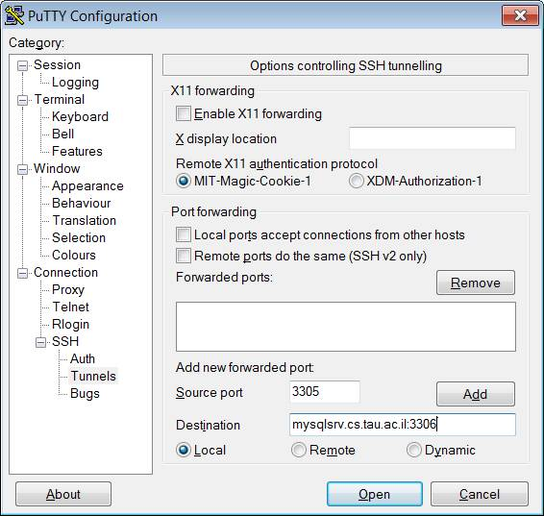
Connecting to TAU MySQL Server(2)
Optional: save for later use!

Slide 15
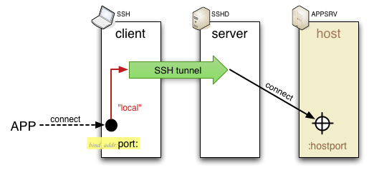
Connecting to TAU MySQL Server(3)
We created a local port forwarding:
Now, we use the local address we defined:
In the example, 127.0.0.1 in port 3305:

Slide 16
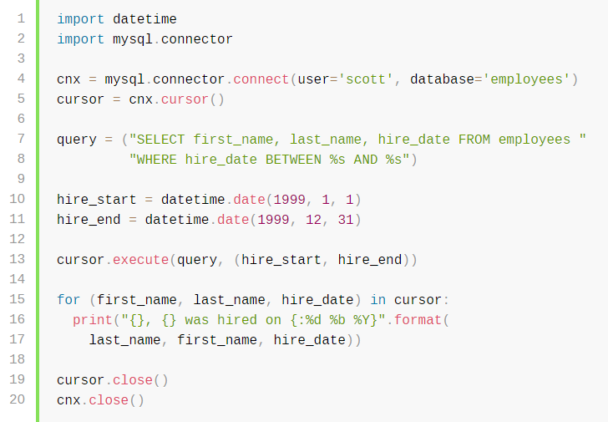
Query Example
Iterating instead of explicitly
calling a fetch function

Slide 17
Insert Example
Connector/Python does not autocommit by default!
What if I changed my mind?

Slide 18
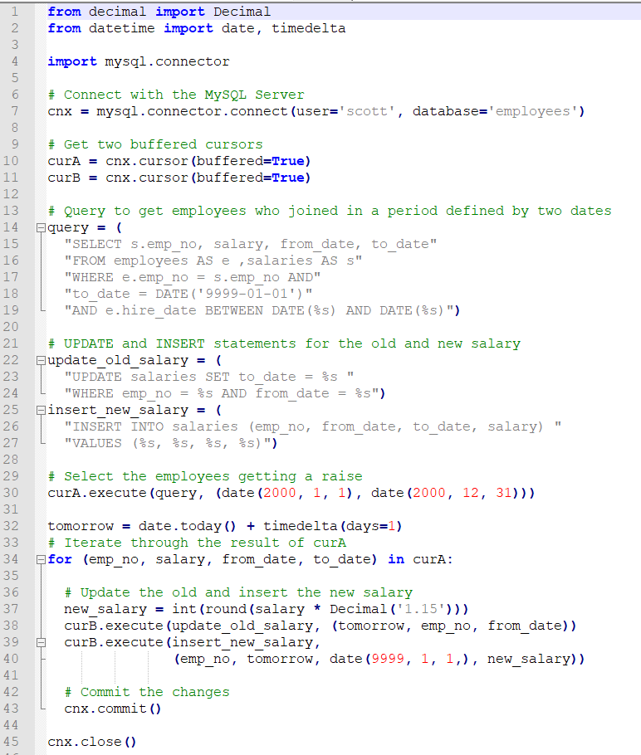
Example:

Slide 19
Useful links
Official documentation: https://dev.mysql.com/doc/connector-python/en/
How to connect to TAU DB servers: http://courses.cs.tau.ac.il/databases/databases201920/slides/moreinfo/connection-guide.htm

