Slide 1
Database Programming

Slide 2
Know Your Data
When developing an application, it is important to know what kind of data the application will handle
Having a well design data model can help programming and maintaining the application
Knowing your data will help designing a schema which is optimal for your needs

Slide 3
DB Design - Keys
Primary keys:
Have special indexes for fast lookups
In case there is no natural primary key, you can create a separate column with auto-increment value
Foreign keys:
Help maintaining data integrity

Slide 4
DB Design - Indexes
Indexes can reduce the search cost
Each index requires an additional structure
Updating an indexed column has an additional cost
Index structures in MySQL:
B-trees
R-trees
Hash tables
Inverted lists
…

Slide 5
DB Design – Indexes(2)
Indexes can be single or multi-column
To save up space, you can create an index which only uses the first N character of a string column
Examples:
CREATE INDEX last ON Students (LastName)
CREATE INDEX full_name ON Students (FirstName, LastName)
CREATE INDEX part_of_name ON Students (LastName(5));

Slide 6
Example: B-tree
A self-balancing search tree
The structure is kept sorted at all times
Fast lookup for exact matches
Fast range queries
Minimizes the number of disk accesses

Slide 7
Example: Inverted List
Used in full-text queries
For each word, stores the list of documents which contains the word
Additional data could be stored, such as position in document
Full-text searching is performed using MATCH() ... AGAINST syntax

Slide 8
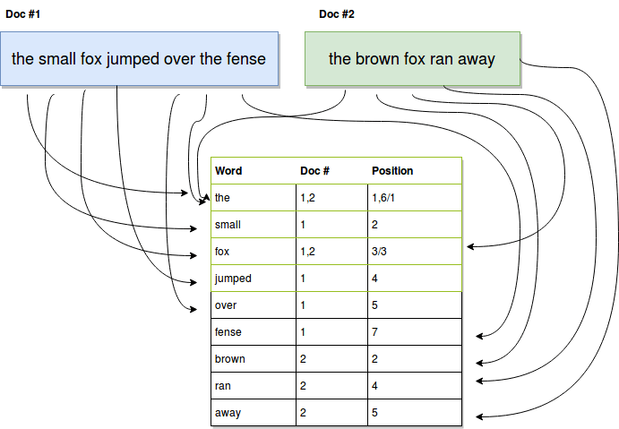
Example: Inverted List(2)

Slide 9
DB Design – Storage Engines
MySQL components that handle the SQL operations for different table types
InnoDB: default and most general-purpose storage engine.
MyISAM: optimized for heavy read operations, and fast insert operations. Does not support transactions.
Memory: stores all data in RAM for fast access
… Many other engines which could be loaded to the server by demand

Slide 10
DB Design – Data Types
Choose the data type according to the range of values your application will use
Choosing the right type will reduce disk space and can enhance performance
Specifically define not null columns
Enable better use of indices
Eliminates the need for special handling null values

Slide 11
DB Design – Value Constraint
Additional constraints:
UNIQUE: ensures that each row for a column must have a unique value
CHECK: ensures that the value in a column meets a specific condition
DEFAULT: Specifies a default value for a column

Slide 12
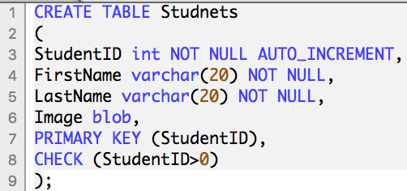
Example: Table Creation

Slide 13
DB Design – Normalization
A technique for organizing the DB:
Each table is responsible for holding data in a single domain
Getting rid of dependencies
Example:
Film(Id, Name, StudioName) is not normalized (there is a dependency between film and studio)
To normalize we use an additional table: Film(Id, Name, StudioId) and Studio(ID, Name)
Notes:
Pros – removed dependency, easier to change studio name
Cons – increased studioname queries cost

Slide 14
User Interaction
In most applications, the user has no direct access to the DB
Each operation is done on the server, which in turn performs the appropriate DB operation
This indirect access might still be used to perform harmful operations on the DB

Slide 15
User Generated Data
Do not rely on the users to provide an appropriate data!
The data might not fit the domain
The data could be harmful
xkcd

Slide 16
SQL Injection
“SELECT * FROM User WHERE UserID = “ + userId
Assume userId is supplied by the user
How could this query compromise the privacy of the users?
What damage could the user cause to the users table?
Solution: use a library with parameterized query support
The library will take care of escaping, type converting etc.
Might improve the query performance, by using the DB cache
Notes:
Compromise: userID := “4 or 1=1”
Damage: userID := “4; DROP TABLE User”

Slide 17
Prepared Statements
A reference to a pre-interpreted query on the database, ready to accept parameters
Advantages:
Protection against SQL injection attacks. The parameter values can contain unescaped SQL quote and delimiter characters.
Less overhead for parsing the statement each time it is executed

