Slide 1
Final Project

Slide 2
Project Goals
Build your own web application
Design a database and optimize it for several queries of your choice
Use a public API to retrieve data from the Web

Slide 3
Complex Queries
You are required to use at least 7 complex queries (including one full-text query)
The queries you choose should:
Serve the purpose of the application
Be efficient (don’t overcomplicate a simple query)
Use the indices you defined
Note: your application will probably use other simpler queries as well

Slide 4
Project Steps
Decide on the target audience for your application
Find an API which suits your need
Decide on the functionality your application should provide
Bonus points will be given for originality!
Design the database
Write a python script to populate your database using the API
Compose the queries
Optimize the DB to support the queries
Build a user interface
Test on university servers
Write the documentation
Submit!

Slide 5
Submission
A single .zip file via Moodle, as specified in the project document
Deployment (on university servers):
Backend (Python): delta-tomcat-vm.cs.tau.ac.il
Using your personal user
DB Server (MySQL): mysqlsrv1.cs.tau.ac.il
Using the user you will be assigned

Slide 6
Working in a Team
The project is done in 4-student teams
One of the students should send me his team details
This user will be regarded as “team leader”
The key to efficient team work:
Plan your application ahead
Define independent tasks
Decide on your source code management

Slide 7
Major Components
The Web
Data Retriever
DBMS
Application

Slide 8
Web Service
An HTTP server which listens for requests at a particular port, and serve data in a machine-readable format (e.g. JSON, XML)
Used for machine to machine communication
Provides an interface (API) which is used to access the data

Slide 9
REST
Stands for “Representational state transfer“
An architecture for designing web services
Instead of exposing operations, the web service exposes resources
The available operation on a resource is according to the HTTP methods (i.e. GET, HEAD, POST, PUT, PATCH, DELETE…)
A web service which follows this architecture is called RESTful

Slide 10
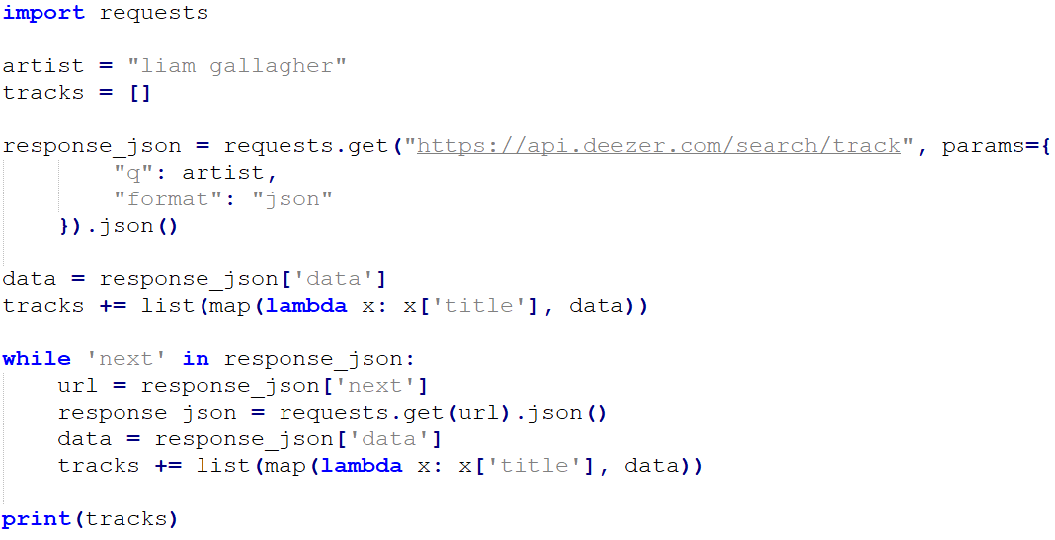
Example: Accessing a Web Service
pagination

Slide 11
Web Service Requests Limit
Web services often limit the access (by requests rate/ by quota)
To reduce the load on the server
To prevent attacks
To encourage payment
How to cope:
Request a bulk of data at once
If possible, request only the data you need
Start the retrieval process early!

Slide 12
User Interface
You application should have a reasonable user interface (UI)
Bonus points will be given for applications which provide an exceptional user experience

Slide 13
JavaScript Compilers
JavaScript is the only code format most browsers understand
But not for long – see WebAssembly!
In order for the browser to run a code written in other language, it first needs to be compiled to JavaScript
The most common scenario – compiling a code written in recent version of ECMA script to a previous version, for older browsers support
Popular tool: babel

