Slide 1
Functional Dependencies

Slide 2
Reminder
A function dependency is a statement of the form A₁, ..., A_{m} → B₁, ..., B_{n}
Meaning: if two tuples agrees on A₁, ..., A_{m} they must also agree on B₁, ..., B_{n}
Example: Professor(SSN, FirstName, LastName, Building, RoomNumber, hasWindow)
SSN → FirstName, LastName
Building, RoomNumber → SSN, hasWindow

Slide 3
BCNF and 3NF
What are the problems with Professor relation?
Redundant room information
Updating one row requires updating others for consistency
When removing a professor we lose room information
Solution: Normal Forms
BCNF: Non trivial A₁, ..., A_{m} → B₁, ..., B_{n} implies A₁, ..., A_{m} is a key
3NF: Non trivial A₁, ..., A_{m} → B₁, ..., B_{n} implies A₁, ..., A_{m} is a key or each B_{i} is part of a minimal key

Slide 4
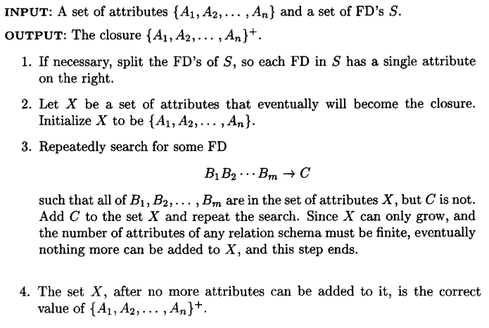
Computing the Closure

Slide 5
Question
Let R be a relation R(A,B,C,D,E,G,H) with the following functional dependencies:
A,C → D
H,D → A
E → C
B,E → H
What are the minimal keys?
{A,B,E,G}, {B,D,E,G}

Slide 6
Minimal FD Set
How to make sure a set T of functional dependencies is minimal?
Use to following algorithm to compute the minimal set:

Slide 7
Question(2)
Is the set of FD of R minimal?
Yes!

Slide 8
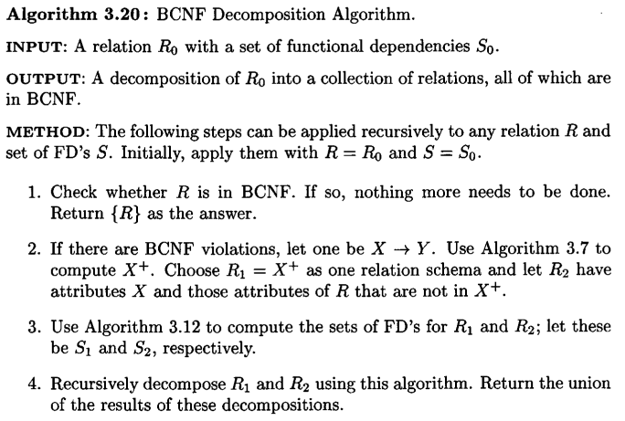
BCNF Decomposition

Slide 9
Question(3)
Decompose R into BCNF using lossless decomposition:
R1 = {A,B,C,D,E,G,H}
R2 = {A,C,D}
R3 = {A,B,C,E,G,H}
R4 = {C,E}
R5 = {A,B,E,G,H}
R6 = {B,E,H}
R7 = {A,B,E,G}

Slide 10
Question(4)
Show a dependency-preserving lossless BCNF decomposition of R
First include all dependencies:
R1 = {A,C,D}
R2 = {H,D,A}
R3 = {E,C}
R4 = {B,E,H}
We now need to make it lossless, by providing a way to join all relations together:
R5 = {A,B,E,G} (a key)

Slide 11
Question 2 (Keys)
Let S(A,B,C) be a relation
Assume {A,B} is the only minimal key of S. Is S in 3NF?
No (see A → C)
Assume {A,B} and {C} are the only minimal keys of S. Is S in BCNF?
Yes! (otherwise it is a contradiction to {A,B} being a minimal key)

Slide 12
Question 3
Let R be a relation, and F be a set of functional dependencies of R. We define the following function:
Func(R,F):
Find a minimal key Z of R For each nontrivial FD X → Y in F If X is not a key then For each A in Y \X: If A is not in Z then return False Return True
What can we say of the form of R if Func returns True?
R is in 3NF
What can we say of the form of R if Func returns False?
Nothing

