Slide 1
JavaScript

Slide 2
Events
As we’ve seen, events are used to handle meaningful things that took place in the document
Element has received focus
Button was clicked
Key was pressed
The document has finished loading
Etc. (see https://developer.mozilla.org/en-US/docs/Web/Events for more)

Slide 3
Events Limitation
Look at the following code:
What happens if the image has already finished loading?

Slide 4
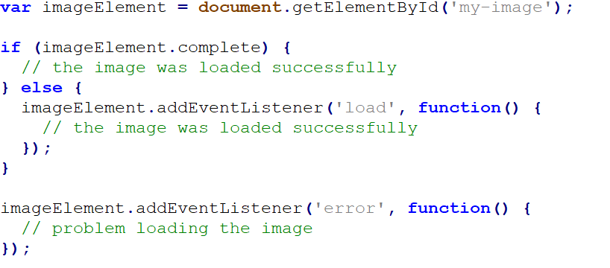
Events Limitation(2)
What if we want to know if multiple images had finished loading?

Slide 5
The Solution: Promise
When dealing with asynchronous success/failure, events are less natural
Ideally, we would want something like that:
A promise is an object which supports this structure

Slide 6
Promise(2)
Main differences between promise and event handler:
A promise can fail or succeed once
A success/fail callback will be called even if defined after the event took place
Promises were implemented in many JS libraries (e.g. Q, when)
Starting from ES6, JavaScript supports Promises natively

Slide 7
Example: HTTP Get Request
We wish to implement a get request with the promise syntax
It is meant for demonstration only!
There are many libraries which implement it, and a native fetch() method – use them!

Slide 8
Example: HTTP Get Request(2)
function get(url) {
return new Promise(function(resolve, reject) {
var req = new XMLHttpRequest();
req.open('GET', url);
req.onload = function() {
if (req.status == 200) {
resolve(req.response);
}
else {
reject(Error(req.statusText));
}
};
req.onerror = function() {
reject(Error("Network Error"));
};
req.send();
});
}
//usage: get('http://api.icndb.com/jokes/random‘)

Slide 9
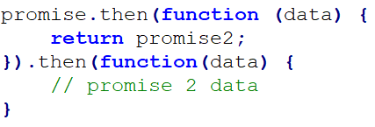
Promise: Usage
Syntax:
Chaining:
Simple data
Additional promise

Slide 10
Promise: Multiple Promises
Back to the original problem, Promise.all method allows us to wait for all promises to succeed, or for one of them to fail:
Promise.all([promise1, promise2]).then(function(results) { //all succeeded })
It is also possible to wait for all promises to finish (either successfully or not) using Promise.allSettled

Slide 11
Promise: Error Handling
The following:
Is a syntactic sugar for:

Slide 12
Falsy Values
There are 7 values which evaluate to false in a condition: 0, 0n (big int), false, null, undefined, NaN (number), “” (empty string)
All other values are “truthy”
Using the not operator !, we can retrieve the associated boolean value: (for a variable x, try !!x)
What does the following instruction do? name = name || “unknown”

Slide 13
var vs. let
As we’ve seen, variables are declared using “var” keyword
EC6 has introduces better ways to declare a variable: let (for a regular variable) and const (for constant values)
The scope of “let” defined variables is the scope in which they were defined (inside the { } brackets)
You cannot use the variable before it was defined

Slide 14
var vs. let (Example)
//don’t be afraid! It only meant to show that “var” scoping can be confusing…
var funcs = [];
for (var i = 0; i < 3; i++) {
funcs[i] = function() {
console.log("My value: " + i);
};
}
for (var j = 0; j < 3; j++) {
funcs[j]();
}

