Slide 1
Introduction to MySQL

Slide 2
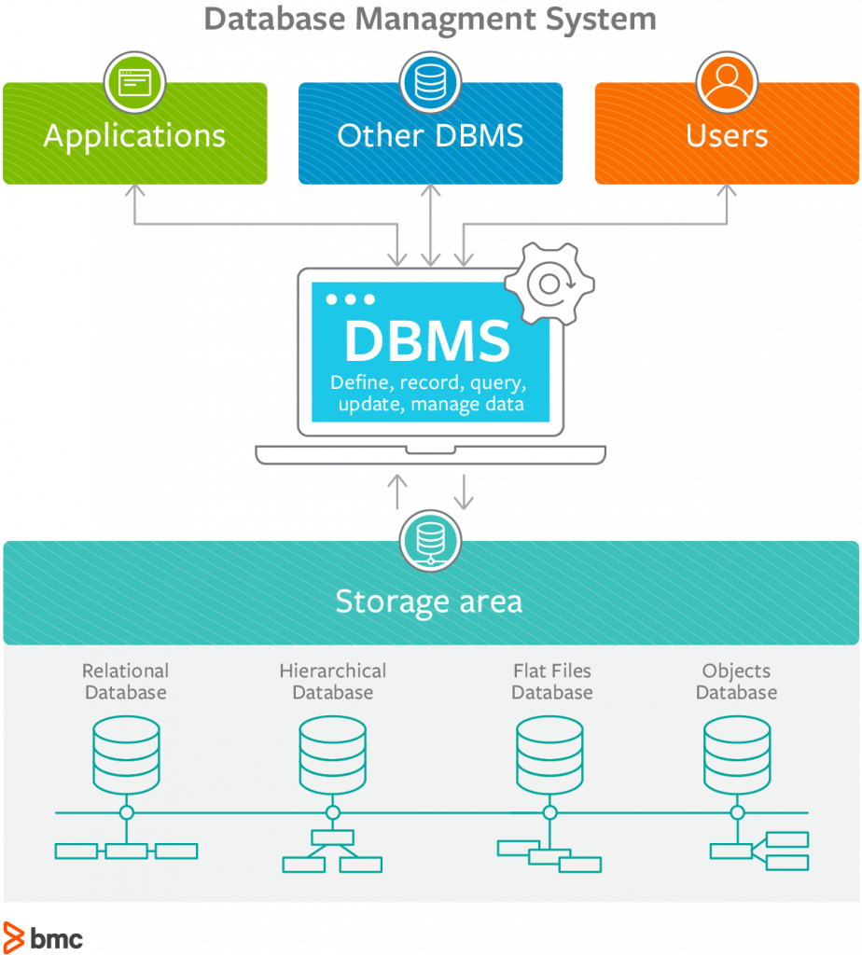
DBMS (Reminder)

Slide 3
MySQL
A database management system
Implements the relational model
Exposes objects as database, table, row, column…
Implements the SQL standard
An open source software, written in C and C++
Named after My Widenius

Slide 4
INFORMATION_SCHEMA
A special database within each MySQL instance
Stores information about all the other databases that the MySQL server maintains
The data in INFORMATION_SCHEMA is readonly
Some of the tables in the DB:
Tables
Columns
User_privileges

Slide 5
MySQL Data Types
For the scope of this course, we will assume each column has a primitive type
Primitive types are divided into 3 categories:
Numeric Types
Integer types (Smallint, int)
Fixed-point types (decimal, numeric)
Bit-value type (Bit)
…
Date Types (Date, Datetime, Timestamp)
String Types (Char, Varchar, Blob etc.)

Slide 6
MySQL Account Management
A user account permit client users to connect to the server and access data managed by the server
MySQL privilege system authenticates the users and associates them with privileges on a database

Slide 7
MySQL User Privileges
Administrative privileges
enable users to manage operation of the MySQL server
not specific to a particular database.
Database privileges
apply to a database and to all objects within it
Privileges for database objects
tables, indexes, views, and stored routines…

Slide 8
Sakila
A sample database for MySQL, designed to represent a DVD rental store
Documentation: https://dev.mysql.com/doc/sakila/en/
For the homework, we will use the university MySQL database server http://mysqlsrv.cs.tau.ac.il/, where you will find a version of the sakila database

Slide 9
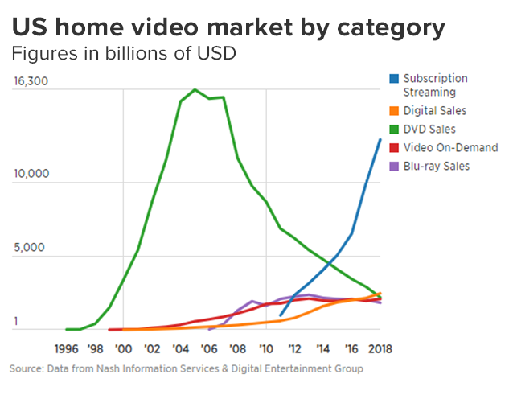
Sakila(2)
First version released in 2006:

Slide 10
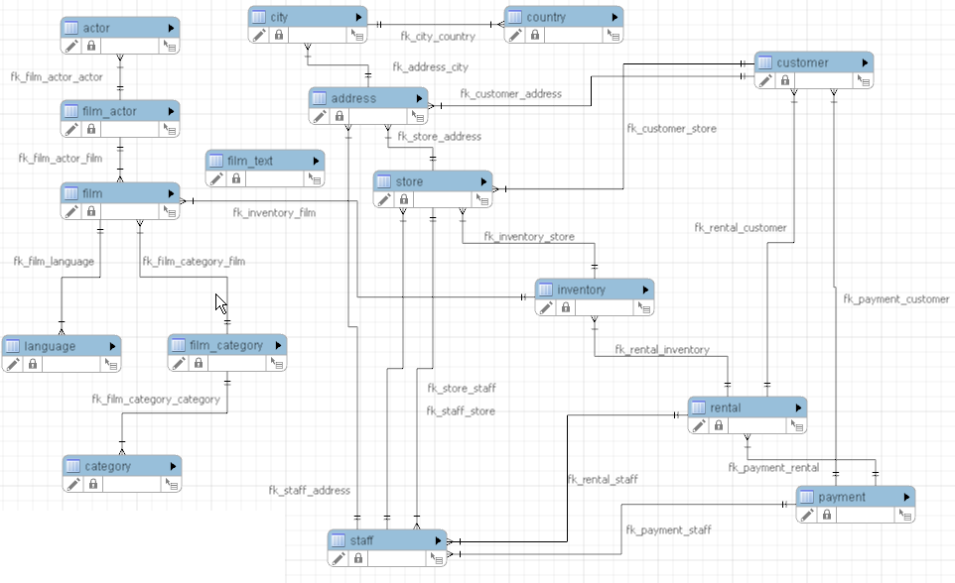
Sakila Structure

Slide 11
How to do HW#1?
First you need to connect to the university MySQL database server, where you will run your queries
Server name: mysqlsrv.cs.tau.ac.il
DB name: sakila
user name: sakila
password: sakila
For security reasons, connection is over SSH

Slide 12
Connection to TAU server
The university firewall denies connections outside the university VPN
The preferred way of enabling remote connection is using sslvpn
Usage information + details on other university services: https://www.cs.tau.ac.il/system/servers

Slide 13
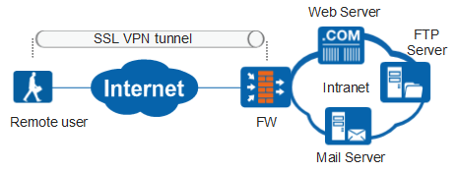
Connection to TAU server(2)
Using the software linked in the manual (Secure Mobility Client), you could connect to university services as if you were a part of the university VPN

Slide 14
CLI + MySQL
Command-line interface (Unix):
Establish connection to nova:
Use Mysql CLI tool to connect to mysqlsrv.tau.ac.il:

Slide 15
CLI + MySQL
Have fun running queries!

Slide 16
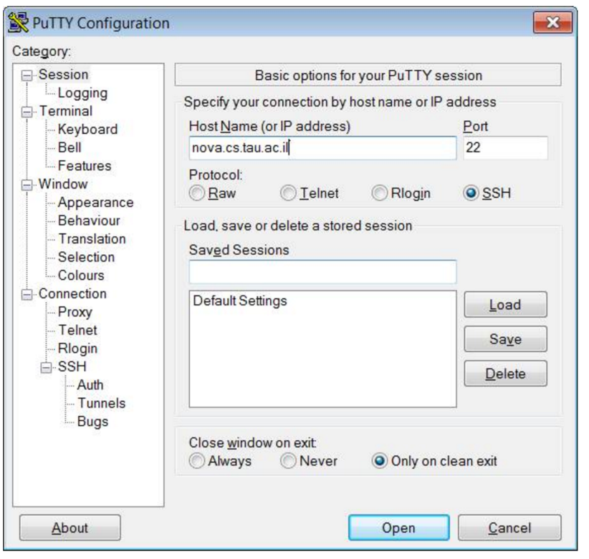
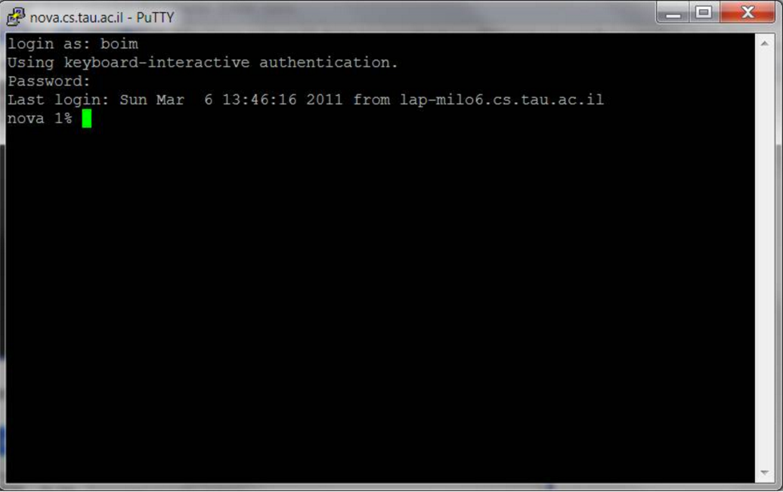
CLI + MySQL
Windows doesn’t come with an SSH client
The recommended one is PuTTY
https://www.putty.org/

Slide 17
MySQL GUI Clients
Why bother working in CLI?
Some recommended MySQL GUI Clients:
Windows users: HeidiSQL
Mac users: SequelPRO
Linux users: DBeaver

Slide 18
HeidiSQL Example
What you need:
HeidiSQL installation
Plink.exe (comes with PuTTY)
What to do
Select SSH tunnel in network type
Enter server details
Enter the path to plink.exe in SSH tunnel tab

Slide 19
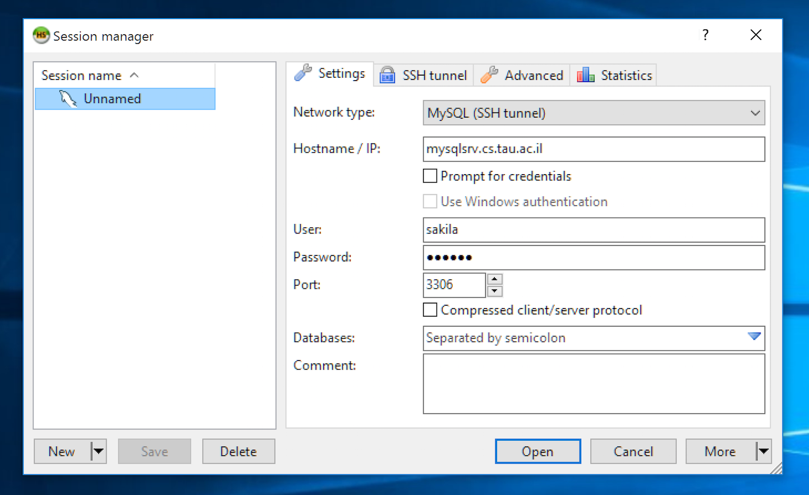
HeidiSQL Example(2)

Slide 20
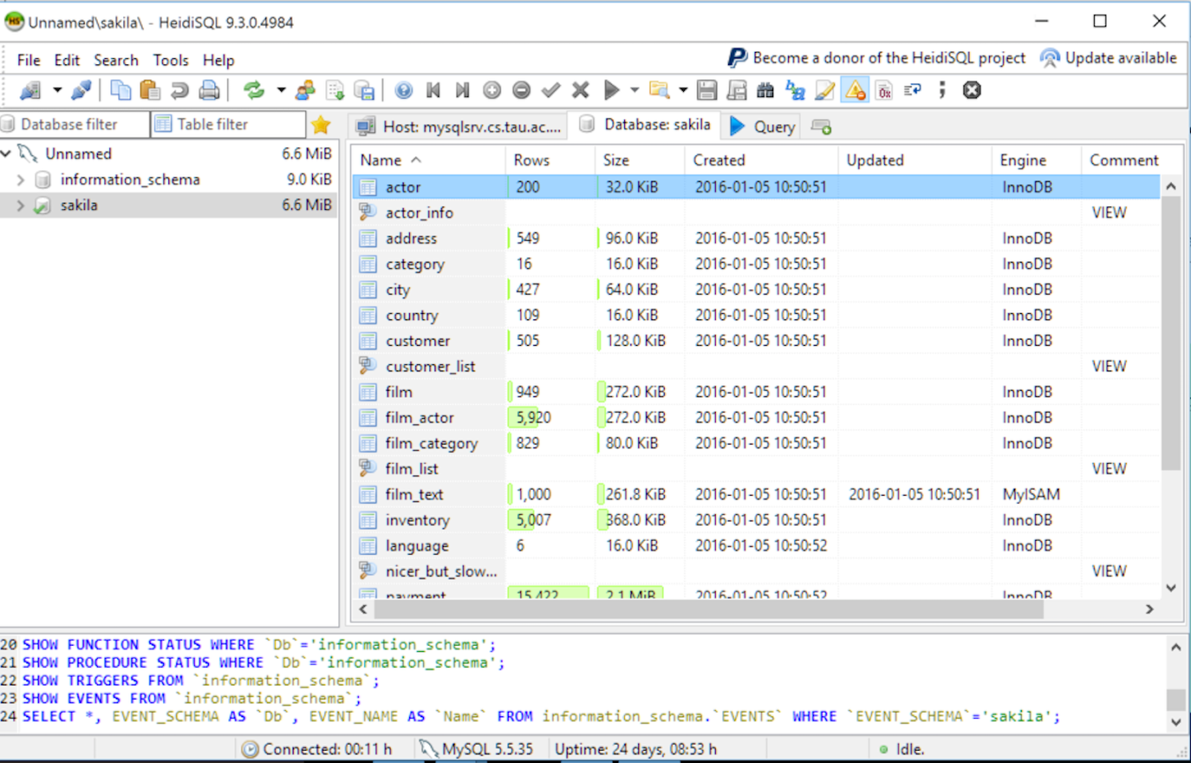
HeidiSQL Example(3)
Choose the Sakila database, and start writing queries!

Slide 21
Readable SQL Queries
What does the query returns?
Things to consider:
Result structure (columns names, duplications,…)
Indentation
Naming
Order of conditions
SELECT DISTINCT(f.title)
FROM customer c, rental r, inventory i, film f
WHERE c.customer_id = r.customer_id AND
r.inventory_id = i.inventory_id AND
i.film_id = f.film_id AND
c.first_name = "LISA"

