Slide 1
Database Systems
Fall 2019/20

Slide 2
General Details
TA: Doron Tiferet
For personal questions or to schedule an appointment: dorontiferet@mail.tau.ac.il
Otherwise, use the Moodle forum!
Grading:
Exam: 50%
Homework (2 Exercises): 15%
Project: 35%

Slide 3
Administration
Homework:
Done in pairs
Submission is done via Moodle, by one of the partners
Project:
Done in group of four students
Goal: develop a fully functional website with a database
Focus on the database design, optimizations, SQL queries, and DB programming best practices
Group size is obligatory!

Slide 4
Support/Questions
Moodle forums:
finding partners
general questions
My email:
personal questions
scheduling an appointment
system@cs.tau.ac.il – for system problems
Lots of resources on the internet!

Slide 5
Scope
We will focus on the practical side of databases
It would be especially relevant to the final project
The main topics we will discuss:
Relational Database Management System
Database programming
Web programming

Slide 6
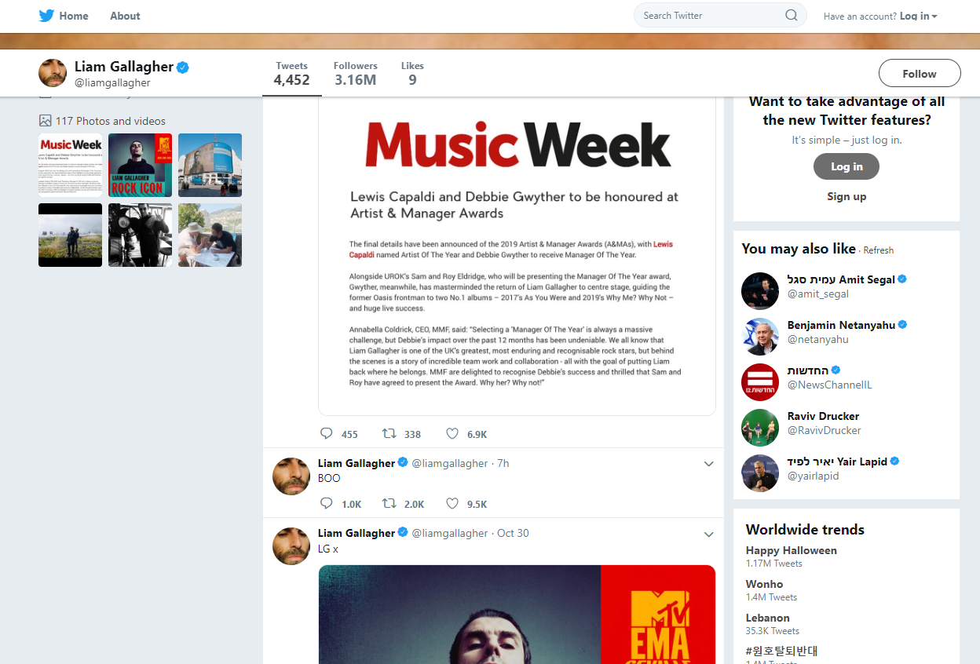
Twitter Example

Slide 7
Twitter Example

Slide 8
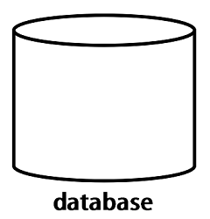
Twitter Example(2)
General task: store and access data
Concerns:
Efficiency
Consistency
Data loss
Security
…

Slide 9
Twitter Example(3)
Solution:
DBMS

Slide 10
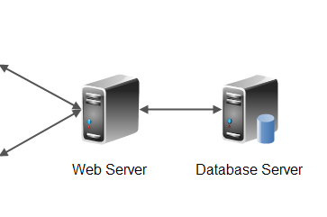
Client-Server Architecture
Authentication
Notifications
API
Images table
Users table
Image Processing
UI operations

Slide 11
Database Server
Database server is a standalone server, which is not is not accessible to web-users
Only the web server communicates with the DB
Administrators have special permissions to access to the database management system directly

Slide 12
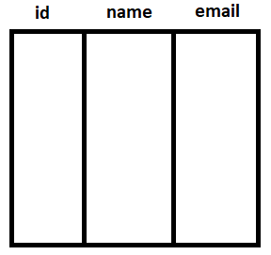
Relational Database
Based on the relational model, proposed by E. F. Codd in 1970
The main language used is SQL
Informally divided to DDL and DML
Users:
Followers:

Slide 13
MySql
A relational database management system (RDBMS)
Free and open-source software written in C and C++
One of the most popular databases
Next tutorial:
Introduction and usage
What you need to know for HW#1

