Slide 1
Optimization in MySQL

Slide 2
Database Optimization
A key aspect for optimizing your DB is making sure the tables are well structured:
The columns have the right data type
The columns corresponds with your application usage (e.g. a table which updates frequently often has fewer columns)
Define the buffer pool size according to your available memory

Slide 3
Query Optimization
Use indices wherever appropriate
To avoid wasted disk space, construct a small set of indexes that speed up many related queries used in your application
Especially important for joins
Minimize the number of full table scans
Avoid transforming the query in ways that make it hard to understand
The optimizer does some of the transformations automatically
Use the EXPLAIN statement to retrieve the query execution plan, and adjust your indices/query accordingly
The execution plan might depend on tables statistics. Run ANALIZE statement to update the statistics of a certain table
Even queries which run fast could benefit from the optimization, by making your application more scalable

Slide 4
Automatic Optimizations
MySQL automatically optimizes your queries, to achieve faster execution
Example for WHERE statement optimizations:
Detecting conditions which never apply
Filter unnecessary values in each table before JOIN
Constant expressions are evaluated once

Slide 5
Example
SELECT year, Max(length) FROM Movies WHERE genre = "comedy“ GROUP BY year HAVING Max(length) > 100
How can we change this query to improve performance?
Move the predicate in the HAVING clause to the WHERE clause, resulting fewer tuples in each group

Slide 6
Example(2)
SELECT year, Max(length), count(*) FROM Movies WHERE genre = "comedy“ GROUP BY year HAVING Max(length) > 100
Would the optimization we proposed still be valid for the above query?
No, because we need to count all comedies in each year – including short ones.

Slide 7
Example 2
Starsln(title, year, starName)
Movies(title, year, length, genre, studioName)
CREATE VIEW Movies0f1996 AS SELECT * FROM Movies WHERE year = 1996;
SELECT starName, studioName FROM MoviesOf1996 JOIN Starsln WITH (year, title);

Slide 8
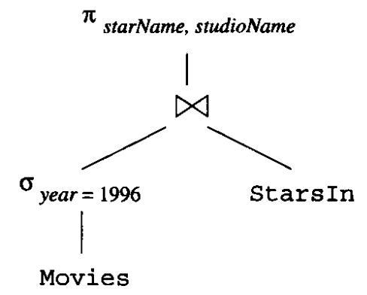
Example 2(2)
Logical execution plan:
How can we improve it?
By applying the rule σ_{C}(R ⋈ S) = σ_{C}(R) ⋈ S

Slide 9
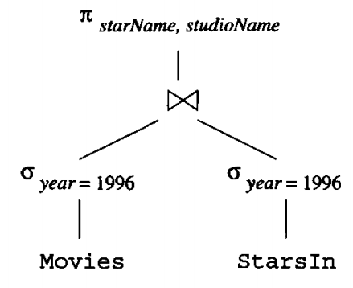
Example 2(3)
Improved execution plan:

Slide 10
NoSQL DBMS
Originally referred to non-SQL database
Now interpreted as Not only SQL (indicating that SQL syntax might also be supported)
Some of the main types of NoSQL DBMS:
Key-value store
Stores a dictionary, allowing quick lookup
Document store
A document is an encoded data
In addition to key lookup, the DBMS exposes an API for retrieving document by content
Graph
Meant for storing a data which represent a graph structure (node, edges and associated data)
Exposes a graph query language

Slide 11
Exam
Date:
Moed A: 19/2/2020
Moed B: 6/4/2020
The exam will consist of 3 parts. The main topics of each part would be as follows:
SQL queries, views, relational algebra
Functional dependency and relational decomposition
Query execution and optimization, indexing
In general, all topics taught in class might appear in the exam, excluding web programming

Slide 12
Project
Due date: 26/1/2020
Don’t wait for the last minute – deploy your application in advance, to make sure it is working
Focus on making your queries interesting and efficient
Remember: A simple user interface is sufficient

