Slide 1
Web Development
Part 2

Slide 2
Reminder
The browser gets information from the web (HTML + CSS + JavaScript) and renders a webpage
Using AJAX, the webpage can access additional resources and update the webpage accordingly
The updates are done on a tree representation of the webpage, according to the Document Object Model (DOM)

Slide 3
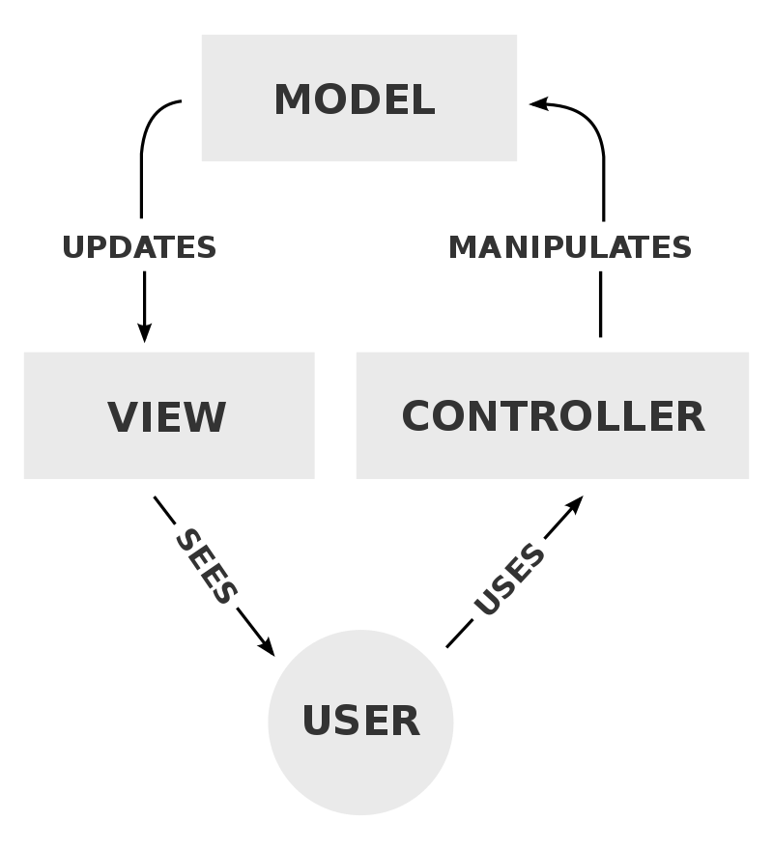
Model-View-Controller (MVC)
A software design pattern commonly used for developing user interfaces
Divides the related program logic into three interconnected elements
Model: Manages the application data
View: Visual representation of the information
Controller: Accepts input, manipulates the model, initiate view updates
Benefits:
Code reuse
parallel development

Slide 4
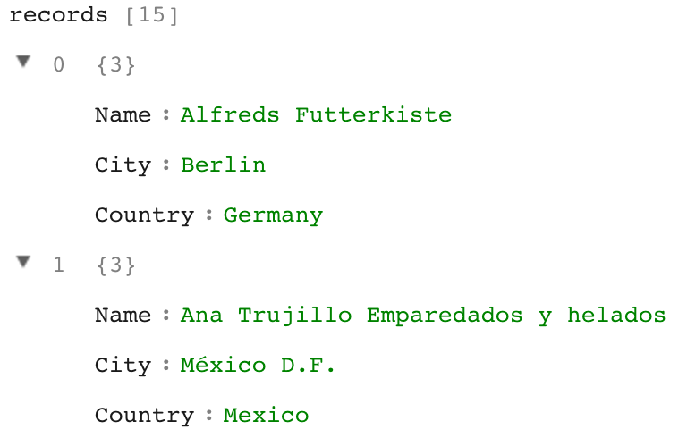
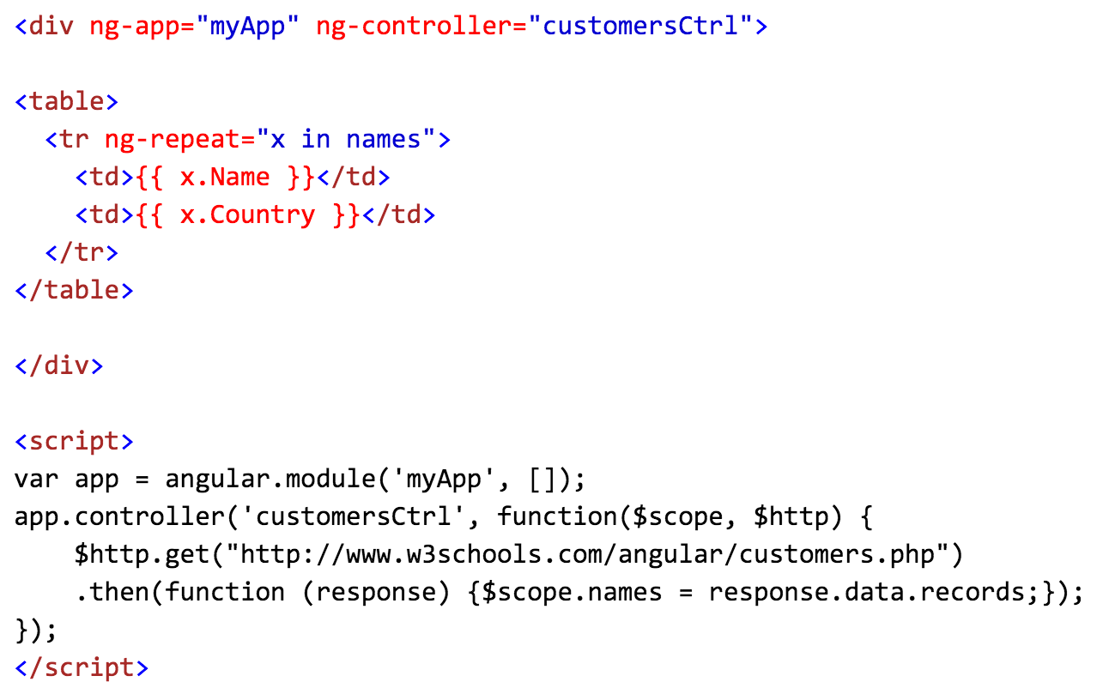
Example: Angular JS
Front end JS framework for MVC architecture
Usage:

Slide 5
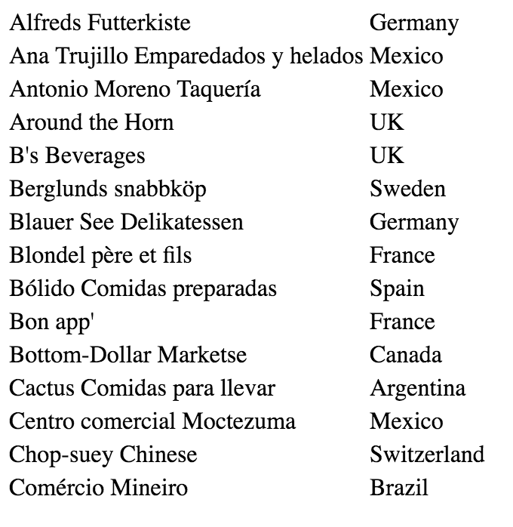
Example: Angular JS(2)
Results:
This is only an example!
Many others libraries and approaches
Some popular libraries: React, jQuery, Angular.io…
Dynamic Views
DOM manipulation
MVC

Slide 6
HTTP
Stands for “Hypertext Transfer Protocol”
The foundation of data communication on the Web
HTTPS is an extension of HTTP to enable secure communication
Prevents man-in-the-middle attacks

Slide 7
HTTP Request
Consists of the following:
URL (Universal Resource Locator)
Request method
GET: retrieve data without side effects (has no body)
POST: add the sent data to the resource
DELETE: delete the specified resource
…some others (https://developer.mozilla.org/en-US/docs/Web/HTTP/Methods)
Header Fields (for metadata – e.g. the requested format)
Optional message body

Slide 8
URL
A URL is a type of URI (Uniform Resource Identifier)
Typical HTTP/HTTPS URL structure:
http[s]://host[:port]path[?query][#fragment]
Host: IP or hostname
Port: the endpoint (defult: 80 for HTTP, 443 for HTTPS)
path: resembles file system path
query: additional parameters (e.g. ?price<5&color=blue)
fragment: position in resource (handled by the client)
E.g. https://moodle.tau.ac.il/course/view.php?id=368345801

Slide 9
HTTP Response
Consists of the following:
Status code
200-299: success (e.g. 200 = OK)
400-499: client errors (e.g. 404 = NOT FOUND)
500-599: server errors (e.g. 500=INTERNAL SERVER ERROR)
For the full list, see https://en.wikipedia.org/wiki/List_of_HTTP_status_codes
Response headers (for metadata – e.g. content length, content type)
Response body

Slide 10
Browser Navigation
The user: Enters a URL to the navigation bar
The browser:
Translates the domain name to IP address using DNS (Domain Name System)
sends an HTTP get request to the server
parses the HTTP response (an HTML document is expected)
builds the DOM tree, and renders a webpage
sends additional requests for other objects embedded in the document (e.g. JavaScript, CSS, images etc.)

Slide 11
Server Side Programming
A server provides a service or resource to the client
An HTTP server handles the client HTTP requests
In this course we will use python to write the server software

Slide 12
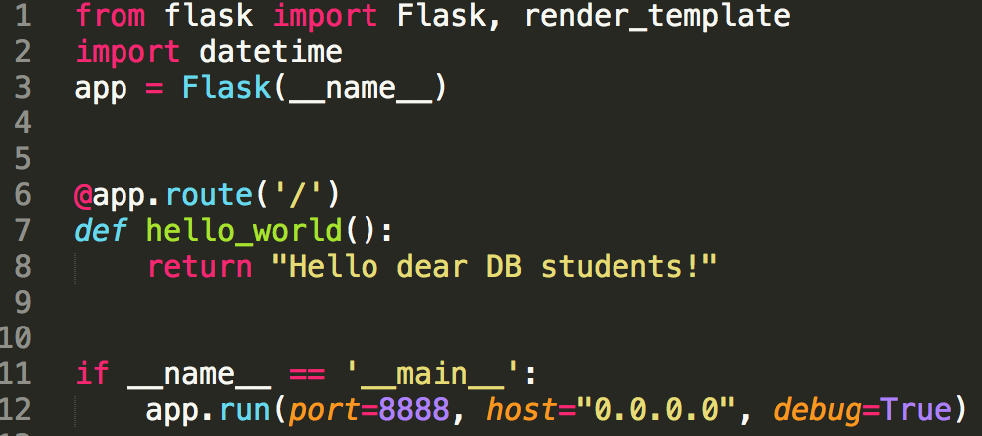
Python - Flask
Flask is a Python web framework
Install flask: pip install flask
Hello World:
Run:
0.0.0.0 makes the application visible across the network
(in this case, you better set debug=False)

Slide 13
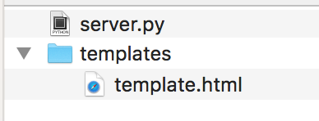
Templates
Flask allows generating HTML from template:
Create template folder (the name is important)
Write a template (the special syntax allows flask to plant values in the appropriate locations)
Use the template:

Slide 14
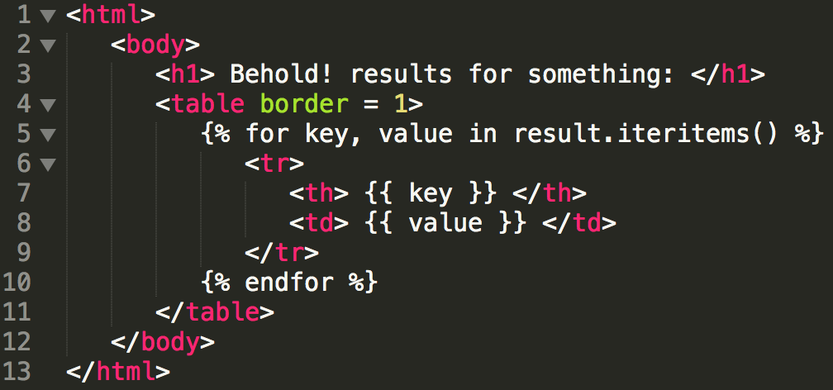
Templates(2)
Template works with more than simple values:
Template:
Code:

Slide 15
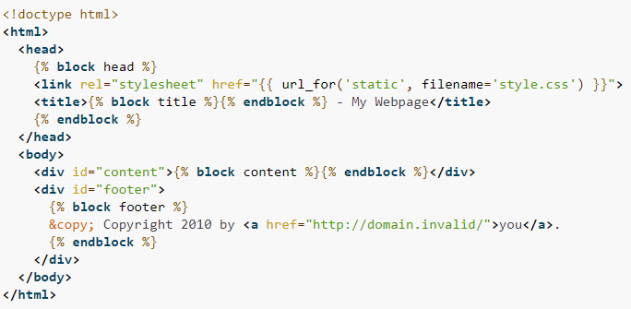
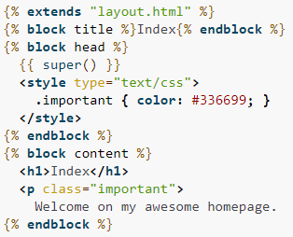
Templates(3)
Template Inheritance:
Used when HTML is shared between pages
child
base
Let child fill this block
Render the parent block

Slide 16
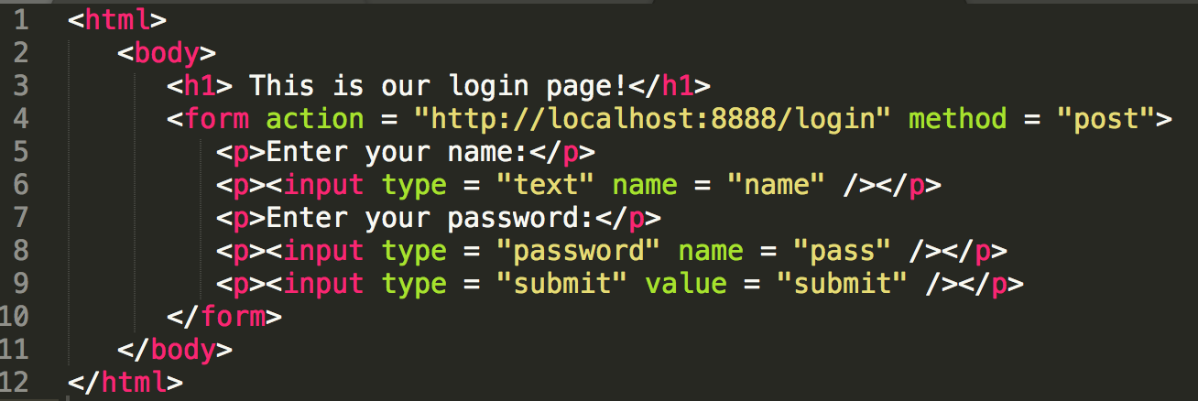
Example: HTML Form
Default behavior of <form>: pass the input to the given address (no additional JavaScript is needed):

Slide 17
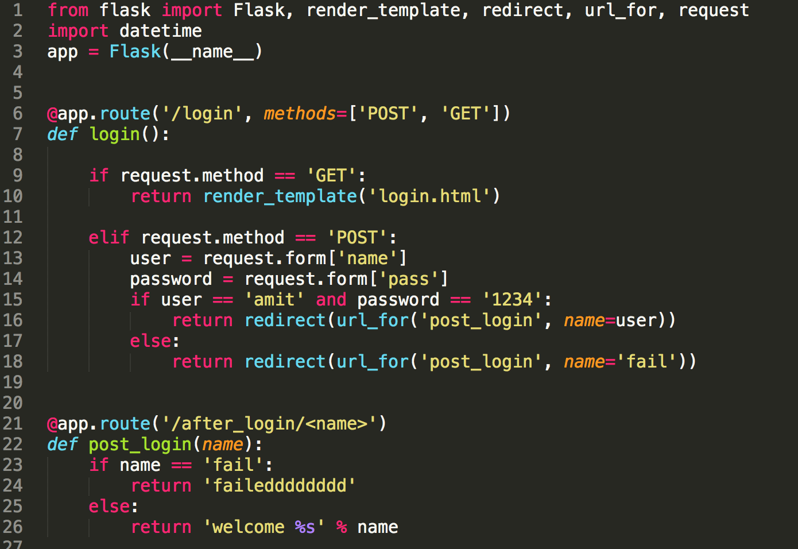
Example: HTML Form(2)
What does the server do?

Slide 18
HTTP Cookie
A small piece of data stored by the browser
Saved per domain, and sent to the corresponding host
Designed to allow the server to remember stateful information, and to record user activity
Can be used for authentication (e.g. to keep the user signed in after authentication, using a special token)

Slide 19
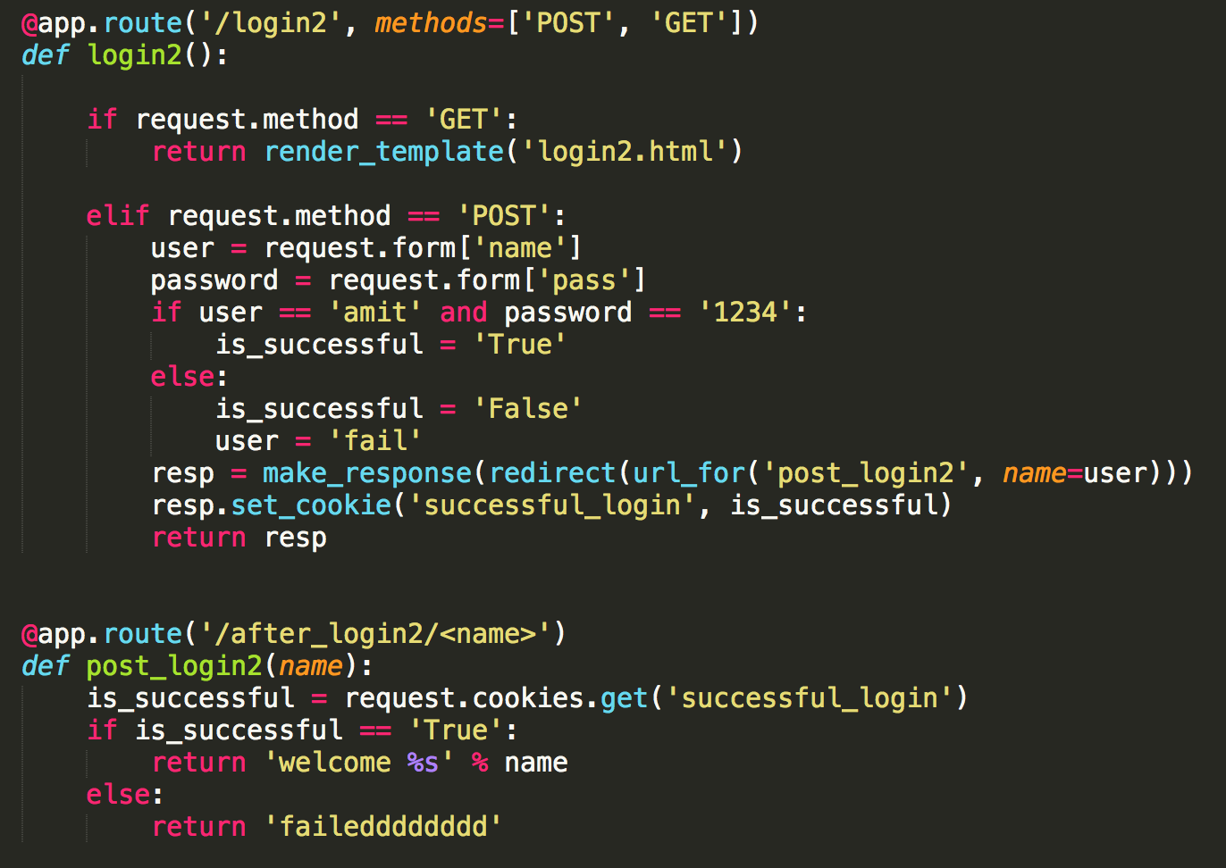
Example: HTTP Cookie

Slide 20
Session
The time interval between entering the website and leaving it
The server assigns the user with session ID, which is used to identify the user and save user related information which is relevant to the current session
Often implemented using cookies

Slide 21
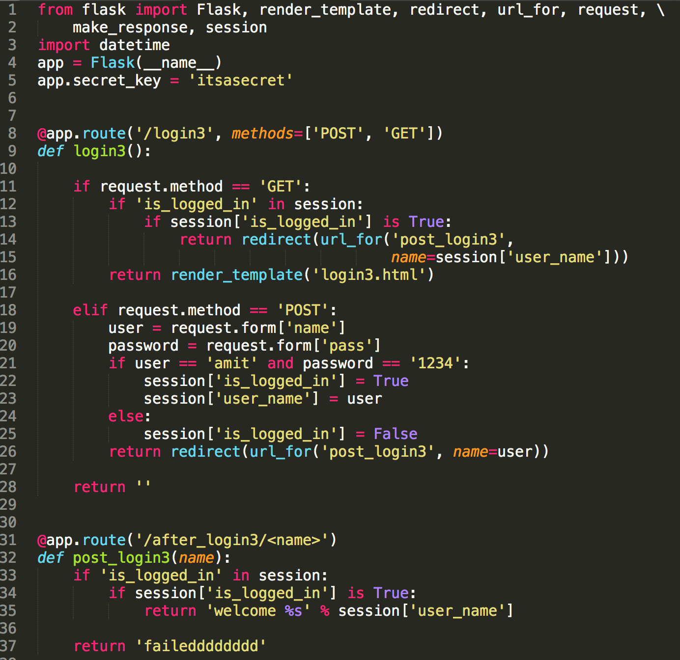
Example: Sessions
Used to encrypt the session
Stores the session information

Slide 22
University Server
You can deploy your server code on the university server “delta-tomcat-vm”
Full Instructions: http://www.cs.tau.ac.il/system/django
Don’t be confused by the “django” part - all that matters is that it allows us to deploy python server
Wait, what is Django?
A python web framework (like Flask)
Flask is lighter and more flexible
We recommend using Flask in the project
The server is available only in the university VPN (if you work from home – use CISCO SSL VPN!)

Slide 23
University Server(2)
Your code should sit here: /specific/scratch/<username>/django
Find an available port (you can use “netstat –tulpn” command)
Run your server code! (python is already installed)
If you wish your application to keep running after closing the terminal, you can use the “screen” command

Slide 24
screen
A Unix program for managing multiple windows
Usage:
screen: opens a new screen
You can run the server inside the screen
(inside a screen) ctrl+a and then d: detach the screen from the current session (it would now terminate when closing the terminal)
screen -r: resume a screen

