Slide 1
Web Development

Slide 2
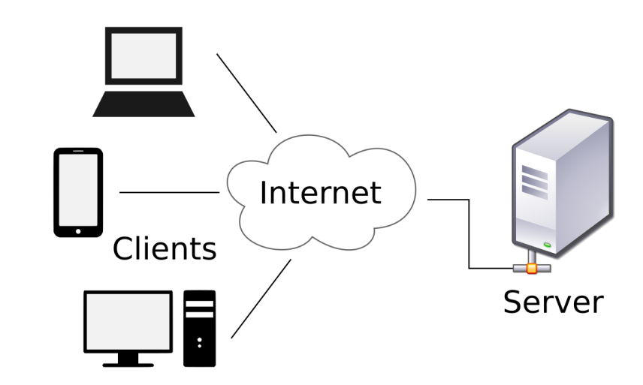
Client-Server Model
A distributed application structure, consists of two components:
Server:
Provides a resource or a service to many clients
Client:
Initiate a request for a service from a server

Slide 3
Web Browser
A client software for accessing information on the World Wide Web
Used to fetch information resources from the Web, and display them on the user’s device
This is done using a rendering engine
The rendered webpage can be interactive
E.g. allowing links to other resources to be clicked

Slide 4
HTML
HTML (Hypertext Markup Language) is the standard markup language for documents designed to be displayed on a web browser
Describes the semantic structure of the webpage
The building blocks of an HTML document are HTML elements
<html>: the root of the document
<head>: holds metadata and external resources
<body>: holds the content of the webpage
<div>: a general purpose content container
…

Slide 5
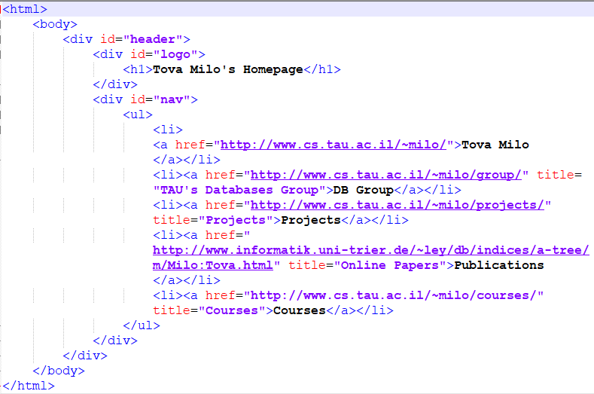
Example
content
attribute
element

Slide 6
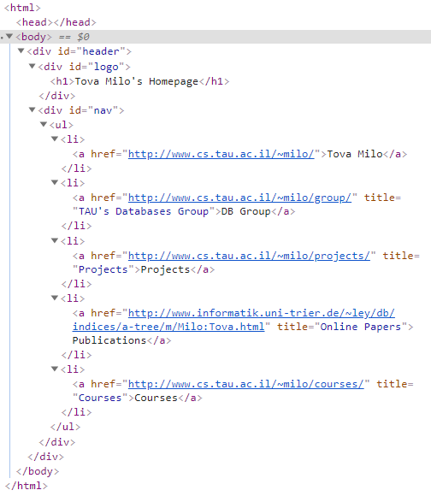
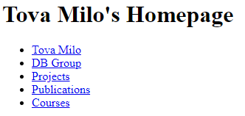
Document Object Model (DOM)
The browser parse the document to form a tree structure – the DOM representation of the document
The HTML elements are organized in a tree structure
Rendering and user interaction are implemented using the internal DOM

Slide 7
Styling
Ideally, we would like to separate presentation and content
Makes the HTML more readable
Enables multiple pages to share formatting
Reduces complexity and repetition
This could be done using CSS (Cascading Style Sheets) – a language which is used for describing the requested presentation of HTML elements

Slide 8
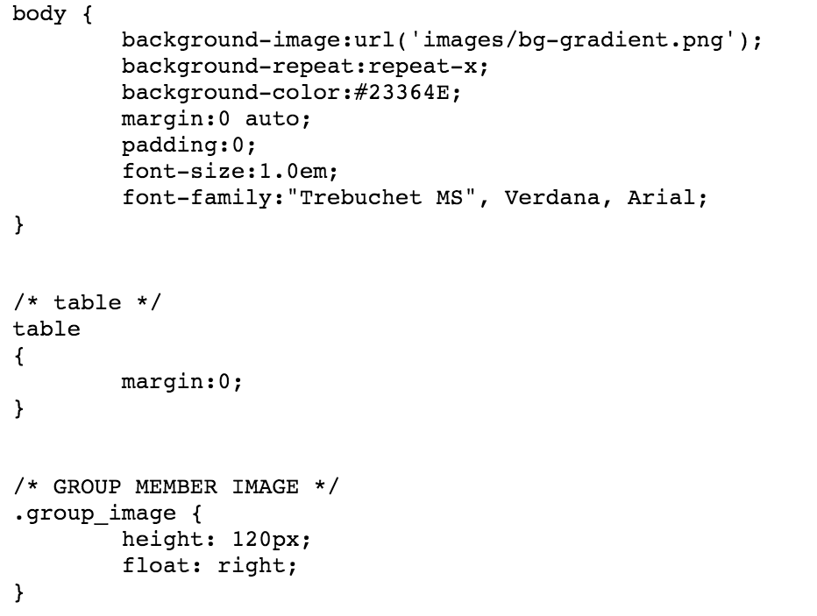
CSS Format
Example of .css File:

Slide 9
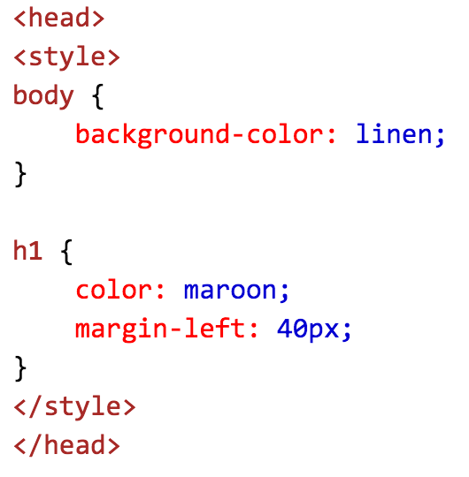
Linking HTML with CSS
In an external file:
Inside a style element in the HTML file:

Slide 10
Linking HTML with CSS(2)
Inline (least recommended):
In case of contradicting rules, the renderer will prefer the inline rules

Slide 11
CSS Selectors
Select by ID (for unique elements):
Select by class:

Slide 12
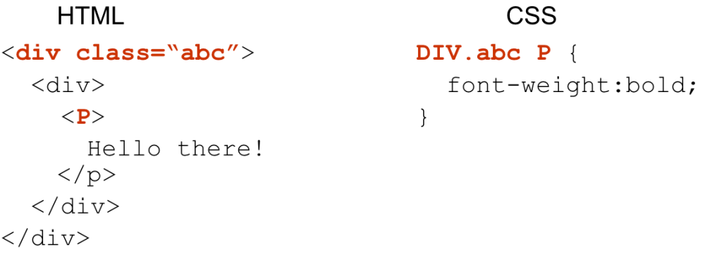
CSS Selectors(2)
Select by tag:
Select descendants

Slide 13
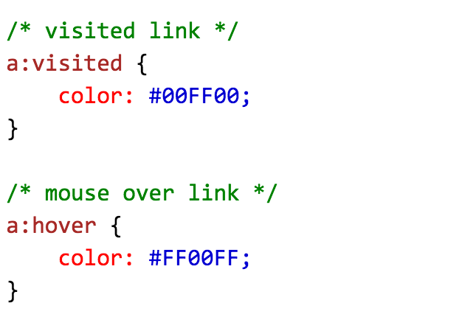
CSS Selectors(3)
Select by attribute:
Pseudo-classed
Select by other properties of the element, such as position on the DOM tree and cursor position

Slide 14
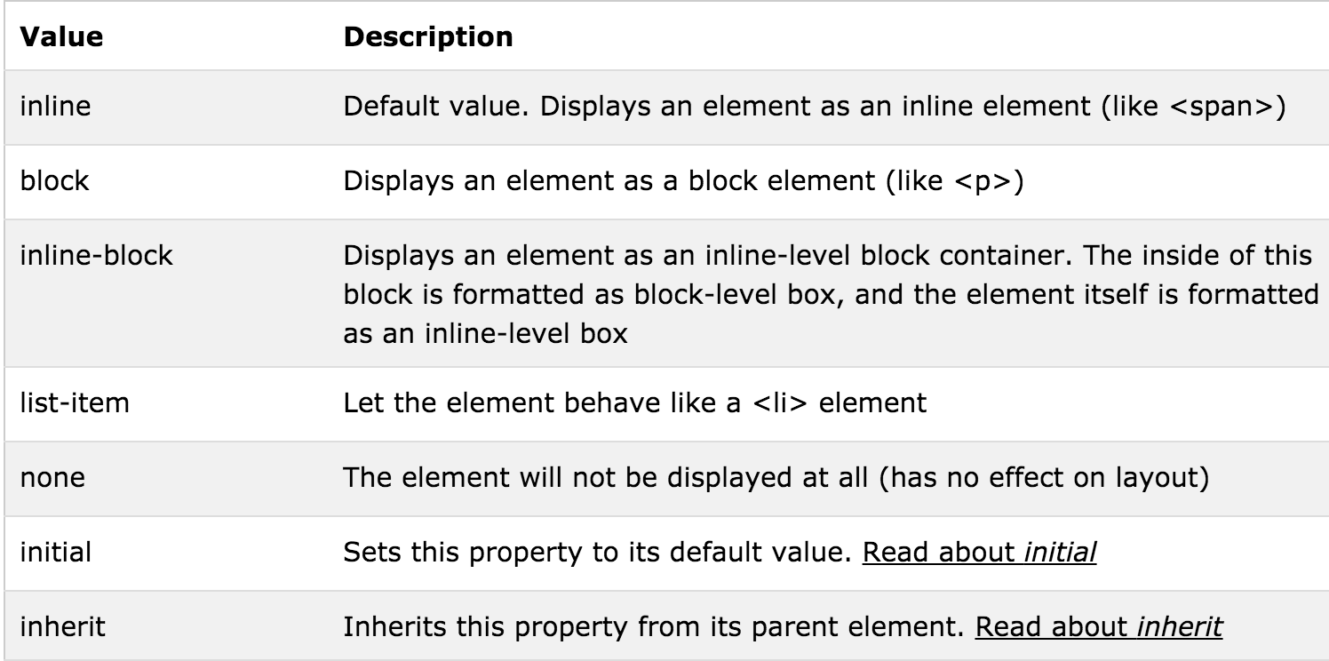
Elements Display
There are two main element display types:
Block: Start a new line and occupy the full available width
Inline: Does not start a new line, takes only needed space
Each HTML element has default display behavior:
div, h1, p are block level
span, a, img are inline
Behavior could be modified using the Display property

Slide 15
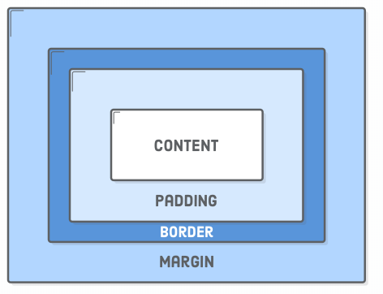
The Box Model
Each element has a surrounding box:
Controlled using the following properties:
Padding: The space between the box’s content and its border.
Border: The line between the box’s padding and margin.
Margin: The space between the box and surrounding boxes.

Slide 16
Elements Position

Slide 17
JavaScript
Using HTML and CSS we can create a static webpages
To add interactivity use the browser supported programming language – i.e. JavaScript
JavaScript allows:
Document tree manipulation
Handling browser events
Sending HTTP requests
Implements ECMAScript specification

Slide 18
JavaScript Functions
JS Function Example:
Usage:
Anonymous function (nameless function):

Slide 19
JavaScript Functions(2)
An anonymous function could be invoked without being assigned to a variable:

Slide 20
Using JavaScript
External file:
Or inline in HTML:

Slide 21
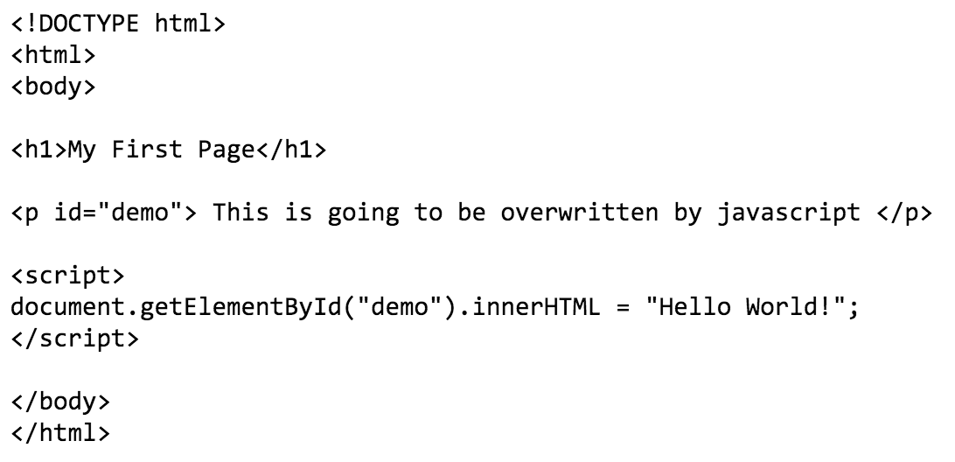
JavaScript DOM Example
Accessing the document tree object:

Slide 22
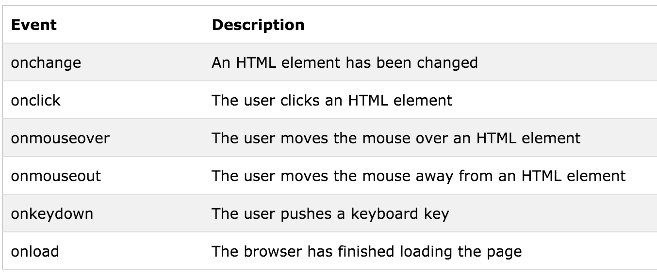
JavaScript: Browser Events
An event is a signal for a change that took place in the browser
Some of the browser events are:

Slide 23
JavaScript: Browser Events(2)
We can define an event handler to execute whenever an event of certain type occurs
In HTML:
In JS:
In JS, without override

Slide 24
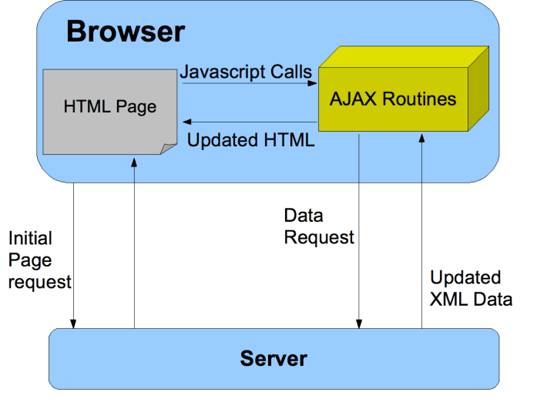
AJAX
AJAX = Asynchronous JavaScript and XML
In practice, JSON (JavaScript Object Notation) has replaced XML
Allows sending and retrieving data from a server in the background
The data can be used to change the webpage dynamically

Slide 25
AJAX(2)
Problems:
Different browser types/versions might expose different functions for AJAX requests
The syntax is often cumbersome
The JS code must be aware to the DOM tree structure
Solution:
Using a library to handle it for you!
More about it next week

