Slide 1
History

Slide 2
Descartes (1629)
If a large dictionary is printed in all the languages in which one wants to be understood, where common characters are put for each primitive word corresponding to the sense and not to the syllables, such as the same character for aymer, amare and filein, those having the dictionary and knowing the grammar would be able, through seeking all these characters one after another, to understand in their language what is being written.

Slide 3

Petr Troyanskii (1933)
multilingual dictionary, stemmer,...

Slide 4
Background
Development of formal language theory (Chomsky, Kleene, Backus)
  Formal characterization of classes of grammar (context-free, regular)
  Association with relevant automata
Probability theory: language understanding as decoding through noisy channel (Shannon)
  Use of information theoretic concepts like entropy to measure success of language models

Slide 5
Weaver (1947)
Recognizing fully, even though necessarily vaguely, the semantic difficulties because of multiple meanings, etc., I have wondered if it were unthinkable to design a computer which would translate. Even if it would translate only scientific material (where the semantic difficulties are very notably less), and even if it did produce an inelegant (but intelligible) result, it would seem to me worth while.

Slide 6
History (1948)
First recognizable NLP application was a dictionary look-up system developed at Birkbeck College, London

Slide 7
Turing Test (1950)
Turing test: machine, human, and human judge
Judge asks questions of computer and human
  Machine's job is to act like a human; human's job is to convince judge that he's not the machine
  Machine judged “intelligent” if it can fool judge
Original: Male and the female try to convince the judge that they were female. If AI replaced male, would judge be more accurate in guessing who real female was?

Slide 8
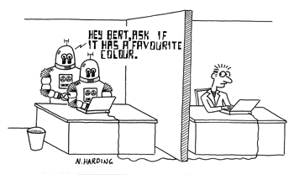

Slide 9
History (1940-1960)
  Symbolic approach
    Generative syntax
    AI
      pattern matching
      logic-based systems
      special-purpose systems
  Stochastic approach
    Bayesian methods

Slide 10
Symbolic vs. Stochastic
Symbolic
  Formal grammars as basis for NLP and learning systems. (Chomsky, Harris)
  Logic and logic-based programming for characterizing syntactic/semantic inference (Kaplan, Kay, Pereira)
  Toy natural-language understanding/generation systems (Woods, Minsky, Schank, Winograd, Colmerauer)
  Discourse processing: Role of intention, focus (Grosz, Sidner, Hobbs)
Stochastic Modeling
  Probabilistic methods for early speech recognition, OCR (Bledsoe and Browning, Jelinek, Black, Mercer)

Slide 11
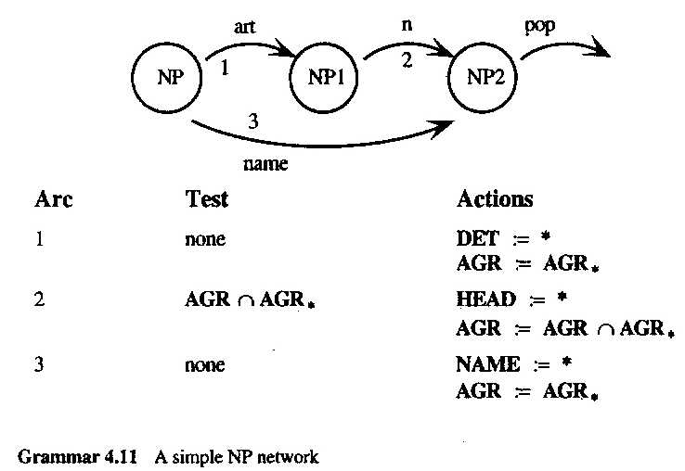
Augmented Transition Networks

Slide 12
Early Excitement (1960s)
  By 1966 US government had spent $20M on machine translation alone
  Critics:
  Bar Hillel – “no way to disambiguation without deep understanding”
  Pierce report (1966): “no way to justify work in terms of practical output”

Slide 13
ELIZA (1966)
Remarkably simple “Rogerian Psychologist”
Uses pattern patching to carry on limited form of conversation
Seemed to pass the Turing Test! (Machines Who Think, McCorduck, 1979)
Attacked (Weizenbaum)
Demos:
  http://www.manifestation.com/neurotoys/eliza.php3
  http://www.lpa.co.uk/pws_dem4.htm

Slide 14
History (1970-1990)
Stochastic
  speech recognition and synthesis (Bell Labs)
Logic-based
  compositional semantics (Montague)
  definite-clause grammars (Pereira&Warren)
Ad-hoc
  SHRDLU robot in blocks world (Winograd)
  knowledge-representation systems (Shank)

Slide 15
SHRDLU (Winograd, 1970)
Answers questions, executes commands, and accepts information in an interactive English dialog... The system contains a parser, a recognition grammar of English, programs for semantic analysis, and a general problem solving system... It can remember and discuss its plans and actions as well as carrying them out... Knowledge in the system is represented in the form of procedures, rather than tables of rules or lists of patterns.

Slide 16
Dave McDonald
SHRDLU was a special program. Even today its parser would be competitive as an architecture. For a recursive descent algorithm it had some clever means of jumping to anticipated alternative analyses.... It defined the whole notion of procedural semantics (though Bill Woods tends to get the credit), and its grammar was the first instance of Systemic Functional Linguistics applied to language understanding and quite well done.

Slide 17
LIFER/LADDER (1978)
Interface to db about Navy ships
Semantic grammar
User-friendly features (e.g. shortcuts)
People adapted to system

Slide 18
History (1970-1990)
Discourse modeling
  anaphora
    If you need one, there's a towel in the top drawer.
  focus/topic (Groz et al.)
  conversational implicature (Grice)

Slide 19
History (1970-1990)
Semantic representations
  Conceptual dependency - method of expressing language in terms of semantic primitives (Schank et al.)
  Semantic network (Quillian)
  Procedural semantics - intermediate representation between NLP system and DB system (Woods )

Slide 20
Empiricism (1983-93)
Use of stochastic techniques for part of speech tagging, parsing, word sense disambiguation, etc.
Comparison of stochastic, symbolic, more or less powerful models for language understanding and learning tasks

Slide 21
Renaissance (1990-)
Lessons from phonology & morphology successes:
  finite-state models are very powerful
  probabilistic models pervasive
  Web creates new opportunities and challenges
  practical applications driving the field again
Multilinguality and Multimodality

Slide 22
Present
Advances in software and hardware create NLP needs for
  information retrieval (web)
  machine translation
  spelling and grammar checking
  speech recognition and synthesis
Stochastic and symbolic methods combine for real-world applications

Slide 23
Issues

Slide 24
NLP Pipeline
speech
text
Phonetic Analysis
OCR/Tokenization
Morphological analysis
Syntactic analysis
Semantic Interpretation
Discourse Processing

Slide 25
NL Understanding
Query:
“Find me all articles concerning car accidents involving more than two cars in Malta during the first half of 2001.”
System must extract enough information to determine whether the article meets the criterion defined by the query

Slide 26
NLU
Compute some representation of the information that can be used for later inference
How much understanding is necessary to achieve the purpose of a given system?

Slide 27
Dialogue-based Applications
Human-machine communication
NL database query systems
Automated customer services
  e.g. banking services

Slide 28
Multimodal Applications
Involve two or more modalities of communication
    Text
    Speech
    Gesture
    Image
Text → speech
Speech → text
  Multimodal document generation
  Spoken translation systems
  Spoken dialogue systems

Slide 29
Ambiguity
I made her duck
I made duckling for her
I made the duckling belonging to her
I created the duck she owns
I forced her to lower her head
By magic, I changed her into a duck

Slide 30
Syntactic Disambiguation
S S
NP VP NP VP
I V NP VP I V NP
made her V made det N
duck her duck
Structural ambiguity:

Slide 31
Part of Speech Tagging and Word Sense Disambiguation
[verb Duck ] !
[noun Duck] is delicious for dinner
I went to the bank to deposit my check.
I went to the bank to look out at the river.
I went to the bank of windows and chose the one dealing with last names beginning with “d”.

Slide 32
Resources
Dictionary
Morphology and Spelling Rules
Grammar Rules
Semantic Interpretation Rules
Discourse Interpretation

Slide 33
Language Technology
Meaning
Natural Language Understanding
Natural Language Generation
Text
Text
Speech Recognition
Speech Synthesis
Speech
Speech

Slide 34
Natural Language Understanding
sound waves
accoustic /phonetic
morphological/ syntactic
semantic / pragmatic
internal representation

Slide 35
NLU
sound waves
accoustic /phonetic
morphological/
syntactic
semantic / pragmatic
Sounds
Symbols
Sense
internal representation

Slide 36
Where are the words?
sound waves
accoustic /phonetic
morphological/syntactic
semantic / pragmatic
“How to recognize speech, not to wreck a nice beach”
“The cat scares all the birds away”
“The cat's cares are few”
internal representation
pauses in speech bear little relation to word breaks
+ intonation offers additional clues to meaning

Slide 37
Dissecting words/sentences
sound waves
accoustic /phonetic
morphological/syntactic
semantic / pragmatic
“The dealer sold the merchant a dog”
“I saw the Golden bridge flying into San Francisco”
Word creation:
establish
establishment
  the church of England as the official state church.
disestablishment
antidisestablishment
antidisestablishmentarian
antidisestablishmentarianism
  is a political philosophy that is opposed to the separation of church and state.
internal representation

Slide 38
What does it mean?
sound waves
accoustic /phonetic
morphological/syntactic
semantic / pragmatic
“I saw Pathfinder on Mars with a telescope”
“Pathfinder photographed Mars”
“The Pathfinder photograph from Ford has arrived”
“When a Pathfinder fords a river it sometimes mars its paint job.”
internal representation

Slide 39
What does it mean?
sound waves
accoustic /phonetic
morphological/syntactic
semantic / pragmatic
“Jack went to the store. He found the milk in aisle 3. He paid for it and left.”
“Surcharge for white orders.”
“ Q: Did you read the report?
  A: I read Bob's email.”
internal representation

Slide 40
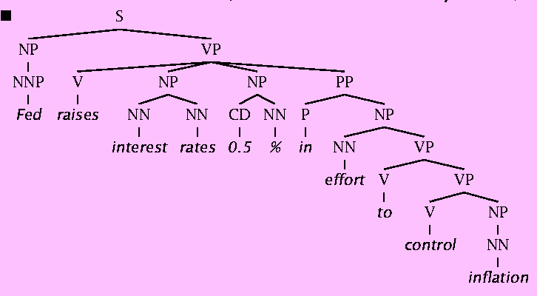
Syntax
The hidden structure of language is highly ambiguous
Structures for: Fed raises interest rates 0.5% in effort to control inflation (NYT headline 5/17/00)

Slide 41
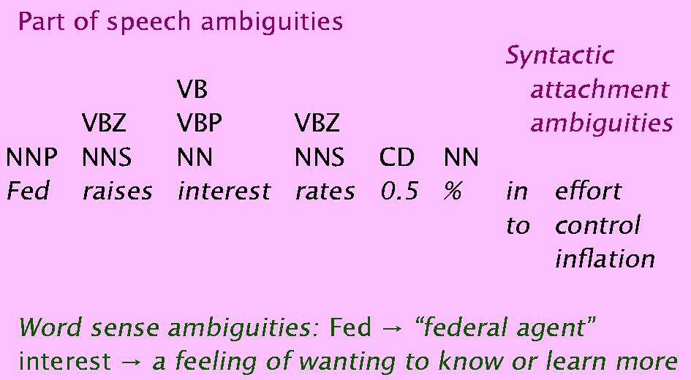
Where are the ambiguities?

Slide 42
POS Tags
NN noun s
NNP proper noun
NNS noun plural
VB v base form
VBZ v 3p s present
VBP v non-3p s present
CD number

Slide 43
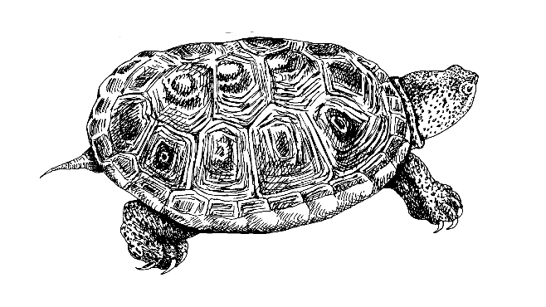
Lexical Semantics
The Terrapin, is whom I watched.
Watch the Terrapin is what I do best.
*Terrapin is what I watched the
I = experiencer
Watch the Terrapin = predicate
The Terrapin = patient
Notes:
Fresh-water turtle

Slide 44
Compositional Semantics
Association of parts of a proposition with semantic roles
Scoping
Proposition
Experiencer Predicate: Be (perc)
I (1st pers, sg) pred patient
saw the Terrapin

Slide 45
Word-Governed Semantics
Any verb can add “able” to form an adjective.
  I taught the class . The class is teachable
  I rejected the idea. The idea is rejectable.
Association of particular words with specific semantic forms.
  John (masculine)
  The boys ( masculine, plural, human)

Slide 46
Pragmatics
Real world knowledge, speaker intention, goal of utterance.
Related to sociology.
Example 1:
  Could you turn in your assignments now (command)
  Could you finish the homework? (question, command)
Example 2:
  I couldn't decide how to catch the crook. Then I decided to spy on the crook with binoculars.
  To my surprise, I found out he had them too. Then I knew to just follow the crook with binoculars.
  [ the crook [with binoculars]]
  [ the crook] [ with binoculars]

Slide 47
Discourse Analysis
Discourse
  Pronoun reference (anaphora)
  The professor told the student to finish the assignment. He was pretty aggravated at how long it was taking to pass it in.
  Multiple reference to same entity (co-reference)
  George W. Bush, president of the U.S.
  Relation between sentences:
  John hit the man. He had stolen his bicycle.

Slide 48
Applications

Slide 49
Interaction Level
NL used to make interaction level more “human”
GUI
NL UI
Command-line
Human
Computer
Interaction level

Slide 50
Spectrum
find all web pages containing
the word Osama in English
read the last 3 months of
the NY Times and provide
a summary of the campaign
so far

Slide 51
Some NLP Applications
Machine Translation—Babelfish (Alta Vista):
Question Answering—Ask Jeeves (Ask Jeeves):
Language Summarization—MEAD (U. Michigan):
Spoken Language Recognition— EduSpeak (SRI):
Automatic Essay evaluation—E-Rater (ETS):
Information Retrieval and Extraction—NetOwl (SRA):
http://babelfish.altavista.com/translate.dyn
http://www.ask.com/
http://www.summarization.com/mead
http://www.eduspeak.com/
http://www.ets.org/research/erater.html
http://www.netowl.com/extractor_summary.html

Slide 52
Text-based Applications
Processing of written texts such as books, news, papers, reports:
Finding appropriate documents on certain topics from a text database
Extracting information from messages, articles, Web pages, etc.

Slide 53
Translating user needs
User need
User query
Results
For RDB, a lot
of people know
how to do this
correctly, using
SQL or a GUI tool
The answers
coming out here
will then be
precisely what the
user wanted

Slide 54
Translating user needs
User need
User query
Results
For meanings in text,
no IR-style query
gives one exactly
what one wants;
it only hints at it
The answers
coming out may
be roughly what
was wanted, or
can be refined
Sometimes!

Slide 55
Translating user needs
User need
NLP query
Results
For a deeper NLP
analysis system,
the system subtly
translates the
user's language
If the answers coming
back aren't what was
wanted, the user
frequently has no idea
how to fix the problem
Risky!

Slide 56
Practical goals
Use language technology to add value to data by:
interpretation
transformation
value filtering
augmentation (providing metadata)
Two motivations:
The amount of information in textual form
Information integration needs NLP methods for coping with ambiguity and context

Slide 57
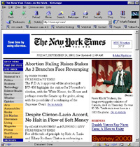
Knowledge Extraction Vision
Multi-dimensional Meta-data Extraction

Slide 58
Terms and technologies
Text processing
  Stuff like TextPad (Emacs, BBEdit), Perl, grep. Semantics and structure blind, but does what you tell it in a nice enough way. Still useful.
Information Retrieval (IR)
  Implies that the computer will try to find documents which are relevant to a user while understanding nothing (big collections)
Intelligent Information Access (IIA)
  Use of clever techniques to help users satisfy an information need (search or UI innovations)

Slide 59
Terms and technologies
Locating small stuff. Useful nuggets of information that a user wants:
  Information Extraction (IE): Database filling
    The relevant bits of text will be found, and the computer will understand enough to satisfy the user's communicative goals
  Wrapper Generation (WG) [or Wrapper Induction]
    Producing filters so agents can “reverse engineer” web pages intended for humans back to the underlying structured data
  Question Answering (QA) – NL querying
  Thesaurus/key phrase/terminology generation

Slide 60
Terms and technologies
Big Stuff. Overviews of data:
  Summarization
    Of one document or a collection of related documents (cross-document summarization)
  Categorization (documents)
    Including text filtering and routing
  Clustering (collections)
Text segmentation: subparts of big texts
Topic detection and tracking
  Combines IE, categorization, segmentation

Slide 61
Terms and technologies
Digital libraries
Text (Data) Mining (TDM)
  Extracting nuggets from text. Opportunistic.
  Unexpected connections that one can discover between bits of human recorded knowledge.
Natural Language Understanding (NLU)
  Implies an attempt to completely understand the text …
Machine translation (MT), OCR, Speech recognition, etc.
  Now available wherever software is sold!

Slide 62
Database Interfaces
Was going to be the big application of NLP in the 1980s
  How many service calls did we receive from Europe last month?
  I am listing the total service calls from Europe for November 2001.
  The total for November 2001 was 1756.
It has been recently integrated into MS SQL Server (English Query)
Problems: need largely hand-built custom semantic support (improved wizards in new version!)
  GUIs more tangible and effective?

Slide 63
Lunar (Woods, 1971)
Moon rock chemistry
ATN and procedural semantics
  sentences into procedure calls acting on db
78% of requests without error
90% when dictionary corrected
Non-realistic numbers

Slide 64
Example : FoG
Produces textual weather reports in English and French
Input:
  Graphical/numerical weather depiction
User:
  Environment Canada (Canadian Weather Service)

Slide 65
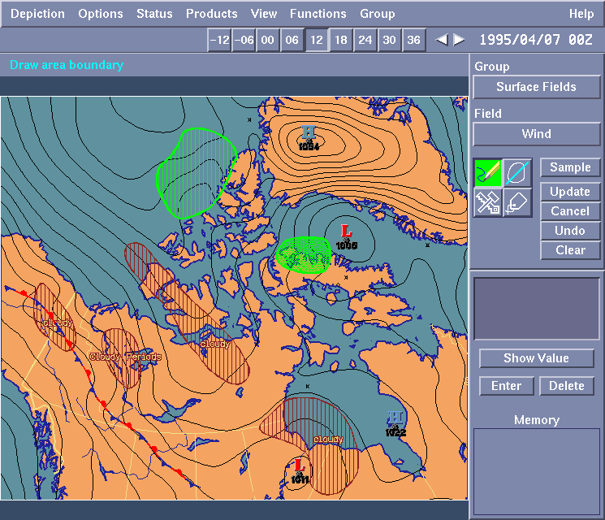
FoG: Input

Slide 66
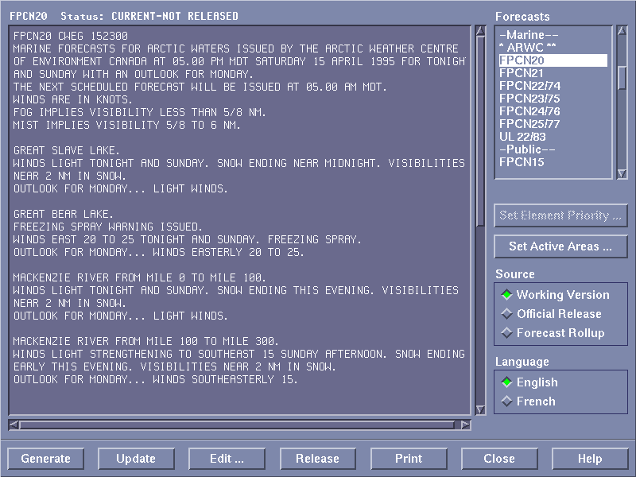
FoG: Output

Slide 67
Word Sense Disambiguation
It's a no-brainer that NLP should be useful and used for web search (and IR in general):
  Search for 'Jaguar'
    the computer should know or ask whether you're interested in big cats [scarce on the web], cars, or, perhaps a molecule geometry and solvation energy package, or a package for fast network I/O in Java
  Search for 'Michael Jordan'
    The basketballer or the machine learning guy?
  Search for laptop, don't find notebook
  Google doesn't even stem:
    Search for probabilistic model, and you don't even match pages with probabilistic models.

Slide 68
WSD
Word sense disambiguation technology generally works well (like text categorization)
Synonyms can be found or listed
Lots of people have been into fixing this
  e-Cyc had a beta version with Hotbot that disambiguated senses, and was going to go live in 2 months … 14 months ago
  Lots of startups:
    LingoMotors
    iPhrase “Traditional keyword search technology is hopelessly outdated”

Slide 69
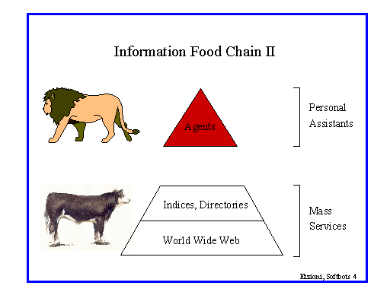

Slide 70
NLP for IR/web search?
Methods which use of rich ontologies, etc., can work very well for intranet search within a customer's site (where anchor-text, link, and click patterns are much less relevant)
  But don't really scale to the whole web
Moral: it's hard to beat keyword search for the task of general ad hoc document retrieval
Conclusion: one should move up the food chain to tasks where finer grained understanding of meaning is needed

Slide 71
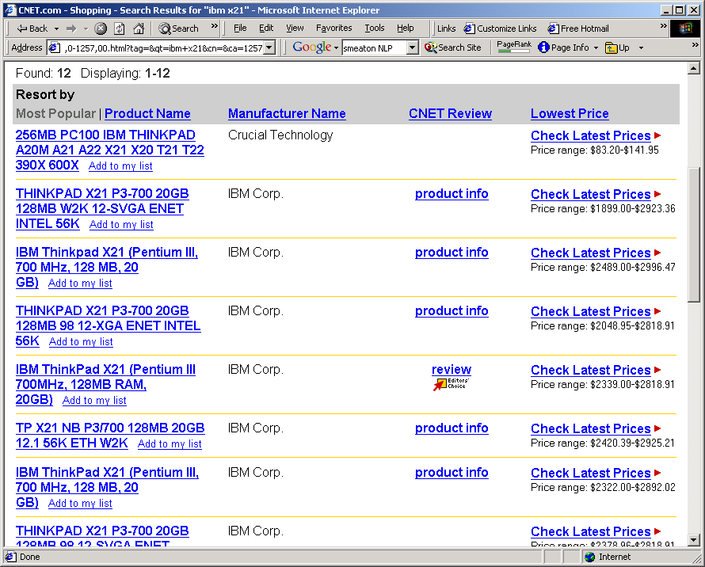
Product information

Slide 72
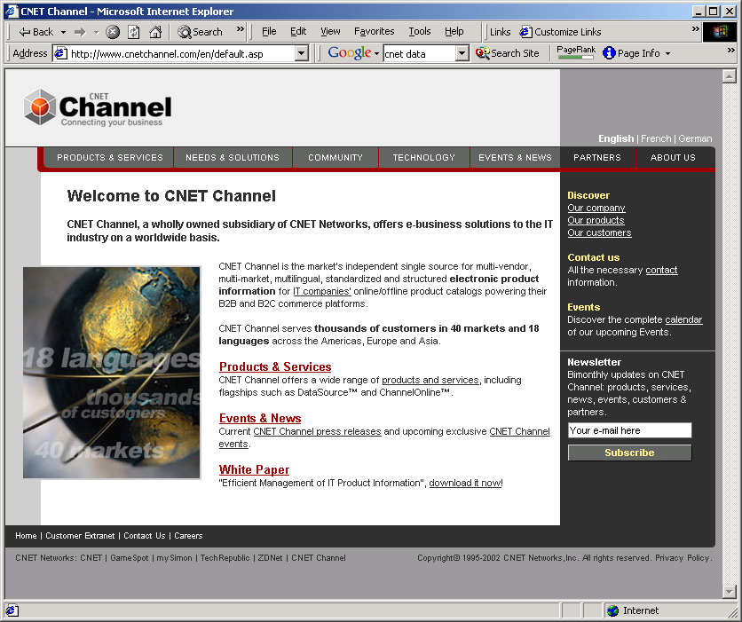
Product info
C-net markets this information
How do they get most of it?
  Phone calls
  Typing.

Slide 73

Inconsistency: digital cameras
Image Capture Device: 1.68 million pixel 1/2-inch CCD sensor
Image Capture Device Total Pixels Approx. 3.34 million Effective Pixels Approx. 3.24 million
Image sensor Total Pixels: Approx. 2.11 million-pixel
Imaging sensor Total Pixels: Approx. 2.11 million 1,688 (H) x 1,248 (V)
CCD Total Pixels: Approx. 3,340,000 (2,140[H] x 1,560 [V] )
  Effective Pixels: Approx. 3,240,000 (2,088 [H] x 1,550 [V] )
  Recording Pixels: Approx. 3,145,000 (2,048 [H] x 1,536 [V] )
These all came off the same manufacturer's website!!
And this is a very technical domain. Try sofa beds.

Slide 74
Comparison shopping
Need to learn to extract info from online vendors
Can exploit uniformity of layout, and (partial) knowledge of domain by querying with known products
E.g., Jango Shopbot (Etzioni and Weld)
  Gives convenient aggregation of online content
Bug: not popular with vendors
  A partial solution is for these tools to be personal agents rather than web services

Slide 75
Email handling
Big point of pain for many people
There just aren't enough hours in the day
  even if you're not a customer service rep
What kind of tools are there to provide an electronic secretary?
  Negotiating routine correspondence
  Scheduling meetings
  Filtering junk
  Summarizing content
“The web's okay to use; it's my email that is out of control”

Slide 76
Text Categorization Uses
Take a document and assign it a label representing its content (MeSH heading, ACM keyword, Yahoo category)
Classic example: decide if a newspaper article is about politics, business, or sports?
There are many other uses for the same technology:
  Is this page a laser printer product page?
  Does this company accept overseas orders?
  What kind of job does this job posting describe?
  What kind of position does this list of responsibilities describe?
  What position does this this list of skills best fit?
  Is this the “computer” or “harbor” sense of port?

Slide 77
Text Categorization
Usually, simple machine learning algorithms are used.
Examples: Naïve Bayes models, decision trees.
Very robust, very re-usable, very fast.
Recently, slightly better performance from better algorithms
  e.g., use of support vector machines, nearest neighbor methods, boosting
Accuracy is more dependent on:
  Naturalness of classes.
  Quality of features extracted and amount of training data available.
Accuracy typically ranges from 65% to 97% depending on the situation
  Note particularly performance on rare classes

Slide 78
Email response: “eCRM”
Automated systems which attempt to categorize incoming email, and to automatically respond to users with standard, or frequently seen questions
Most but not all are more sophisticated than just keyword matching
Generally use text classification techniques
  E.g., Echomail, Kana Classify, Banter
  More linguistic analysis: YY software
Can save real money by doing 50% of the task close to 100% right

Slide 79
Financial markets
Quantitative data are (relatively) easily and rapidly processed by computer systems, and consequently many numerical tools are available to stock market analysts
  However, a lot of these are in the form of (widely derided) technical analysis
  It's meant to be information that moves markets
Financial market players are overloaded with qualitative information – mainly news articles – with few tools to help them (beyond people)
  Need tools to identify, summarize, and partition information, and to generate meaningful links

Slide 80
Text Clustering
Scatter/Gather Clustering
  Cutting, Pedersen, Karger, Tukey '92, '93
Cluster sets of documents into general “themes”, like a table of contents
Display the contents of the clusters by showing topical terms and typical titles
User chooses subsets of the clusters and re-clusters the documents within them
Resulting new groups have different “themes”

Slide 81
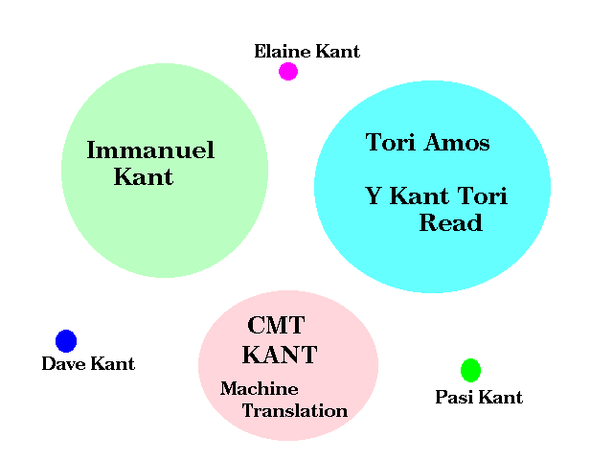
Clustering (of query Kant)

Slide 82
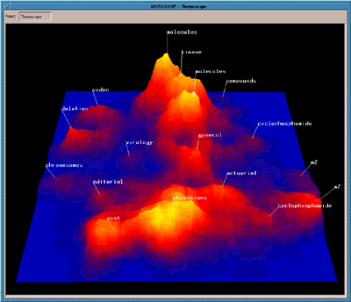
Clustering a Multi-Dimensional Document Space
Notes:
This summarized the topics in a week's newswire articles

Slide 83
Clustering
June 11, 2001: The latest KDnuggets Poll asked: What types of analysis did you do in the past 12 months.
  The results, multiple choices allowed, indicate that a wide variety of tasks is performed by data miners. Clustering was by far the most frequent (22%), followed by Direct Marketing (14%), and Cross-Sell Models (12%)
Clustering of results can work well in certain domains (e.g., biomedical literature)
But it doesn't seem compelling for the average user, it appears (Altavista, Northern Light, Vivisimo)

Slide 84
Citeseer/ResearchIndex
An online repository of papers, with citations, etc. Specialized search with semantics in it
Great product; research people love it
However it's fairly low tech. NLP could improve on it:
  Better parsing of bibliographic entries
  Better linking from author names to web pages
  Better resolution of cases of name identity
    E.g., by also using the paper content
    Cf. Cora, which did some of these tasks better

Slide 85
Chats, Forums, etc.
Many of these are public on the web
The signal to noise ratio is very low
But there's still lots of good information there
Some of it has commercial value
  What problems have users had with your product?
  Why did people end up buying product X rather than your product Y
Some of it is time sensitive
  Rumors on chat rooms can affect stockprice
    Regardless of whether they are factual or not

Slide 86
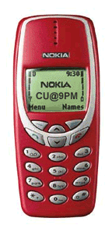
Small devices
With a big monitor, humans can scan for the right information
On a small screen, there's hugely more value from a system that can show you what you want:
  phone number
  business hours
  email summary
    “Call me at 11 to finalize this”

Slide 87
Machine translation
High quality MT is still a distant goal
But MT is effective for scanning content
And for machine-assisted human translation
Dictionary use accounts for about half of a traditional translator's time.
Printed lexical resources are not up-to-date
Electronic lexical resources ease access to terminological data.
“Translation memory” systems: remember previously translated documents, allowing automatic recycling of translations

Slide 88
Jackson & Moulinier
The Web really changed everything, because there was suddenly a pressing need to process large amounts of text, and there was also a ready-made vehicle for delivering it to the world. Technologies such as information retrieval, information extraction, and text categorization no longer seemed quite so arcane to upper management. The applications were, in some cases, obvious to anyone with half a brain; all one needed to do was demonstrate that they could be built and made to work, which we proceeded to do.”

Slide 89
Information Extraction
Suppositions:
A lot of information that could be represented in a structured semantically clear format isn't
It may be costly, not desired, or not in one's control (screen scraping) to change this.
Goal: being able to answer semantic queries using “unstructured” natural language sources

Slide 90
Information Extraction
Information extraction systems
  Find and understand relevant parts of texts.
  Produce a structured representation of the relevant information: relations (in the DB sense)
  Combine knowledge about language and the application domain
  Automatically extract the desired information
When is IE appropriate?
  Clear, factual information (who did what to whom and when?)
  Only a small portion of the text is relevant.
  Some errors can be tolerated

Slide 91
Wrapper Induction
Wrapper Induction
  Sometimes, the relations are structural.
    Web pages generated by a database.
    Tables, lists, etc.
  Wrapper induction is usually regular relations which can be expressed by the structure of the document:
    the item in bold in the 3rd column of the table is the price
Handcoding a wrapper in Perl isn't very viable
  sites are numerous, and their surface structure mutates rapidly
Wrapper induction techniques can also learn:
  If there is a page about a research project X and there is a link near the word 'people' to a page that is about a person Y then Y is a member of the project X.
    [e.g, Tom Mitchell's Web->KB project]

Slide 92
Existing IE Systems
Systems to summarize medical patient records by extracting diagnoses, symptoms, physical findings, test results, and therapeutic treatments.
Gathering earnings, profits, board members, etc. from company reports
Verification of construction industry specifications documents (are the quantities correct/reasonable?)
Real estate advertisements
Building job databases from textual job vacancy postings
Extraction of company take-over events
Extracting gene locations from biomed texts

Slide 93
3 generations of IE systems
Hand-Built Systems – Knowledge Engineering [1980s– ]
  Rules written by hand
  Require experts who understand both the systems and the domain
  Iterative guess-test-tweak-repeat cycle
Automatic, Trainable Rule-Extraction Systems [1990s– ]
  Rules discovered automatically using predefined templates, using methods like ILP
  Require huge, labeled corpora (effort is just moved!)
Statistical Generative Models [1997 – ]
  One decodes the statistical model to find which bits of the text were relevant, using HMMs or statistical parsers
  Learning usually supervised; may be partially unsupervised

Slide 94
Name Extraction via HMMs
The delegation, which included the commander of the U.N. troops in Bosnia, Lt. Gen. Sir Michael Rose, went to the Serb stronghold of Pale, near Sarajevo, for talks with Bosnian Serb leader Radovan Karadzic.
The delegation, which included the commander of the U.N. troops in Bosnia, Lt. Gen. Sir Michael Rose, went to the Serb stronghold of Pale, near Sarajevo, for talks with Bosnian Serb leader Radovan Karadzic.
training
sentences
Training
Program
answers
NE
Models
Speech
Speech
Recognition
Entities
Extractor
Text
Prior to 1997 - no learning approach competitive with hand-built rule systems
Since 1997 - Statistical approaches (BBN, NYU, MITRE, CMU/JustSystems) achieve state-of-the-art performance
Locations
Persons
Organizations

Slide 95
Classified Advertisements
<ADNUM>2067206v1</ADNUM>
<DATE>March 02, 1998</DATE>
<ADTITLE>MADDINGTON $89,000</ADTITLE>
<ADTEXT>
OPEN 1.00 - 1.45<BR>
U 11 / 10 BERTRAM ST<BR>
NEW TO MARKET Beautiful<BR>
3 brm freestanding<BR>
villa, close to shops & bus<BR>
Owner moved to Melbourne<BR>
ideally suit 1st home buyer,<BR>
investor & 55 and over.<BR>
Brian Hazelden 0418 958 996<BR>
R WHITE LEEMING 9332 3477
</ADTEXT>
Background:
Advertisements are plain text
Lowest common denominator: only thing that 70+ newspapers with 20+ publishing systems can all handle

Slide 96
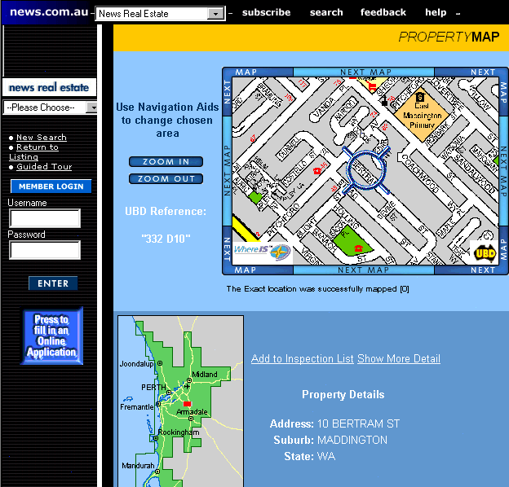

Slide 97
Why doesn't text search (IR) work?
What you search for in real estate advertisements:
Suburbs. You might think easy, but:
  Real estate agents: Coldwell Banker, Mosman
  Phrases: Only 45 minutes from Parramatta
  Multiple property ads have different suburbs
Money: want a range not a textual match
  Multiple amounts: was $155K, now $145K
  Variations: offers in the high 700s [but not rents for $270]
Bedrooms: similar issues (br, bdr, beds, B/R)

Slide 98
Machine learning
To keep up with and exploit the web, you need to be able to learn
  Discovery: How do you find new information sources S?
  Extraction: How can you access and parse the information in S?
  Semantics: How does one understand and link up the information in contained in S?
  Pragmatics: What is the accuracy, reliability, and scope of information in S?
Hand-coding just doesn't scale

Slide 99
Question Answering
TREC 8/9 QA competition: an idea originating from the IR community
With massive collections of on-line documents, manual translation of knowledge is impractical: we want answers from textbases [cf. bioinformatics]
Evaluated output is 5 answers of 50/250 byte snippets of text drawn from a 3 Gb text collection, and required to contain at least one concept of the semantic category of the expected answer type. (IR think. Suggests the use of named entity recognizers.)
Get reciprocal points for highest correct answer.

Slide 100
Pasca and Harabagiu (2001)
Good IR is needed: paragraph retrieval based on SMART
Large taxonomy of question types and expected answer types is crucial
Statistical parser (modeled on Collins 1997) used to parse questions and relevant text for answers, and to build knowledge base
Controlled query expansion loops (morphological, lexical synonyms, and semantic relations) are all important
Answer ranking by simple ML method

Slide 101
Question-Answering
How hot does the inside of an active volcano get?
get(TEMPERATURE, inside(volcano(active)))
“lava fragments belched out of the mountain were as hot as 300 degrees Fahrenheit”
fragments(lava, TEMPERATURE(degrees(300)),
  belched(out, mountain))
  volcano ISA mountain
  lava ISPARTOF volcano • lava inside volcano
  fragments of lava HAVEPROPERTIESOF lava
The needed semantic information is in WordNet definitions, and was successfully translated into a form that can be used for rough 'proofs'

Slide 102
Machine Translation

Slide 103
Machine Translation
Translation from one natural language to another by means of a computerized system
Early failures
Later: varying degrees of success

Slide 104
An Old Example
The spirit is willing but the flesh is weak
The vodka is good but the meat is rotten

Slide 105
Machine Translation
analysis
input
generation
output
Morphological analysis
Morphological synthesis
Syntactic analysis
Syntactic realization
Semantic Interpretation
Lexical selection
Interlingua

Slide 106
Machine Translation History
1950's: Intensive research activity in MT
1960's: Direct word-for-word replacement
1966 (ALPAC): NRC Report on MT
Conclusion: MT no longer worthy of serious scientific investigation.
1966-1975: Recovery period
1975-1985: Resurgence (Europe, Japan)
1985-present: Resurgence (US)
Internet

Slide 107
What happened?
Need for MT and other NLP applications confirmed
Change in expectations
Computers have become faster, more powerful
WWW
Political state of the world
Maturation of Linguistics
Development of hybrid statistical/symbolic approaches

Slide 108
MT Approaches
Interlingua
Semantic
Composition
Semantic
Decomposition
Semantic
Structure
Semantic
Structure
Semantic
Analysis
Semantic
Transfer
Semantic
Generation
Syntactic
Structure
Syntactic
Structure
Syntactic
Analysis
Syntactic
Transfer
Syntactic
Generation
Word
Structure
Word
Structure
Direct
Morphological
Analysis
Morphological
Generation
Source Text
Target Text

Slide 109
Three Approaches
Direct:
  I checked his answers against those of the teacher →
  Yo comparé sus respuestas a las de la profesora
  Rule: [check X against Y] → [comparar X a Y]
Transfer:
  Ich habe ihn gesehen → I have seen him
  Rule: [clause agt aux obj pred] → [clause agt aux pred obj]
Interlingual:
  I like Mary→ Mary me gusta a mí
  Rep: [Be_{Ident} (I [AT_{Ident} (I, Mary)] Like+ingly)]

Slide 110
Direct
Pros
  Fast
  Simple
  Inexpensive
Cons
  Unreliable
  Not powerful
  Rule proliferation
  Requires too much context
  Major restructuring after lexical substitution

Slide 111
Transfer
Pros
  Don't need to find language-neutral rep
  No translation rules hidden in lexicon
  Relatively fast
Cons
  N² sets of transfer rules: Difficult to extend
  Proliferation of language-specific rules in lexicon and syntax
  Cross-language generalizations lost

Slide 112
Interlingual
Pros
  Portable (avoids N² problem)
  Lexical rules and structural transformations stated more simply on normalized representation
  Explanatory Adequacy
Cons
  Difficult to deal with terms on primitive level: universals?
  Must decompose and reassemble concepts
  Useful information lost (paraphrase)

Slide 113
Mapping from Input Dependency to English Dependency Tree
Mary le dio patadas a John → Mary kicked John
GIVE_{V}
KICK_{V}
[CAUSE GO]
[CAUSE GO]
Agent
Theme
Goal
Agent
Goal
MARY
KICK_{N}
JOHN
MARY
JOHN
Knowledge Resources in English only: (LVD; Dorr, 2001).

Slide 114
Statistical Extraction
Mary kicked John . [0.670270 ]
Mary gave a kick at John . [-2.175831]
Mary gave the kick at John . [-3.969686]
Mary gave an kick at John . [-4.489933]
Mary gave a kick by John . [-4.803054]
Mary gave a kick to John . [-5.045810]
Mary gave a kick into John . [-5.810673]
Mary gave a kick through John . [-5.836419]
Mary gave a foot wound by John . [-6.041891]
Mary gave John a foot wound . [-6.212851]

Slide 115
MT Challenges: Ambiguity
Syntactic Ambiguity
I saw the man on the hill with the telescope
Lexical Ambiguity
  E: book
  S: libro, reservar
Semantic Ambiguity
  Homography:
  ball(E) = pelota, baile(S)
  Polysemy:
  kill(E), matar, acabar (S)
  Semantic granularity
  esperar(S) = wait, expect, hope (E)
  be(E) = ser, estar(S)
  fish(E) = pez, pescado(S)

Slide 116
Conclusion

Slide 117
Controversial questions
Language organ
Universal grammar
Single dramatic mutation or gradual adaptation?

Slide 118
Thanks...
Bob Berwick (MIT)
Chris Manning (Stanford)
Bonnie Dorr, Nizar Habash (Maryland)
Peter Hancox (Birmingham)
Paula Matuszek, Mary-Angela Papalaskari (Villanova)
Heshaam Feili (Sharif)
Ehud Reiter (Aberdeen)

