Slide 1


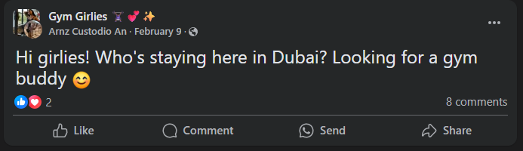
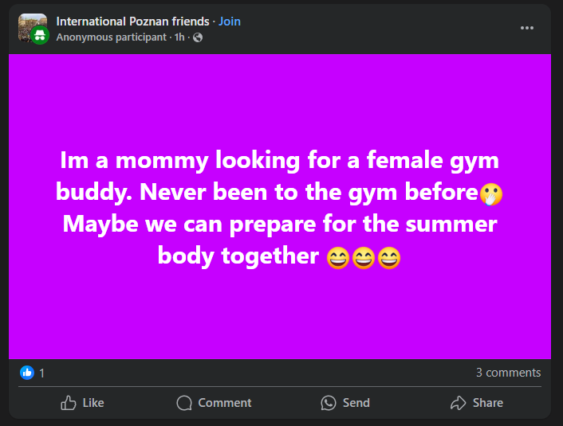
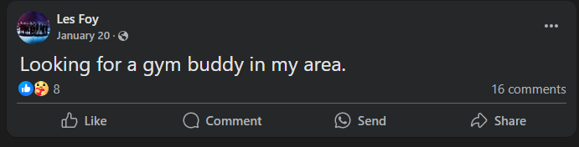
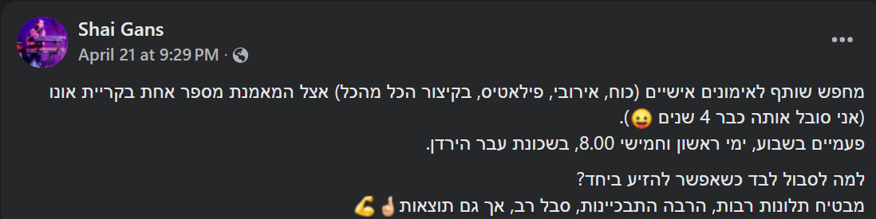

Slide 2

Gymder
Almog Haviv, Nir Anchel, Tal Cohen and Saar Molina

Slide 3



Gymder transforms your fitness journey by delivering personalized recommendations that drive connection, motivation, and results.
Connects users with compatible workout partners
Value
Proposition
Provides targeted exercise video content
Learns and adapts to your preferences

Slide 4
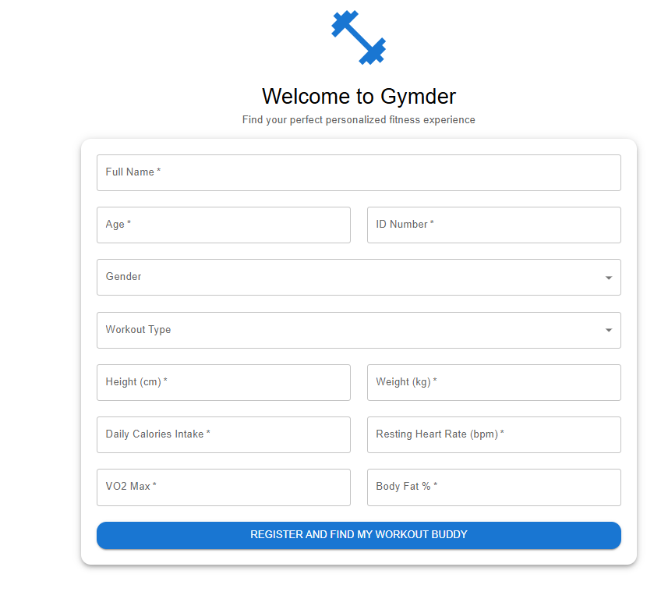
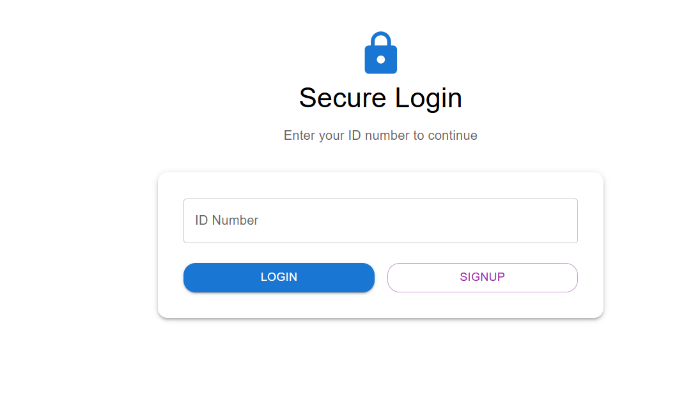
Notes:
https://myfitnesswebapp-frontend.onrender.com/

Slide 5
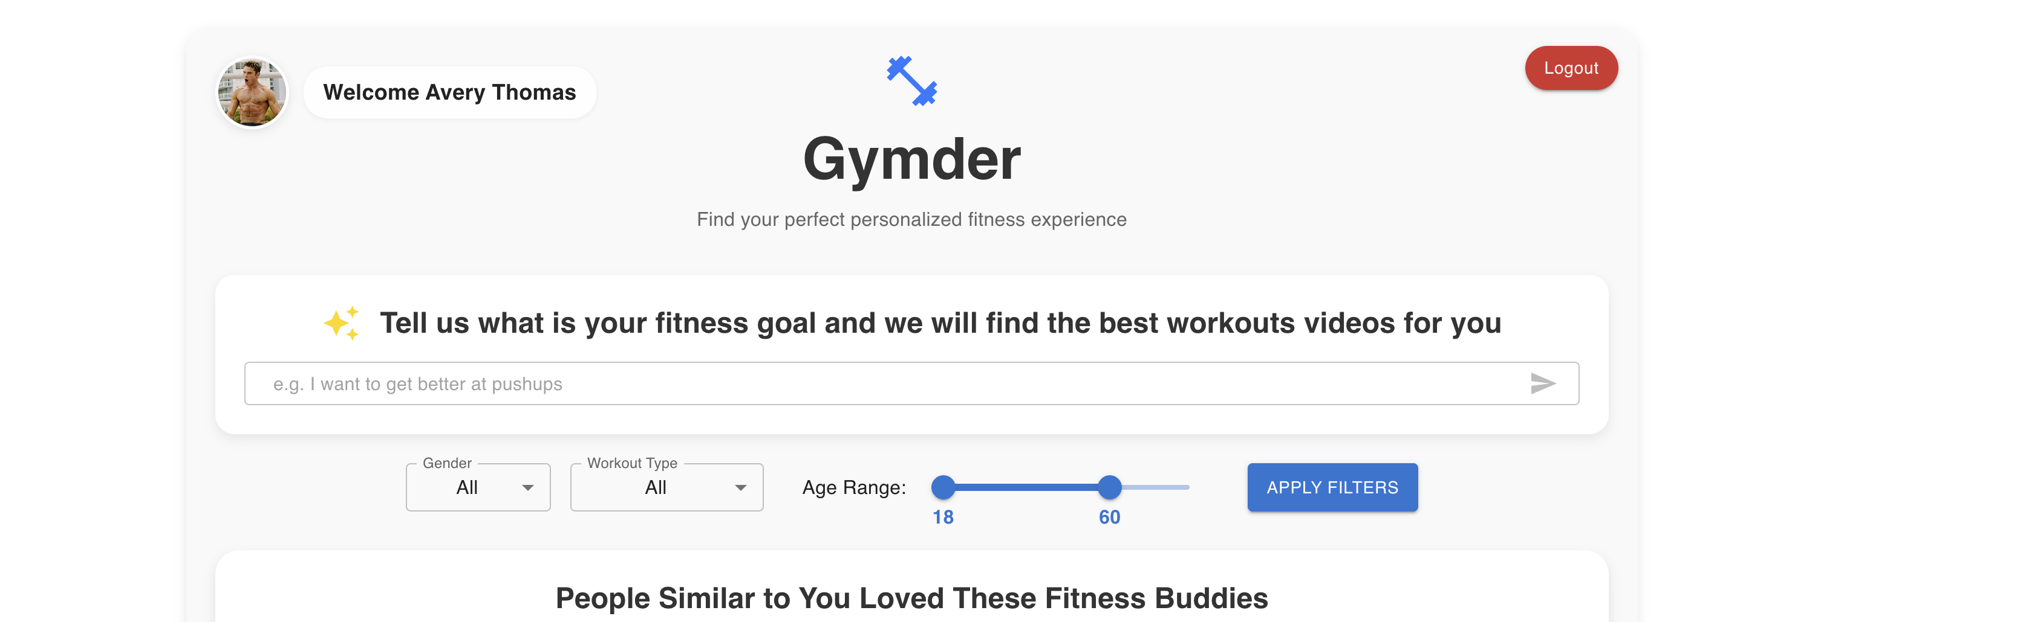
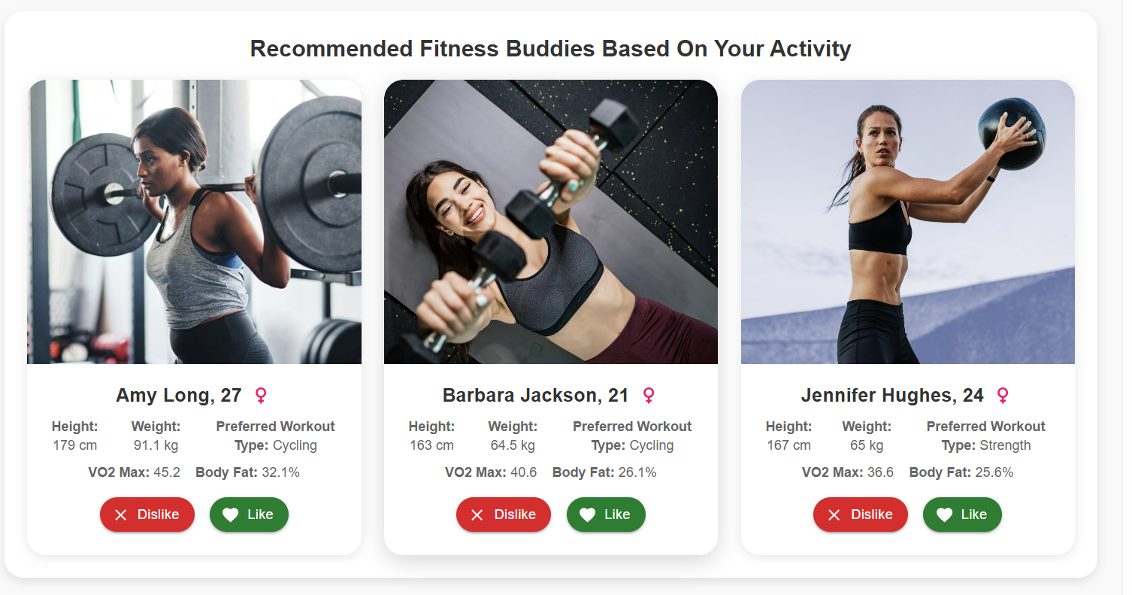
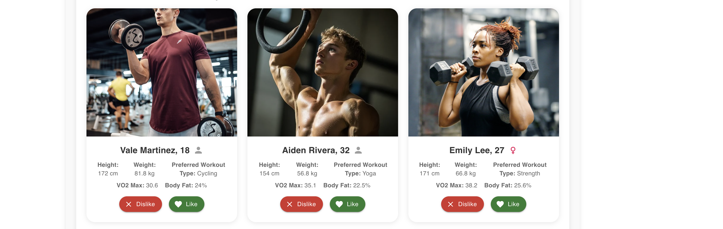
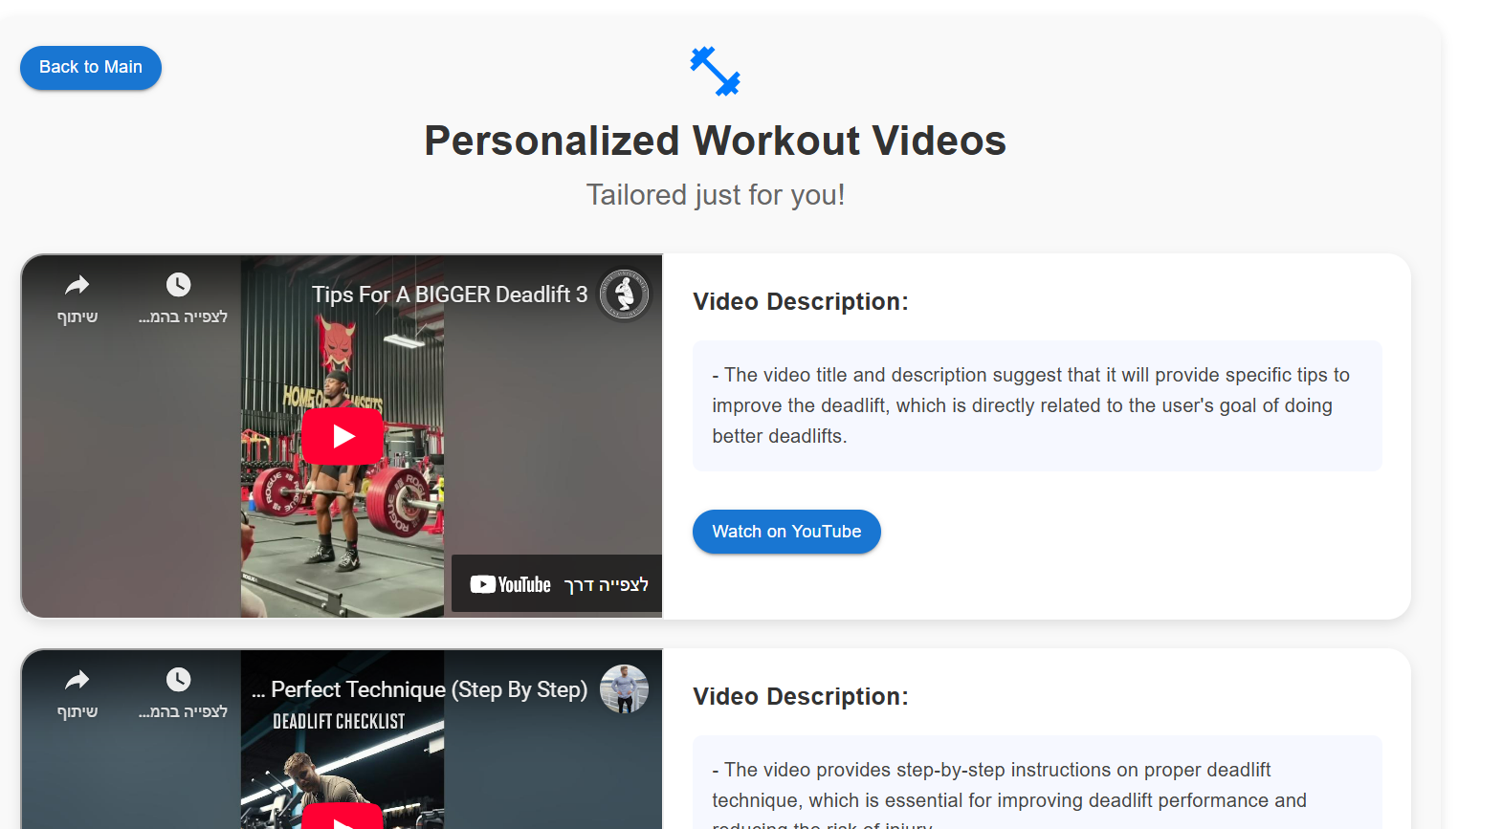
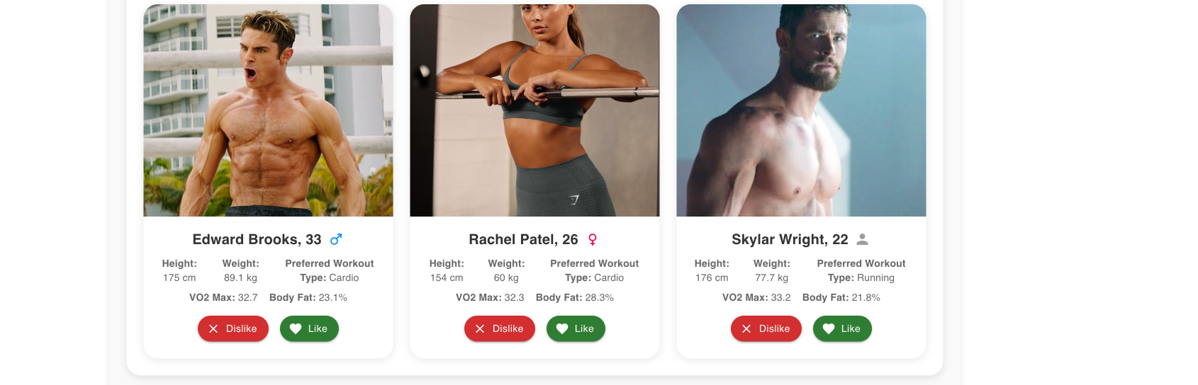
Notes:
https://myfitnesswebapp-frontend.onrender.com/

Slide 6
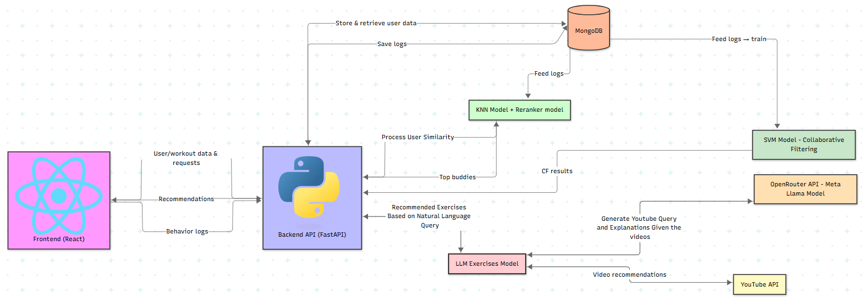
Project Architecture

Slide 7
Datesets
Dataset 1: Workout & Fitness Tracker Dataset
Contains user physiological data (e.g., age, gender, workout type, height, weight, etc.).
Enhancements: Added BMI and body fat using preprocessing scripts
Dataset 2: Synthetic interaction dataset
750,000 user-buddy like/dislike interactions.
Created using compatibility-based rules and probabilistic modeling.

Slide 8
ML Models
K-NN
XGBoost
Finds similar users (buddies) as candidates
Reranks KNN candidates using rich features for best recommendations
SVD
LLM
Learns deeper user-buddy compatibility from interaction data
Generates and explains workout video recommendations

Slide 9
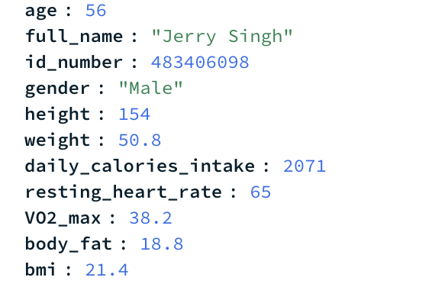
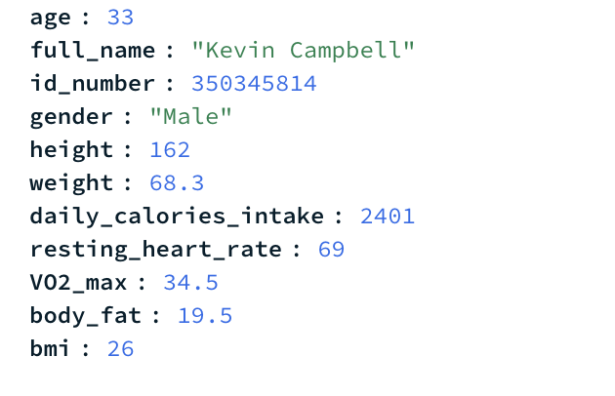
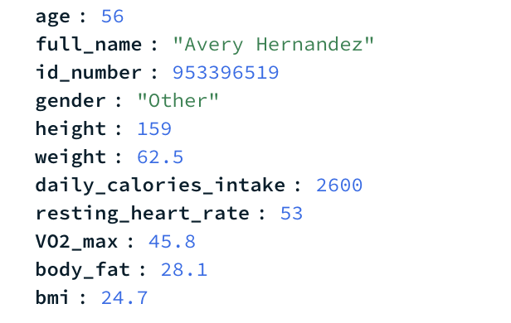
K-NN: Content-Based Filtering
Finds physiologically similar users based on fitness characteristics
Interactions:
Receives user profile data
Processes fitness metrics
Provides input to XGBoost reranker
Features:
Separate models for male/other and female users
Euclidean distance with feature weighting
Real-time filtering by age, gender, and workout type
Technology: scikit-learn, NumPy, Pandas

Slide 10
XGBoost Reranker: Hybrid Approach
Reranks and optimizes recommendations from the KNN model using advanced features
Huge lift in performance!
Features Engineering:
Compatibility score
Same workout type indicator
Matches user's recent liked workouts
Gender & age similarity
Historical interaction context
Output: Top 6 recommended buddies
KNN results
3
1
2
4
Technology: XGBoost, scikit-learn RandomizedSearchCV

Slide 11
SVD: Collaborative Filtering
Discovers latent user-buddy preferences from interaction patterns
Uses user-buddy interaction matrix (likes/dislikes)
Generates user and buddy embeddings (20 latent factors)
Provides collaborative filtering recommendations
Works alongside content-based filtering for hybrid approach
Output: Top 3 recommended buddies
user id | 1 | 2 | 3 | 4 | 5
1 | 0 | -1 | 0 | 1 | 0
2 | 1 | 0 | 1 | -1 | 0
3 | 0 | -1 | 0 | 0 | 1
4 | -1 | 1 | 0 | 0 | 0
5 | 0 | 0 | -1 | 1 | 0
Like = “1”
Dislike = “–1”
Technology: scikit-learn, PyTorch

Slide 12
XGBoost Reranker
SVD (Scikit-learn)
Accuracy: 0.9064
Precision: 0.8831
Recall: 0.6635
F1-Score: 0.7577
ROC-AUC: 0.9386
NDCG@6: 0.8954
NDCG@10: 0.9222
Accuracy: 0.2241
Precision: 0.2204
Recall: 0.9964
F1_Dcore: 0.3610
ROC-AUC: 0.5460
NDCG@6: 0.6579
NDCG@10: 0.6070
🤝
vs.
Excels at precision and ranking the most relevant buddies at the top.
May miss less obvious matches due to its focus on strong signals.
Achieves extremely high recall by exploring the full interaction space, surfacing buddies XGBoost might overlook.
Precision/Recall for classification performance
F1-Score for balanced performance
ROC-AUC for model discrimination
NDCG@K for ranking quality
Notes:
While the XGBoost reranker excels at precision and ranking the most relevant buddies at the top, it can struggle with recall - potentially missing out on less obvious but still relevant matches due to its focus on strong signals and boosting. The SVD model, by contrast, is highly effective at recall: it explores the full user-buddy interaction matrix and can surface buddies that XGBoost might overlook, ensuring that nearly all relevant candidates are considered. This is reflected in its extremely high recall (0.9964), meaning it rarely misses a possible match, even if its precision is lower.

Slide 13
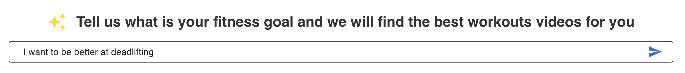
LLM: Workout Recommendations
Generates personalized workout video recommendations using NLP
Enhances user queries using LLM for better YouTube search
Analyzes video content and generates personalized explanations
Returns curated workout videos with descrpitions
Output: 4 personalized workout video recommendations
Technology: OpenRouter API, YouTube Data API
Self-hosted LLM models: latency and resource issues

Slide 14

Real-time model updates
Smarter diversity control
Into The
Future
More accurate and personalized workout suggestions

