Slide 1

News Rec.
Shahar Glam, Daniel Volkov, Gil Greenstein, Aviv Bar-Or
Notes:
Good afternoon everyone, and thank you for staying until now.
We’re the last team standing — so let’s make sure we leave a good final impression.
Today, we’re excited to present our final project — Hermes, a personalized news recommendation system.

Slide 2

THE PROBLEM
Too much information
Too little trust
Radical & Independent sources
Notes:
So the motivation for our project is a problem we all are familiar with — the way people consume news today is broken.
We’re living in the most connected era in history — and yet, people are more misinformed, overwhelmed, and polarized than ever.
News is everywhere — but today we either get it from old-school platforms filled with irrelevant content, or from social media full of clickbait posts and misinformation.
Either way, we end up seeing content that just reinforces what we already believe.
As a result, many people avoid the news altogether — and when they do try to engage, they’re often left with a distorted or incomplete picture.

Slide 3



Notes:
So let’s just review this quick example from just last Saturday. (Cue slide)
Two major outlets reported the exact same event — but in completely different ways.
So if you only follow one source, you’re not uninformed — you’re misinformed.
So to conclude, the core problem we are addressing is helping people access news that’s relevant and personalised to them,
without leaving them trapped in a bubble and half informed.
We are now going to dive straight into the live DEMO. for that i’m going to pass the stage to Shahar

Slide 4
DEMO
Notes:
shahar

Slide 5
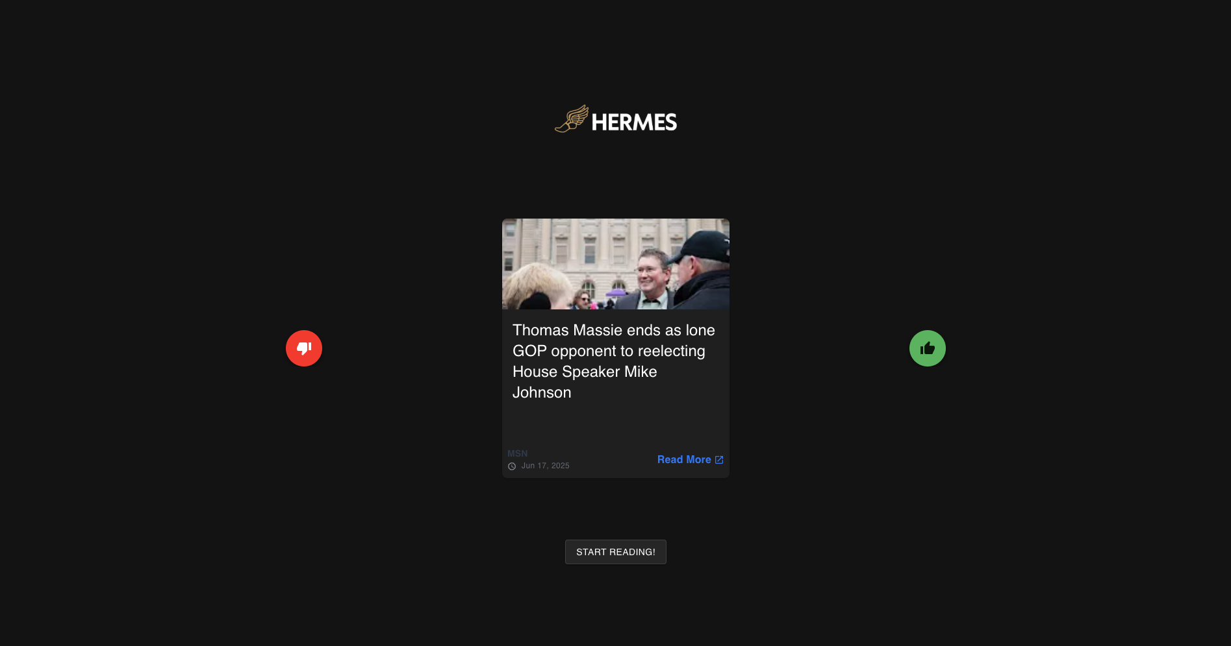
Notes:
shahar

Slide 6
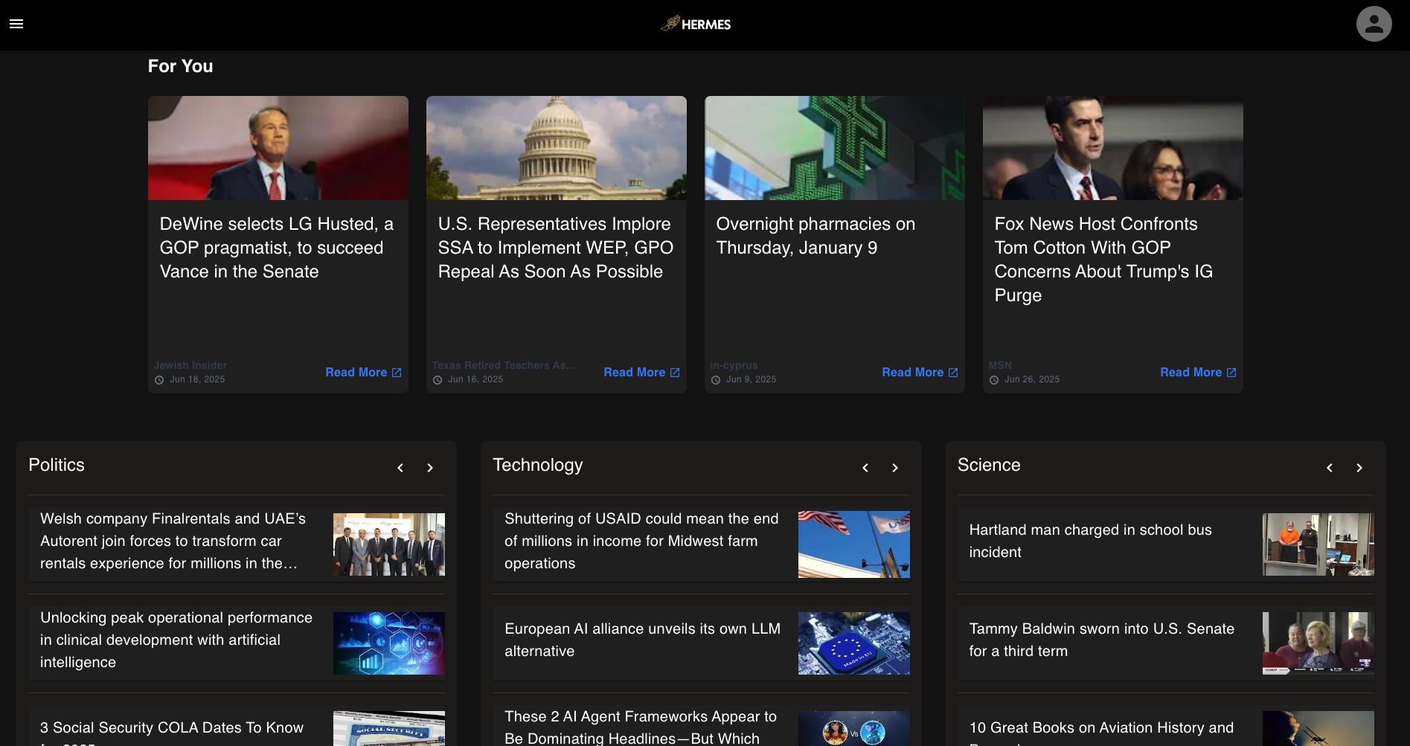
Notes:
shahar

Slide 7





An Article’s Journey
Classify topic
Scrape
Embed
Notes:
Let’s start at the very beginning of our pipeline — with the articles themselves.
We fetch news articles from two sources:
First, a large static dataset of over 150,000 articles from Google News,
and second, live articles pulled using the GNews API.
Once we fetch an article, it goes through two main components:
First, we assign it a topic using meta’s roberta zero shot classifier, which helps us classify each article into a clear category.
Second, we embed the article title — this allows us to compare it with other articles and use it later on in the recommendation model.
Once both steps are complete, the article is stored in our MongoDB database, ready to power real-time personalization.

Slide 8
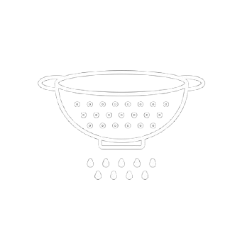
FILTERING ARTICLES
^{Candidates}
^{Stale Articles}

Slide 9
RECOMMENDATION ENGINE (!)
Rank user’s top topics based on history. We use counts of topics from the user’s history.
For each topic, rank topic’s articles conditioned on user’s history and the article titles. (Purely content based)
Notes:
Daniel -
To achieve the fully personalized interface we saw earlier, we use a hierarchical approach:
For each user, we first rank the most relevant topics for him, based on his history, by simply sorting them by their counts in the user’s history.
Then, for each topic - we rank the articles inside that topic using a content based approach.

Slide 10
RANKING ARTICLES
(Inspired by the NRMS paper!)
Article Embedding
MLP
Sum Pool
…
Transformer Encoder
…
“Elon
Musk
Presents
New
Spaceship”
(Article header, tokenized)
Notes:
Daniel -
For the ranking of articles we draw inspiration from the NRMS paper, training on the same dataset and having a very similar architecture.
We take a latent-space embedding approach, hoping to capture semantic meanings of titles in a given user’s history, and recommending items with titles which semantically match their taste.
First, we need a way to embed a given article to a dense vector - to do this, we first tokenize it’s header and pass it through a transformer encoder. By that point we have a sequence of vectors which should be semantically contextualized. We then sum all embeddings to acquire a single vector, and finally pass that through a small MLP post-net to obtain the final article embedding.

Slide 11
Click probability
MLP
Dot product
Sum Pool
…
Transformer Encoder
…
Use cached embeddings
Article embedding (prev. slide)
Article encoder
…
…
Candidate article
Article 1
Article K
(User’s article history)
Notes:
Daniel -
Then, to model a user’s probability of clicking on a candidate article we use the article embeddings from the previous slide - We feed them into another transformer encoder, which now should output a sequence of contextualized ‘article tokens’, essentially representing the user’s taste as a sequence of vectors.
We then sum-pool and run another post-net to acquire a ‘user embedding’, which should be a vector that represents a given user’s taste, based on their history.
We then encode the candidate article using the same encoder from the previous slide, and take the dot product between the user and candidate embeddings to achieve the final click probability.
In practice, we run the article embedding once on every article when it enters our database, and cache the result to be used to recommend items faster.

Slide 12
FUTURE WORK
Diversity We will be adding more diversity, doing so will help users discover new and unexpected content they actually care about. | Event Categorization Event categorization will give us an enhanced understanding of what suits the user — so we can better keep them engaged in the event in real time.
Notes:
To wrap up, we’d like to briefly highlight two major features we didn’t get to fully implement, but see as important next steps for Hermes.
The first is diversity-aware re-ranking: Re-ranking is a post-processing step where we take the top recommended articles and reorder them to balance relevance with diversity — for example, mixing political viewpoints or introducing topic variety — without sacrificing too much engagement.
Practically, we would use algorithms like MMR (Maximal Marginal Relevance) or intent-aware re-ranking, which penalize redundancy and encourage topical or ideological variety.
The second feature is event-based categorization. Currently, articles are grouped into broad, predefined categories like business, technology, or health. But real-world news often revolves around emerging events, like The War in Ukraine or Elections 2025.
Our goal was to dynamically cluster articles into such high-level events — so users could explore evolving stories beyond static topics.
To do this, we’d apply unsupervised clustering on article embeddings — possibly using BERTopic or other topic modeling techniques — and assign emerging event labels based on semantic similarity and timeline grouping.”

Slide 13
THANK YOU!

