Slide 1



ScoutPro
Smarter scouting. Data-driven decisions. Game-changing results.

Slide 2

Table of Contents
Overview of the ScoutPro Recommendation System
01
02
03
Project Motivation
The Data
System Architecture
Why modern football scouting needs smarter tools.
What datasets we used and how we prepared them.
Behind the scenes: data flow, algorithms, and structure.
04
05
06
Scoring and Recommendation Logic
Demo & User Interface
Conclusion & Future Work
Screenshots and walkthrough of the platform.
Takeaways and ideas for improving ScoutPro.
How players are evaluated and ranked (Similarity Score).

Slide 3

Why Smart Scouting Matters
Modern football is driven by data. Clubs manage hundreds of player profiles.
Traditional scouting is often subjective, inconsistent, and time-consuming.
There’s a growing need for tools that help scouts make fast, data-driven decisions.
ScoutPro was built to fill this gap - giving every scout the power of smart analysis.

Slide 4

Data Collection & Preparation
Final Dataset:
We got 4,000 active players From hundreds of clubs worldwide Includes:
  Personal details
  Full skill attributes
  Season stats
  Club-position mapping
We collected a player dataset from Kaggle, including all footballers and clubs and filtered out retired players to keep only active ones.
We used a match appearances dataset and cross-referenced with active players to extract goals and assists from the current season.
We added detailed FIFA-style attributes and merged them into our dataset to add attrivutes to each player profile.
We cleaned missing data and removed players with missing critical attributes or stats.
We built a team dictionary that maps each club to its current players, grouped by position.
We also used a transfers dataset, that has transfers of players from one club to another in the last five years.
This dataset was the foundation for all our algorithms and recommendation logic.

Slide 5
Algorithms and Changes From Mid Presentation
01
Transfer Vectors:
Each team will have a transfer vector representing the types of players they tend to buy based on past transfers.
This captures the team's player acquisition preferences.
02
Team Vectors:
Team vectors will be built based on the attributes of current squad players, reflecting the team's playing style
03
Matrix Factorization:
We will use matrix factorization with cosine similarity to identify similar teams based on their historical transfers and current squad profiles.
04
Hybrid Recommendation Model:
Combine CF (based on transfer data) and CB (based on player attributes) to provide more accurate recommendations.
The final score will reflect both player fit within the existing squad and similarity to players preferred by similar clubs.

Slide 6

How ScoutPro Works (Behind the Scenes)
Scoring Engine: Calculates:
Content Based filtering on TF-IDF vectors for players and vectors for teams based on their current players.
Collaborative Filtering based on TF-IDF vectors for players and vectors for teams based on their recent players they bought.
Tech Stack:
Flask for backend routing and templating
Pandas + scikit-learn for data processing and ML
Bootstrap for UI
Similarity Score: For each method we computed a Matrix and calculated the cosine similarity between the player and the team.
Final Score = 0.8 * CB + 0.2 * CF

Slide 7




Our Recommendation modes
Two Recommendation Modes:
Search Mode:
The user gets a variety of filters to choose from, and gets the most fitting
players for his team based on these filters.
Smart Recommendation Mode:
This works just like Netflix: "Because your team has players like X - we recommend Y."
Here we focus purely on style-based similarity, highlighting players who best match the roles, patterns, and clusters found in your current squad,
based on categories like top players under 21, the hottest players in the world
and more.

Slide 8



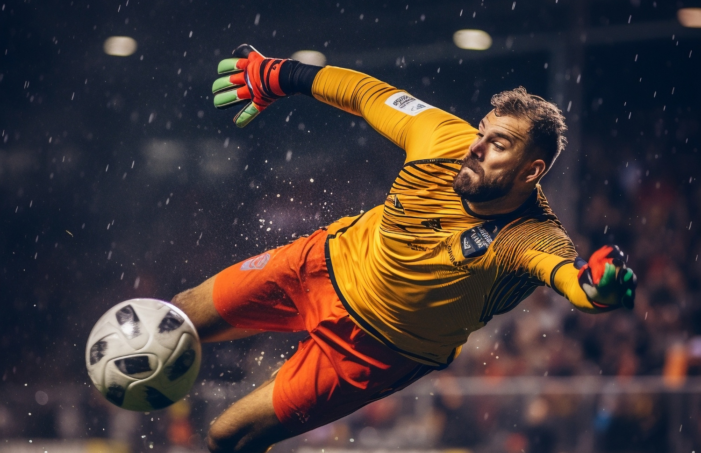


Demo

Slide 9
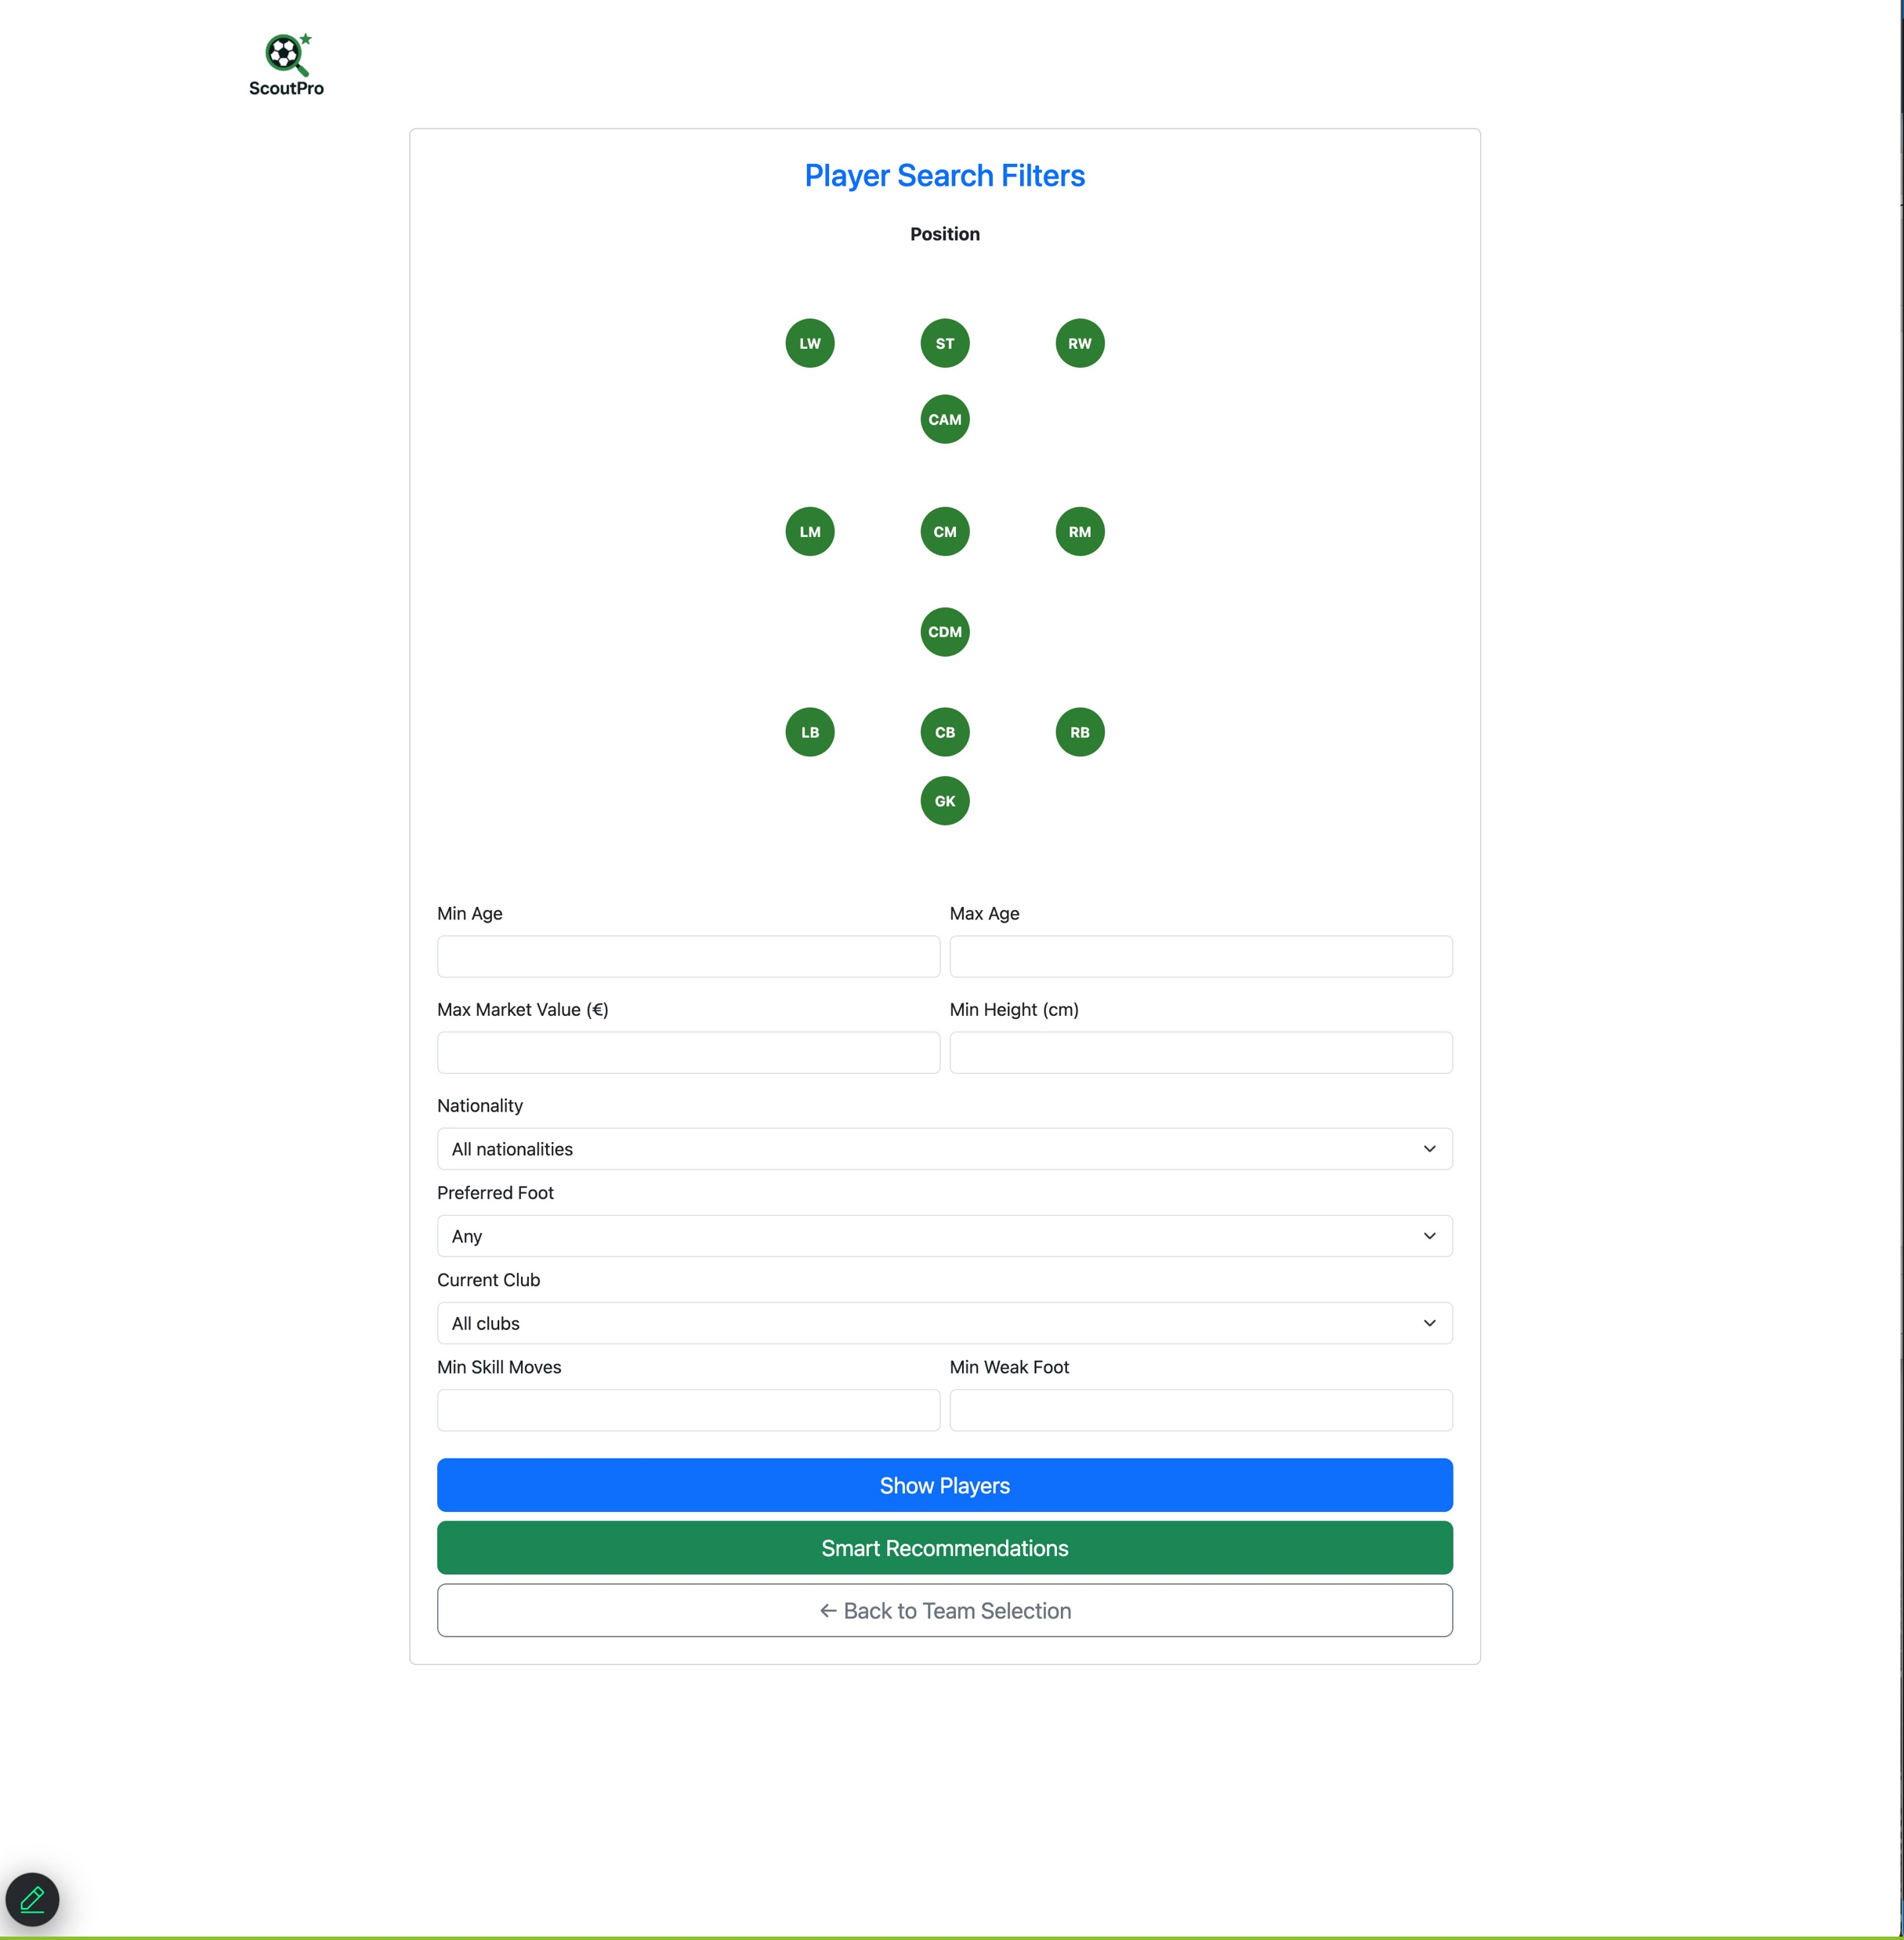
Screenshots

Slide 10
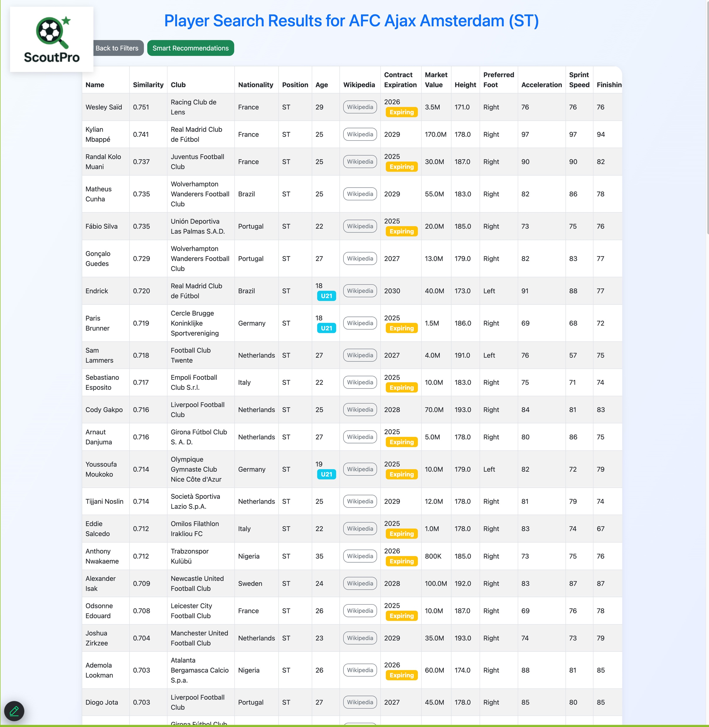
Screenshots

Slide 11
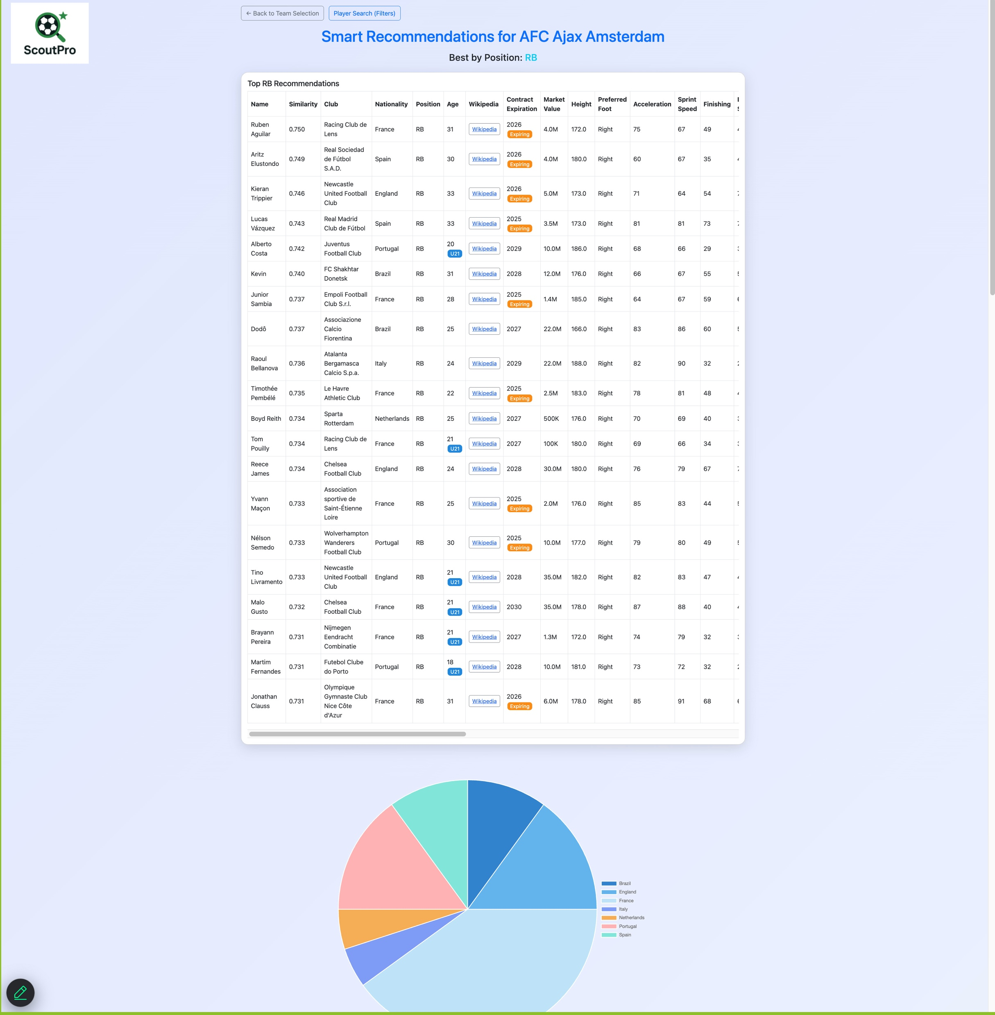
Screenshots

Slide 12
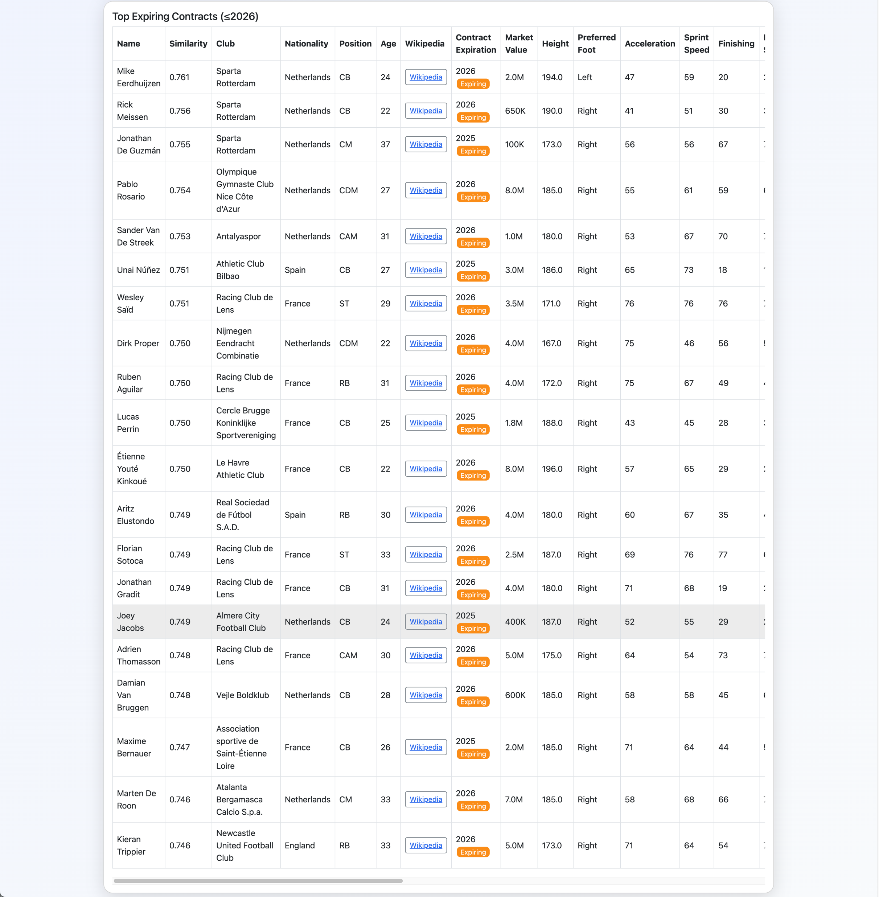
Screenshots

Slide 13
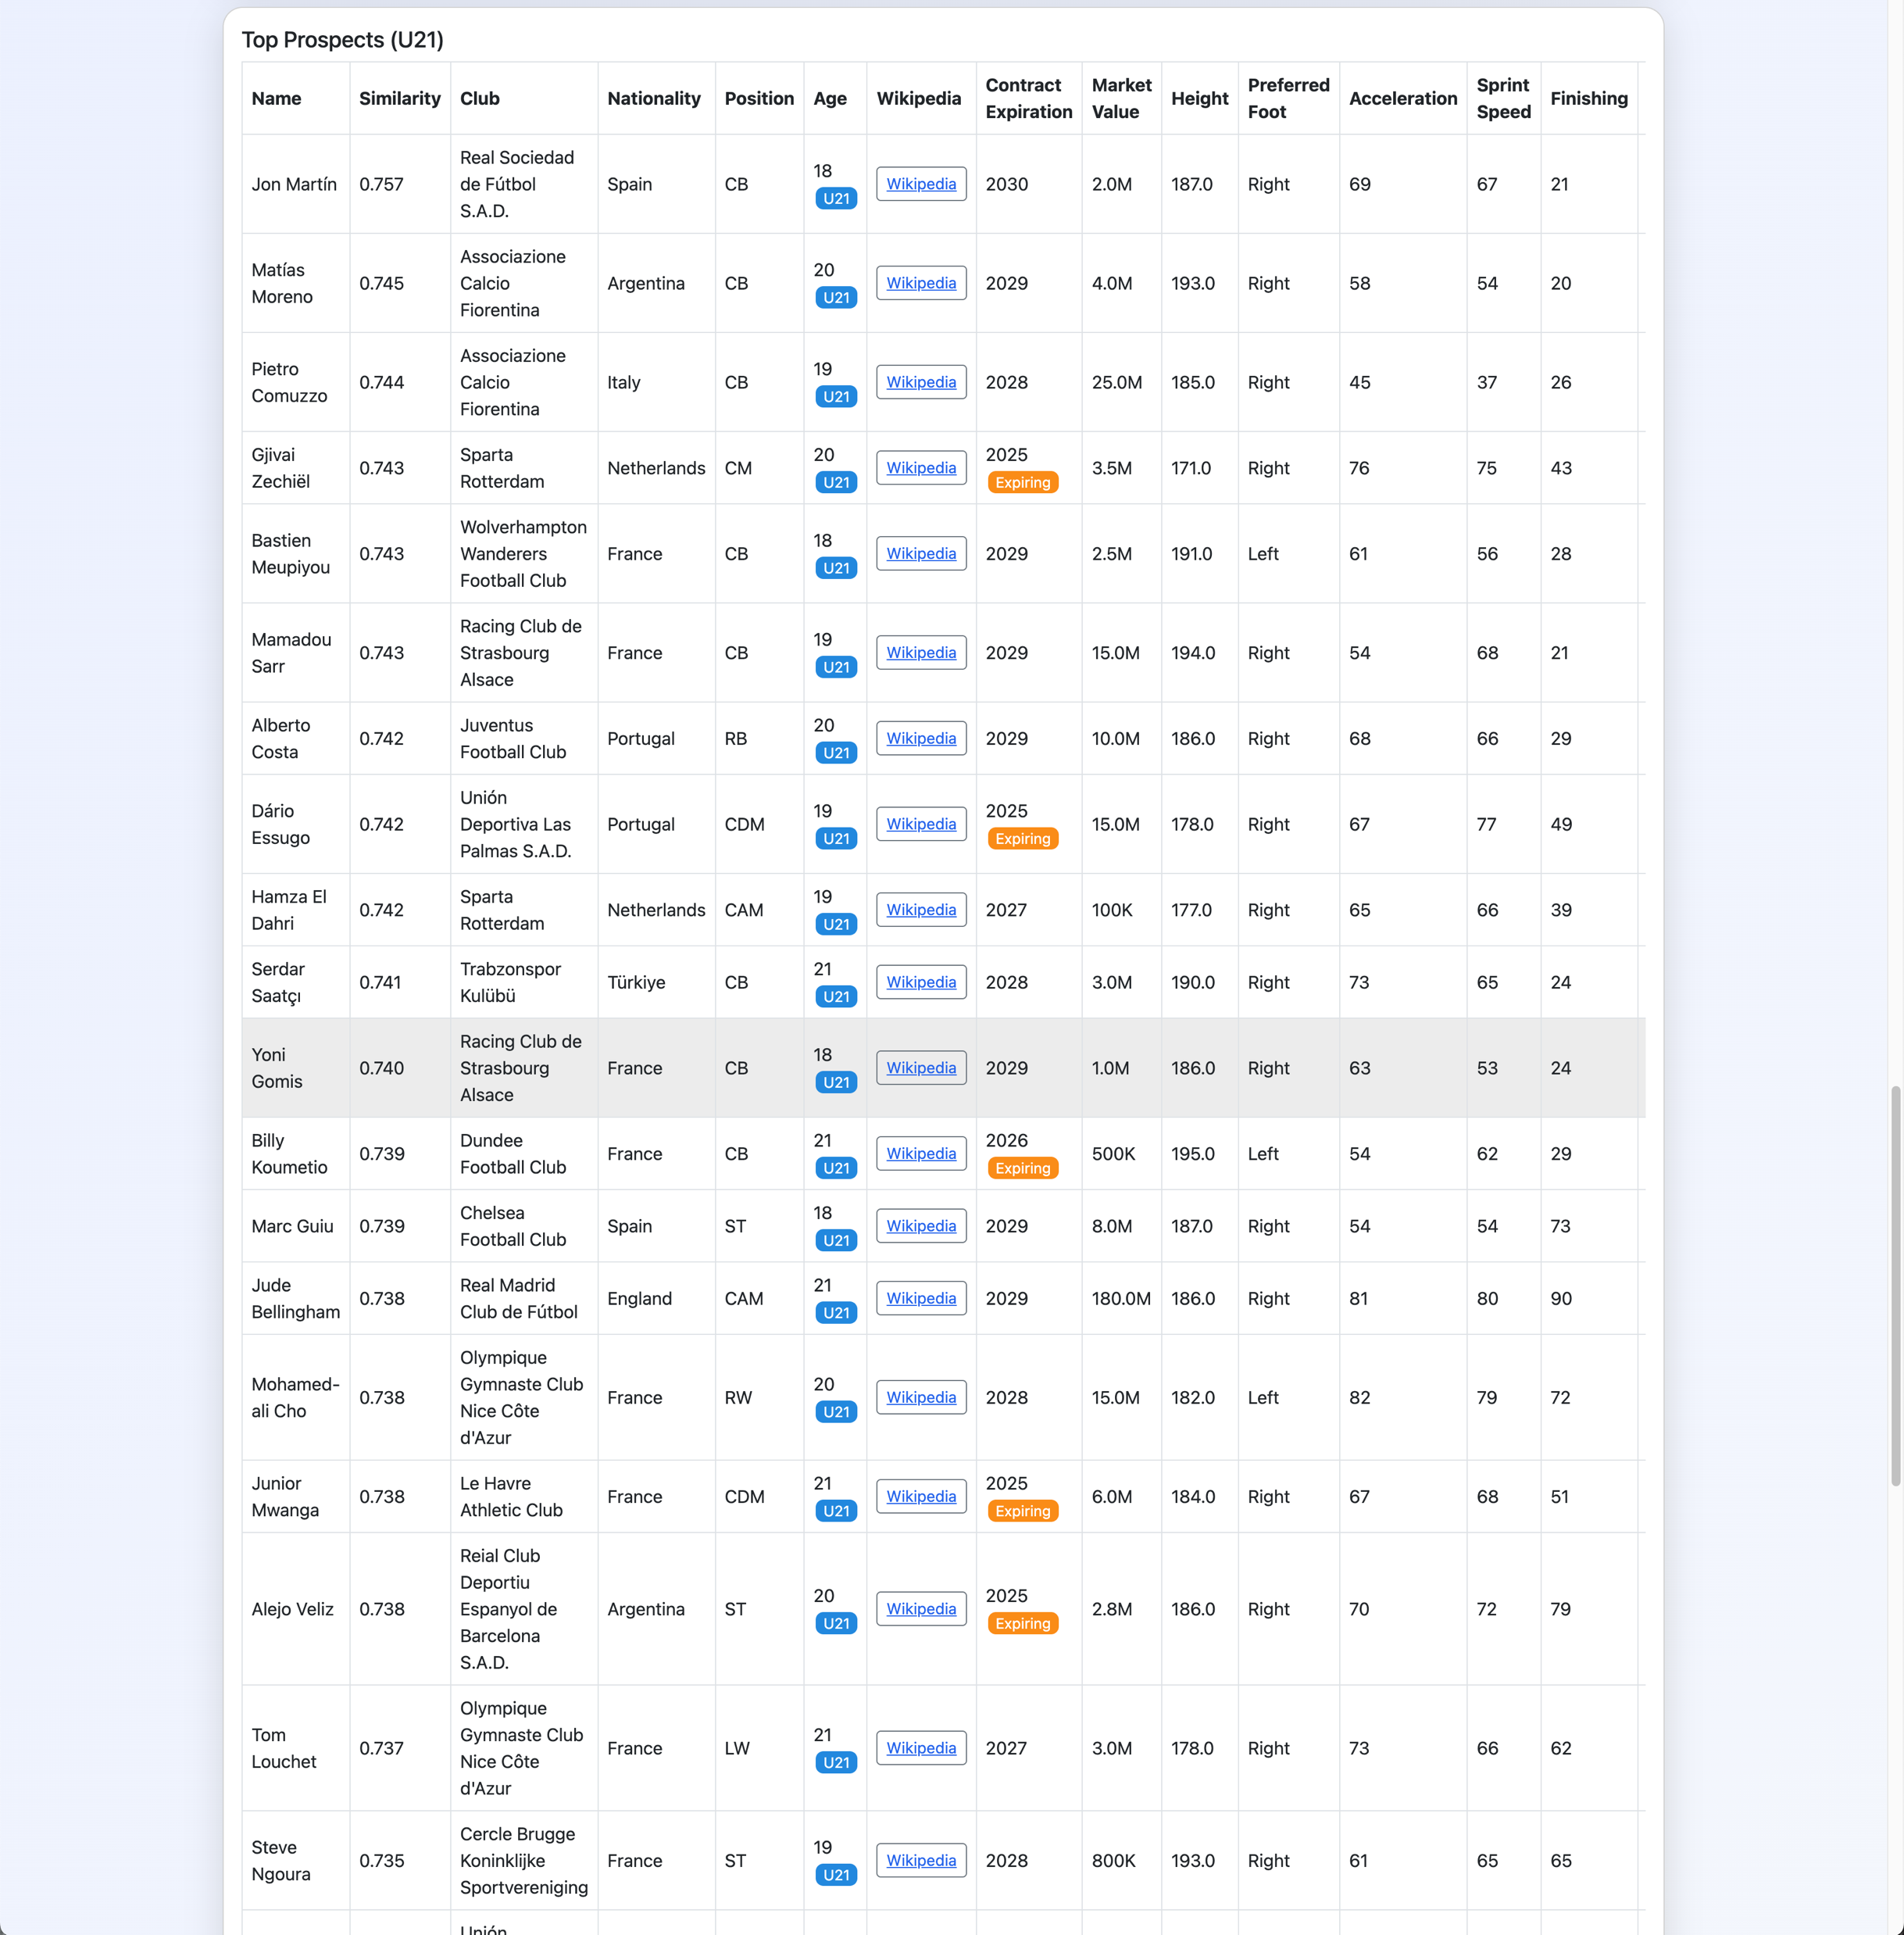
Screenshots

Slide 14

Thank You!

