Slide 1


Your Real-Life Netflix

Slide 2


The
Problem

Slide 3
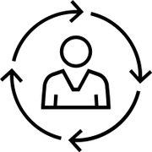


Value
Proposition
Personalized recommendations
Seamless friends network features
Quick desicion making

Slide 4
Data Set
Yelp Business Dataset
6,990,280 Reviews
150,346 Businesses
11 Metropolitan areas
200,100 pictures
Philadelphia Business Dataset
609,660 Reviews
7,690 Businesses
86,964 Users
~24,000 pictures
Data set Link

Slide 5

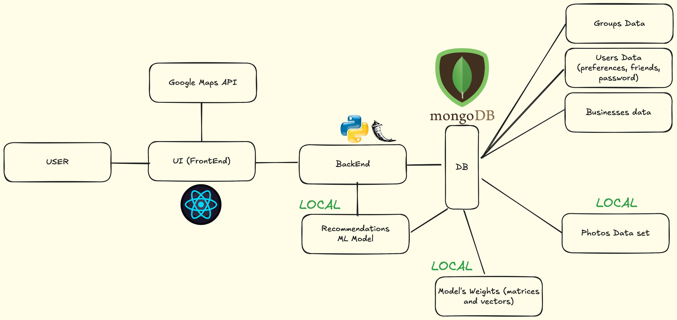



Slide 6
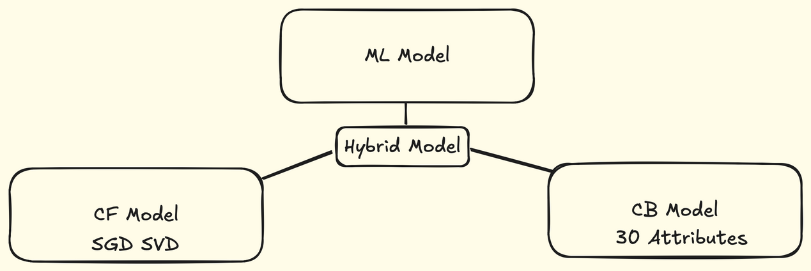
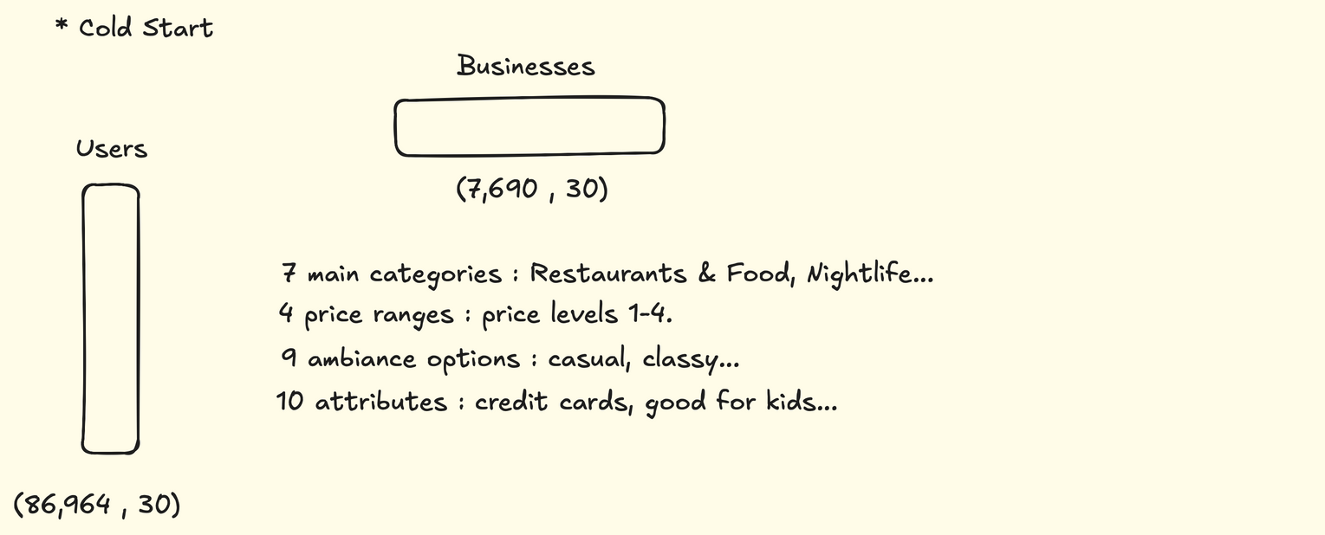

Slide 7
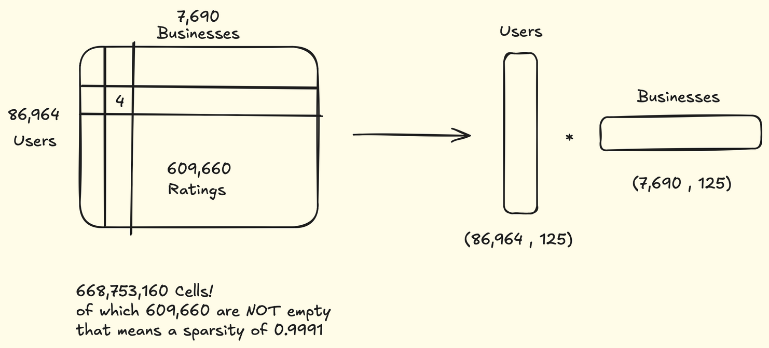

Slide 8
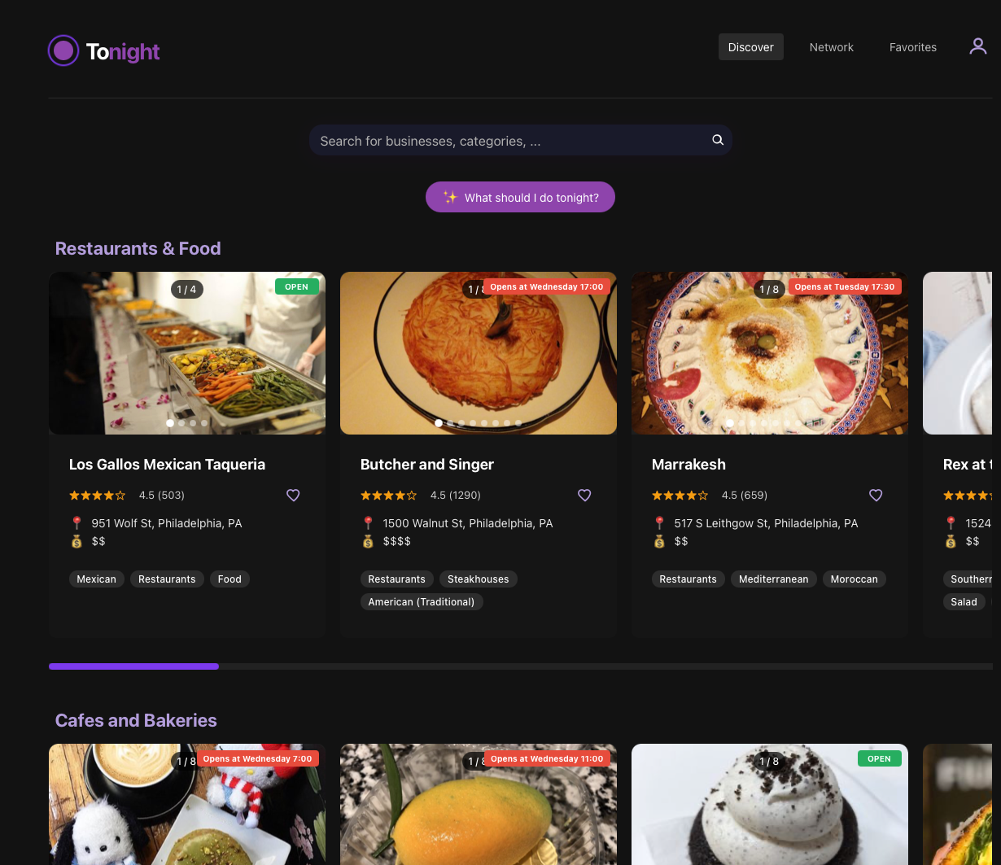
Demo
Time:
Main Page

Slide 9
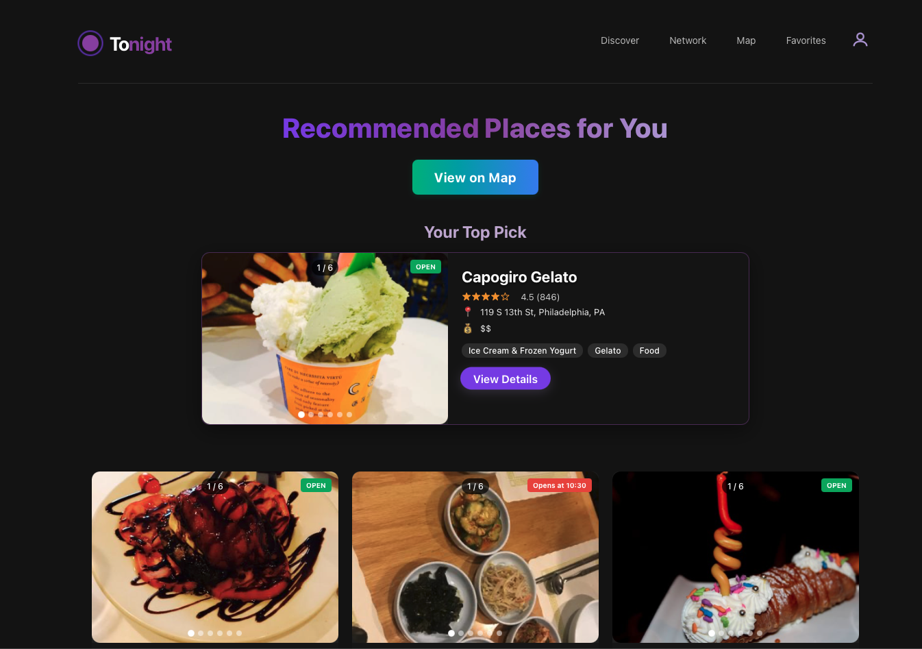
Recommendation Page

Slide 10
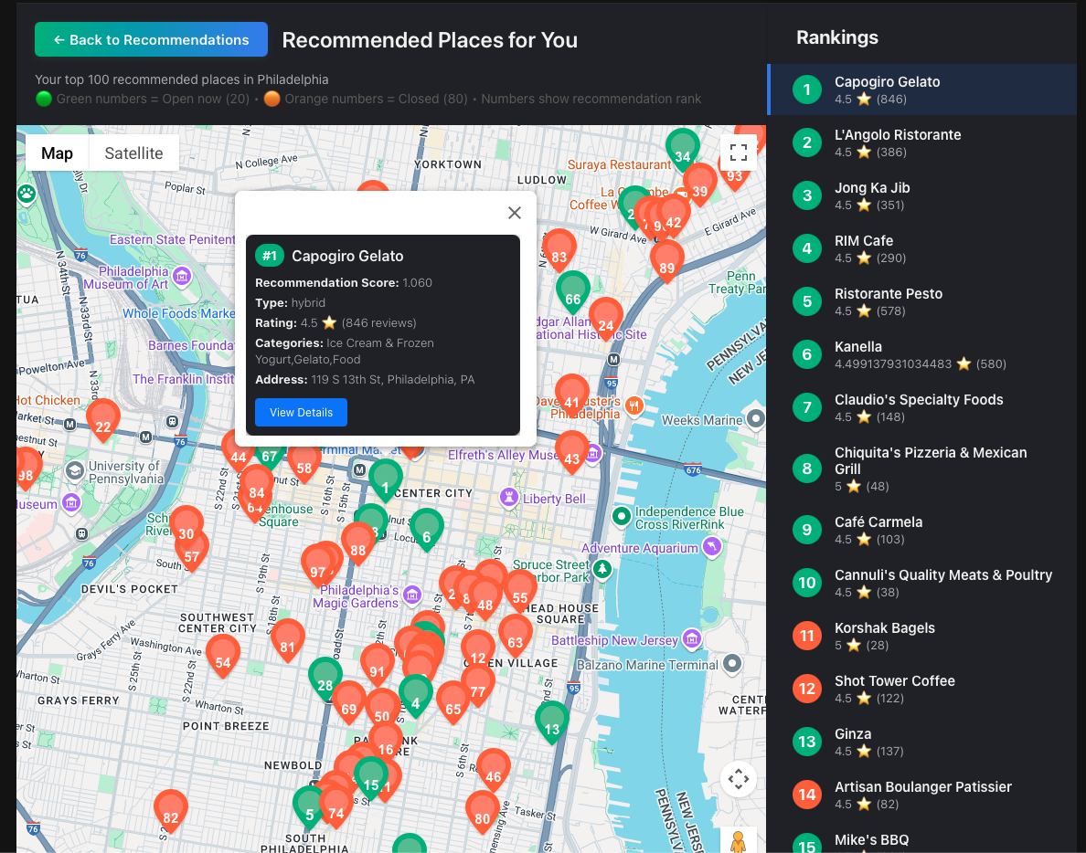
Recommendation Map

Slide 11
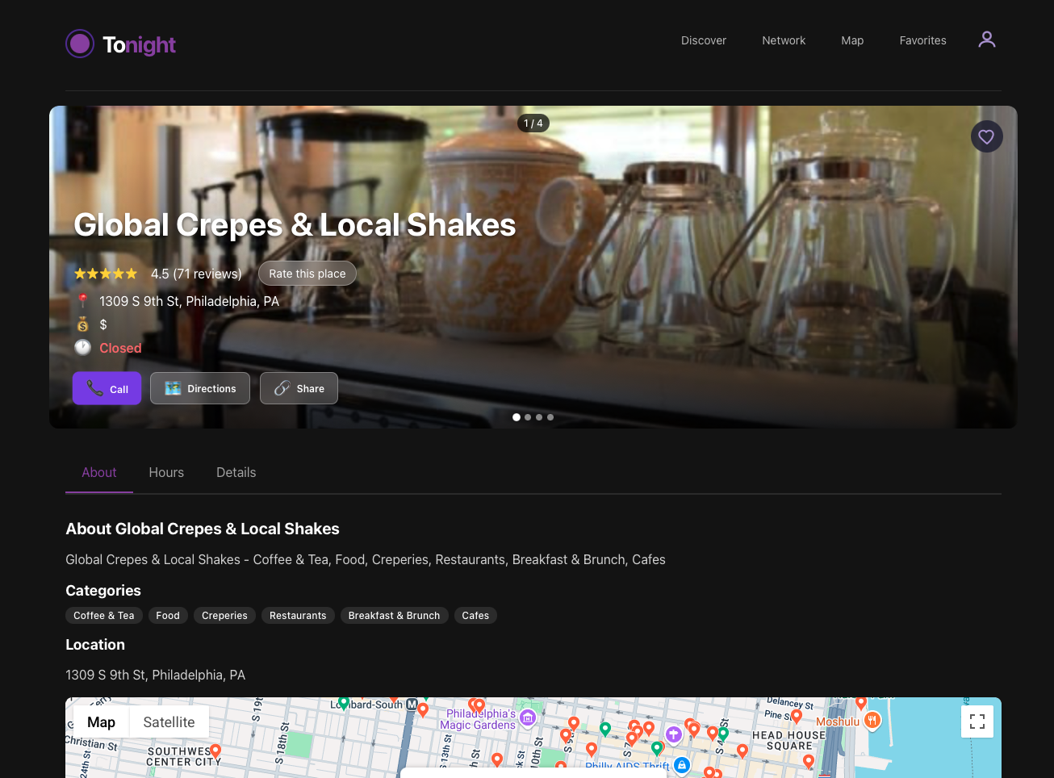
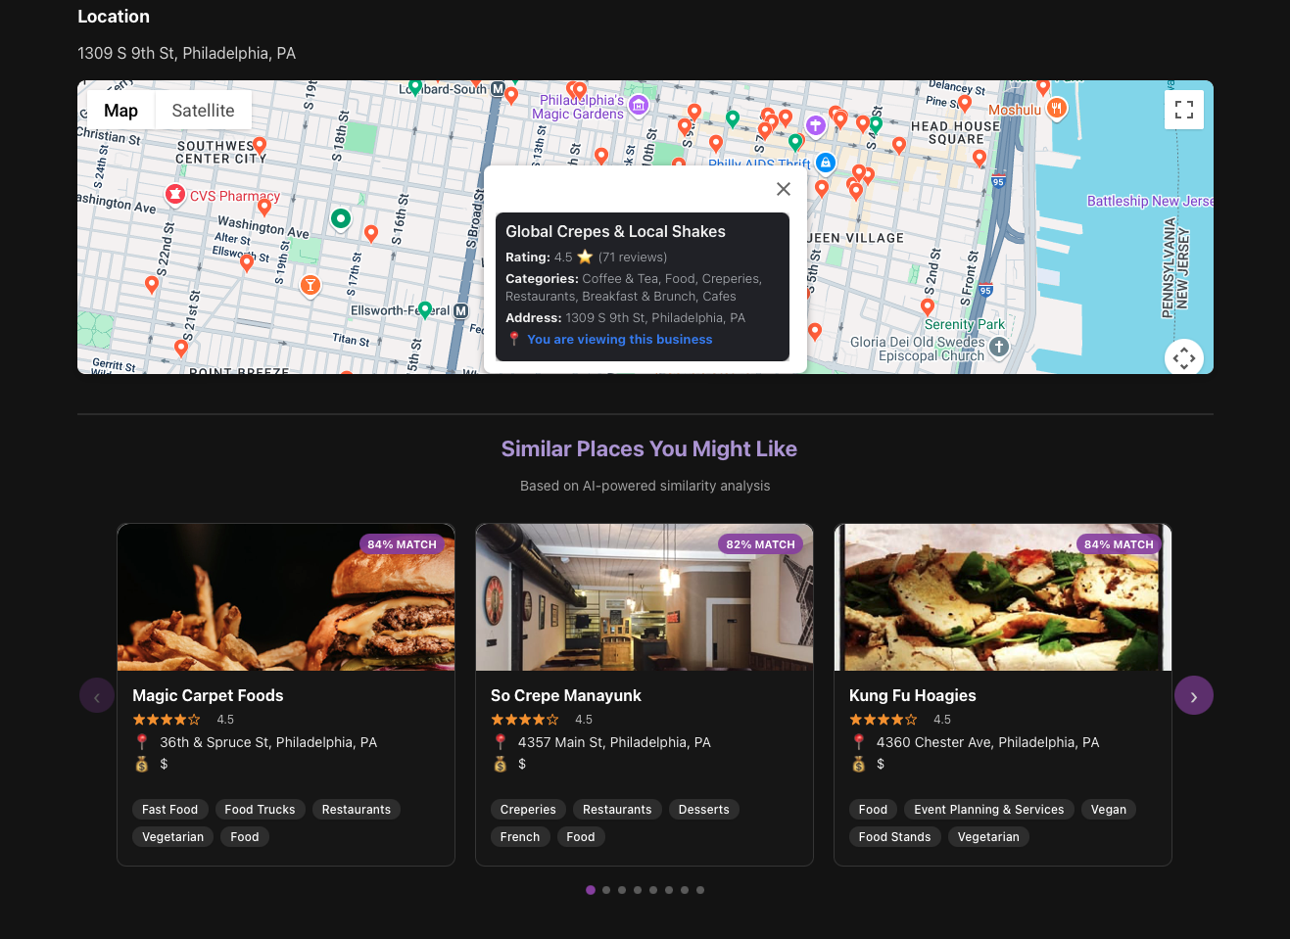
Business Page

Slide 12
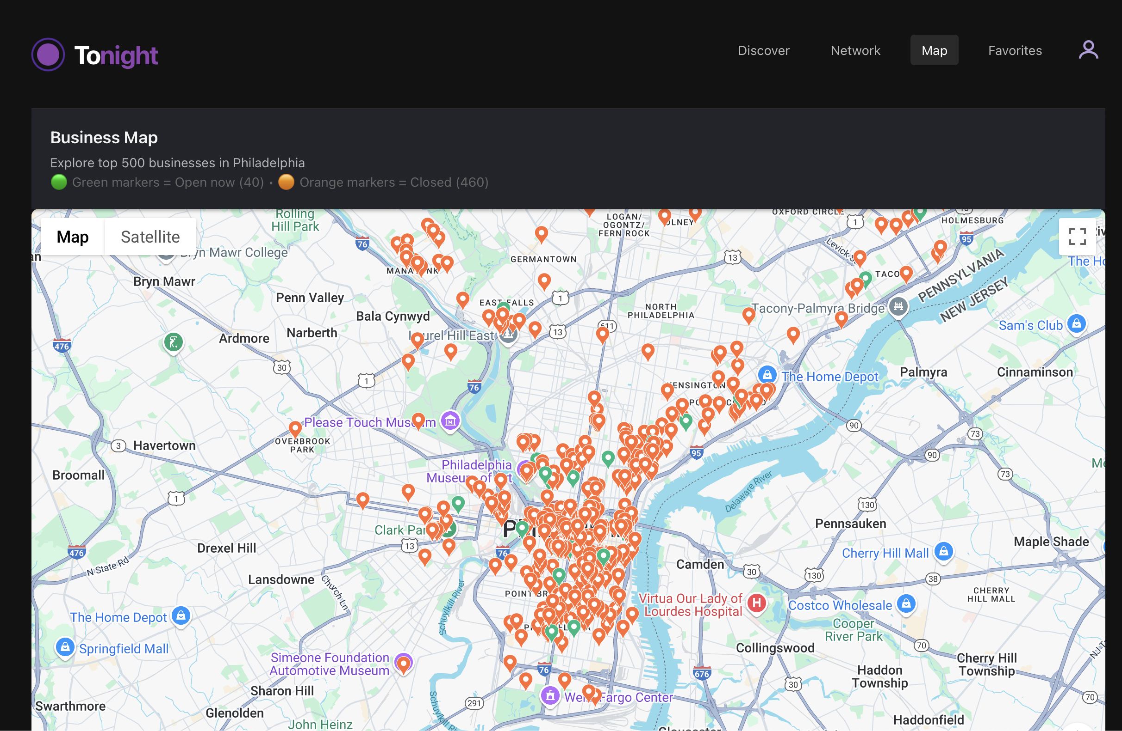
Business Map

Slide 13
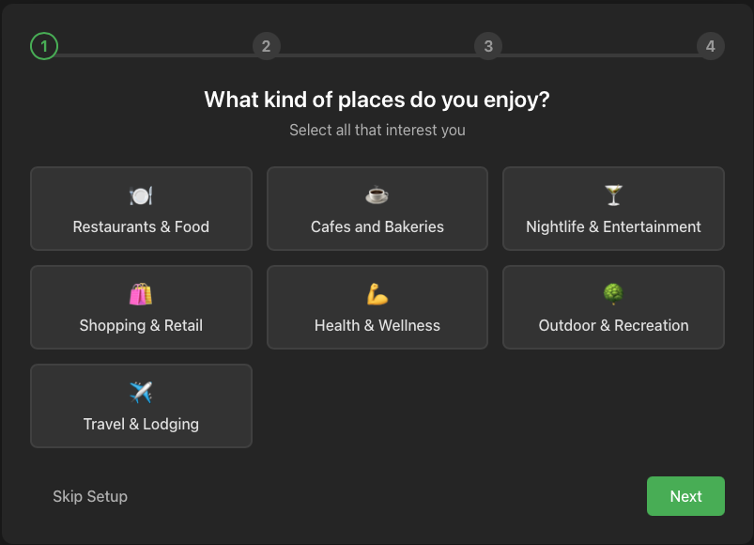
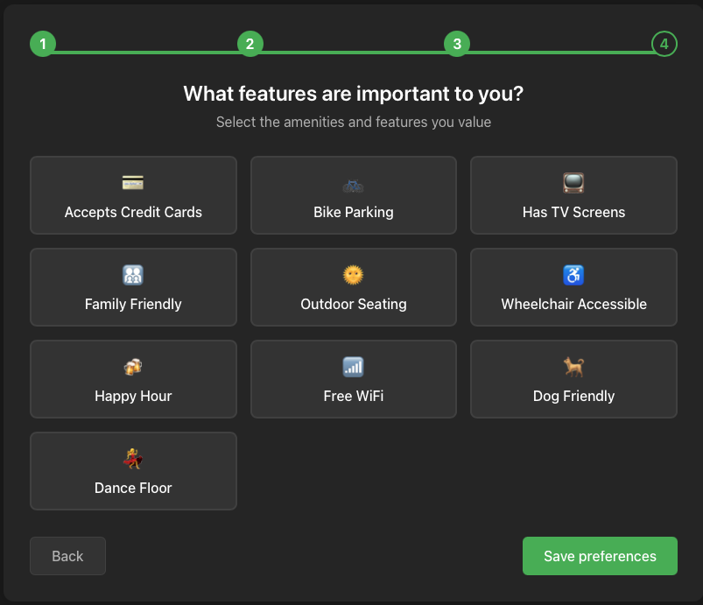
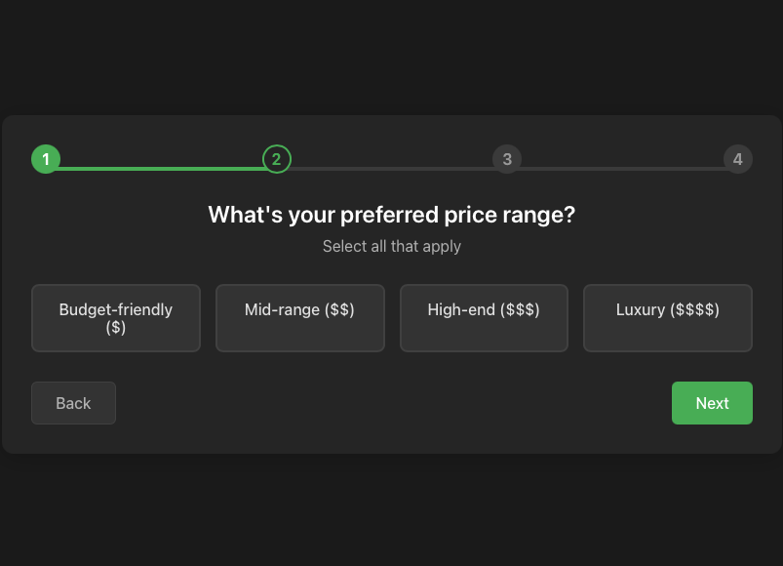
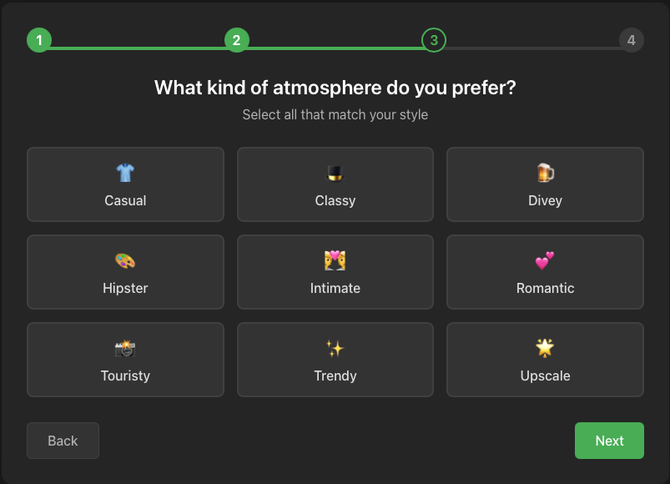
User Info (sign-up questioner)

Slide 14
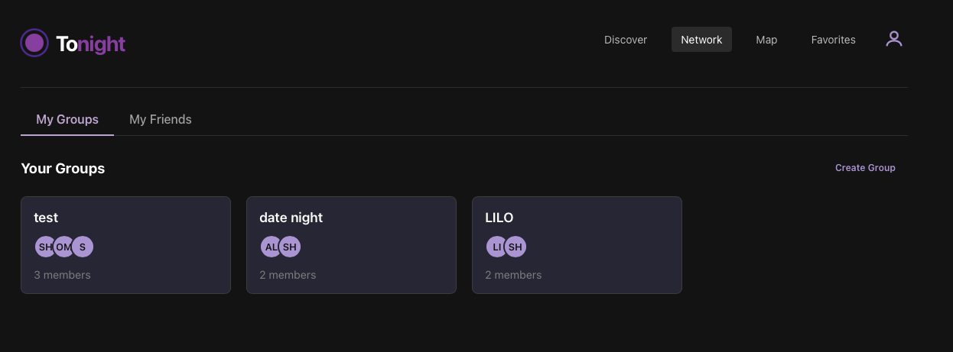
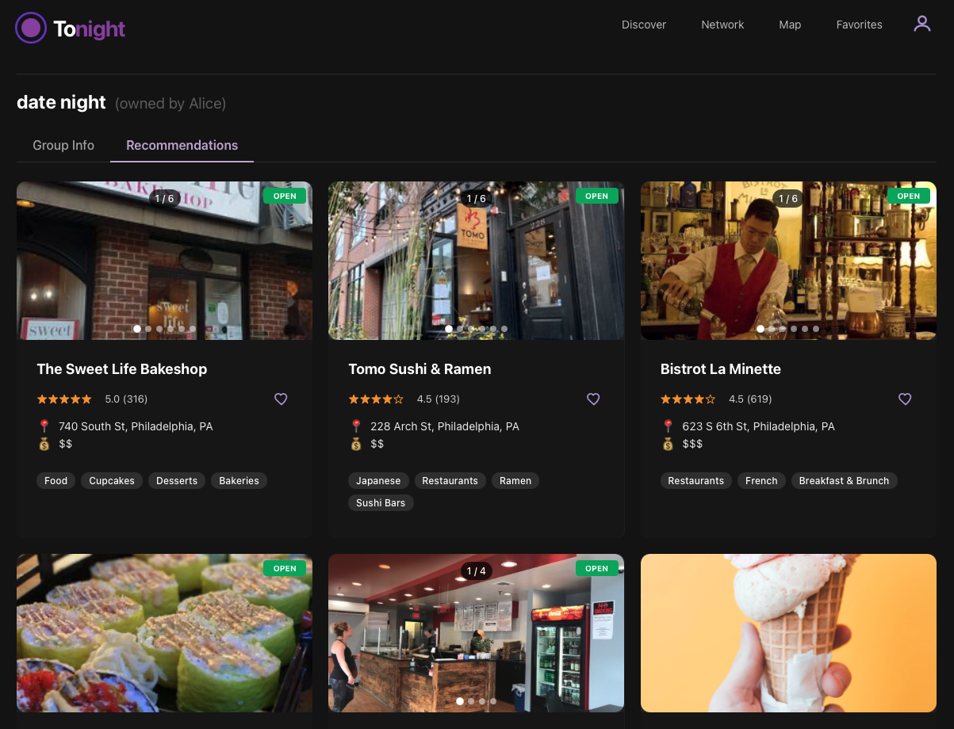
Network (group recommendations)

Slide 15
Future
Steps
  Rows personalization
  Online model training mechanism
  LLM integration (reviews, user)
  Friends-business recommendation
  Detailed map
“unfortunate
reserve duty of 2/3
of the team since IRAN”

Slide 16

Thank you!
Questions ?

