Slide 1
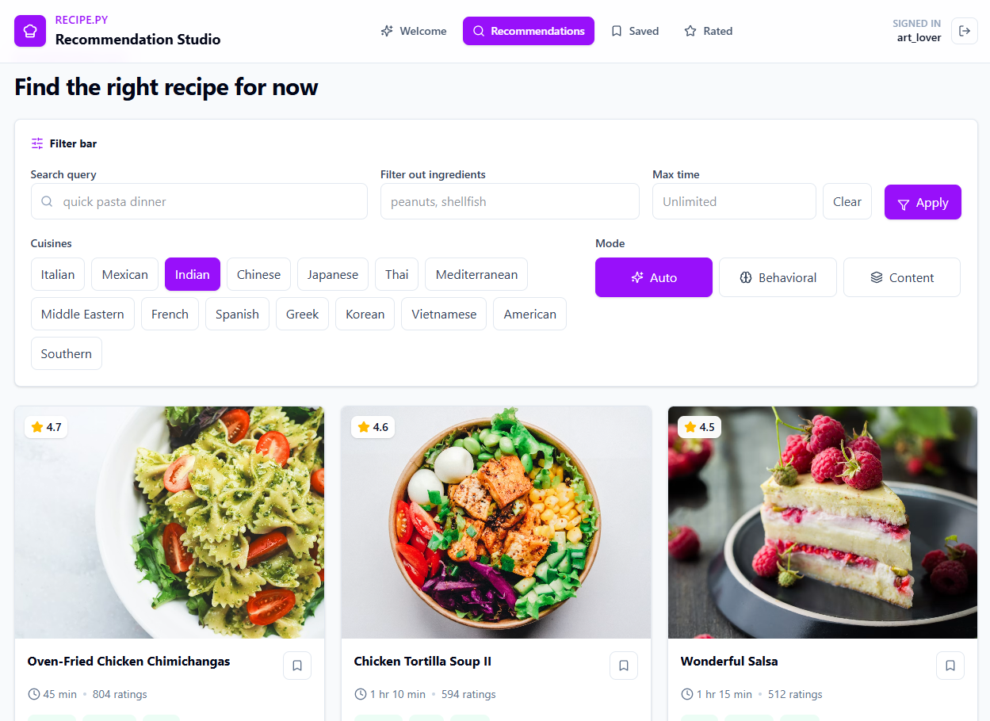




Reci.py
A Smart Recipe Recommender System
Rotem Gardashnik · Eyal Mador · Niv Aschek · Omri Davidi
Smart Search
Hybrid Models
Recipe Discovery

Slide 2

A Bit of Motivation…
2 / 18

Slide 3



A Bit of Motivation
Picture a very normal weeknight in a very normal kitchen-
6:30 PM
6:50 PM
7:20 PM
The Fridge Standoff
The Endless Scroll
“Let’s Just Order In”
Hungry, fridge full, brain totally blank.
12 tabs deep, buried under 900-word life stories.
Defeated again - that’s takeout four nights running.
Enter Reci.py - your 7:20 PM hero.
Tell it what you love, and it serves the right recipe for you! right now. No endless scrolling, no 900-word backstories, no pizza guilt.
2 / 18

Slide 4



What We Are Working On
Recipe Recommender System
Full Stack Application
Intelligent recipe suggestions powered by hybrid models
React frontend + FastAPI backend, production-ready architecture
What Makes Us (Hopefully) Different?
Hybrid Approach
Personalization via Adaptive Weights
Combining 5 models - both collaborative (behavioral) and content-based - for richer, more accurate recommendations
Dynamic weighting adjusts the balance of each model per user context - known users, cold starts, and search queries each get tailored scoring
3 / 18

Slide 5

LIVE WALKTHROUGH
Live Demo
Let’s see Reci.py in action.
4 / 18

Slide 6
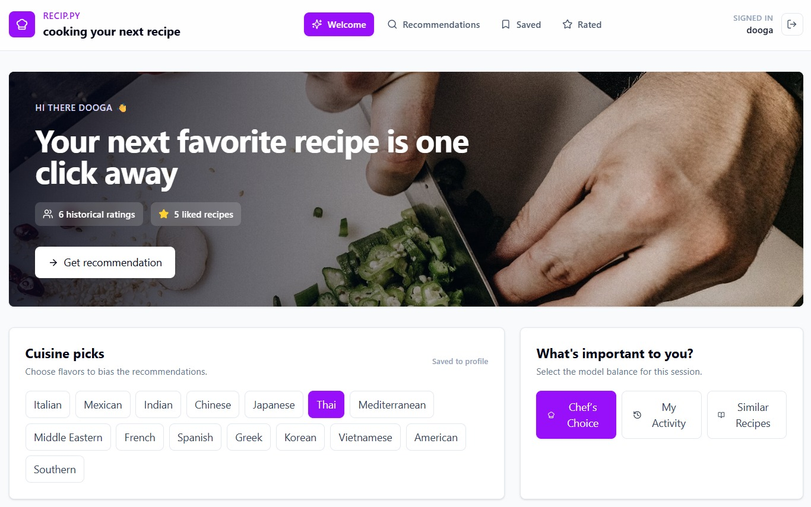

Welcome & Cold Start
STEP 01 / 06
First visit? We learn your taste before you lift a fork.
New here? No problem
Pick a few cuisines you love to seed your very first recommendations.
Set the vibe
Choose how the engine balances behavior vs. content for this session.
5 / 18

Slide 7
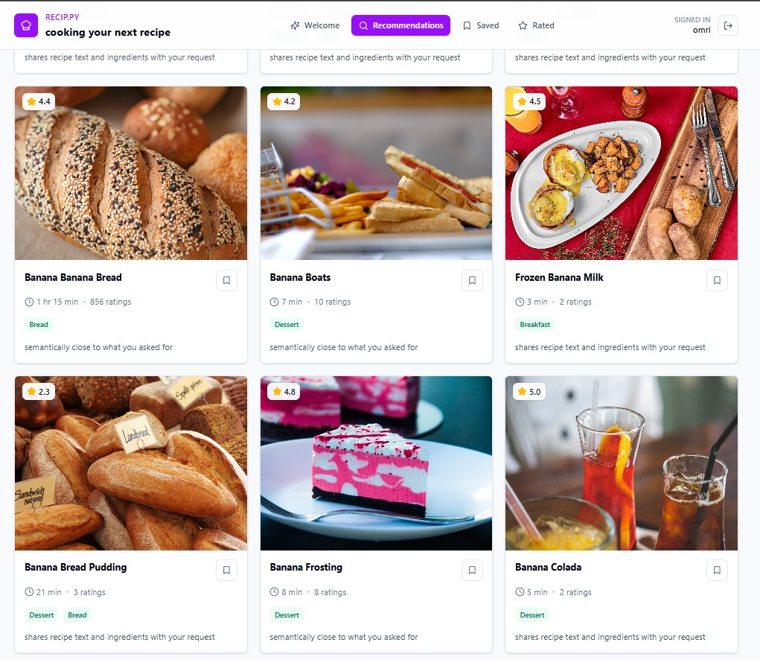
Your Recommendations
STEP 02 / 06
The right recipe for right now - tuned to you.
Filters & modes
Cuisines, excluded ingredients, max cook time, and Auto / Behavioral / Content.
6 / 18

Slide 8
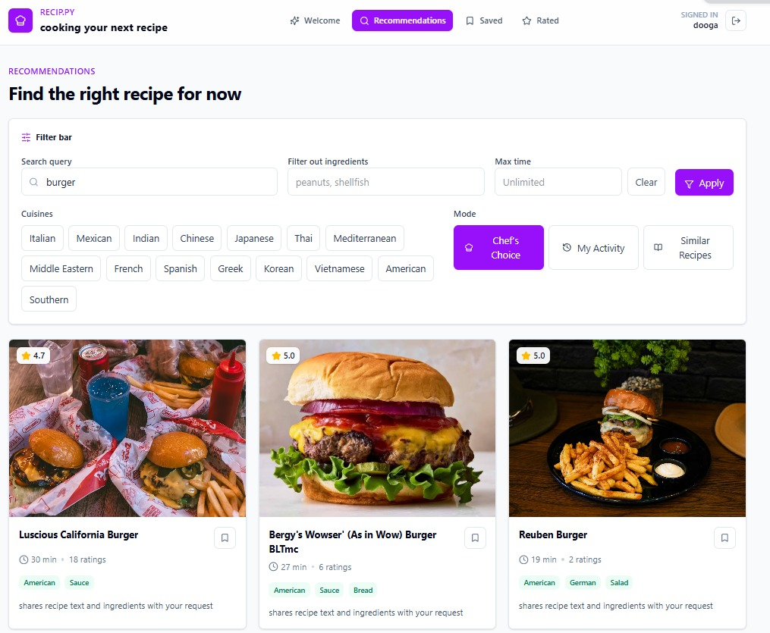
Search by Text & Filters
STEP 03 / 06
Craving something specific? Just ask.
Free-text query
Type a dish or ingredient, set filters, and get matches instantly.
Refine on the fly
Exclude ingredients or cap the cook time to narrow results.
7 / 18
Notes:
TFIDF + Embed.

Slide 9
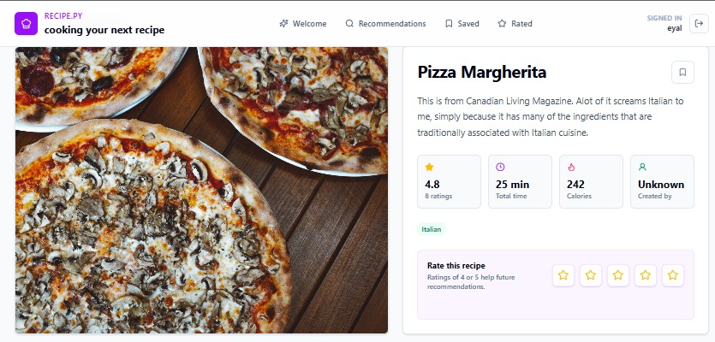


Recipe Page - Essentials
STEP 04 / 06
Everything you need, at a glance.
At-a-glance facts
Rating, total time, calories and category tags right up top.
Rate to improve
Your rating feeds straight back into future recommendations.
8 / 18

Slide 10
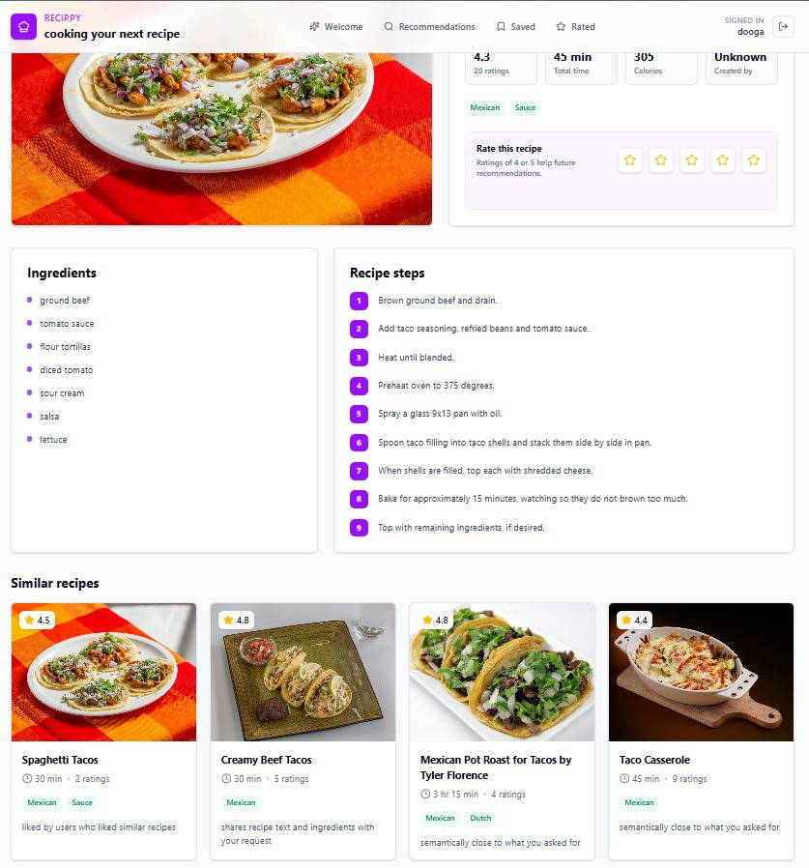

Recipe Page - Deeper
STEP 05 / 06
Ingredients, steps, and smart look-alikes.
The full recipe
Ingredients and numbered steps, cleanly laid out.
Similar + why
Each suggestion shows the reason it was matched to this dish.
9 / 18

Slide 11
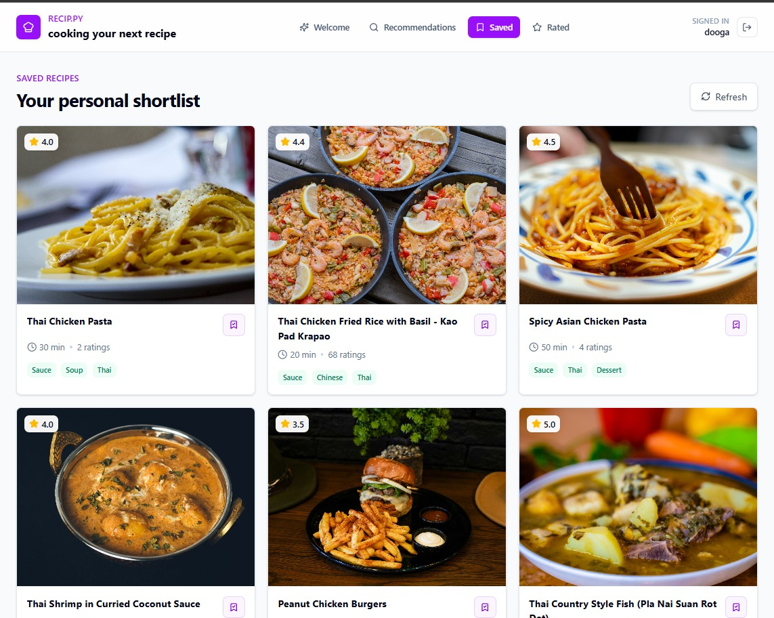
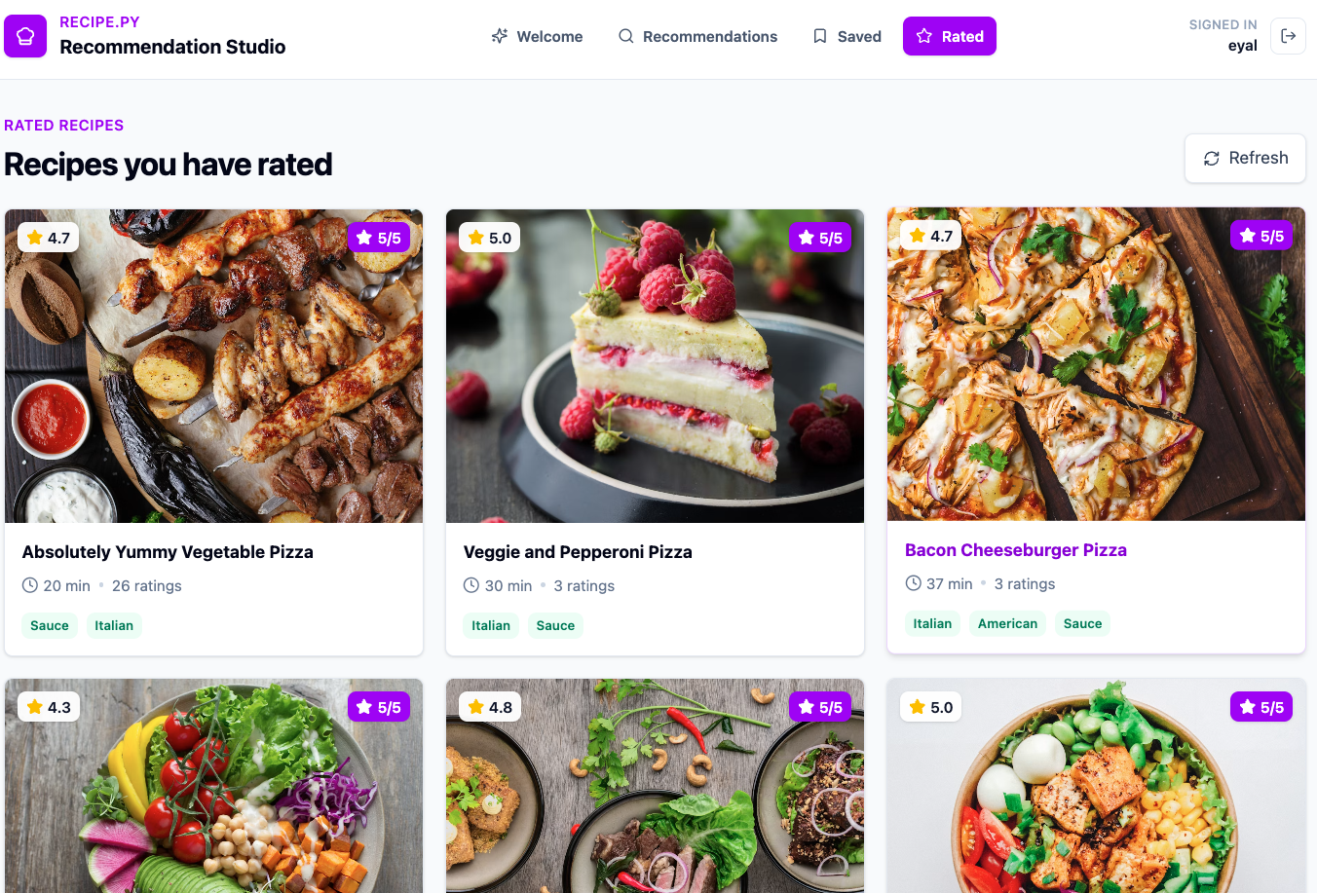
Your Saved & Rated Recipes
STEP 06 / 06
Everything you’ve saced\rated, in one place.
Your history
Revisit past recipes anytime - the model remembers.
Signals that stick
Ratings continuously sharpen what Reci.py shows you next.
10 / 18

Slide 12

UNDER THE HOOD
The Technical Side of the Moon
How Reci.py actually works - the data, the architecture, and the hybrid engine.
11 / 18

Slide 13
Our Dataset
Based on Food.com Recipes & Reviews Dataset on Kaggle
Recipes Table
Reviews Table
ID, name, author, description, ingredients, instructions, categories, nutrition, ratings
ID, recipe ID, author, rating
⚠
First Challenge - Sparse Behavior
Most users have very few reviews, making collaborative filtering particularly challenging.
Our Seasoning
Adding food type labels for better recipe photo matching
Recipes with < 2 reviews removed
Adding cuisine labels from recipe text using hybrid fallback
12 / 18

Slide 14





A Bit of Architecture
Offline Path - The Recommender Artifact
Food.com
→
Postgres
→
Training
→
recommender
.joblib
Online Path - The Actual App
React
FastAPI
recommender
.joblib
+ Postgres
Recommen-
dations
→
→
→
13 / 18

Slide 15




The Magic - Hybrid Recommendation
Behavioral
Behavioral
Content
ALS
Item Similarity
TF-IDF
Collaborative filtering from user rating behavior
Recipes liked together by similar users
Text similarity over recipe content
Content
Behavioral
Content
Semantic Similarity
Popularity
Cuisine Match
Sentence transformer embeddings for deep meaning
Bayesian rating upon reviews count
Recipe auto generated cuisine classification alignment with user cuisine preferences
14 / 18

Slide 16


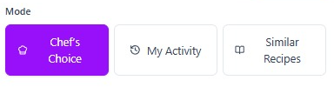
Set the Mood, Tune the Food
Adaptive Score Weights
Known User
Cold Start
Search Query
History - Behavioral-Heavy
Preference - Content + Cuisine-Heavy
Intent - Text + Semantic-Heavy
ALS / Item-CF 70%
ALS / Item-CF 10%
ALS / Item-CF 0%
Content / Semantic 15%
Content / Semantic 40%
Content / Semantic 70%
Popularity 15%
Popularity 50%
Popularity 30%
The user can also choose the recommendation type (Auto / Behavioral / Content) to override the default weighting.
15 / 18

Slide 17
Thank You!
Questions?
Reci.py - A Smart Recipe Recommender

