Slide 1


BEER RECOMMENDATION SYSTEM
RuBeer
Stop guessing at the bar. Let our recommender system find your perfect pint.
Recommender Systems Workshop • Tel Aviv University

Slide 2

THE BREWERS BEHIND THE CODE
Meet the Team
Nitzan Zacharia
Inbal Moryles
Moran Khoury
Nadav Ravid
Dudi Benudiz
Recommender Systems Workshop, Tel Aviv University
RUBEER
02

Slide 3




As young entrepreneurs, we were all taught:
Creating the exceptional
“good startups solve problems”
But the truth is:
exceptional startups actually create them
whether it was Social Media, which completely spoiled our social interactions
or cars, providing us with freedom of navigation, but sometimes at the cost of horrifying car crashes
02

Slide 4

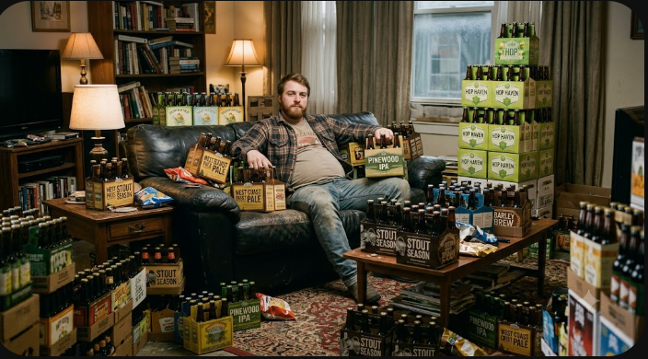

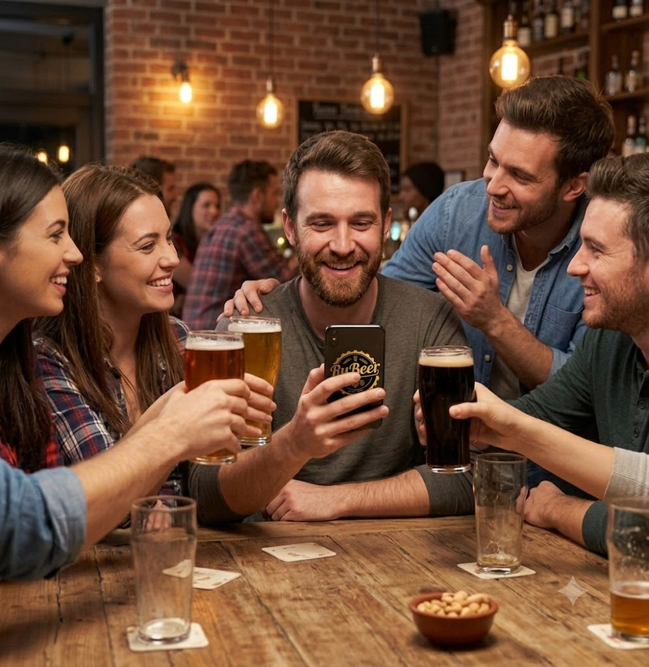
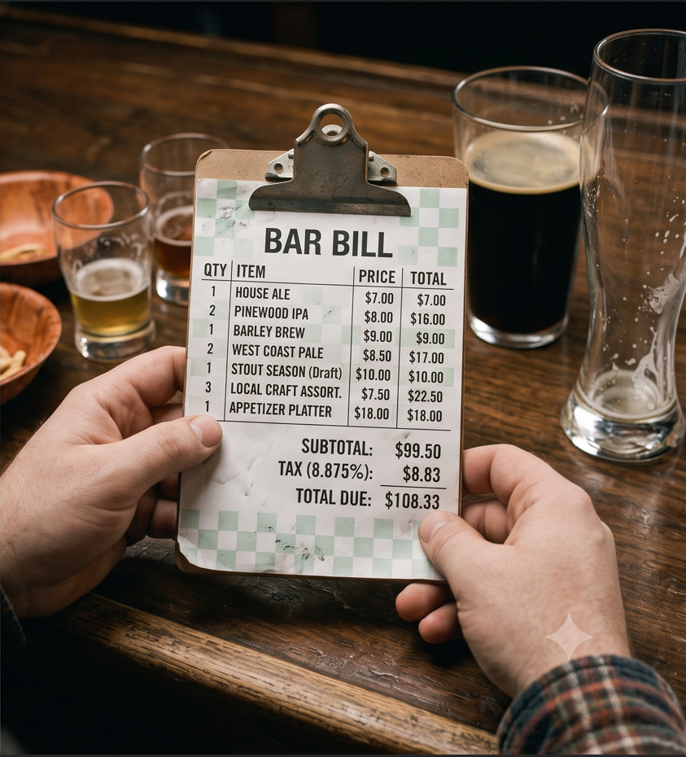
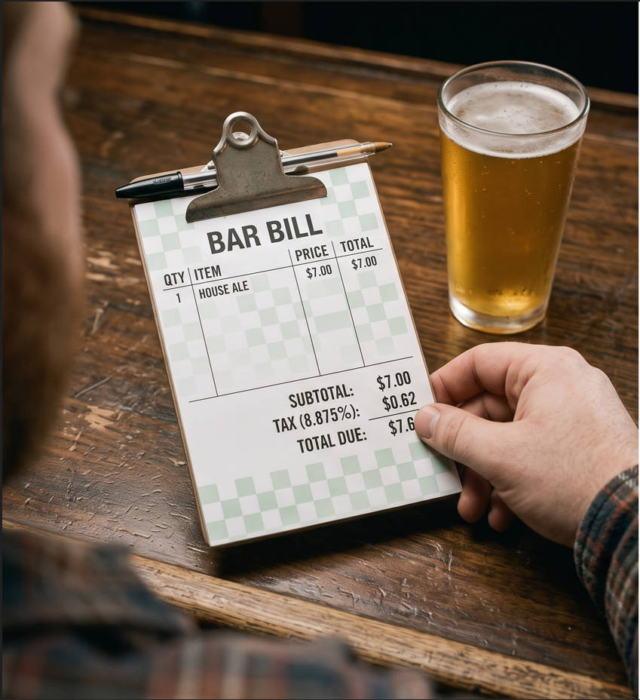
Solving problems?
Creating problems!
you may also find, that your bar tab has become heavily inflated
And now with RuBeer, you may find that the words 6-pack have a slightly different meaning
Stop guessing at the bar. Let us find your perfect pint.
but the advantages of our platform highly outweigh its downsides, providing you with the real meaningful moments in life
03

Slide 5

VALUE PROPOSITION
How It Works
1
2
3
Rate Beers
The Hybrid Engine
Get Recommendations
Tell us what you've enjoyed in the past — or answer a quick taste quiz — to build your unique profile.
Collaborative filtering and content-based models crunch the numbers together to find hidden matches.
Discover your next favorite pint, ranked and re-ranked for diversity, matched to your palate.
RUBEER
04

Slide 6
LIVE DEMO
Onboarding → Personalized Feed → Real-Time Re-Ranking

Slide 7
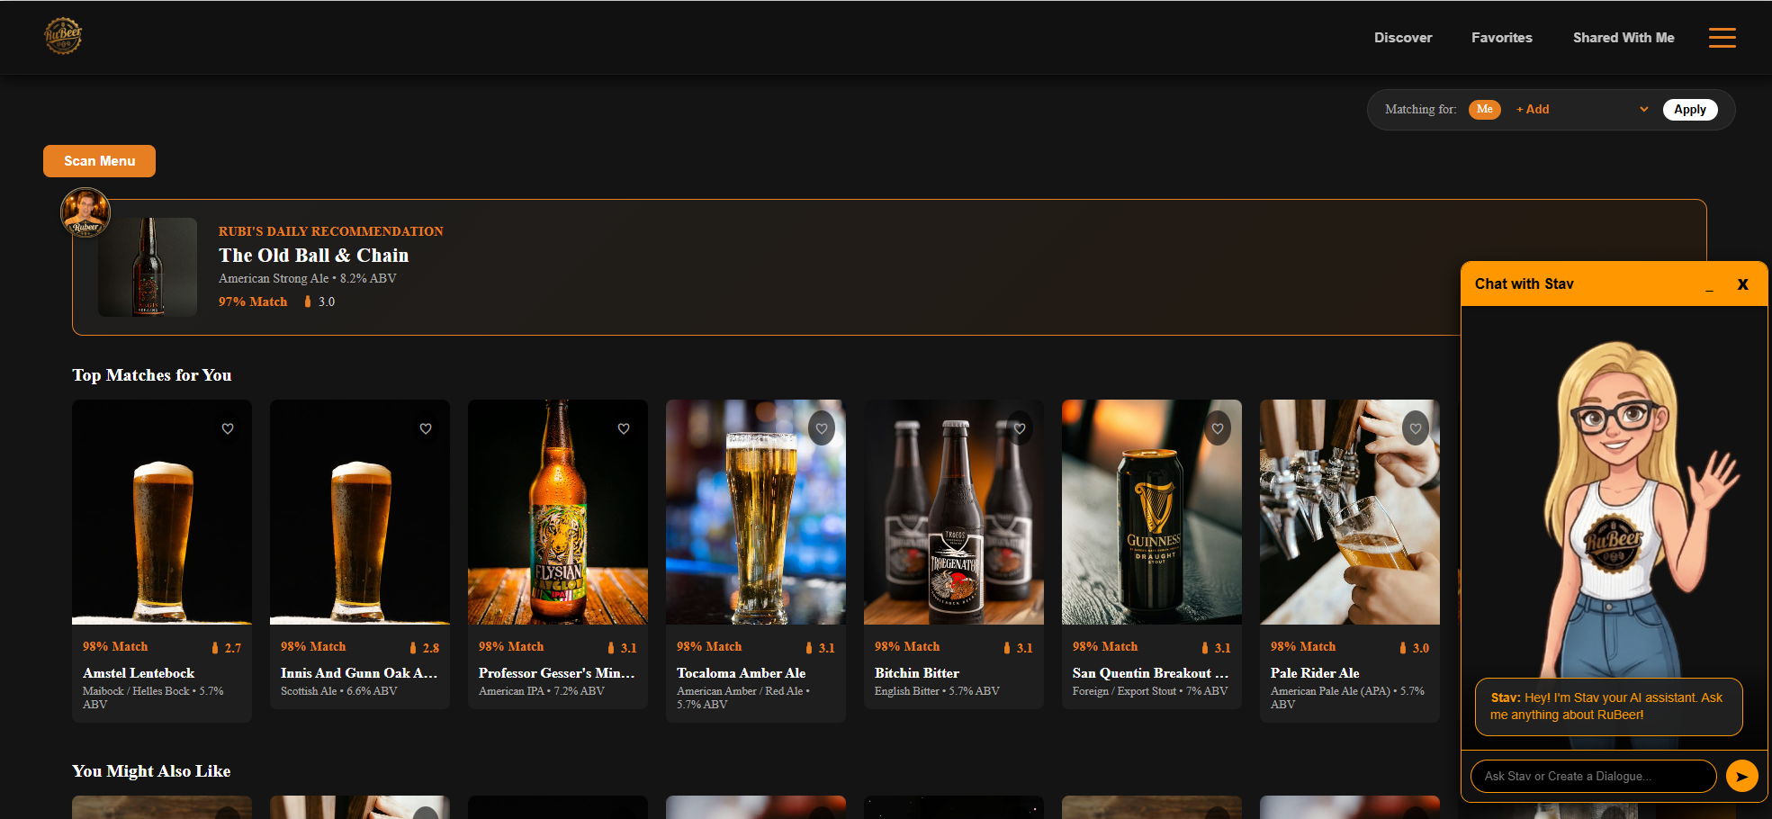
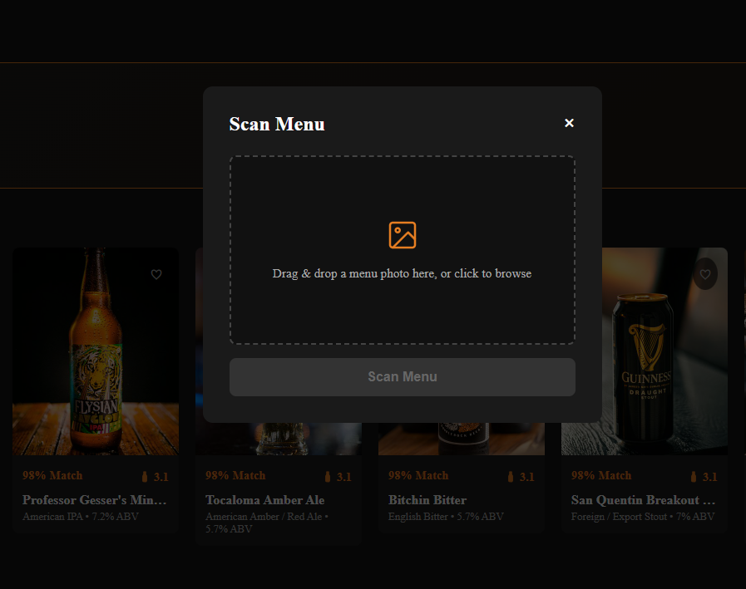
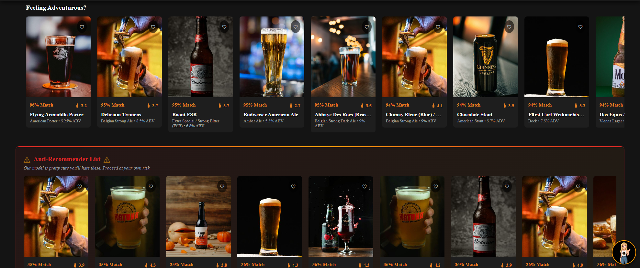
Dashboard

Slide 8
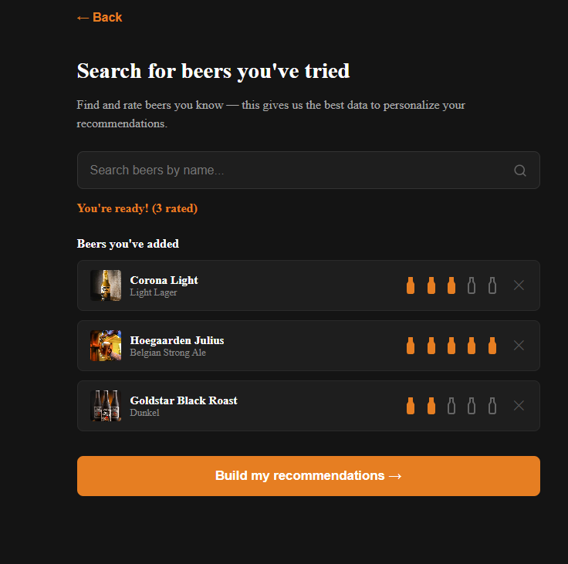
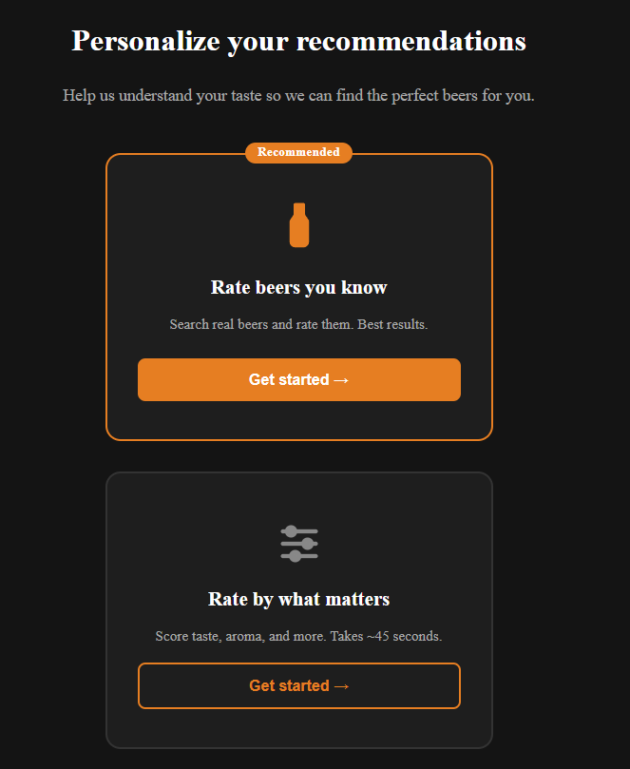
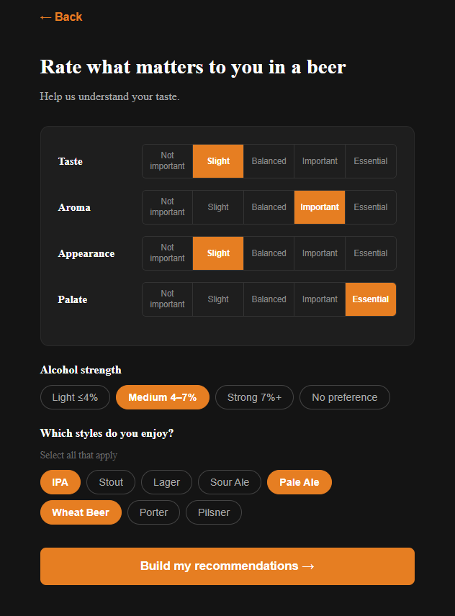
Cold Starts

Slide 9
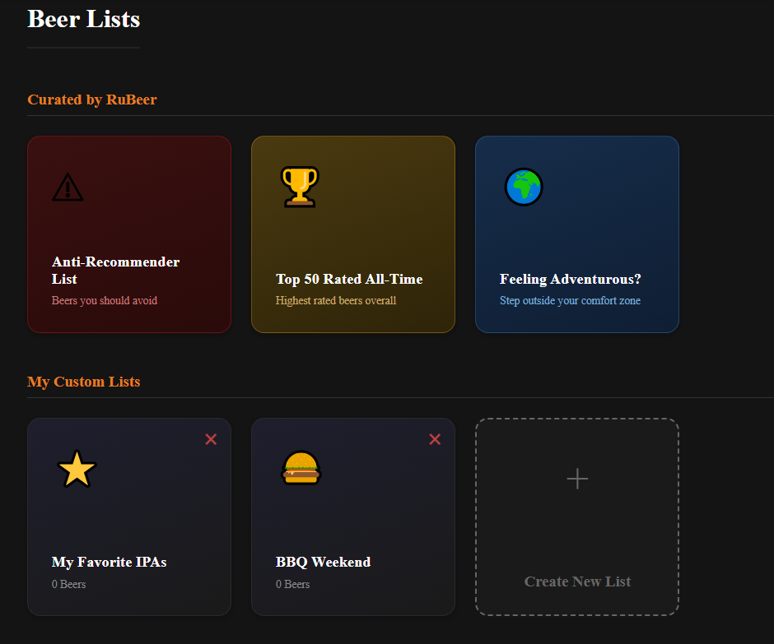
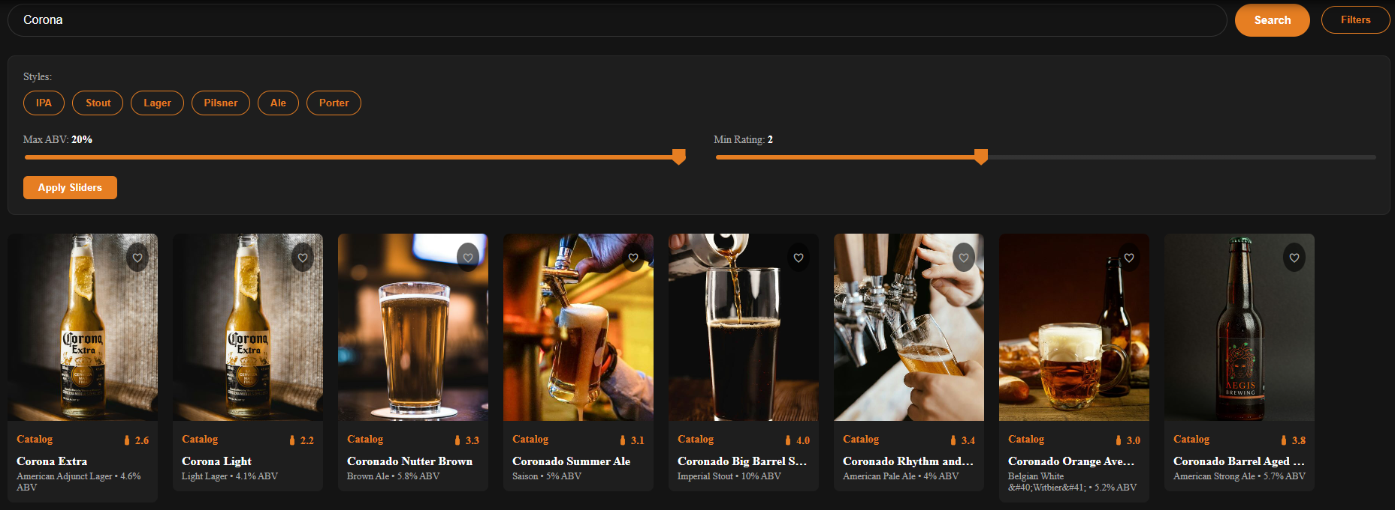
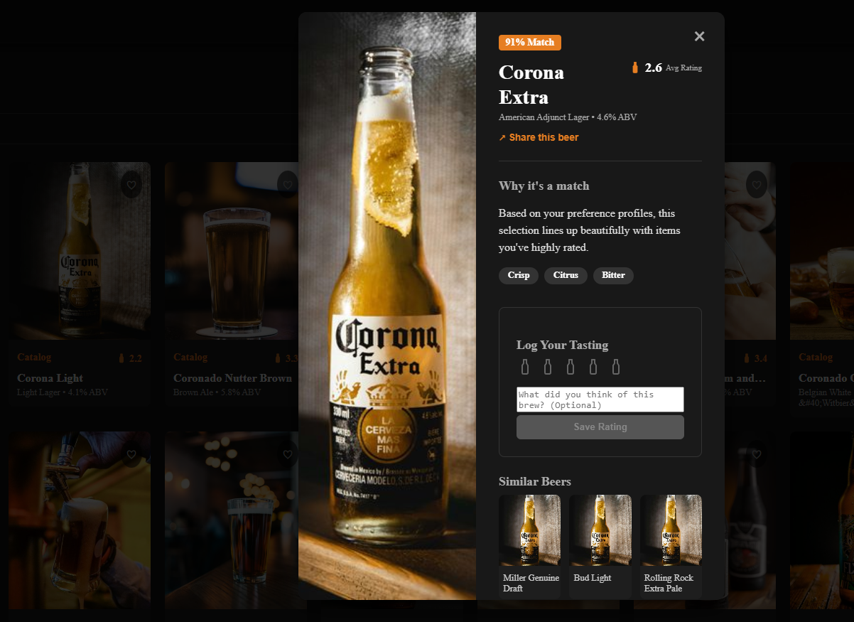
Discover & Beer Lists

Slide 10
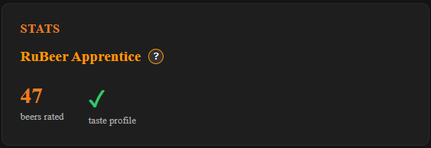
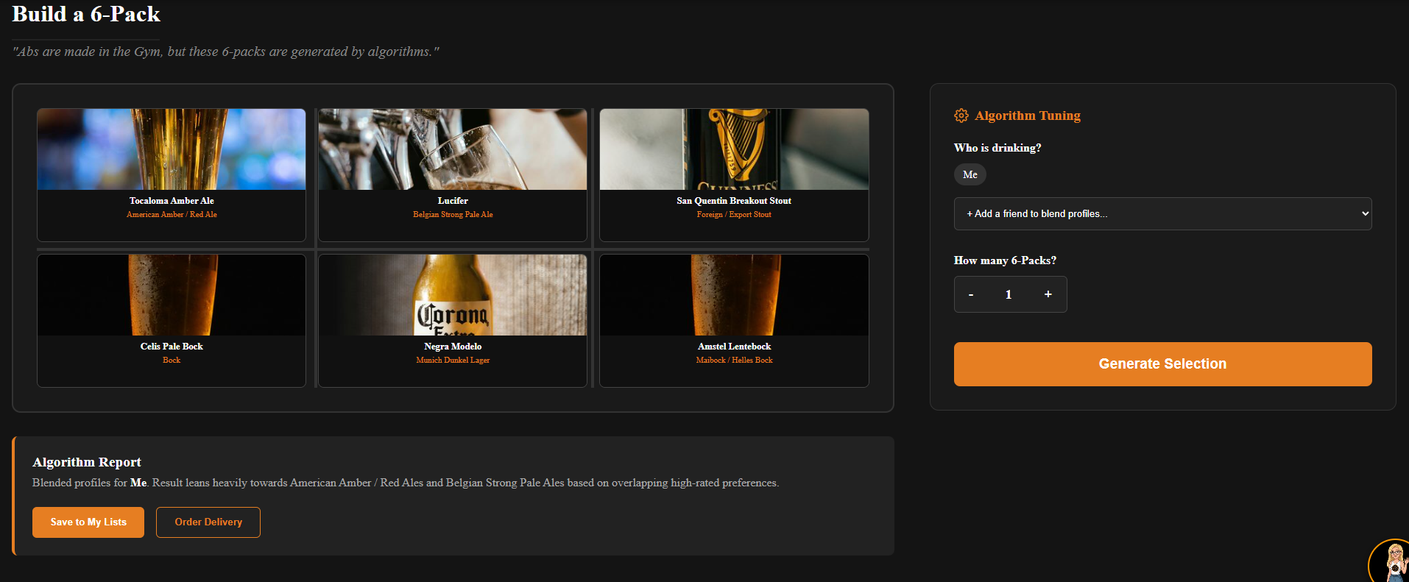
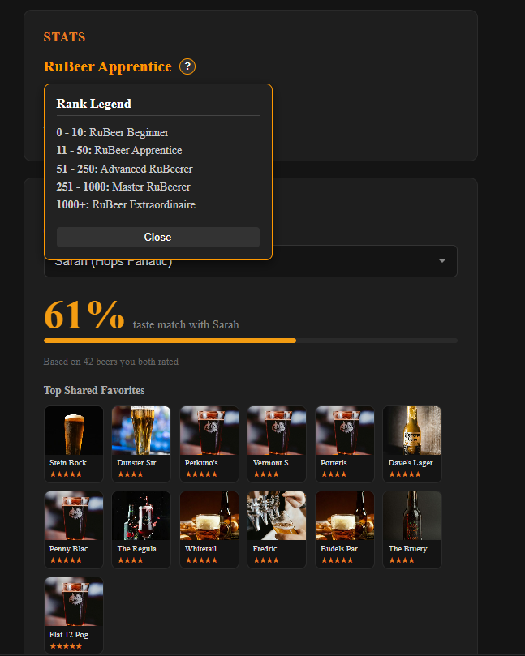
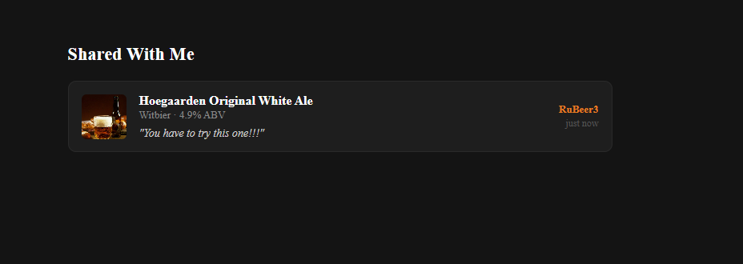
Build a 6 Pack & Sharing and profile

Slide 11



CORE FEATURES — PART I
Getting a User to a Great First Feed
Hybrid Recommendation Feed
Two-Method Cold-Start
Real-Time Feedback Loop
CF + CB blended, MMR-reranked. Zero-signal users see honest “Popular Beers” — never a substituted feed.
Search & rate ≥ 3 beers, or take a quick taste quiz. Either way, real ratings are saved from session one.
Rating a beer instantly updates the feed — exclusion, score adjustments, SVD fold-in, no retraining.
RUBEER
06

Slide 12




CORE FEATURES — PART II
Beyond the Basic Feed
Scan Menu
Adventurous Tab
Upload a photo of a bar menu — Gemini Vision extracts beer names, rapidfuzz maps them to the catalog, and only that matched subset is scored against your personal taste.
Surfaces mid-range picks (ranks 50–200) that diverge from your core taste, with a “Surprise Me Again” re-roll.
Rubi's Daily Pick
Friend Compatibility
A hero card highlighting one standout beer, guaranteed not to overlap the swimlanes shown below it.
Compares your full rating history against demo friend personas — a taste-match % plus “Top Shared Favorites,” stable across feed refreshes.
RUBEER
07

Slide 13

THE DATA
Two Communities of Beer Reviewers
4,241,024
Total interactions
26,774
Unique Users
70,243
Unique Beers
99.8%
Sparsity
BeerAdvocate
RateBeer
Stanford SNAP / BeerAdvocate review dataset
Stanford SNAP / RateBeer review dataset
Raw JSON
PostgreSQL
Feature Eng. +
Train/Val/Test Split
Enriched CSVs
Ingested via data_processing/process_json.py → pipeline.py
Semantic beer/brewery metadata layered in for content-based features
RUBEER
08

Slide 14




SYSTEM ARCHITECTURE
Request Flow, End to End
PostgreSQL
Reviews & beer details
CB Pipeline
TF-IDF
2. Get user details
4a. Get CB scores
BACKEND PROCESS
Rubeer Website
Node + React
3. Request recs
Rubeer Backend
FastAPI
Gemini
1. User wants recs
5. Merge & rerank
7. Rate chosen beer
6. Return recs
User
4b. Get CF scores
8. Update store
CF Pipeline
Truncated SVD
Online Store
In-process module
RUBEER
09
Notes:
We’ve shown you a lot of features today, so let’s take a moment to peek behind the curtain and talk about how those features work
Firstly all the information our services need, like reviews beer info and user details, is stored in a central PostgreSQL database
The website we showed you is a node and react based frontend which uses api calls to get recommendations and scores from the backend
The backend is a FastAPI based service which combines multiple modules to produce accurate recommendations.
we have an online store which keeps track of reviews that have come in since the last time we retrained our pipelines
then we use two scoring pipelines:
A content based pipeline which uses tf idf based on beer properties
and A Collaborative Filtering based pipeline which uses Truncated SVD to generate personalised scores
both our pipelines take into account the information from the online store to update the recommendations without retraining
The backend gets recommendation candidates from both pipelines and merges them,
because the effectiveness of CF depends on how well we know the user we use a scaling weight to average the scores
We then use mmr reranking on the candidates to make sure we return a diverse set of recommendations
our selected recommendations are sent back to the frontend who then displays them to the user
lastly we have a module that powers our AI based features using the gemini api

Slide 15


WHAT'S NEXT
Open Issues & Future Work
Shipped
Next Up
Real-time feedback loop with immediate exclusion & SVD fold-in
Create complimentary mobile app for easier use on the go
Durable cold-start across both onboarding methods
Improve and tune LLM features to provide better assistance with higher success rates
Per-style diversity caps for candidate generation
Add additional social features like inviting people for a beer or finding users with similar tastes
Stable Friend Compatibility using full rating history
RUBEER
11
Notes:
So finally now you’ve seen what Rubeer can do, let’s talk about what it could do
There were a few features that were either too big to finish or out of scope for the project
opening a website at the bar isn’t really convenient
A mobile app for use on the go just makes sense
Drinking beer is ultimately a social experience
so we’d love to add a variety of social features like inviting your friends for a beer or connecting to other users with similar tastes
We think we can continue tuning and improving our llm based features to provide an even better experience

Slide 16
Turning a wall of taps into
a personal pour.
Thank you — questions welcome.
RuBeer • Nitzan Zacharia • Inbal Moryles • Moran Khoury • Nadav Ravid • Dudi Benudiz

