Slide 1
FINAL PROJECT PRESENTATION
VibeDine
🍽️
Dining recommendations that match your vibe.
PRESENTED BY: AYA ROTBART, ESTER TKACH, YUVAL HAZUT, LIORA YACOB, YUVAL NAMIR BARR

Slide 2


THE DINING DILEMMA
Restaurant discovery is more than matching cuisine or ratings.
Restaurants are social experiences, not just places to eat
People look for a restaurant that matches the moment, context, and vibe
Existing platforms focus on ratings, cuisine, and location
But atmosphere is difficult to capture using semantic data alone
So where does the vibe come from?
User-generated content.

Slide 3
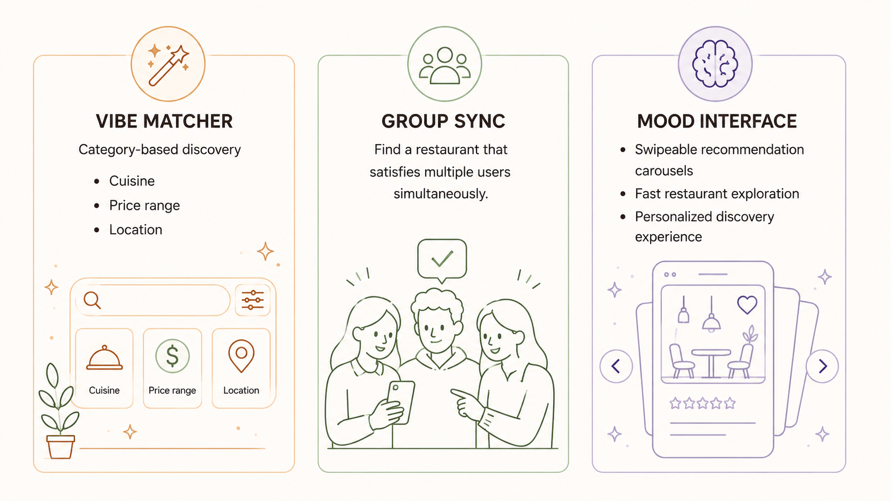
INTRODUCING
VibeDine
VibeDine is a hybrid restaurant recommendation system designed to match users with restaurants that fit their preferences, context, and vibe.

Slide 4
LET'S SEE IT!
Experiencing personalized dining recommendations in action.

Slide 5
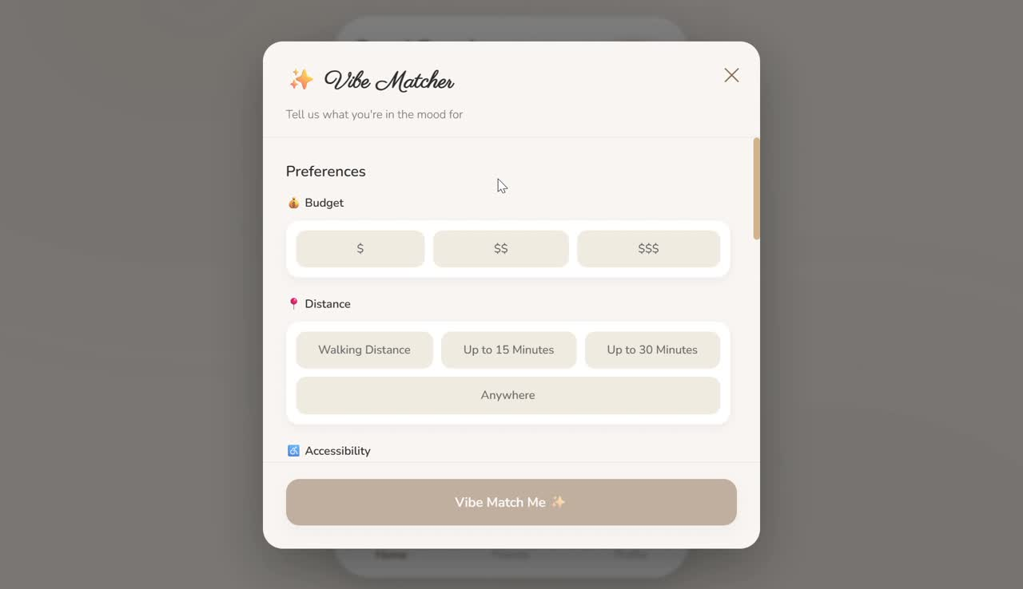
FEATUER 1 - VIBE MATCHER

Slide 6
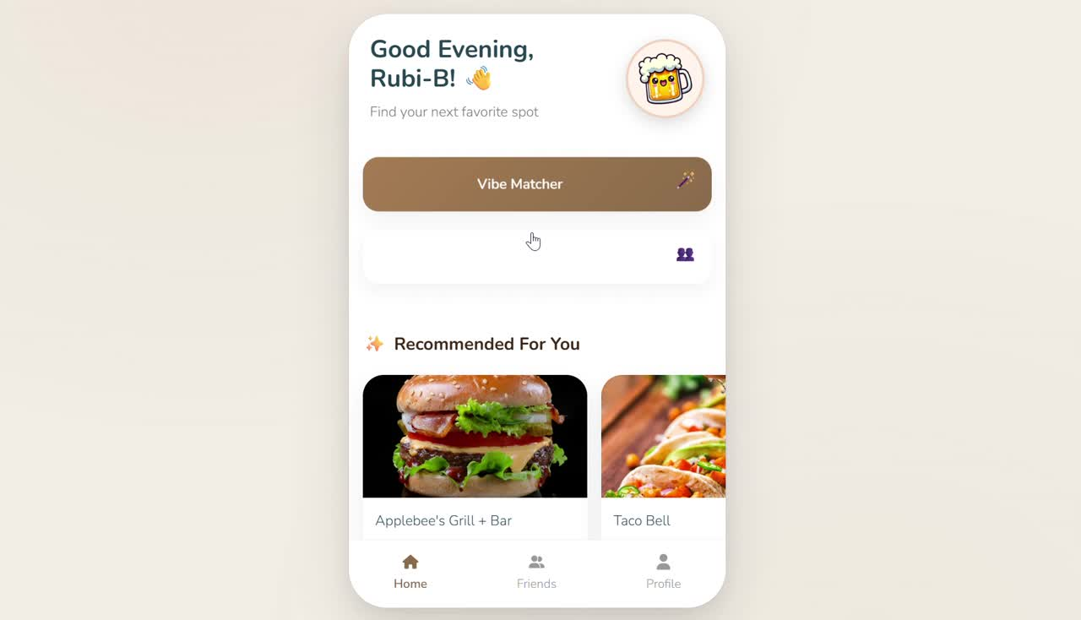
FEATUER 2 - GROUP SYNC

Slide 7
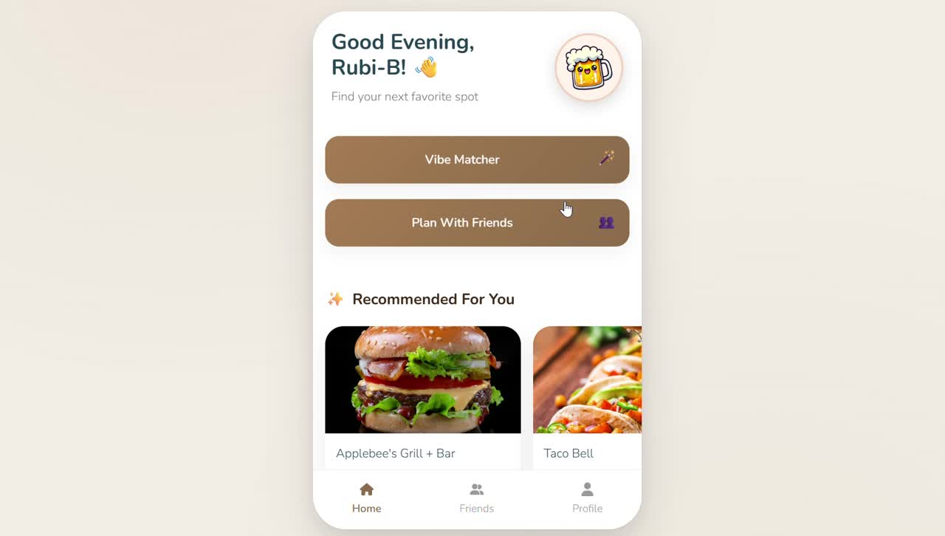
FEATUER 3 - MOOD INTERFACE

Slide 8
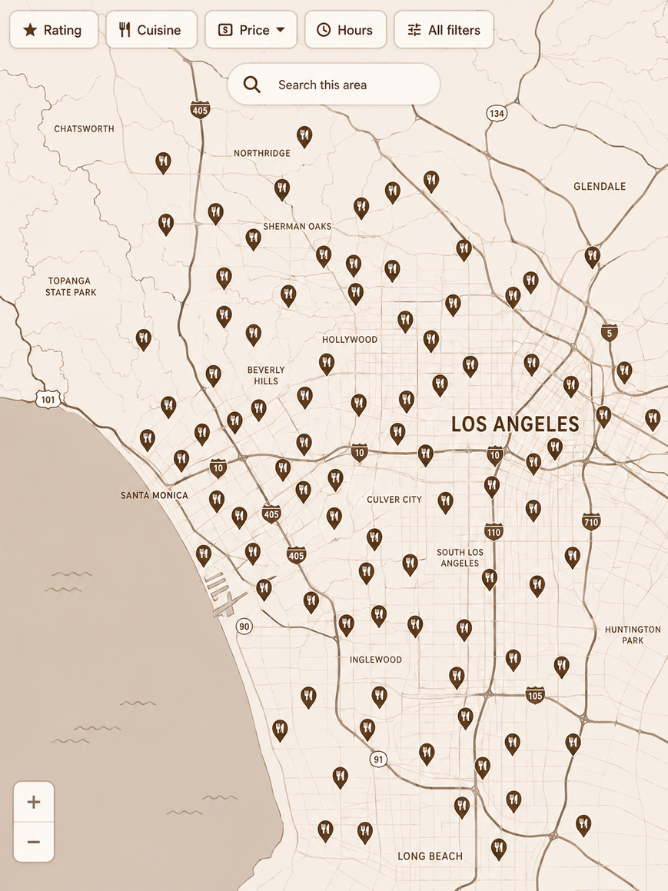
DATASET
GOOGLE LOCAL DATA
Google Maps data collected across the United States (up to 2021).
Consists of two complementary datasets:
business name, business ID, coordinates, category, rating, etc. Additional attributes provided by business owners
US Businesses:
Includes user ID, business ID, rating, textual reviews, and optional photos.
Reviews:

Slide 9

DATA PREPROCESSING PIPELINE
FILTERING
CLEANING
REFORMATTING
  Selected California Only restaurants
  Food-related businesses only
  Created enums for feature standardization
  Removed duplicate records
  Applied 5-core filtering
  Standardized missing and inconsistent values
  Generated Parquet files
  Stored data in MongoDB
  Built CF interaction matrix
  Created content feature tables

Slide 10

DATA PREPROCESSING PIPELINE
FILTERING
CLEANING
REFORMATTING
  Selected California Only restaurants
  Food-related businesses only
  Created enums for feature standardization
  Removed duplicate records
  Applied 5-core filtering
  Standardized missing and inconsistent values
  Generated Parquet files
  Stored data in MongoDB
  Built CF interaction matrix
  Created content feature tables
40,645 RESTAURANTS
9.7M REVIEWS
CF & CBF DATASETS

Slide 11
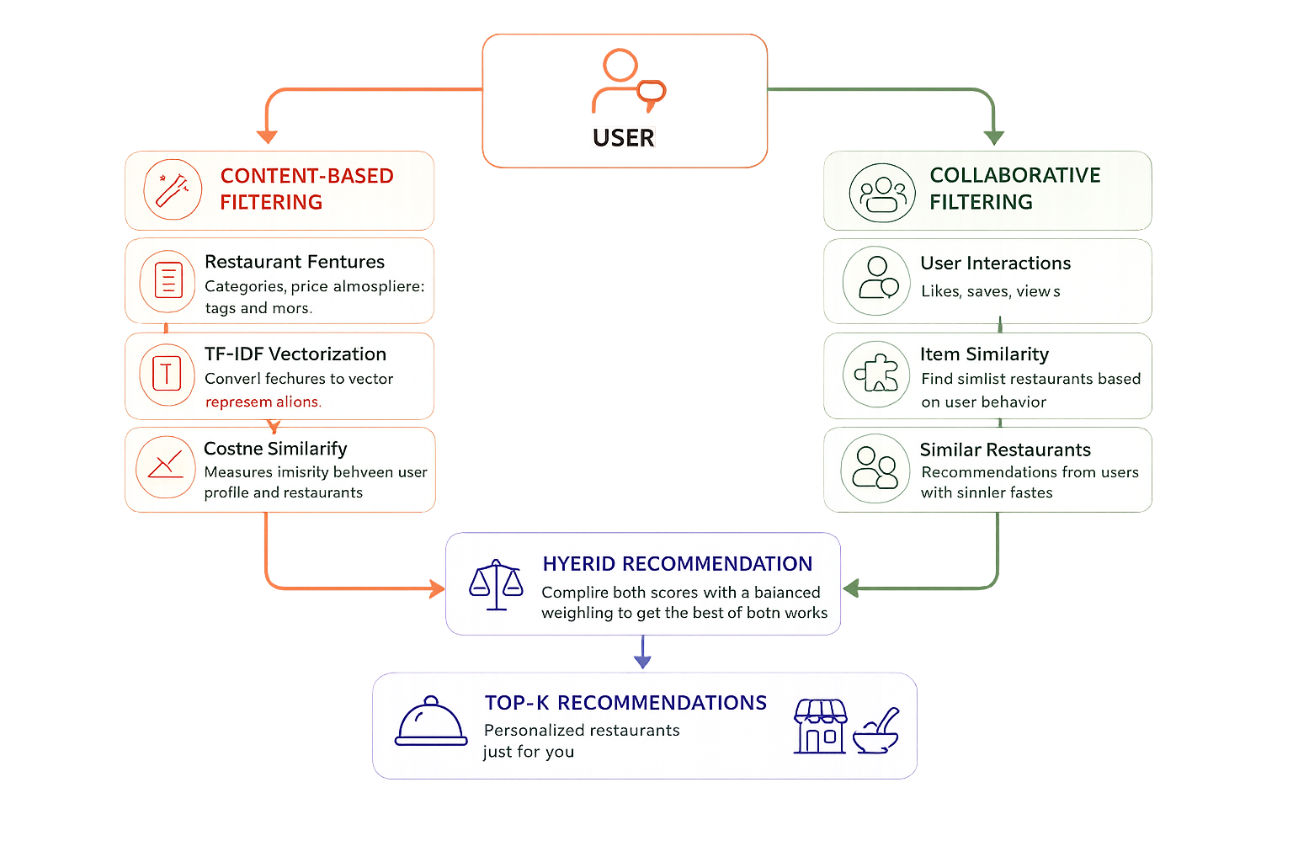
ML ALGORITHMS
Notes:
Both models support candidate filtering, allowing recommendations to be generated only from restaurants that match the user's search constraints (e.g., location, accessibility…).
Combining the two approaches with weights (work in progress).

Slide 12
ML ALGORITHMS
Content-Based Filtering
  Restaurants represented using TF-IDF feature vectors
  Cosine similarity identifies similar restaurants
Notes:
Both models support candidate filtering, allowing recommendations to be generated only from restaurants that match the user's search constraints (e.g., location, accessibility…).
Combining the two approaches with weights (work in progress).

Slide 13
ML ALGORITHMS
Content-Based Filtering
  Restaurants represented using TF-IDF feature vectors
  Cosine similarity identifies similar restaurants
Collaborative Filtering
  Item-based cosine similarity on user ratings
  Recommendations derived from similar restaurant interactions
Notes:
Both models support candidate filtering, allowing recommendations to be generated only from restaurants that match the user's search constraints (e.g., location, accessibility…).
Combining the two approaches with weights (work in progress).

Slide 14
ML ALGORITHMS
Content-Based Filtering
  Restaurants represented using TF-IDF feature vectors
  Cosine similarity identifies similar restaurants
Collaborative Filtering
  Item-based cosine similarity on user ratings
  Recommendations derived from similar restaurant interactions
Hybrid Model
  Combines content similarity and user behavior
  Supports candidate filtering and ranking
Notes:
Both models support candidate filtering, allowing recommendations to be generated only from restaurants that match the user's search constraints (e.g., location, accessibility…).
Combining the two approaches with weights (work in progress).

Slide 15
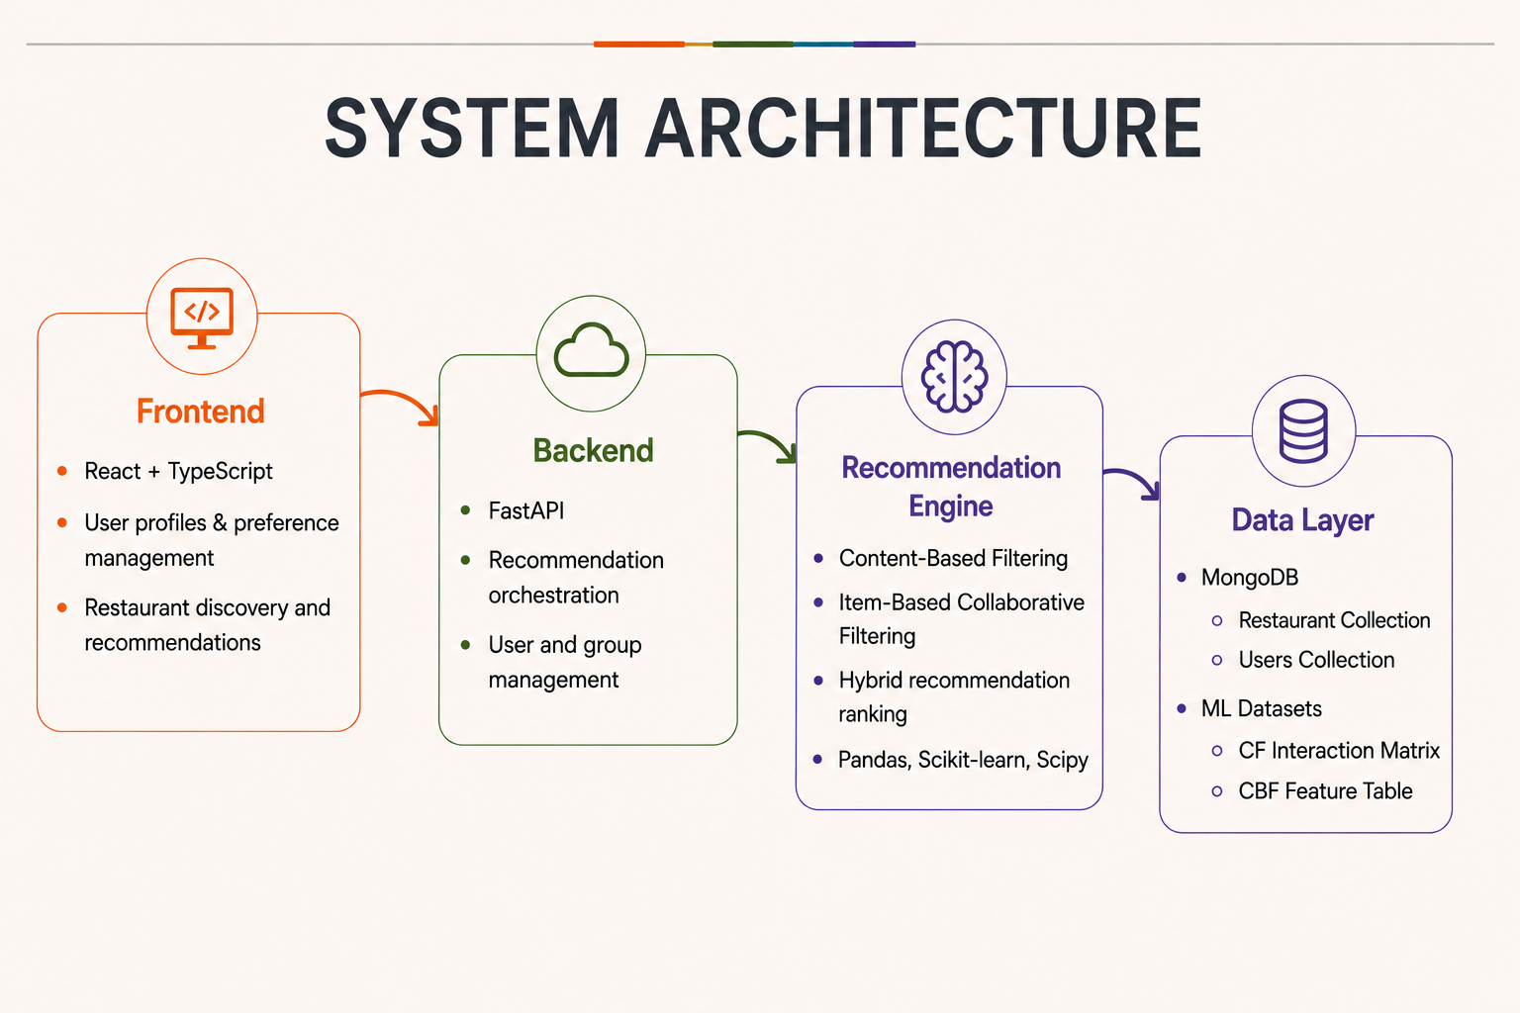
SYSTEM ARCHITECTURE

Slide 16
SYSTEM ARCHITECTURE

Slide 17
SYSTEM ARCHITECTURE

Slide 18
SYSTEM ARCHITECTURE

Slide 19

ROADMAP & MILESTONES
MODEL TRAINING
TRAINING COLLABORATIVE VS CONTENT-BASED HYBRID SYSTEMS WITH BASELINE METRICS
FRONT AND FEATURES SYNCHING MODULES
CONNECTING DB
ONLINE TRAINING
FUTURE FEATURES
DATASETS
CREATING AND CLEANING THE INITIAL DB STRUCTURES.
HYBRID TUNING
INTEGRATING CUSTOM "VIBE VECTORS" AND OPTIMIZING RECOMMENDATIONS.
ADVANCED FEATURES
COLD START
GROUP RECOMMENDATION
CONTEXT-AWARE RECOMMENDATIONS (TIME, LOCATION...)

Slide 20
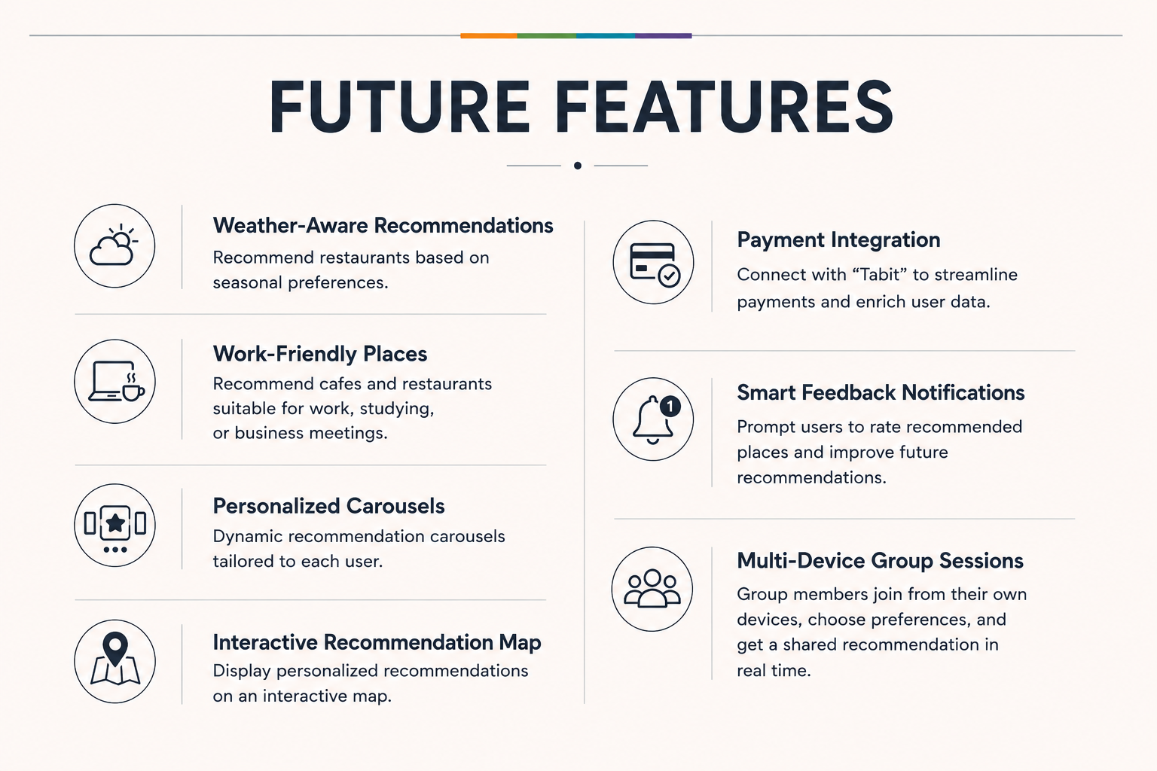
FUTURE FEATURES

Slide 21
Thank You!
🍽️

